Slide 1
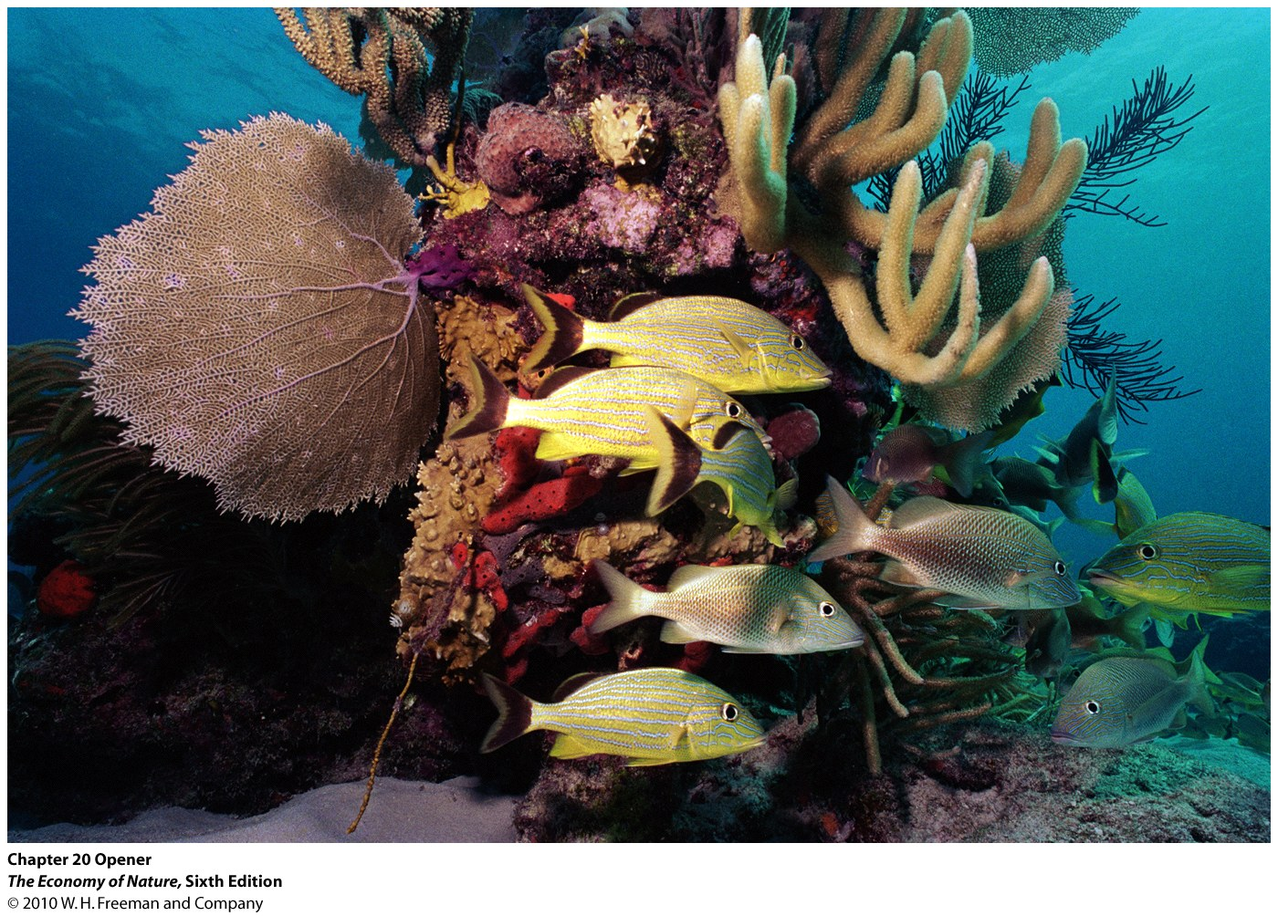
BIODIVERSITY

Slide 2
Community Ecology
I. Patterns and Processes
The Species-Area Relationship
  1. The pattern

Slide 3
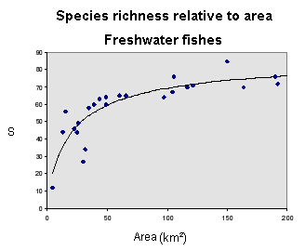
"species - area relationship"

Slide 4
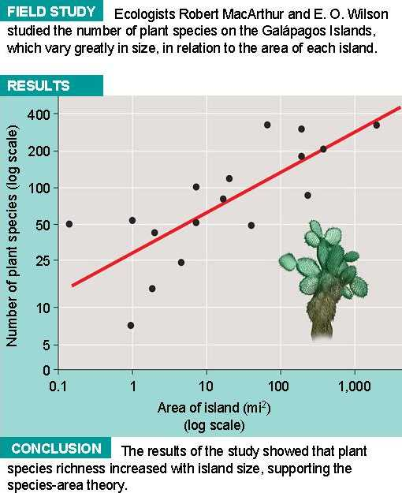
S = CA^{z}
log₁₀S = log₁₀ C + z log₁₀ A
where C is the y intercept and z is the slope of the line.

Slide 5
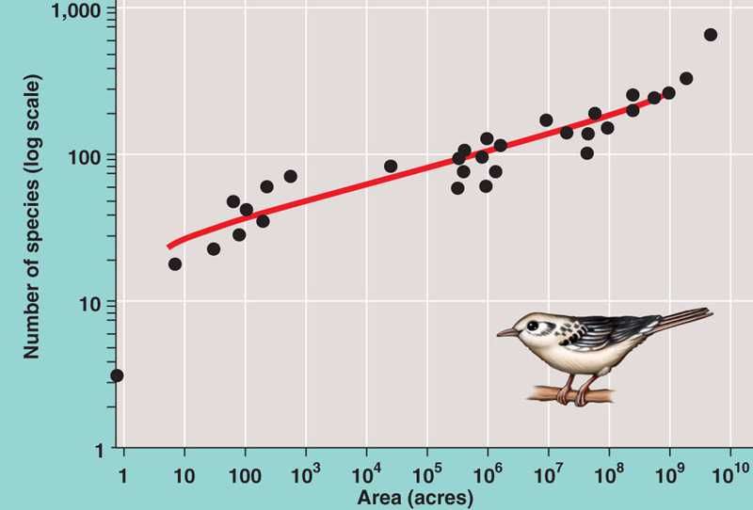
"species - area relationship"
Breedings Birds - North Am.

Slide 6
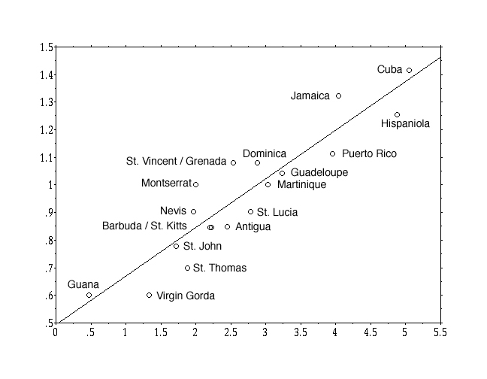
"species - area relationship"
Number of Bat Species log(N)
Island Area log(square km)

Slide 7
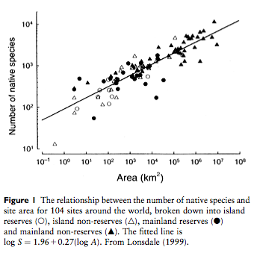

Slide 8
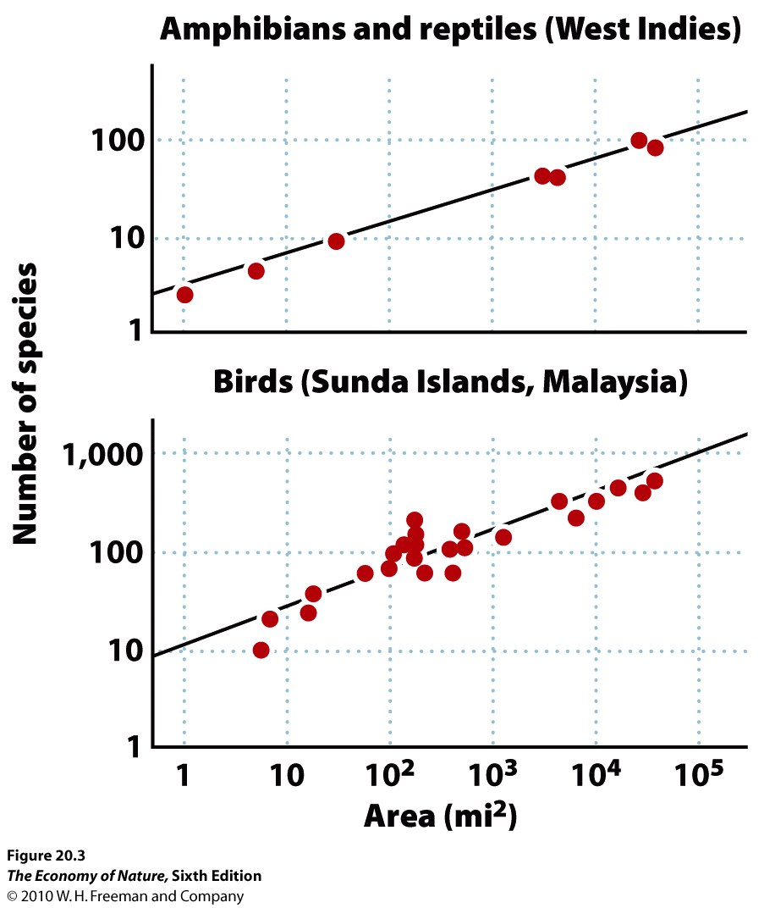

Slide 9
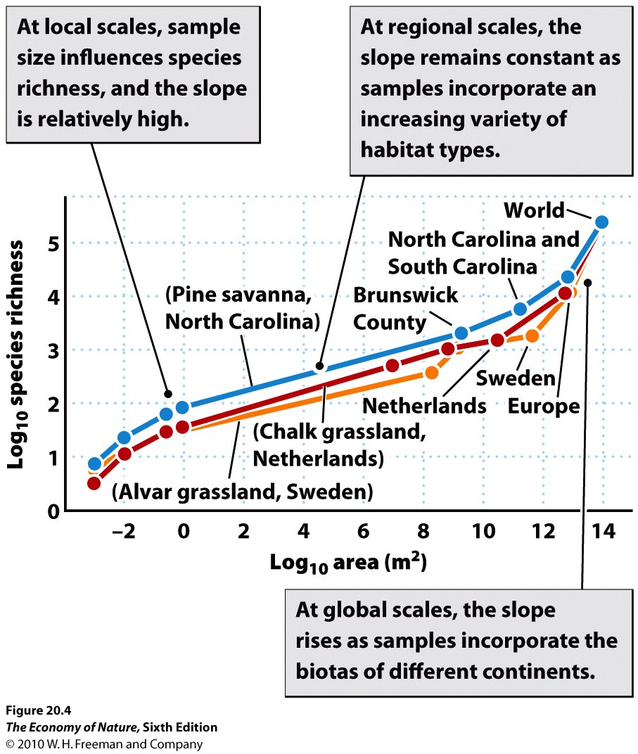

Slide 10
Community Ecology
I. Introduction
II. Multispecies Interactions with a Trophic Level
III. Multispecies Interactions across Trophic Levels
IV. Succession
V. Biodiversity: Patterns and Processes
The Species-Area Relationship
1. The pattern
2. The Theory of Island Biogeography

Slide 11
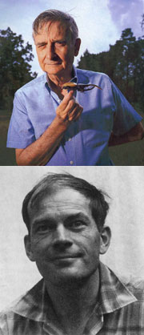
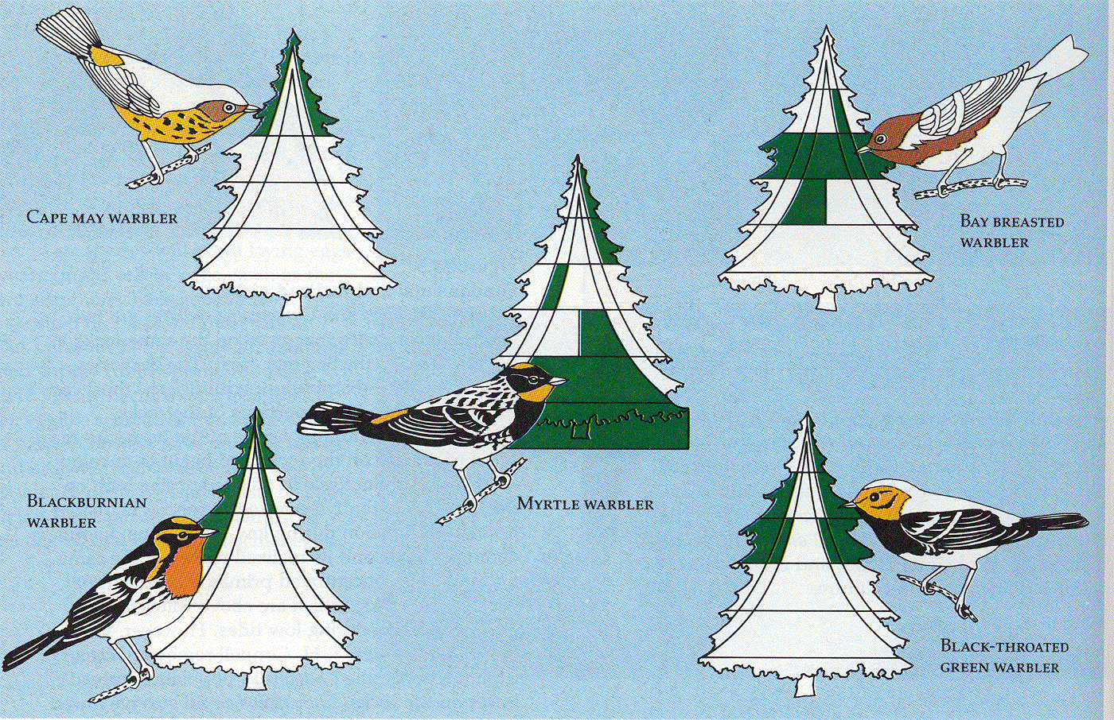
MacArthur and Wilson (1967)
THEORY OF ISLAND BIOGEOGRAPHY
Edward O. Wilson
Prof. Emer., Harvard
Robert MacArthur
1930-1972

Slide 12
MacArthur and Wilson (1967)
THEORY OF ISLAND BIOGEOGRAPHY
- Species Richness is a balance between
COLONIZATION (adds species)
and
EXTINCTION (subtracts species)

Slide 13
- Colonization Increases with Area
- larger target
- more habitats
Mainland

Slide 14
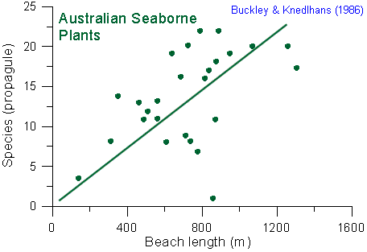
confirmation: greater immigration rate on larger islands

Slide 15
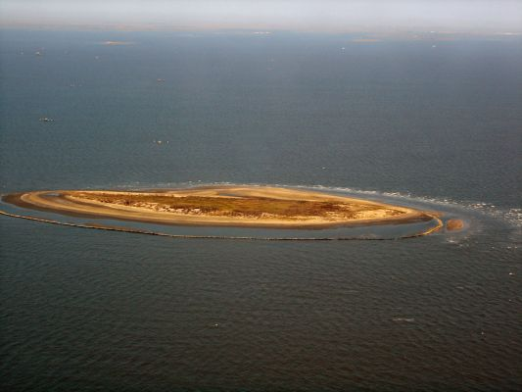
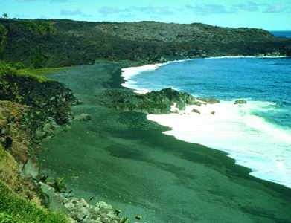
- Colonization Increases with Area
- larger target
- more habitats

Slide 16
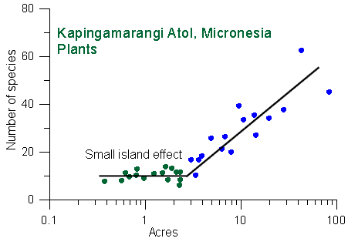
- Colonization Increases with Area
- larger target
- more habitats (except very small)
Niering, W.A. 1963. Terrestrial ecology of Kapingamarangi Atoll, Caroline Islands. Ecological Monographs 33:131-160.

Slide 17
- Colonization Increases with Area
- larger target
- more habitats
- Extinction Decreases with Area
- more food means larger populations that are less likely to bounce to a size of "0" (extinction)

Slide 18
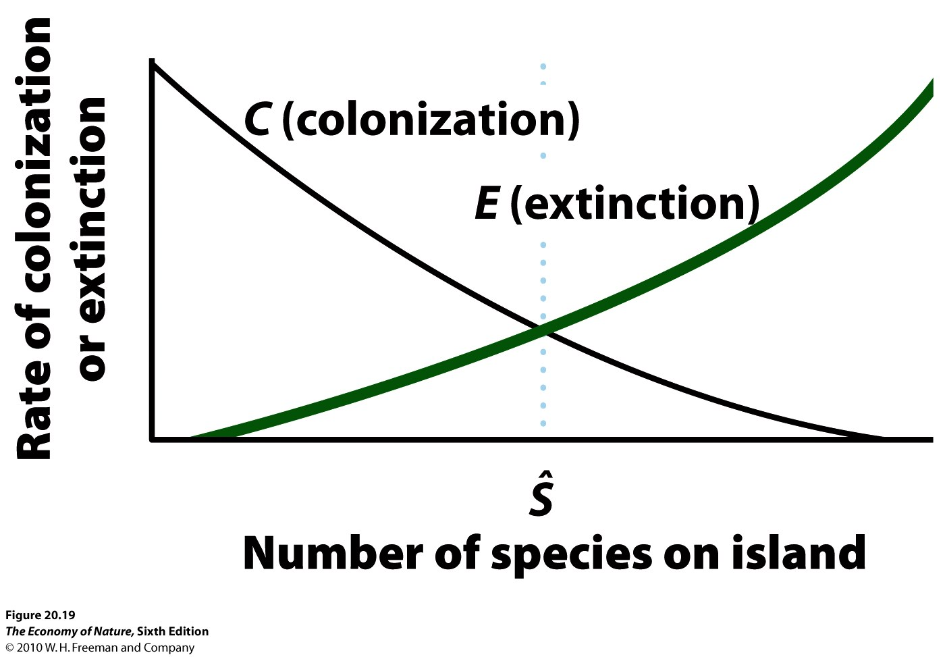

Slide 19
COL - large
RATE
EXT - small
COL - small
EXT - large
SMALL
LARGE
species richness

Slide 20
- Colonization Decreases with Distance
- fewer species can reach
Mainland

Slide 21
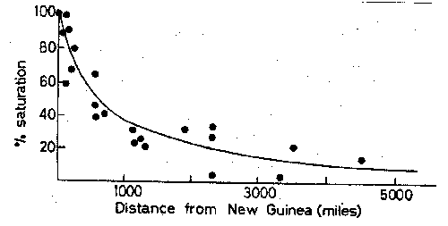
- Colonization Decreases with Distance
- fewer species can reach
saturation is the % of species found on a patch of mainland that size

Slide 22
- Extinction Increases with Distance
- recolonization less likely at distance
Mainland
"Rescue Effect"

Slide 23
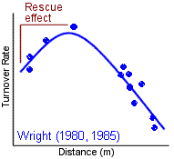
- Extinction Increases with Distance
- recolonization less likely at distance
Wright, S.J. 1980. Density compensation in island avifaunas. Oecologia 45: 385-389.
Wright, S. J. 1985. How isolation affects rates of turnover of species on islands. Oikos 44:331-340.

Slide 24
COL - close
RATE
EXT - far
COL - far
EXT - close
far
close
species richness

Slide 25
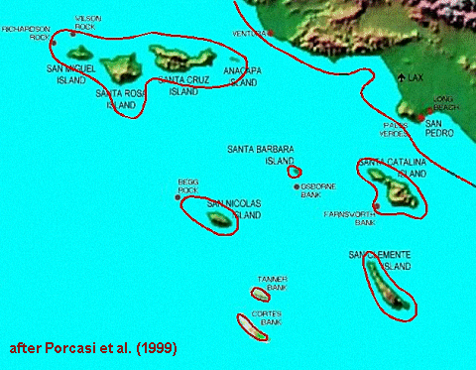

Slide 26
Equilbrium Island Biogeography & Turnover Turnover on "Landbridge" islands (California Channel Islands)
Island | Area km2 | Distance km | Bird Spp. 1917 | Bird Spp. 1968 | Extinctions | Human Introd. | Immigrations | Turnover %
Los Coronados | 2.6 | 13 | 11 | 11 | 4 | 0 | 4 | 36
San Nicholas | 57 | 98 | 11 | 11 | 6 | 2 | 4 | 50
San Clemente | 145 | 79 | 28 | 24 | 9 | 1 | 4 | 25
Santa Catalina | 194 | 32 | 30 | 34 | 6 | 1 | 9 | 24
Santa Barbara | 2.6 | 61 | 10 | 6 | 7 | 0 | 3 | 62
San Miguel | 36 | 42 | 11 | 15 | 4 | 0 | 8 | 46
Santa Rosa | 218 | 44 | 14 | 25 | 1 | 1 | 11 | 32
Santa Cruz | 249 | 31 | 36 | 37 | 6 | 1 | 5 | 17
Anacapa | 2.9 | 21 | 15 | 14 | 5 | 0 | 4 | 31
Diamond, J.M. 1969. Avifaunal equilibria and species turnover rates on the Channel Islands of California. Proc. Natl. Acad. Sci 64: 57-63. Jones, H.L. and Diamond, J.M. 1976. Short-time-base studies of turnover in breeding bird populations on the Channel Islands of California. Condore 73: 526-549. [+]
equilibria

Slide 27
equilibria and turnover
Equilbrium Island Biogeography & Turnover Turnover on "Landbridge" islands (California Channel Islands)
Island | Area km2 | Distance km | Bird Spp. 1917 | Bird Spp. 1968 | Extinctions | Human Introd. | Immigrations | Turnover %
Los Coronados | 2.6 | 13 | 11 | 11 | 4 | 0 | 4 | 36
San Nicholas | 57 | 98 | 11 | 11 | 6 | 2 | 4 | 50
San Clemente | 145 | 79 | 28 | 24 | 9 | 1 | 4 | 25
Santa Catalina | 194 | 32 | 30 | 34 | 6 | 1 | 9 | 24
Santa Barbara | 2.6 | 61 | 10 | 6 | 7 | 0 | 3 | 62
San Miguel | 36 | 42 | 11 | 15 | 4 | 0 | 8 | 46
Santa Rosa | 218 | 44 | 14 | 25 | 1 | 1 | 11 | 32
Santa Cruz | 249 | 31 | 36 | 37 | 6 | 1 | 5 | 17
Anacapa | 2.9 | 21 | 15 | 14 | 5 | 0 | 4 | 31
Diamond, J.M. 1969. Avifaunal equilibria and species turnover rates on the Channel Islands of California. Proc. Natl. Acad. Sci 64: 57-63. Jones, H.L. and Diamond, J.M. 1976. Short-time-base studies of turnover in breeding bird populations on the Channel Islands of California. Condore 73: 526-549. [+]

Slide 28
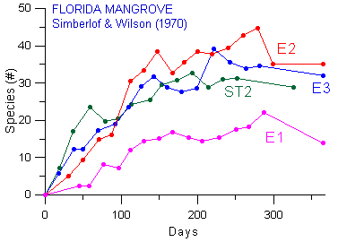

Slide 29
Dramatic evidence that, although the communities had recovered in terms of species richness, the composition was very different with typically about 80% of the species turning over.

Slide 30
Community Ecology
I. Introduction
II. Multispecies Interactions with a Trophic Level
III. Multispecies Interactions across Trophic Levels
IV. Succession
V. Biodiversity: Patterns and Processes
The Species-Area Relationship
1. The pattern
2. The Theory of Island Biogeography
3. Why is this important? Fragmentation

Slide 31
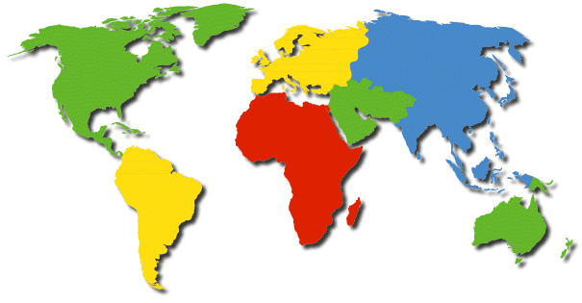
- Why is this important?
- all habitats except the atmosphere are islands.
Continents -
big islands

Slide 32
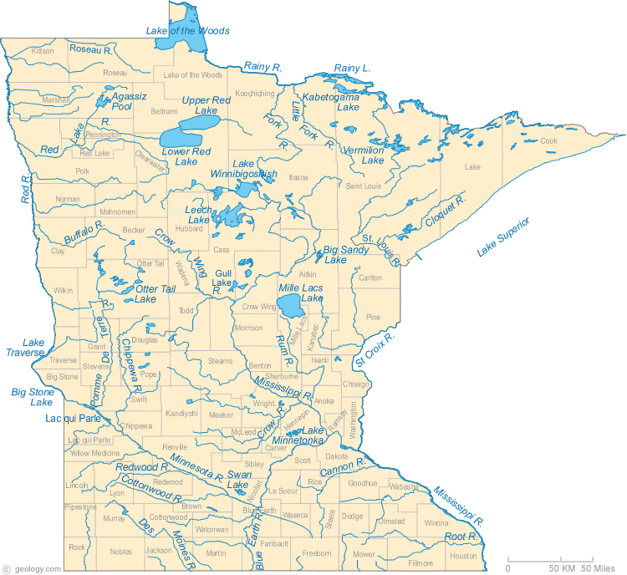
Minnesota: Land O'Lakes

Slide 33
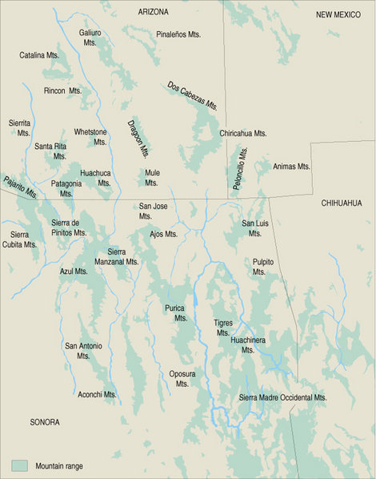
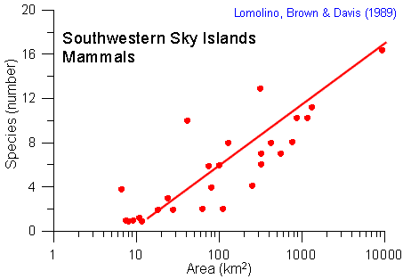
"Sky Islands"
High elevation habitats separated by inhospitable (desert) habitat.

Slide 34
- Why is this important?
- all habitats except the atmosphere are islands.
- human activity fragments a landscape, making lots of islands, too.

Slide 35
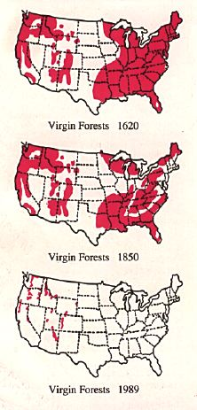

Slide 36
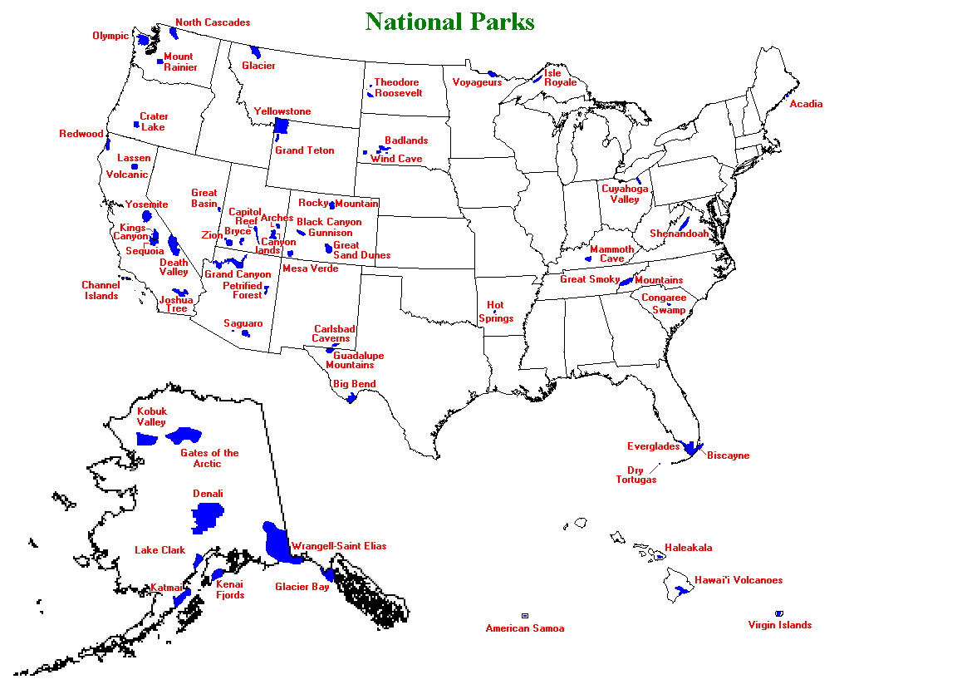

Slide 37
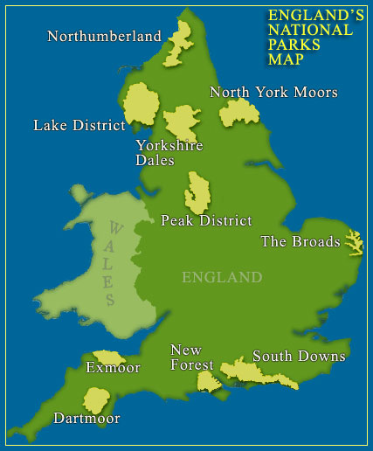

Slide 38
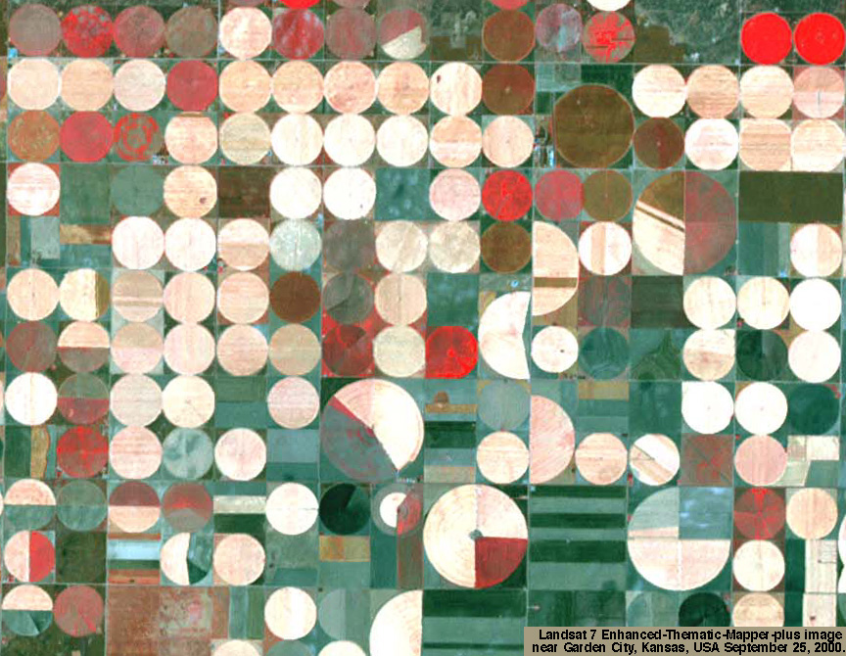

Slide 39
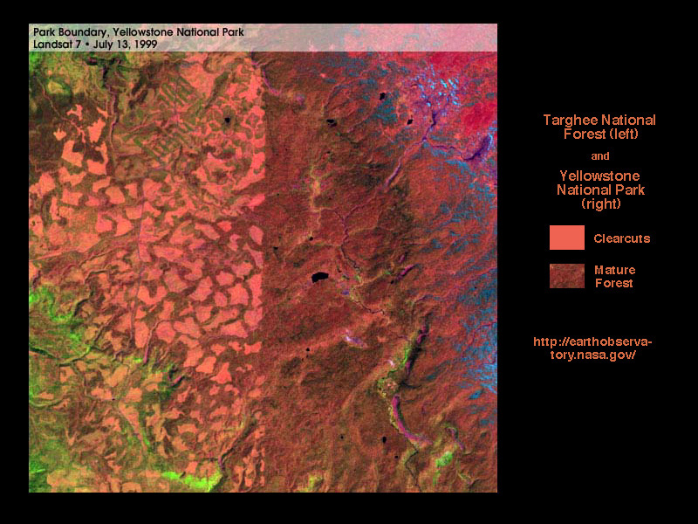

Slide 40
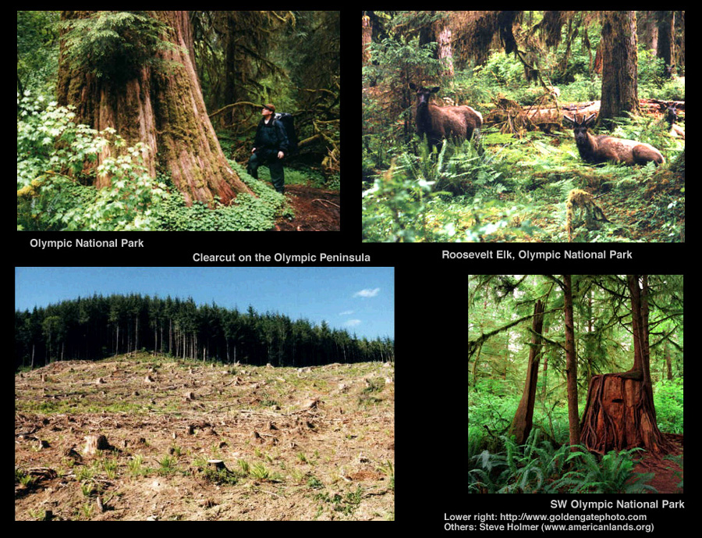

Slide 41
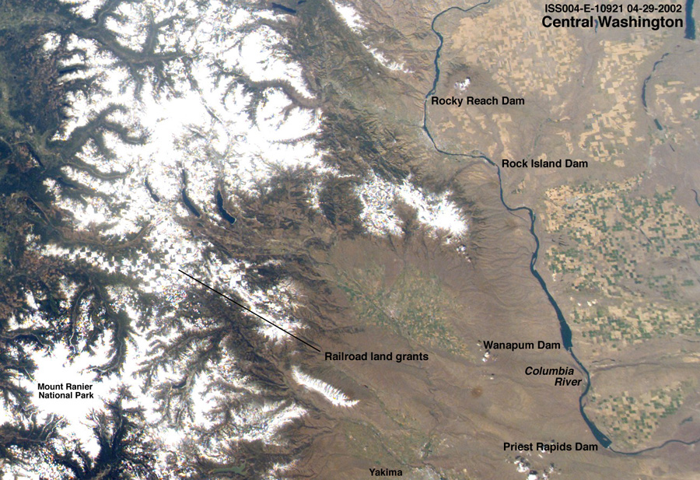

Slide 42
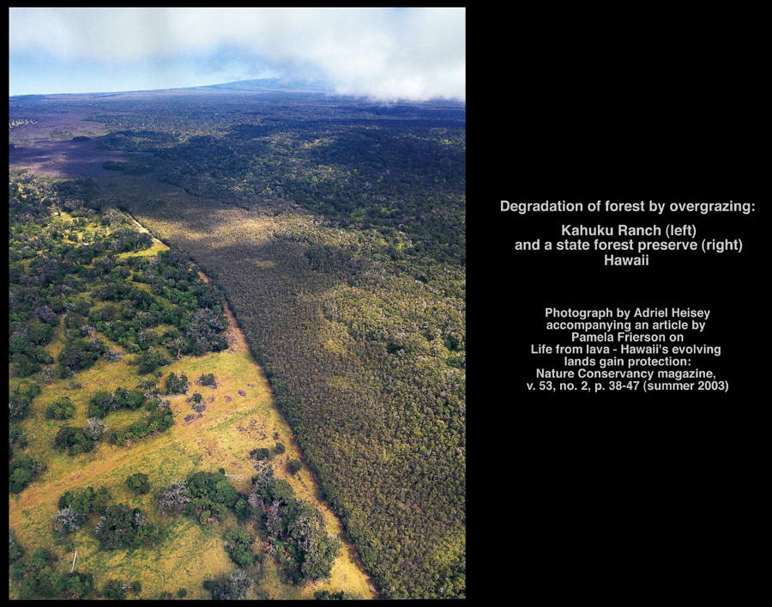

Slide 43
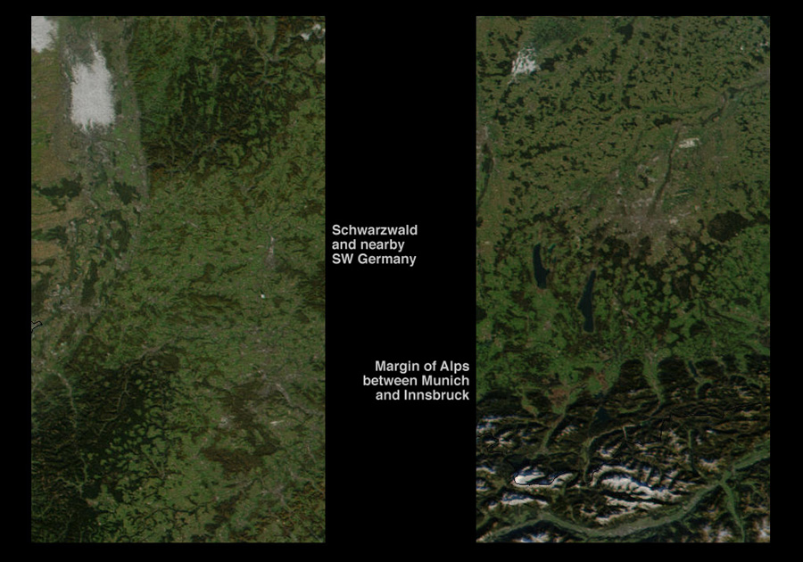

Slide 44
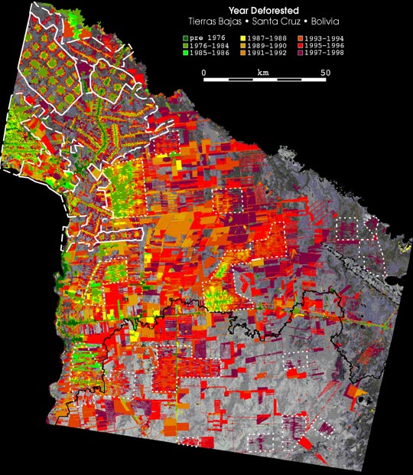
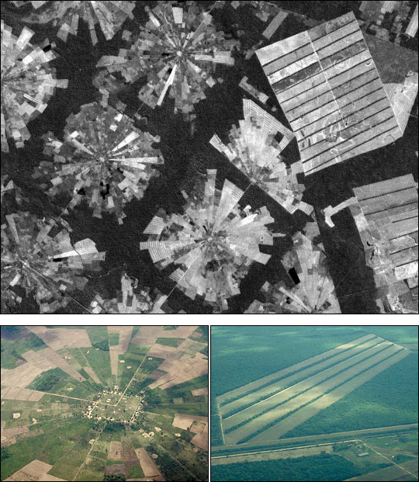
Bolivia has lost 50% of its rainforest in last 30 years

Slide 45
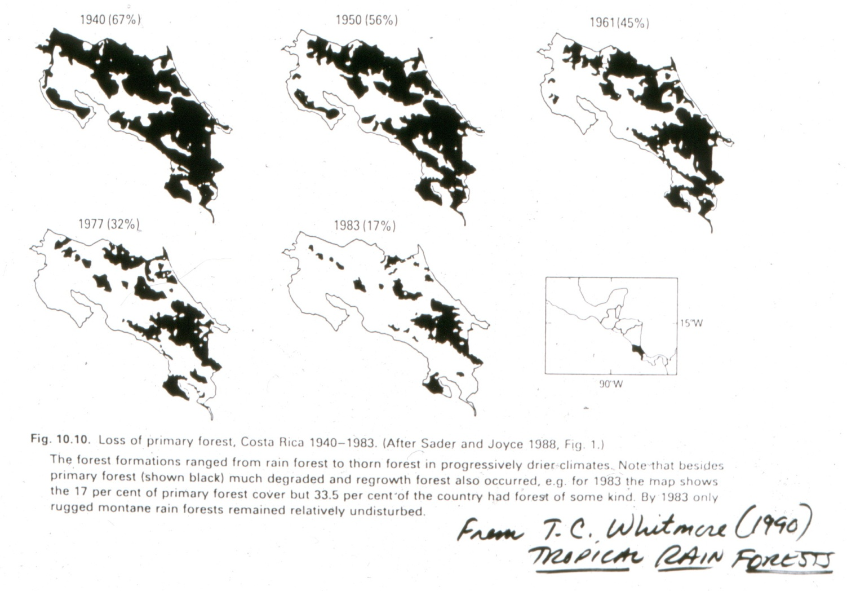
Even Costa Rica has lost 95% of its old growth forest that is outside of national parks...

Slide 46
Community Ecology
I. Introduction
II. Multispecies Interactions with a Trophic Level
III. Multispecies Interactions across Trophic Levels
IV. Succession
V. Biodiversity: Patterns and Processes
The Species-Area Relationship
1. The pattern
2. The Theory of Island Biogeography
3. Why is this important? Fragmentation
4. The SLOSS debate

Slide 47
- The SLOSS Debate
- So, to preserve biodiversity (and the ecosystem services it provides to humanity), conservationists began to consider the best strategy for maximizing the preservation of diversity...should we preserve several small areas, or a single large one?

Slide 48
- Why is this important?
- Conserving Diversity: the SLOSS debate
Large > Small
Minimize Edge
Clumped
Corridors
Wilson and Willis (1975)

Slide 49
- Why is this important?
- Conserving Diversity: the SLOSS debate
Number of Species
Area in Square Meters
Simberloff and Gotelli (1983)

Slide 50
BUT! Can we maintain all the species if they live on different islands?
All species preserved while accommodating the species area effect!
A B
C D
E F
G H
A
B
C D
E F G
H

Slide 51
- BUT! Can we maintain all the species if they live on different islands?
- Probably not, because communities are NESTED.
A B
C D
E F
G H
A
B
C D
E F G
H

Slide 52
- BUT! Can we maintain all the species if they live on different islands?
- Probably not, because communities are NESTED.
Nested Subset Structure: Species on species-poor islands are also found on species-rich islands.
A B
C D
E F
G H
A
B
C D
E F G
H

Slide 53
- BUT! Can we maintain all the species if they live on different islands?
- Probably not, because communities are NESTED.
Nested Subset Structure: Species on species-poor islands are also found on specie-rich islands.
NOT NESTED
NESTED
A B
C D
E F
G H
A
B
A
A
C D
A B
E F G
H
A B C
A

Slide 54
Community Ecology
I. Introduction
II. Multispecies Interactions with a Trophic Level
III. Multispecies Interactions across Trophic Levels
IV. Succession
V. Biodiversity: Patterns and Processes
The Species-Area Relationship
1. The pattern
2. The Theory of Island Biogeography
3. Why is this important? Fragmentation
4. The SLOSS debate
5. Nestedness

Slide 55
NESTED-SUBSET STRUCTURE:
(Darlington 1957, Patterson and Atmar 1986)
- Why is this important?
- Conserving Diversity: the SLOSS debate
- "Nestedness" (Darlington (1957); Patterson and Atmar (1986)
Communities are ‘nested’ if the species in depauperate assemblages are also found in progressively more species rich communities
A B C D E
A B C
A
A B C D

Slide 56
NESTEDNESS
(Patterson and Atmar 1986)
A B C D E F G H I J K L M N O P Q R S T U V W X Y Z 26
A B C D E F G H I J K L M N O P Q R S T U V W X 24
A B C D E F G H I J K L M N O + Q R S T U V W X 23
A B C D E F G H I J K L M N O P Q R S T U + 21
A B C D E F G H I J K L M + O P Q R S T + 19
A B C D E + G H I J K + + N O P + 13
A B C D E + G + I J K + + N O + Q + V 14
A B C D E + + H I J K L + N O + + 12
A B C D E F G H + +K L + + O P + 11
A B C D E F G + I J K + + + + + 10
A B C D E F G H I J + + + + + 10
A B C D E F G + + + + M + R 9
A B C D E F + H + + L + + P 9
A B C + E + I J + N 7
A B C D E F I + 7
A B C D E F + M 7
A B C D E + G + M 7
A B C D E F H + 7
A B C D E F H + 7
A B C D E F + 6
A B C D + F L 6
A B C D E + 5
A B C + + F L 5
A B + D E 4
A B + F 3
A B + 2
C 1
C 1

Slide 57
NESTEDNESS AND NICHE SPACE
(Kodric-Brown and Brown 1993)
Goby 1 1 1 1 1 1 1 1 1 1 1 1 1 1 1 1 1 1 1 1 1 1 1 1 1 1 1
Gudgeon 1 1 1 1 1 1 1 1 1 1 1 1 1 1 1 1 1 1
Catfish 1 1 1 1 1 1 1 1 1 1 1 1 1 1
Hardyhead 1 1 1 1 1 1 1 1 1
Perch 1 1 1 1 1 1 1

Slide 58
NESTEDNESS AND NICHE SPACE
(Kodric-Brown and Brown 1993)
Goby
Catfish
Perch
Gudgeon
Hardyhead
Notes:
6
7

Slide 59
- Why is this important?
- Conserving Diversity: the SLOSS debate
- "Nestedness" (Darlington (1957); Patterson and Atmar (1986)
- Fragmentation causes decreased diversity
- non-random loss of predators
- subsequent declines – keystone effects

Slide 60
- Why is this important?
- Conserving Diversity: the SLOSS debate
- "Nestedness" (Darlington (1957); Patterson and Atmar (1986)
- Fragmentation causes decreased diversity
- increased stress decreases diversity non-randomly

Slide 66
Summary: Causes of nestedness
- nested niche space
- differences in dispersal capabilities
differences in extinction probabilities
As these are the same factors that cause the species-area relationship, itself, we should not be surprized that communities distributed across habitats of different size are often nested, too.

Slide 67
Community Ecology
I. Introduction
II. Multispecies Interactions with a Trophic Level
III. Multispecies Interactions across Trophic Levels
IV. Succession
V. Biodiversity: Patterns and Processes
The Species-Area Relationship
The Latitudinal Trend in Diversity
1. The patterns

Slide 68
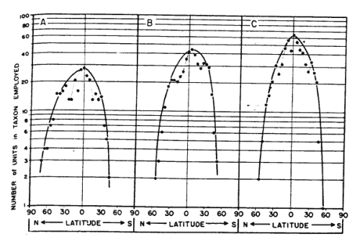
Amphibians
Lizards
Snakes

Slide 69
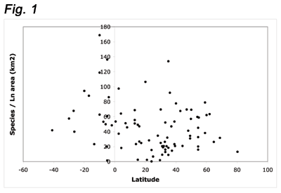
Moss

Slide 70
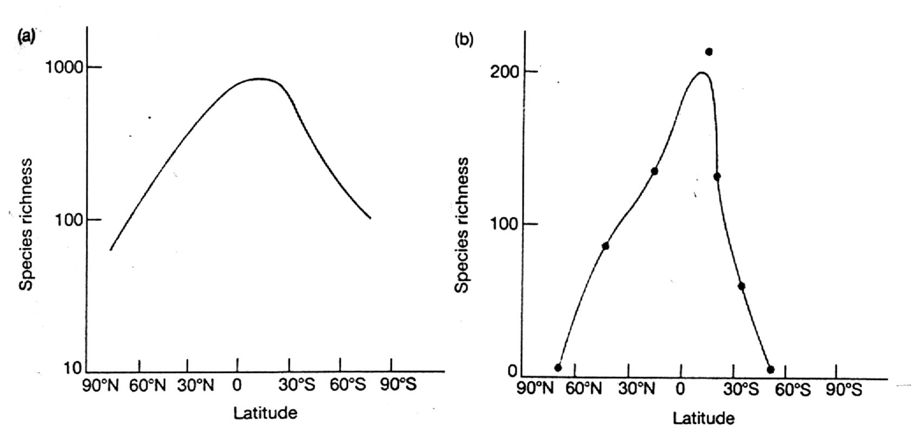
Bivalves
Ants

Slide 71
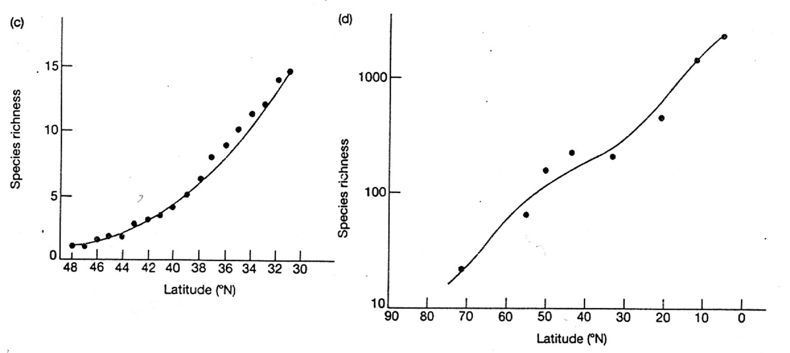
Lizards
Birds

Slide 72
Marine Gastropods

Slide 73
Community Ecology
I. Introduction
II. Multispecies Interactions with a Trophic Level
III. Multispecies Interactions across Trophic Levels
IV. Succession
V. Biodiversity: Patterns and Processes
The Species-Area Relationship
The Latitudinal Trend in Diversity
The patterns
Potential Causes
a. energy-diversity hypothesis

Slide 74
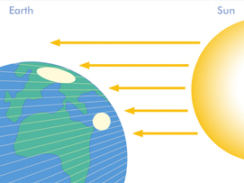
"Bottom-Up" - more Energy, more sp.
- quantitative effects

Slide 75
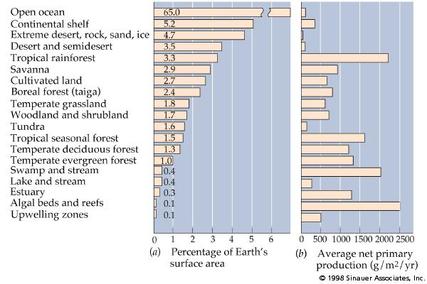
"Bottom-Up" - more Energy, more sp.
- quantitative effects

Slide 76
"Bottom-Up" - more Energy, more sp.
"Top-Down" – more energy, more predators, less, competitive exclusion at each trophic level.

