Slide 1
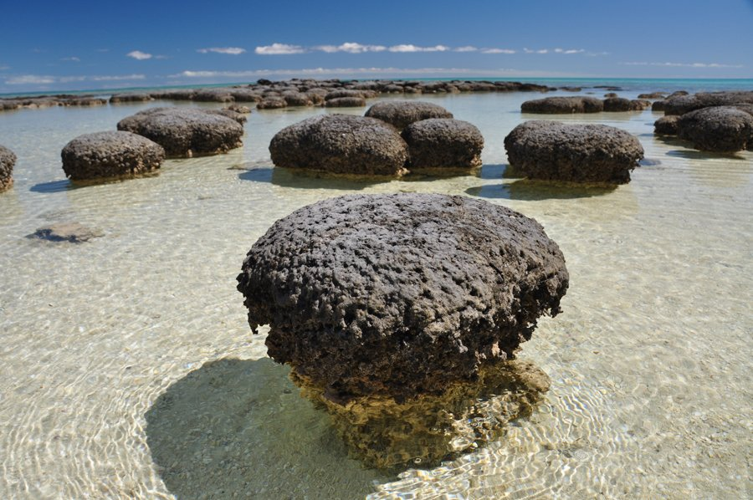
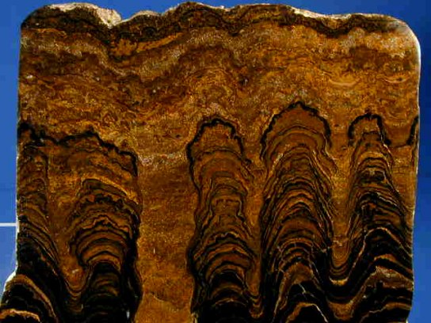
Lecture 2: Molecules and Membranes
The oldest fossils date to 3.5-3.8 bya. How did life originate? “Reductionism” would suggest that the components of life—molecules—would have had to form first. Let’s meet them, and then see how they form.

Slide 2
Biologically Important Molecules
A. Water
B. Carbohydrates (sugars and their derivatives, like starch)
1. Structure
monomer = “monosaccharide” (simple sugar)
C_{n}H_{2n}O_{n}
Glucose, galactose, fructose are ‘hexose’ sugars with 6 carbon atoms.
Ribose and deoxyribose are ‘pentose’ sugars with 5 carbons atoms.

Slide 3
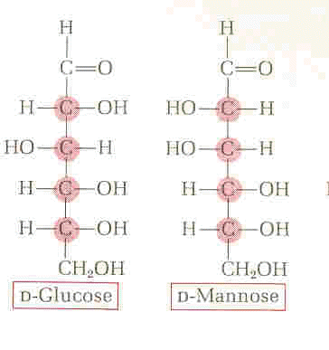
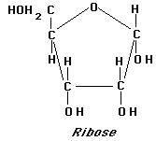

Slide 4
Biologically Important Molecules
A. Water
B. Carbohydrates (sugars and their derivatives, like starch)
1. Structure
monomer = “monosaccharide” (simple sugar)
C_{n}H_{2n}O_{n}
polymers = “polysaccharides”
monomers are linked together into polymers using dehydration synthesis - a removal of a water molecule (dehydration) and the synthesis of a bond. This requires energy and is catalyzed by enzymes in living systems.

Slide 5
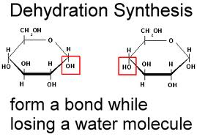
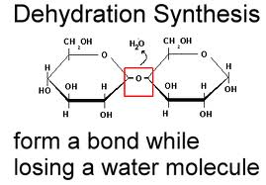

Slide 6
Biologically Important Molecules
A. Water
B. Carbohydrates (sugars and their derivatives, like starch)
1. Structure
monomer = “monosaccharide” (simple sugar)
C_{n}H_{2n}O_{n}
polymers = “polysaccharides”
monomers are linked together into polymers using dehydration synthesis - a removal of a water molecule (dehydration) and the synthesis of a bond. This requires energy and is catalyzed by enzymes in living systems.
Examples of disaccharides: sucrose, lactose
Examples of polysaccharides: starch, glycogen, chitin, and cellulose

Slide 7
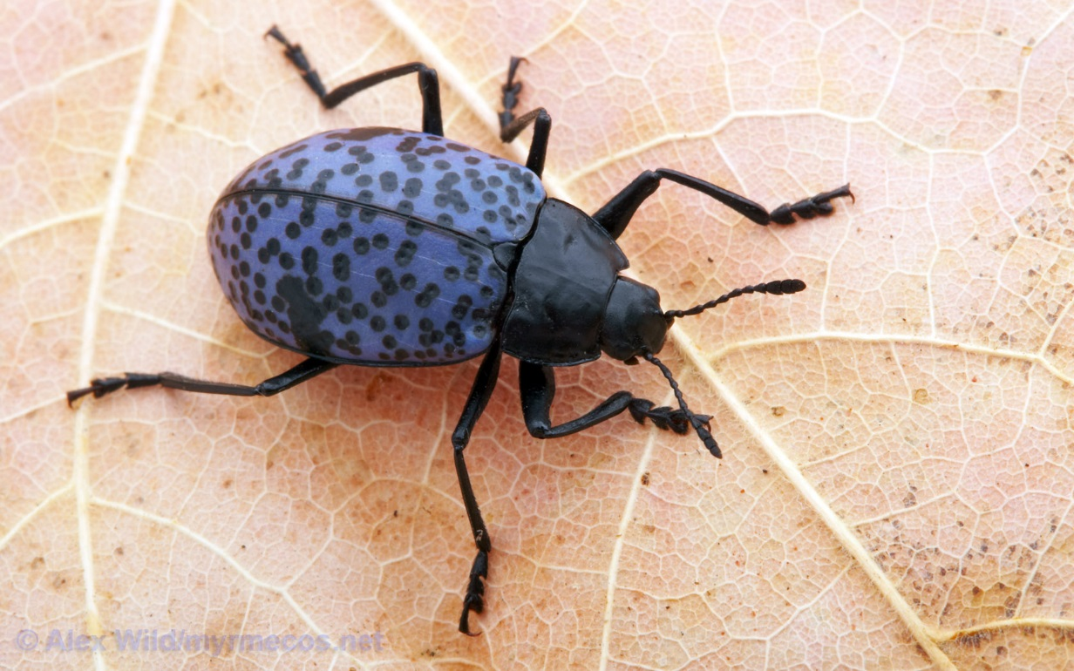
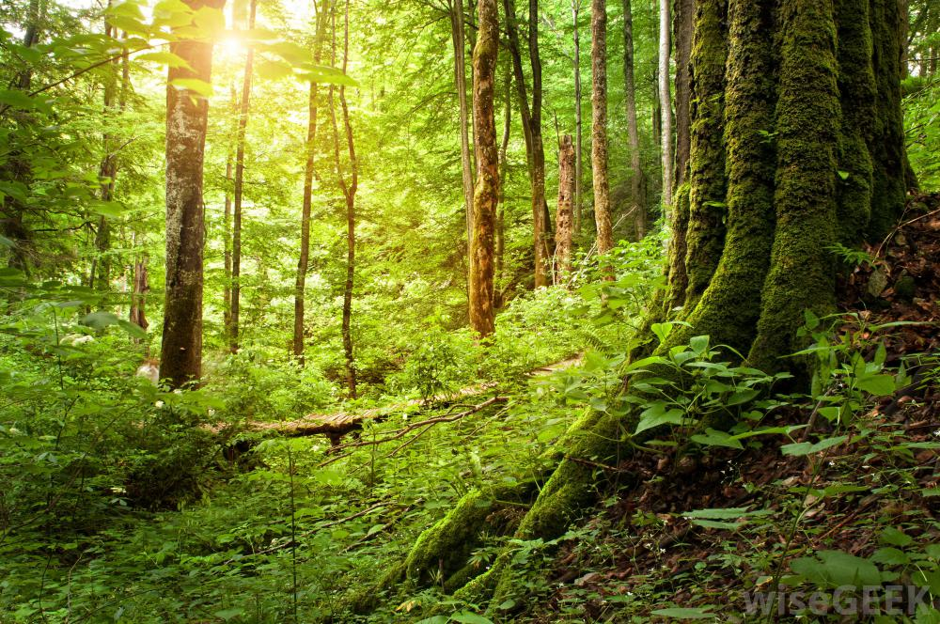
Biologically Important Molecules
A. Water
B. Carbohydrates (sugars and their derivatives, like starch)
1. Structure
2. Functions
- energy storage (true for carbo’s, fats, proteins, etc.)
- structural: chitin and cellulose

Slide 8
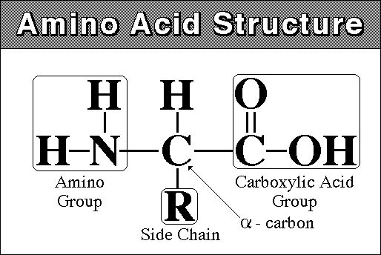
Biologically Important Molecules
A. Water
B. Carbohydrates
C. Proteins (enzymes, transport proteins, structural proteins)
1. Structure
monomer = “amino acid”

Slide 9
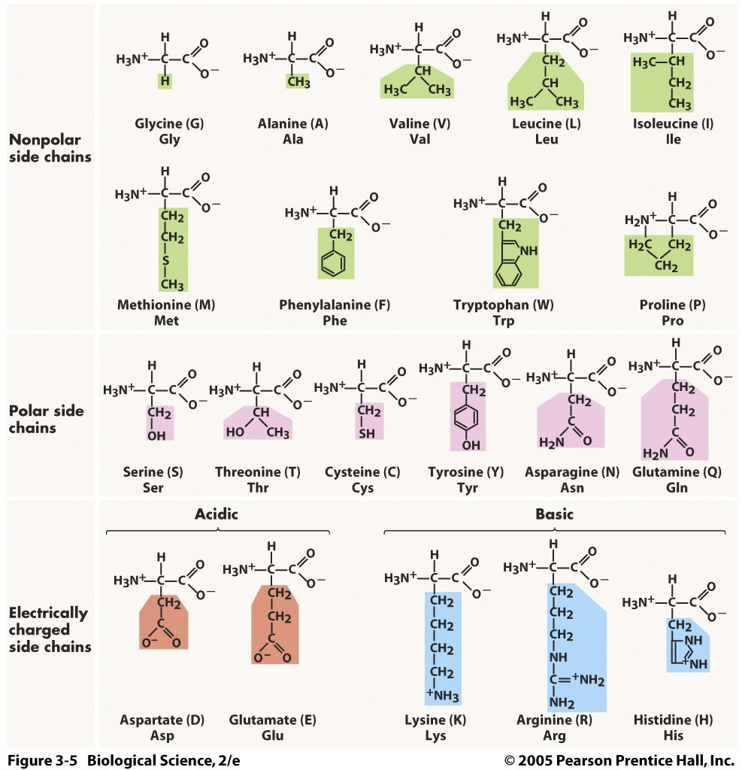
20 in living things

Slide 10
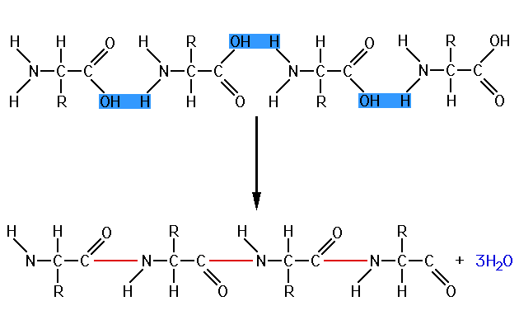
Biologically Important Molecules
A. Water
B. Carbohydrates
C. Proteins (enzymes, transport proteins, structural proteins)
1. Structure
monomer = “amino acid”
polymer = “polypeptide” / “protein”… 100-300 aa long
Also form by dehydration synthesis reactions….

Slide 11
Biologically Important Molecules
A. Water
B. Carbohydrates
C. Proteins (enzymes, transport proteins, structural proteins)
1. Structure
2. Functions
Because there are 20 “letters” (aa), and 100-300 are joined to make a word, there is INCREDIBLE VARIATION IN STRUCTURE that can be produced. This is reflected in INCREDIBLE VARIATION IN FUNCTION.

Slide 12
Biologically Important Molecules
A. Water
B. Carbohydrates
C. Proteins (enzymes, transport proteins, structural proteins)
1. Structure
2. Functions
Because there are 20 “letters” (aa), and 100-300 are joined to make a word, there is INCREDIBLE VARIATION IN STRUCTURE that can be produced. This is reflected in INCREDIBLE VARIATION IN FUNCTION.
- enzymes: these catalyze specific chemical reactions, bonding things together to make something new, or breaking something down. A different enzyme is needed for each reaction in a cell.

Slide 13
Biologically Important Molecules
A. Water
B. Carbohydrates
C. Proteins (enzymes, transport proteins, structural proteins)
1. Structure
2. Functions
Because there are 20 “letters” (aa), and 100-300 are joined to make a word, there is INCREDIBLE VARIATION IN STRUCTURE that can be produced. This is reflected in INCREDIBLE VARIATION IN FUNCTION.
- enzymes: these catalyze specific chemical reactions, bonding things together to make something new, or breaking something down. A different enzyme is needed for each reaction in a cell.
- structural: after water (75-80%), animals are mostly protein. Actin and myosin in muscle allow contraction; collagen and elastin hold skin cells together and are the fibers in bone.

Slide 14
Biologically Important Molecules
A. Water
B. Carbohydrates
C. Proteins (enzymes, transport proteins, structural proteins)
1. Structure
2. Functions
Because there are 20 “letters” (aa), and 100-300 are joined to make a word, there is INCREDIBLE VARIATION IN STRUCTURE that can be produced. This is reflected in INCREDIBLE VARIATION IN FUNCTION.
- enzymes:
- structural:
- transport proteins: are in cell membranes and are critical to getting things in and out of cells.

Slide 15
Biologically Important Molecules
A. Water
B. Carbohydrates
C. Proteins (enzymes, transport proteins, structural proteins)
1. Structure
2. Functions
Because there are 20 “letters” (aa), and 100-300 are joined to make a word, there is INCREDIBLE VARIATION IN STRUCTURE that can be produced. This is reflected in INCREDIBLE VARIATION IN FUNCTION.
- enzymes:
- structural:
- transport proteins:
- immunity: antibodies protect against infection

Slide 16
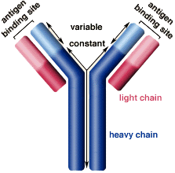
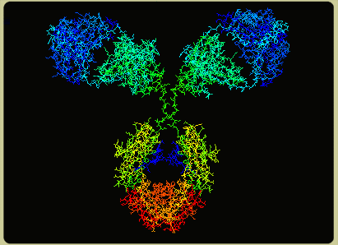

Slide 17
Biologically Important Molecules
A. Water
B. Carbohydrates
C. Proteins (enzymes, transport proteins, structural proteins)
D. Lipids (fats and oils)

Slide 18
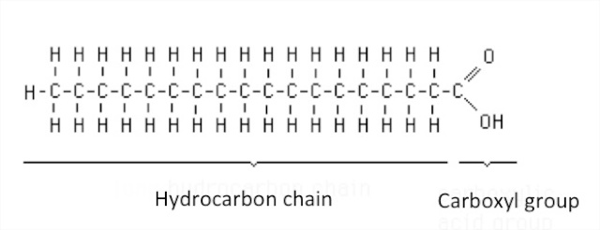
Biologically Important Molecules
A. Water
B. Carbohydrates
C. Proteins (enzymes, transport proteins, structural proteins)
D. Lipids (fats and oils)
1. Structure:
- monomer = ‘fatty acid’

Slide 19
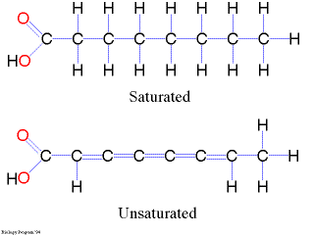
D. Lipids (fats and oils)
1. Structure:
monomer = ‘fatty acid’
- mammal, bird, reptile fats – ‘saturated’ - solid at room temp
- fish, plants – often ‘unsaturated’ – liquid (oil)
- unsaturated can be ‘hydrogenated’ (peanut butter)

Slide 20
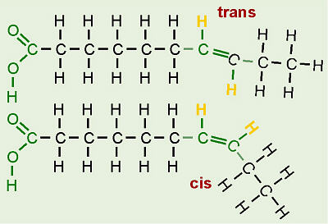
transfats associated with atherosclerosis

Slide 21
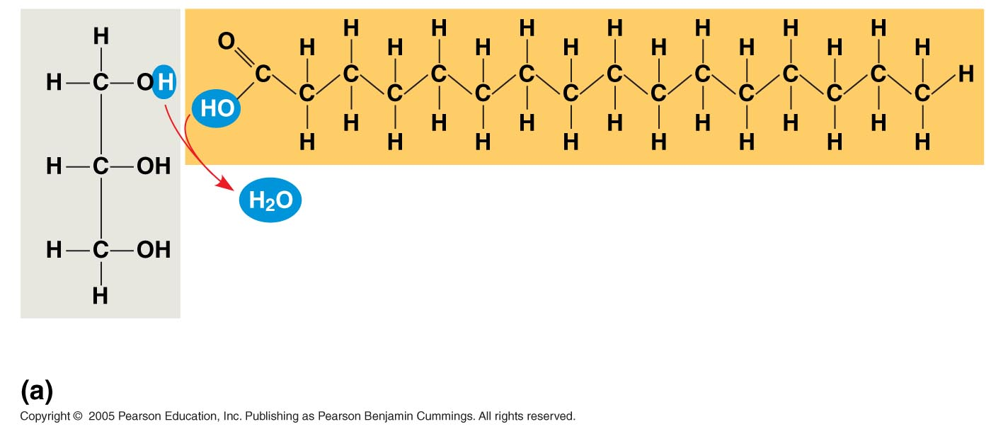
LE 5-11a
D. Lipids
1. Structure
- polymers: triglycerides
Fatty acid
(palmitic acid)
Glycerol
Dehydration reaction in the synthesis of a fat

Slide 22
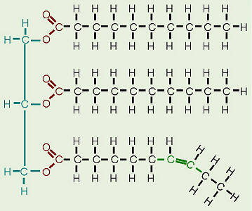
D. Lipids
1. Structure
- polymers: triglycerides

Slide 23
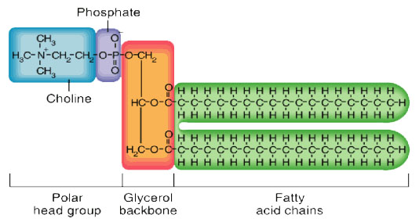
D. Lipids
1. Structure
- polymers: phospholipids

Slide 24
D. Lipids
1. Structure
2. Function
a. energy storage - long term - densely packed bonds
b. Cell membranes
c. insulation
d. homones and cholesterol derivatives

Slide 25
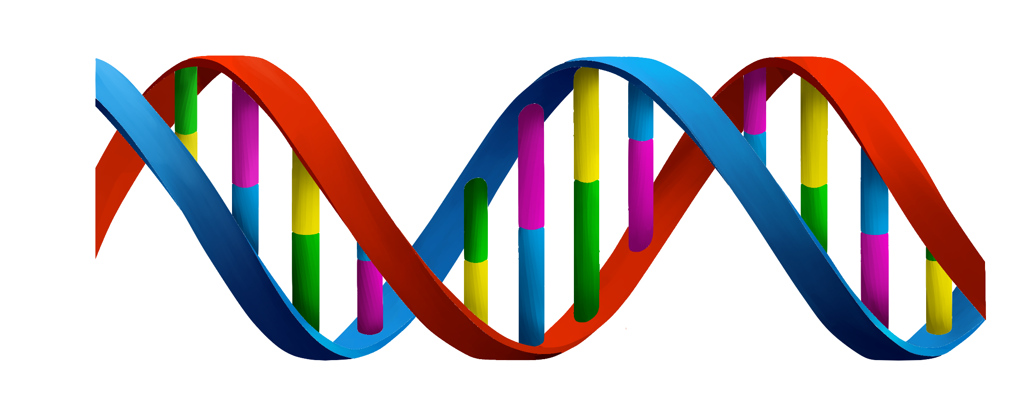
Biologically Important Molecules
A. Water
B. Carbohydrates
C. Proteins (enzymes, transport proteins, structural proteins)
D. Lipids (fats and oils)
E. Nucleic Acids (DNA and RNA) - later

Slide 26
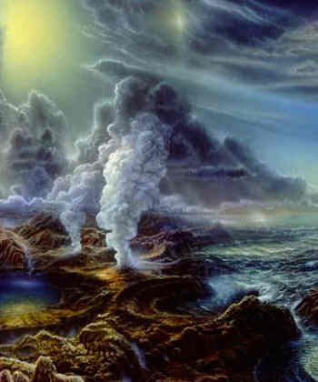
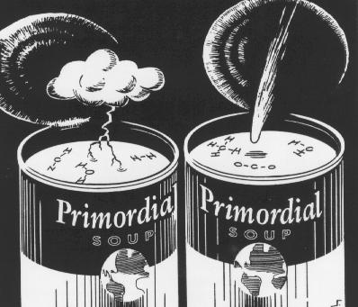
Biologically Important Molecules
II. Formation of Biologically Important Molecules

Slide 27
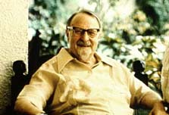
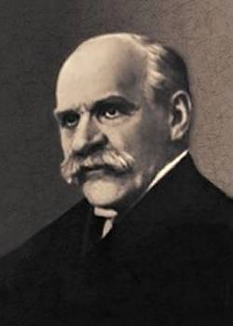
II. Formation of Biologically Important Molecules
A. Formation of Monomers
- Oparin-Haldane Hypothesis (1924):
- in a reducing atmosphere, biomonomers would form spontaneously
Aleksandr Oparin
(1894-1980)
J.B.S. Haldane
(1892-1964)

Slide 28
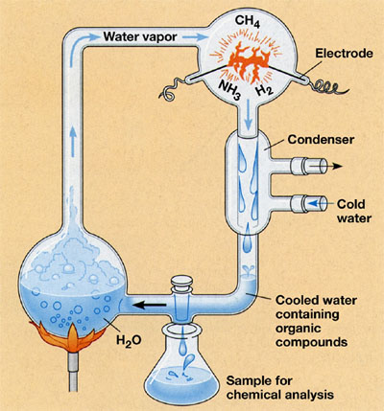
II. The Formation of Biologically Important Molecules
A. Formation of Monomers
- Oparin-Haldane Hypothesis (1924):
- in a reducing atmosphere, biomonomers would form spontaneously
- Miller-Urey (1953)
all biologically important monomers have been produced by these experiments, even while changing gas composition and energy sources

Slide 29
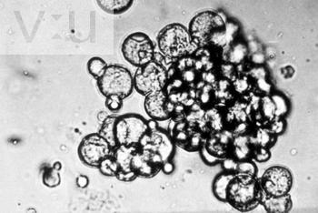
II. The Formation of Biologically Important Molecules
A. Formation of Monomers
B. Formation of Polymers
- Sydney Fox - 1970 - polymerized protein microspheres

Slide 30
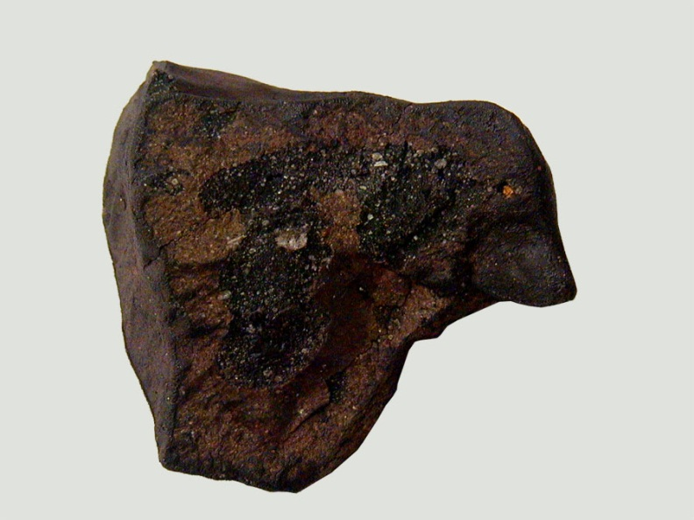
II. The Formation of Biologically Important Molecules
A. Formation of Monomers
B. Formation of Polymers
- Sydney Fox - 1970 - polymerized protein microspheres
- Cairns-Smith (1960-70) - clays as templates for non-random polymerization
- 1969 - Murcheson meteorite - amino acids present; some not found on Earth. To date, 74 meteoric AA's.
- 2004 - Szostak - clays could catalyze formation of RNA's

Slide 31
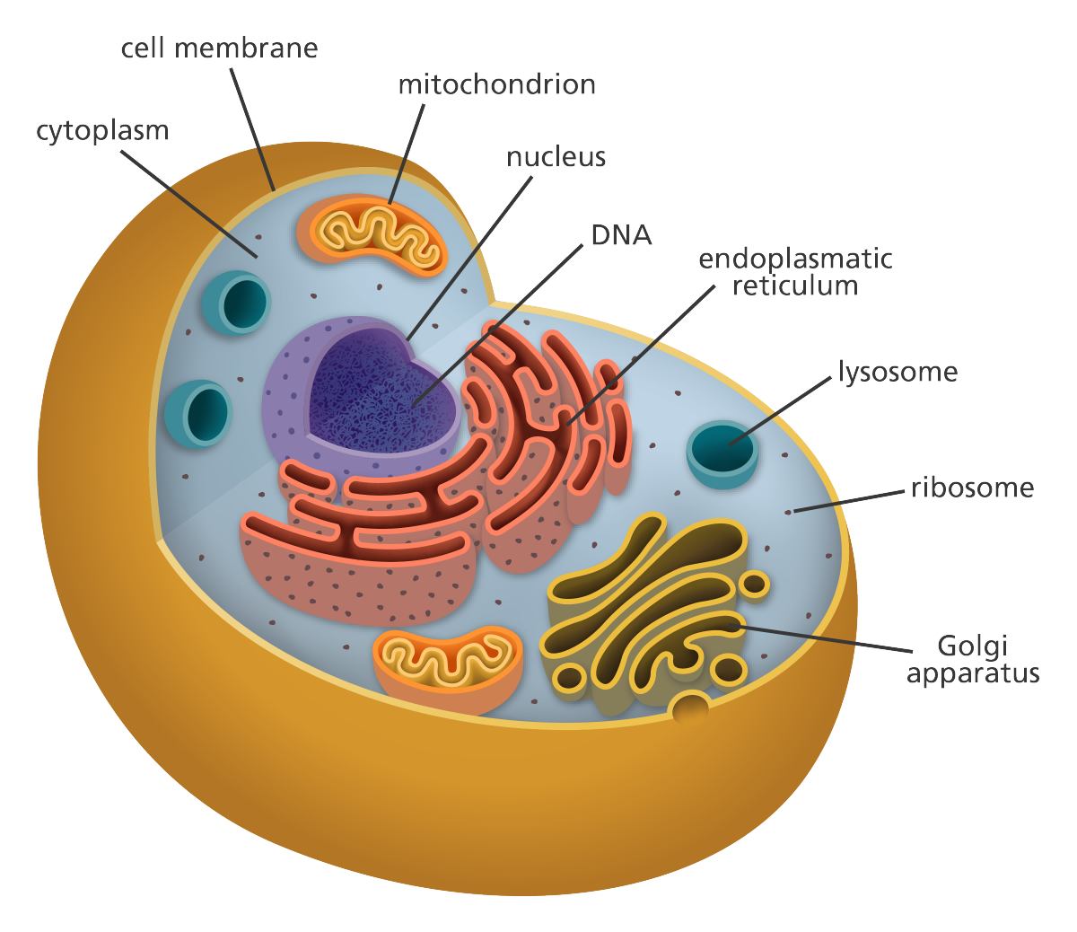
C. Acquiring the Characteristics of Life
Three Primary Attributes:
- Barrier (phospholipid membrane)
- Metabolism (reaction pathways)
- Genetic System

Slide 32
How Cells Live
- take stuff in

Slide 33
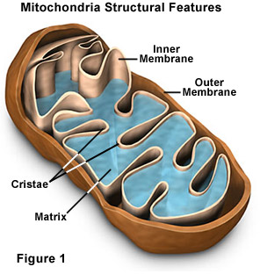
How Cells Live
- take stuff in
- break it down and
harvest energy
(enzymes needed)
mitochondria
ADP +P
ATP

Slide 34
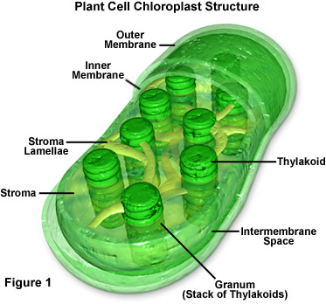
How Cells Live
- take stuff in
- break it down and
harvest energy
(enzymes needed)
and
- transform radiant energy to chemical energy
chloroplast
ADP +P
ATP
mitochondria
ADP +P
ATP

Slide 35
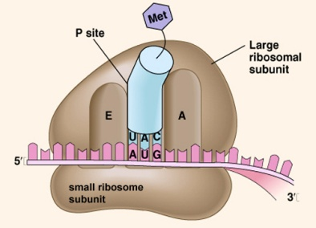
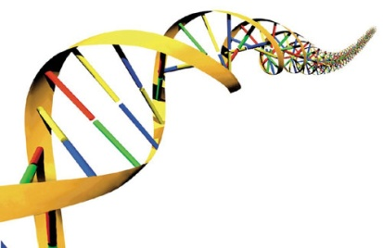
How Cells Live
- take stuff in
- break it down and
harvest energy
(enzymes needed)
- use energy to make stuff
(like enzymes and other proteins, and lipids, polysaccharides, and nucleic acids)
- DNA determines sequence of amino acids in enzymes and other proteins
ADP +P
ATP
ribosome

Slide 36
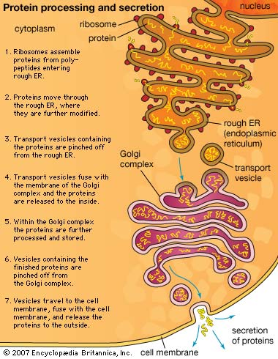
ADP +P
ATP
ribosome

Slide 37
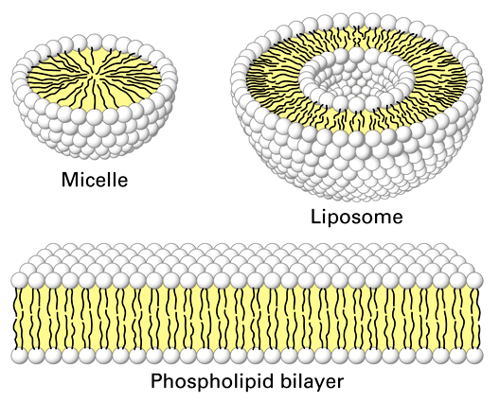
Biologically Important Molecules
Formation of Biologically Important Molecules
Membranes
A. Evolution of a Membrane
- phospholipids form spontaneously in Miller-Urey experiments
- In a turbid environment, wave action will cause these films to ball-up as single-layer micelles and as phospholipid bilayers.
- these bilayers form the basis of a semi-permeable membrane found in all living cells. So, the formation of a membrane is the easiest and most well-understood piece of the puzzle.

Slide 38
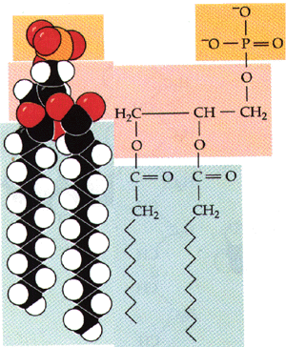
III. Membranes
A. Evolution of a Membrane
B. Structure
- phospholipid bilayer

Slide 39
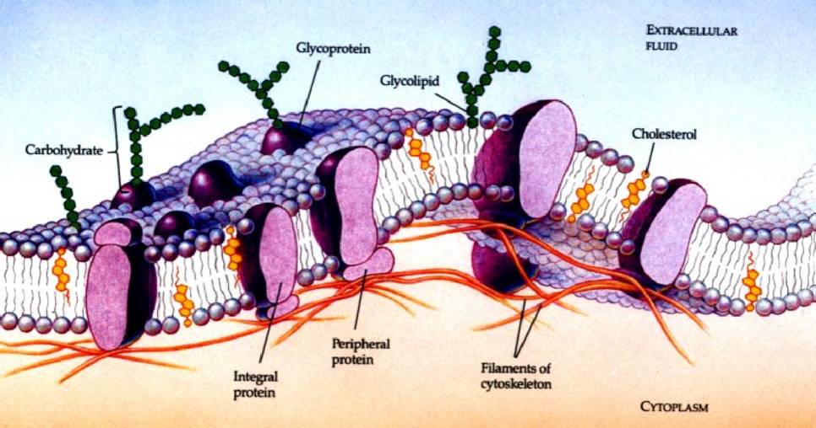
III. Membranes
A. Evolution of a Membrane
B. Structure
- phospholipid bilayer
- proteins and carbohydrates

Slide 40
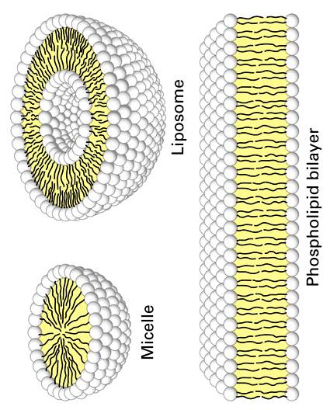
III. Membranes
A. Evolution of a Membrane
B. Structure
C. Functions
- semi-permeable barrier
Aqueous Solution (outside cell)
dissolved ions
dissolved polar molecules
suspended non-polar
(lipid soluble)
Aqueous Solution (inside cell)
dissolved ions
dissolved polar molecules
suspended non-polar
(lipid soluble)

Slide 41
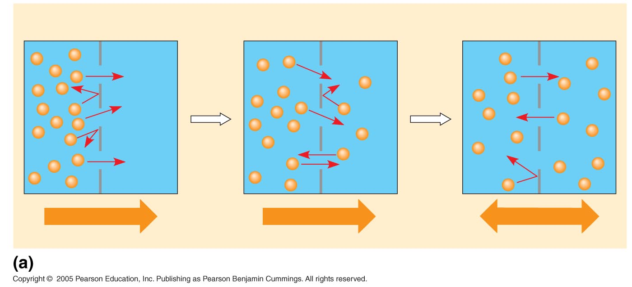
III. Membranes
A. Evolution of a Membrane
B. Structure
C. Functions
- semi-permeable barrier
- absorption and expulsion of materials (transport)
Net diffusion
Net diffusion
equilibrium

Slide 42
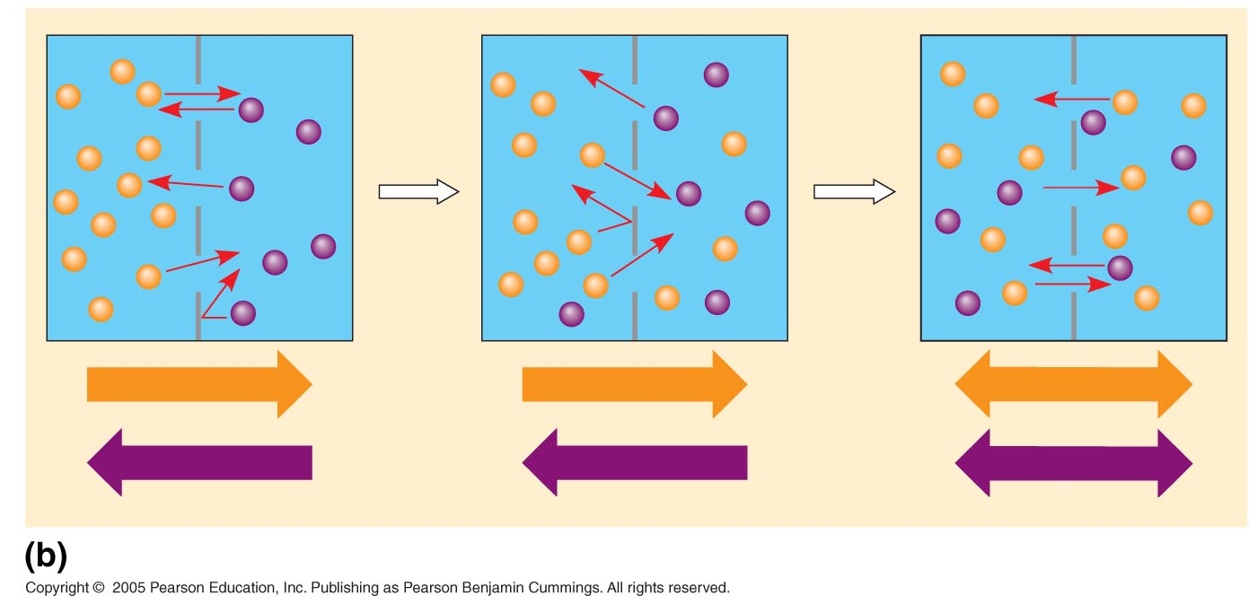
III. Membranes
A. Evolution of a Membrane
B. Structure
C. Functions
- semi-permeable barrier
- absorption and expulsion of materials (transport)
- DIFFUSION
Net diffusion
Net diffusion
Equilibrium
Net diffusion
Net diffusion
equilibrium
Net diffusion
Net diffusion
Equilibrium

Slide 43
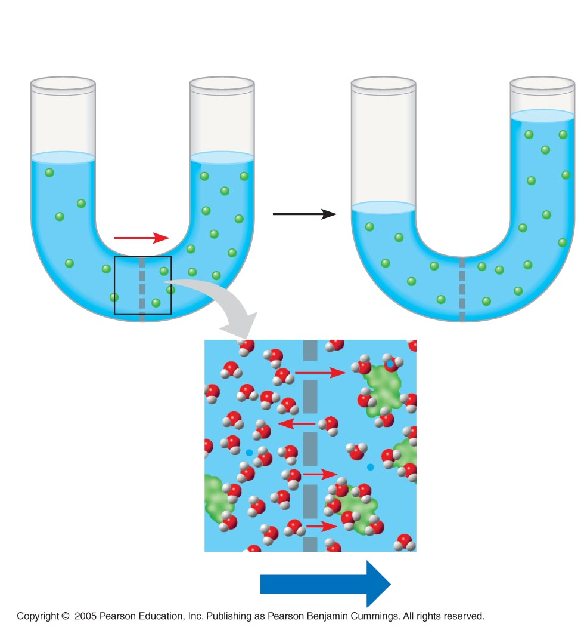
III. Membranes
A. Evolution of a Membrane
B. Structure
C. Functions
- semi-permeable barrier
- absorption and expulsion of materials (transport)
- DIFFUSION
- OSMOSIS

Slide 44
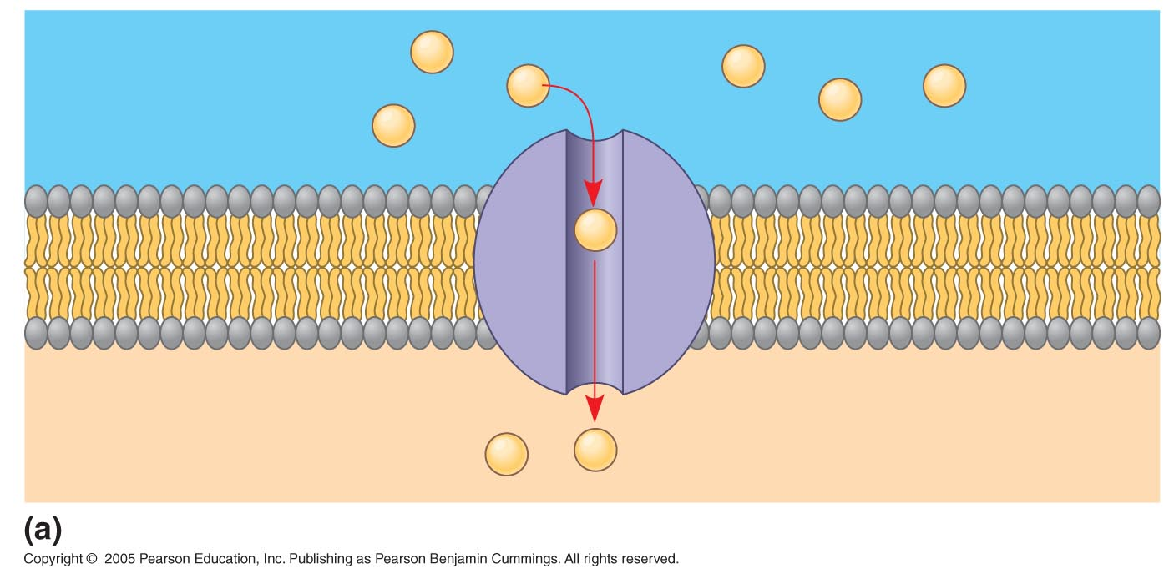
III. Membranes
A. Evolution of a Membrane
B. Structure
C. Functions
- semi-permeable barrier
- absorption and expulsion of materials (transport)
- FACILITATED DIFFUSION

Slide 45
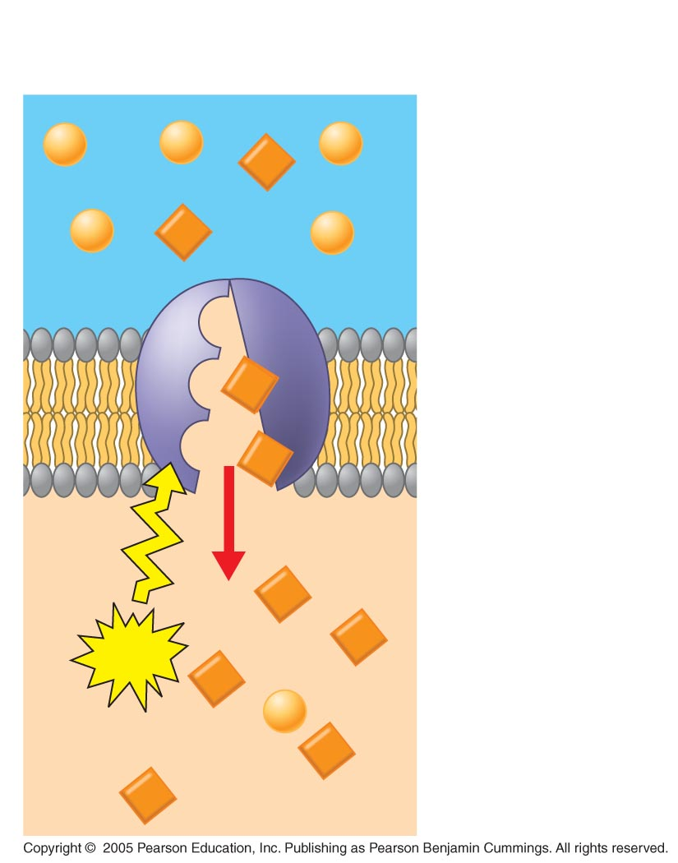
III. Membranes
A. Evolution of a Membrane
B. Structure
C. Functions
- semi-permeable barrier
- absorption and expulsion of materials (transport)
- ACTIVE TRANSPORT

Slide 46
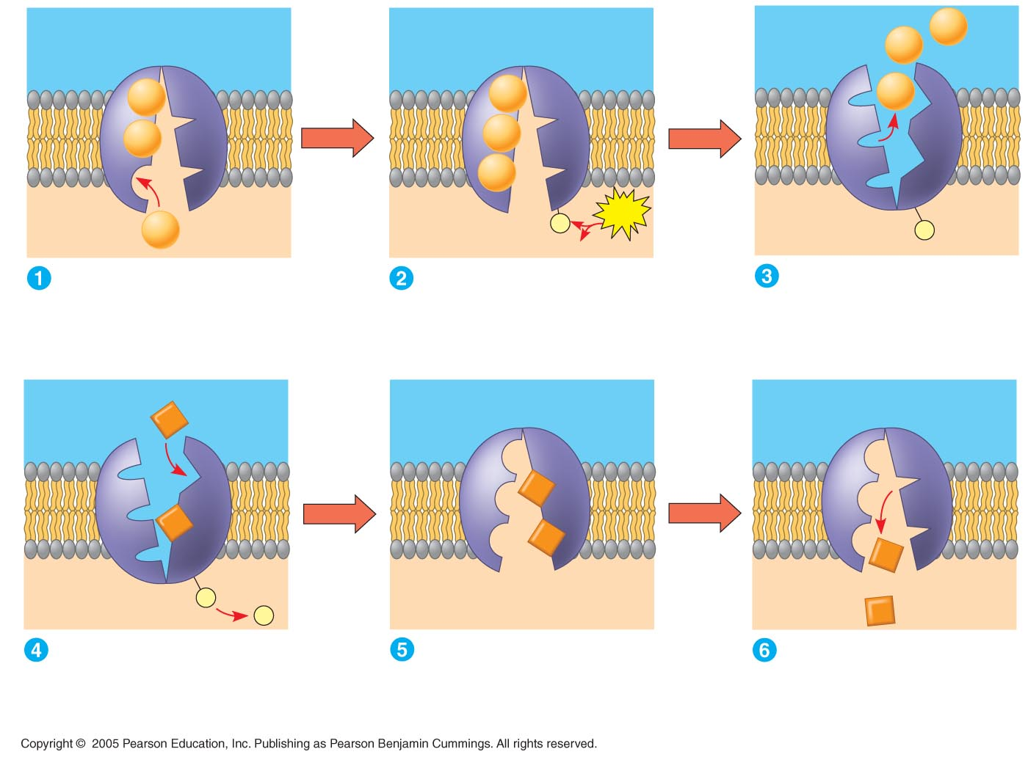
Cytoplasmic Na⁺ bonds to
the sodium-potassium pump
Na⁺ binding stimulates
phosphorylation by ATP.
Phosphorylation causes
the protein to change its
conformation, expelling Na⁺
to the outside.
Extracellular K⁺ binds
to the protein, triggering
release of the phosphate
group.
Loss of the phosphate
restores the protein’s
original conformation.
K⁺ is released and Na⁺
sites are receptive again;
the cycle repeats.

Slide 47
III. Membranes
A. Evolution of a Membrane
B. Structure
C. Functions
- semi-permeable barrier
- absorption and expulsion of materials (transport)
- signal transduction

Slide 48
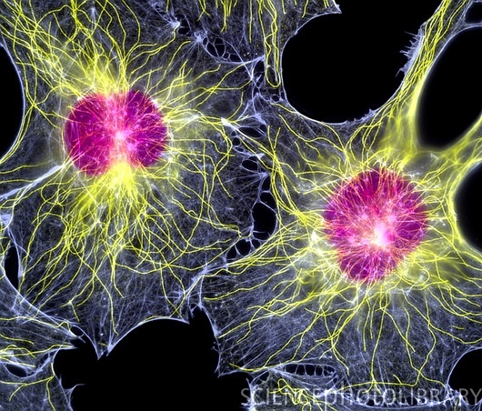
III. Membranes
A. Evolution of a Membrane
B. Structure
C. Functions
- semi-permeable barrier
- absorption and expulsion of materials (transport)
- signal transduction
- cell-cell binding
- cell recognition
- cytoskeleton attachment

