Slide 1
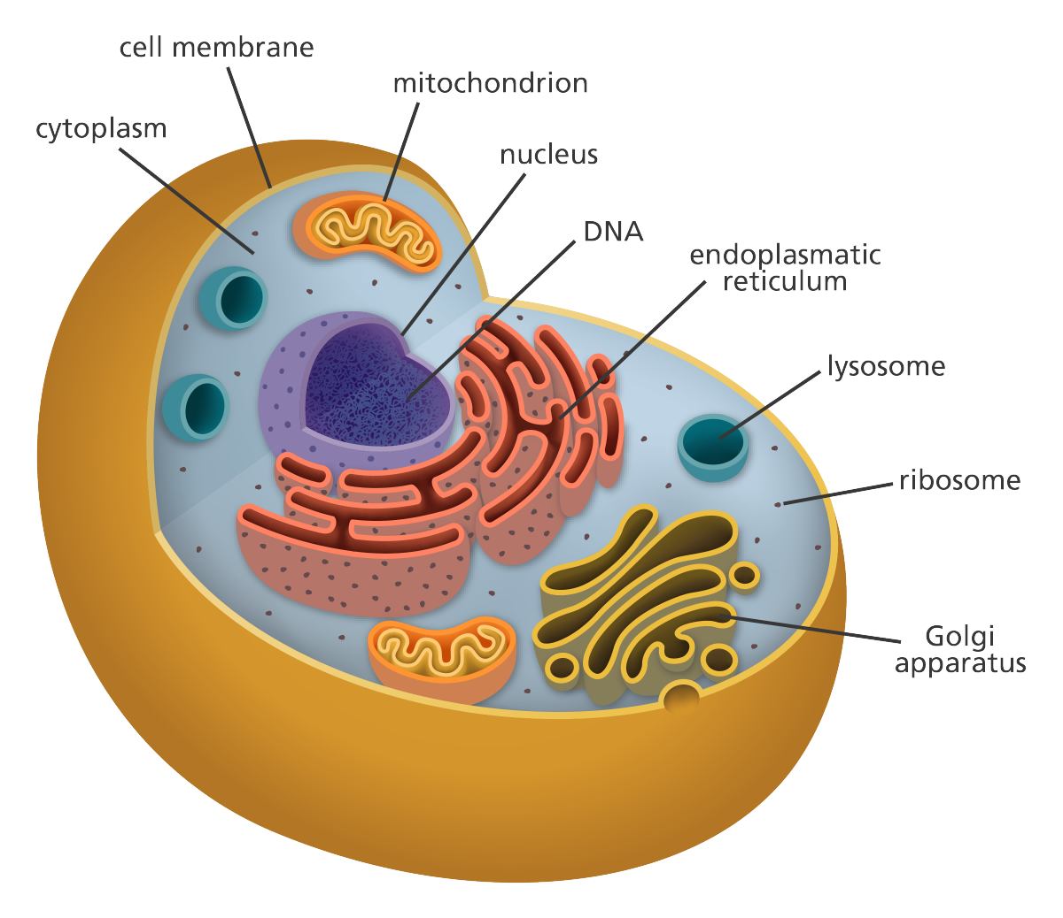
LECTURE 3: ENERGY HARVEST

Slide 2
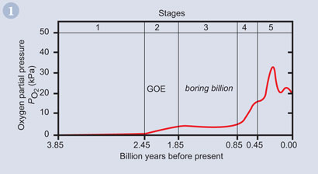
Oldest Life
Oxygenic photosynthesis
?

Slide 3
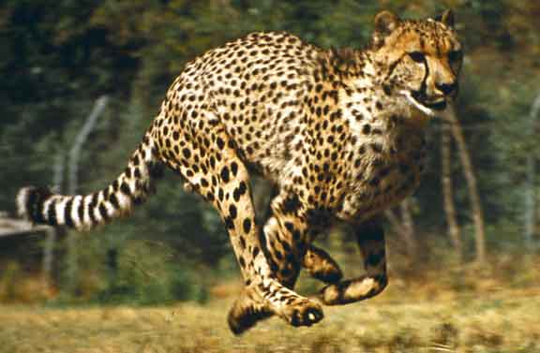
Cellular Respiration

Slide 4
Chemical Potential Energy
CATABOLISM
ENERGY FOR:
“ENTROPY”
ANABOLISM
WORK

Slide 5
+
Energy
Coupled Reaction
+
Energy

Slide 6
+
Energy
Coupled Reaction
ATP
ADP + P +
Energy
Coupled Reaction
+
Energy

Slide 7
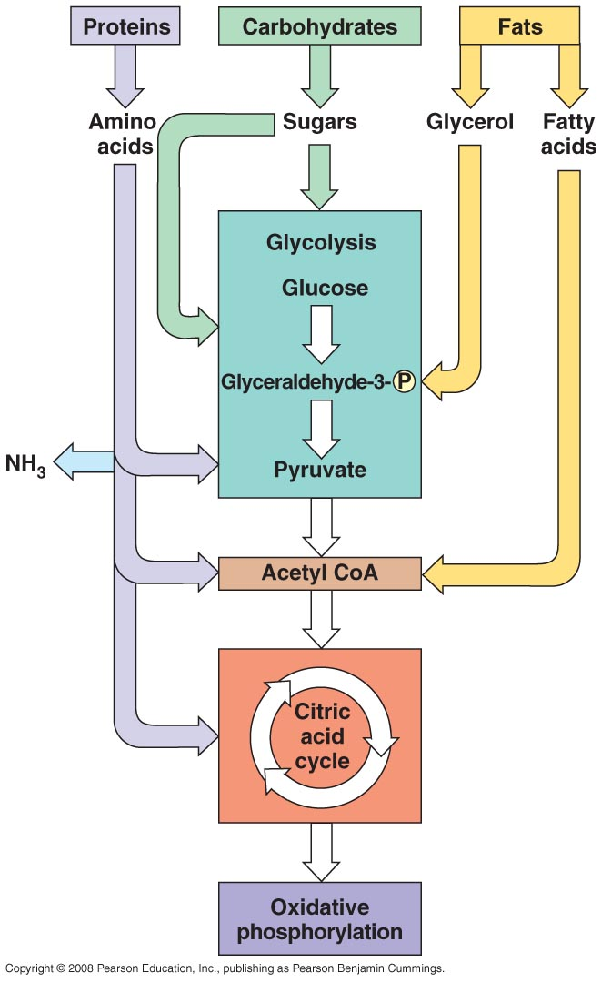
III. Cellular Respiration
Overview:

Slide 8
MONOMERS and WASTE
MATTER and ENERGY in FOOD
DIGESTION AND CELLULAR RESPIRATION
ADP + P
ATP

Slide 9
III. Cellular Respiration
Overview:
Focus on core process…
Glucose metabolism
GLYCOLYSIS

Slide 10
III. Cellular Respiration
Overview:
Focus on core process…
Glucose metabolism
GLYCOLYSIS
Oxygen Present? Oxygen Absent?
Aerobic Resp. Anaerobic Resp.

Slide 11
III. Cellular Respiration
Overview:
Focus on core process…
Glucose metabolism
GLYCOLYSIS
Oxygen Present? Oxygen Absent?
Fermentation
A little ATP

Slide 12
III. Cellular Respiration
Overview:
Focus on core process…
Glucose metabolism
GLYCOLYSIS
Oxygen Present? Oxygen Absent?
Gateway
CAC
ETC
Fermentation
LOTS OF ATP
A little ATP

Slide 13
III. Cellular Respiration
Overview:
1. Glycolysis:
- Occurs in presence OR absence of oxygen gas.
- All cells do this! (very primitive pathway)
- Occurs in the cytoplasm of all cells

Slide 14
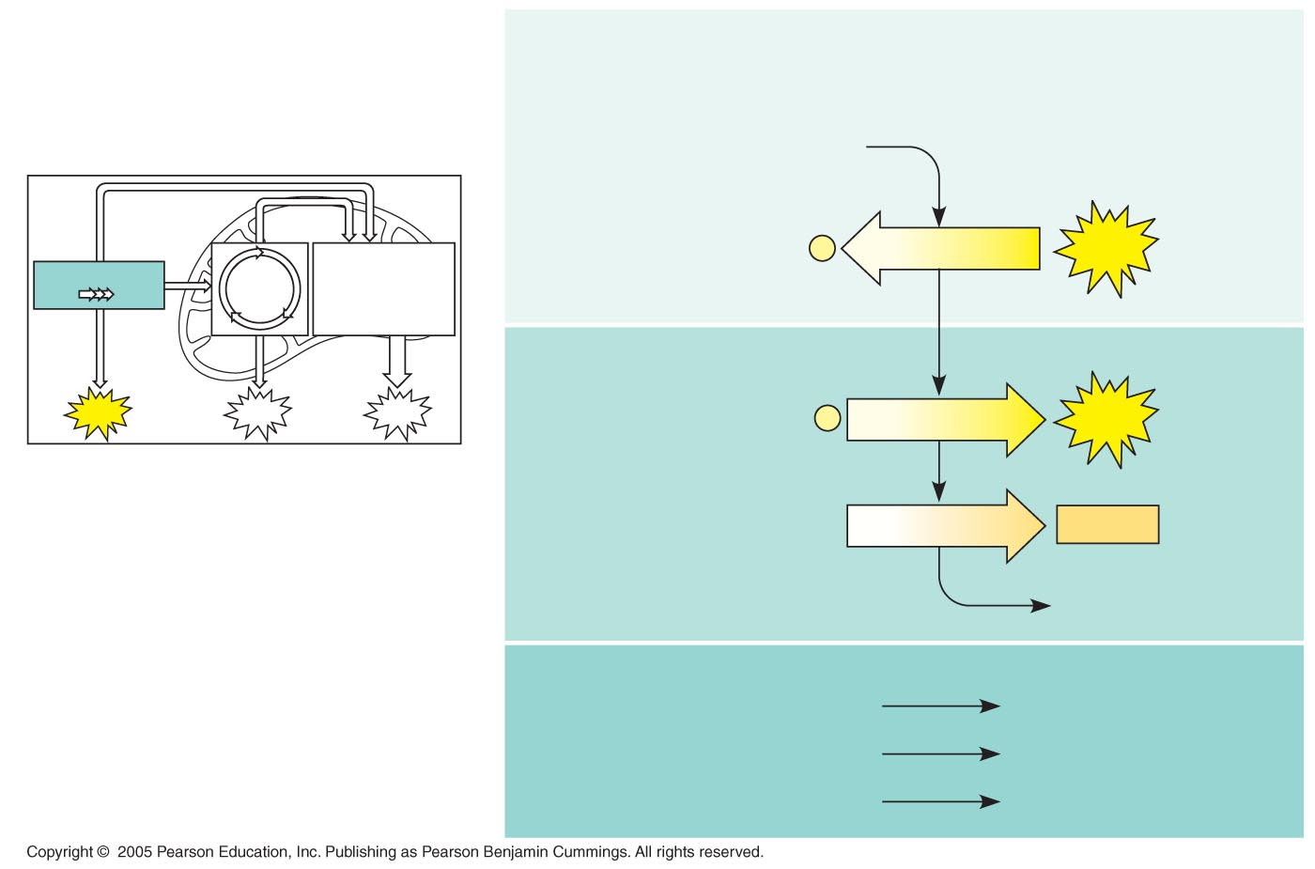
LE 9-8
III. Cellular Respiration
Overview:
1. Glycolysis:
Energy investment phase
Glucose
2 ADP + 2 P
2 ATP
used
Glycolysis
Energy payoff phase
ATP
ATP
ATP
4 ADP + 4 P
4 ATP
formed
2 NAD⁺ + 4 e– + 4 H⁺
2 NADH
+ 2 H⁺
2 Pyruvate + 2 H₂O
Net
Glucose
2 Pyruvate + 2 H₂O
4 ATP formed – 2 ATP used
2 ATP
2 NAD+ + 4 e– + 4 H⁺
2 NADH + 2 H⁺

Slide 15
LE 9-8
What's needed to keep the reaction going?
Energy investment phase
Glucose
2 ADP + 2 P
2 ATP
used
Glycolysis
Energy payoff phase
ATP
ATP
ATP
4 ADP + 4 P
4 ATP
formed
2 NAD⁺ + 4 e– + 4 H⁺
2 NADH
+ 2 H⁺
2 Pyruvate + 2 H₂O
Net
Glucose
2 Pyruvate + 2 H₂O
4 ATP formed – 2 ATP used
2 ATP
2 NAD+ + 4 e– + 4 H⁺
2 NADH + 2 H⁺

Slide 16
LE 9-8
What's needed to keep the reaction going?
- glucose.... (moot)
Energy investment phase
Glucose
2 ADP + 2 P
2 ATP
used
Glycolysis
Energy payoff phase
ATP
ATP
ATP
4 ADP + 4 P
4 ATP
formed
2 NAD⁺ + 4 e– + 4 H⁺
2 NADH
+ 2 H⁺
2 Pyruvate + 2 H₂O
Net
Glucose
2 Pyruvate + 2 H₂O
4 ATP formed – 2 ATP used
2 ATP
2 NAD+ + 4 e– + 4 H⁺
2 NADH + 2 H⁺

Slide 17
LE 9-8
What's needed to keep the reaction going?
- glucose....
- ATP... but previous rxn made some, so that's there
Energy investment phase
Glucose
2 ADP + 2 P
2 ATP
used
Glycolysis
Energy payoff phase
ATP
ATP
ATP
4 ADP + 4 P
4 ATP
formed
2 NAD⁺ + 4 e– + 4 H⁺
2 NADH
+ 2 H⁺
2 Pyruvate + 2 H₂O
Net
Glucose
2 Pyruvate + 2 H₂O
4 ATP formed – 2 ATP used
2 ATP
2 NAD+ + 4 e– + 4 H⁺
2 NADH + 2 H⁺

Slide 18
LE 9-8
What's needed to keep the reaction going?
- glucose....
- ATP... but previous rxn made some, so that's there
and you need NAD to accept the electrons....
(nicotinamide adenine dinucleotide)
Energy investment phase
Glucose
2 ADP + 2 P
2 ATP
used
Glycolysis
Energy payoff phase
ATP
ATP
ATP
4 ADP + 4 P
4 ATP
formed
2 NAD⁺ + 4 e– + 4 H⁺
2 NADH
+ 2 H⁺
2 Pyruvate + 2 H₂O
Net
Glucose
2 Pyruvate + 2 H₂O
4 ATP formed – 2 ATP used
2 ATP
2 NAD+ + 4 e– + 4 H⁺
2 NADH + 2 H⁺

Slide 19
LE 9-8
What's needed to keep the reaction going?
- glucose....
- ATP... but previous rxn made some, so that's there
- and you need NAD to accept the electrons....
AS GLYCOLYSIS PROCEEDS, THE [NAD+] DECLINES AND CAN BECOME LIMITING....
Energy investment phase
Glucose
2 ADP + 2 P
2 ATP
used
Glycolysis
Energy payoff phase
ATP
ATP
ATP
4 ADP + 4 P
4 ATP
formed
2 NAD⁺ + 4 e– + 4 H⁺
2 NADH
+ 2 H⁺
2 Pyruvate + 2 H₂O
Net
Glucose
2 Pyruvate + 2 H₂O
4 ATP formed – 2 ATP used
2 ATP
2 NAD+ + 4 e– + 4 H⁺
2 NADH + 2 H⁺

Slide 20
LE 9-8
What's needed to keep the reaction going?
- glucose....
- ATP... but previous rxn made some, so that's there
- and you need NAD to accept the electrons....
AS GLYCOLYSIS PROCEEDS, THE [NAD+] DECLINES AND CAN BECOME LIMITING....
CELLS HAVE EVOLVED TO RECYCLE NAD+..... SO GLYCOLYSIS CAN CONTINUE....
Energy investment phase
Glucose
2 ADP + 2 P
2 ATP
used
Glycolysis
Energy payoff phase
ATP
ATP
ATP
4 ADP + 4 P
4 ATP
formed
2 NAD⁺ + 4 e– + 4 H⁺
2 NADH
+ 2 H⁺
2 Pyruvate + 2 H₂O
Net
Glucose
2 Pyruvate + 2 H₂O
4 ATP formed – 2 ATP used
2 ATP
2 NAD+ + 4 e– + 4 H⁺
2 NADH + 2 H⁺

Slide 21
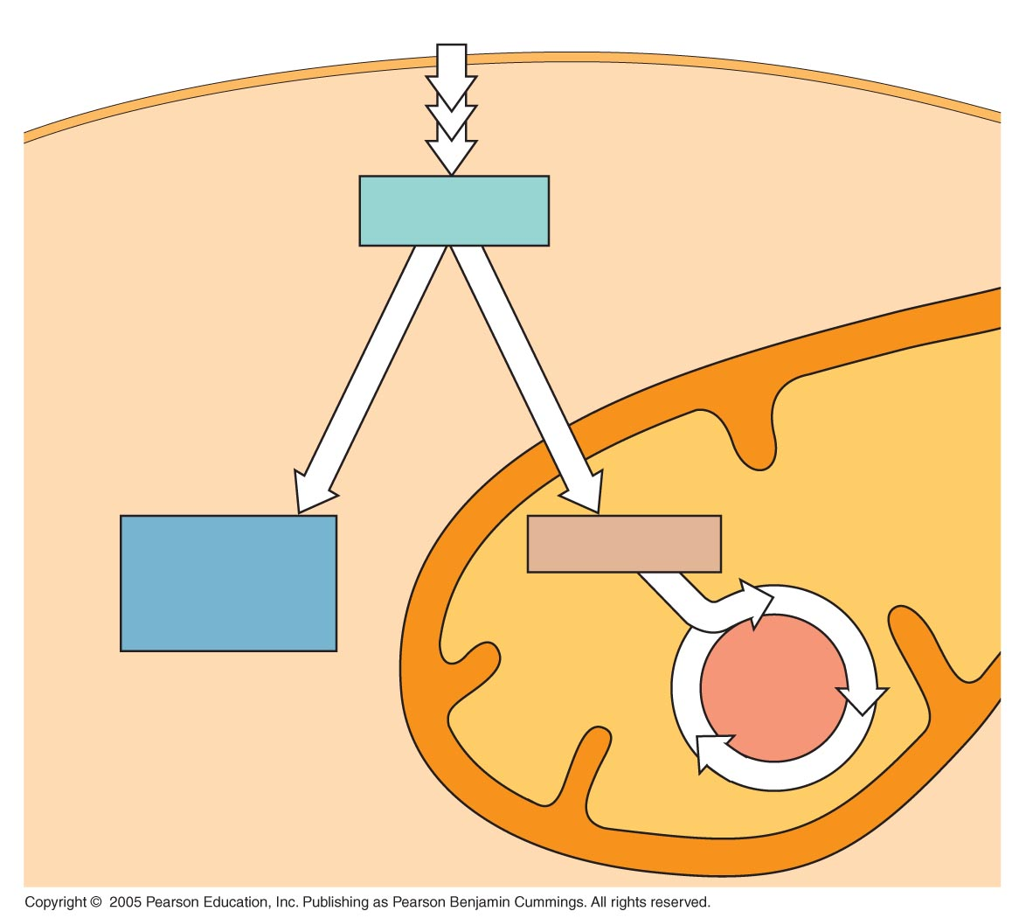
LE 9-18
Glucose
CYTOSOL
NAD+
NAD+
PYRUVATE
Pyruvate
No O₂ present
Fermentation
O₂ present
Cellular respiration
MITOCHONDRION
Ethanol
or
lactate
Acetyl CoA
Citric
acid
cycle

Slide 22
III. Cellular Respiration
Overview:
Glycolysis
Anaerobic Respiration

Slide 23
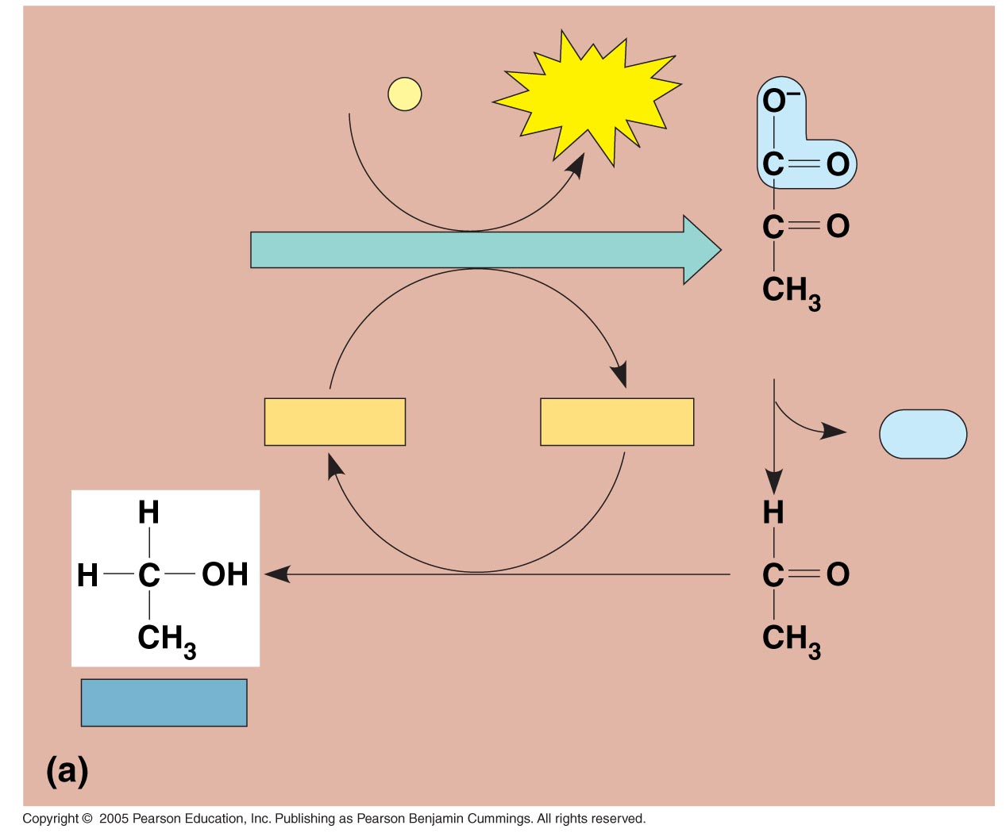
LE 9-17a
2 ADP + 2
P
i
2 ATP
Glucose
Glycolysis
2 Pyruvate
2 NAD⁺
2 NADH
2
CO₂
+ 2 H⁺
2 Ethanol
2 Acetaldehyde
Alcohol fermentation

Slide 24
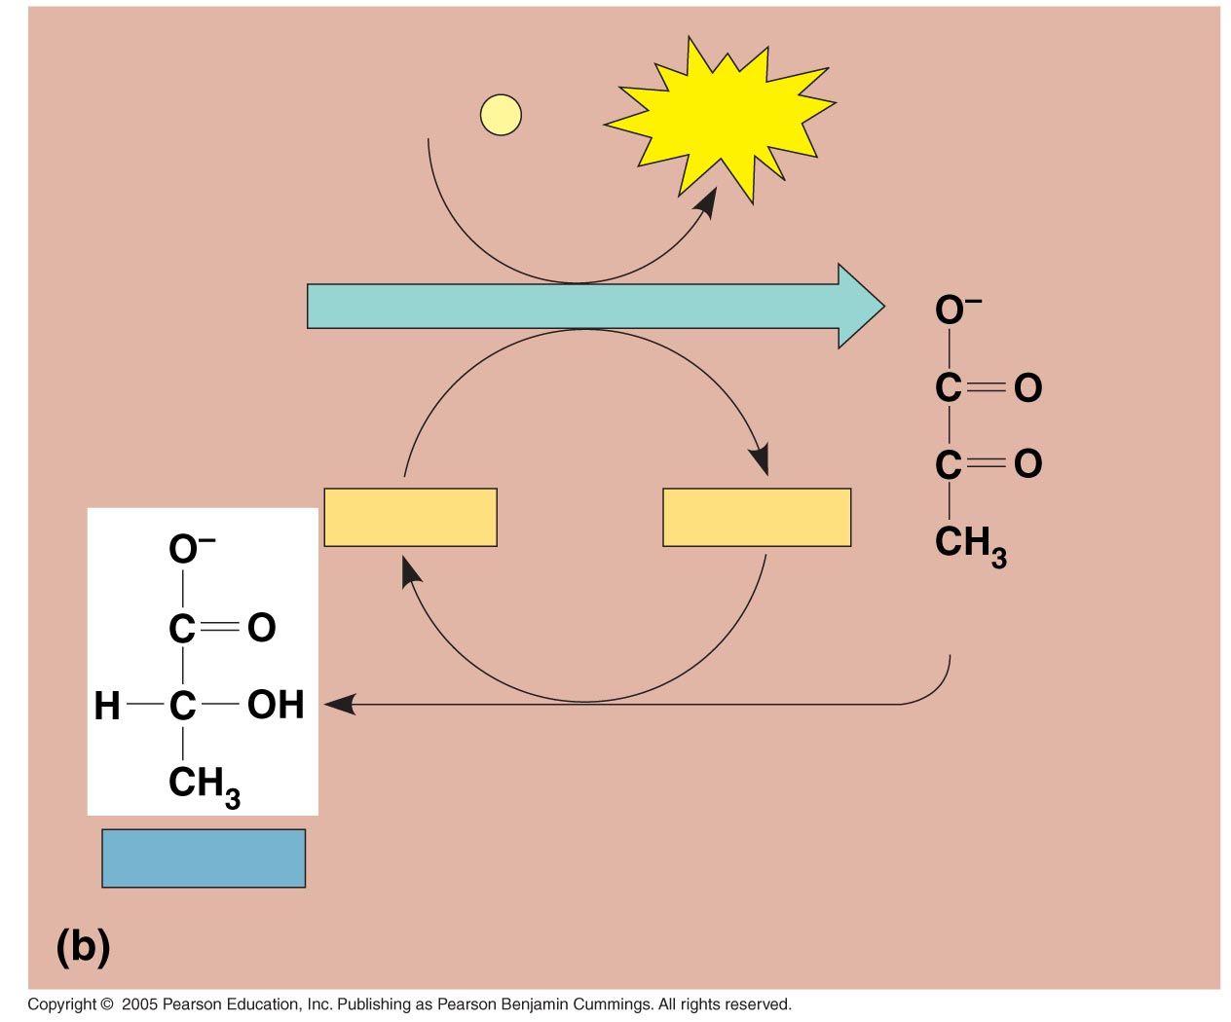
LE 9-17b
2 ADP + 2
P
i
2 ATP
Glucose
Glycolysis
2 NAD⁺
2 NADH
+ 2 H⁺
2 Pyruvate
Lactate
2 Lactate
Lactic acid fermentation

Slide 25
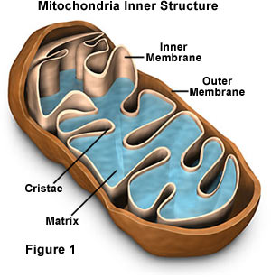
III. Cellular Respiration
Overview:
Glycolysis
Anaerobic Respiration
Aerobic Respiration

Slide 26
III. Cellular Respiration
Overview:
Glycolysis
Anaerobic Respiration
Aerobic Respiration
- Had Glycolysis: C₆ (glucose) 2C₃ (pyruvate) + ATP, NADH
a - Gateway step: 2C₃ 2C₂ (acetyl) + 2C (CO₂) + NADH
b - Citric Acid Cycle: 2C₂ (acetyl) 4C (CO₂) + NADH, FADH, ATP
c - Electron Transport Chain: convert energy in NADH, FADH to ATP

Slide 27
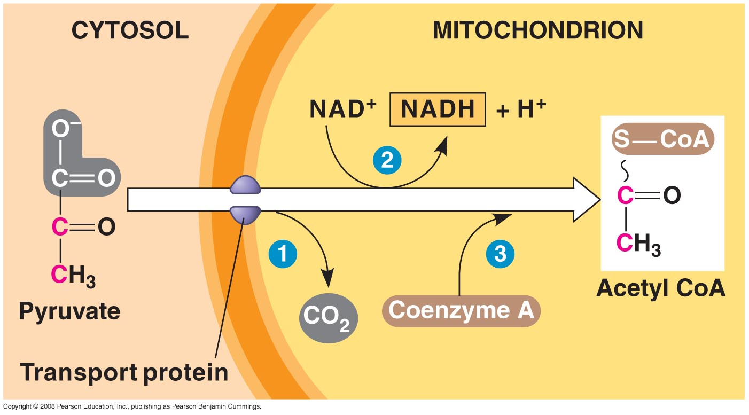
LE 9-10
Gateway step: 2C₃ 2C₂ (acetyl) + 2C (CO₂) + NADH
energy harvested as NADH
NAD⁺
NADH
+ H⁺
Acetyl Co A
Pyruvate
CO₂
Coenzyme A
Transport protein

Slide 28
III. Cellular Respiration
Overview:
Glycolysis
Anaerobic Respiration
Aerobic Respiration
- Had Glycolysis: C₆ (glucose) 2C₃ (pyruvate) + ATP, NADH
a - Gateway step: 2C₃ 2C₂ (acetyl) + 2C (CO₂) + NADH
b - Citric Acid Cycle: 2C₂ (acetyl) 4C (CO₂) + NADH, FADH, ATP
c - Electron Transport Chain: convert energy in NADH, FADH to ATP

Slide 29
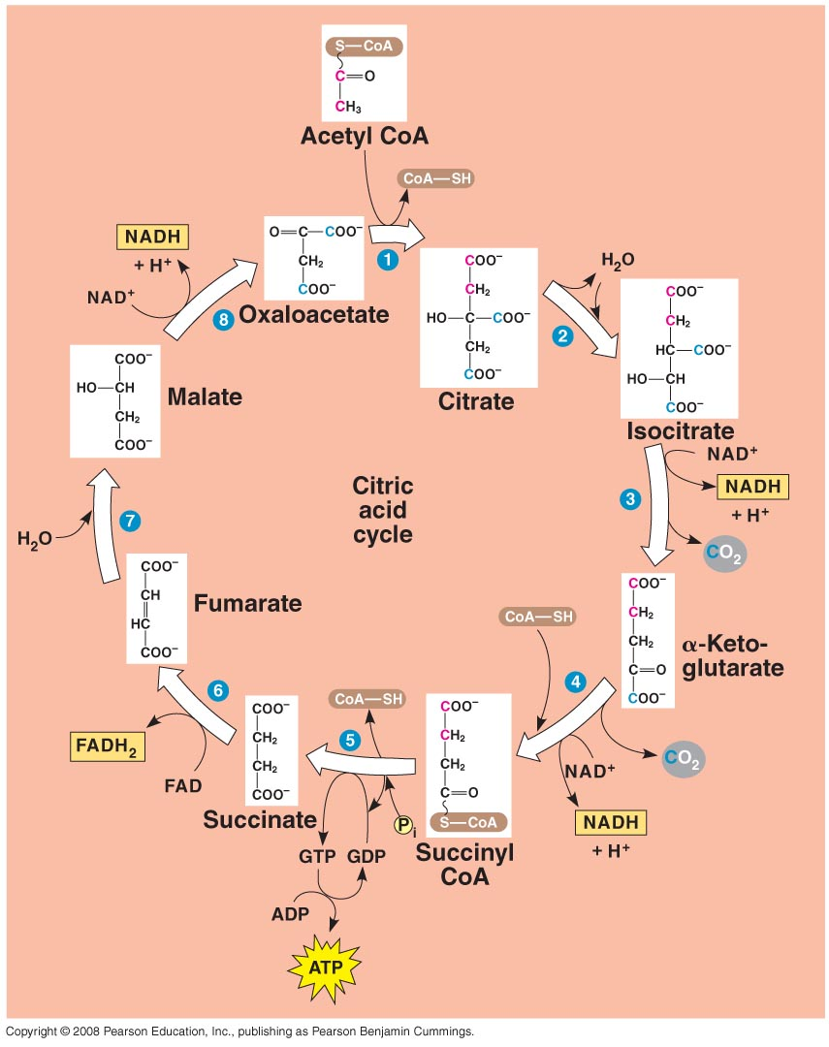
b - Citric Acid Cycle: 2C₂ (acetyl) 4C (CO₂) + NADH, FADH, ATP

Slide 30
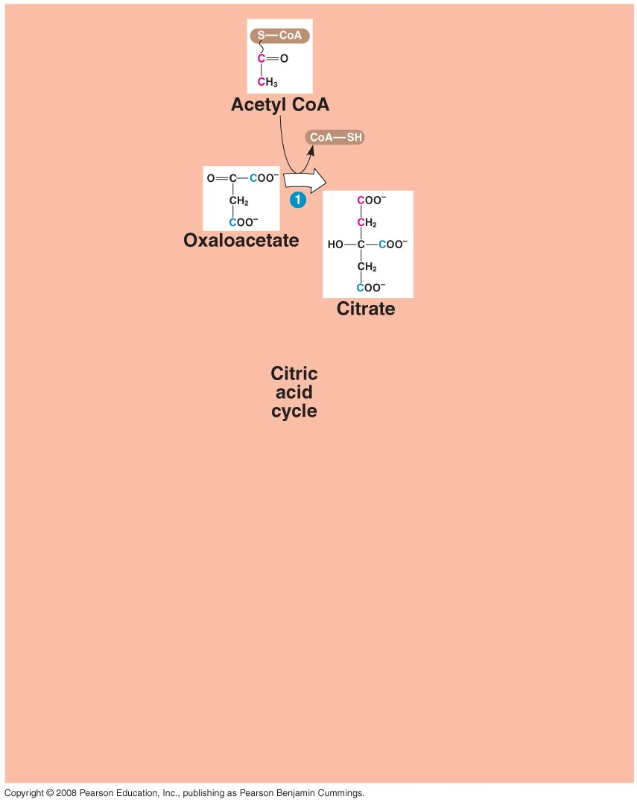
b - Citric Acid Cycle: 2C₂ (acetyl) 4C (CO₂) + NADH, FADH, ATP
1. C₂ (acetyl) binds to C₄ (oxaloacetate), making a C₆ molecule (citrate)

Slide 31
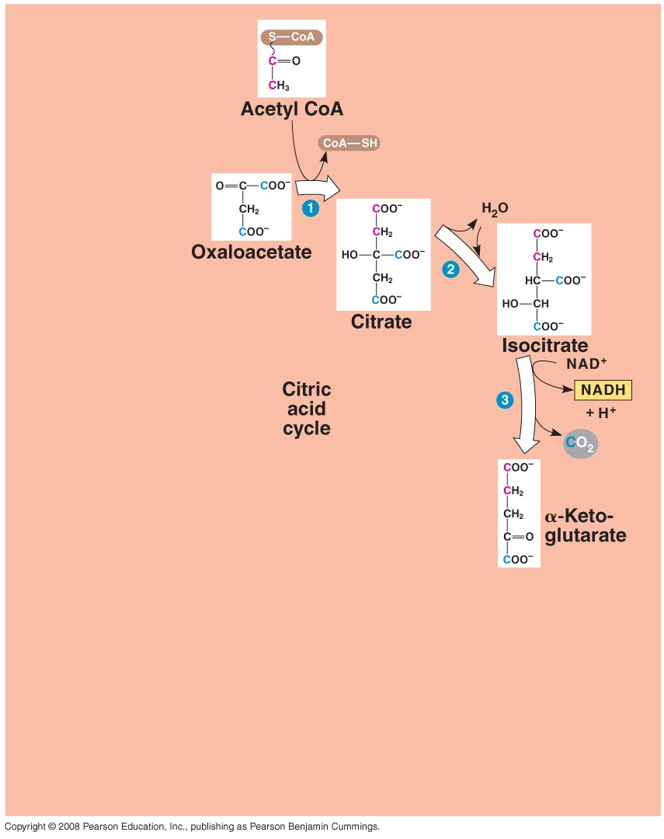
b - Citric Acid Cycle: 2C₂ (acetyl) 4C (CO₂) + NADH, FADH, ATP
C₂ (acetyl) binds to C₄ (oxaloacetate), making a C₆ molecule (citrate)
One C is broken off (CO₂) and NAD accepts energy (NADH)

Slide 32
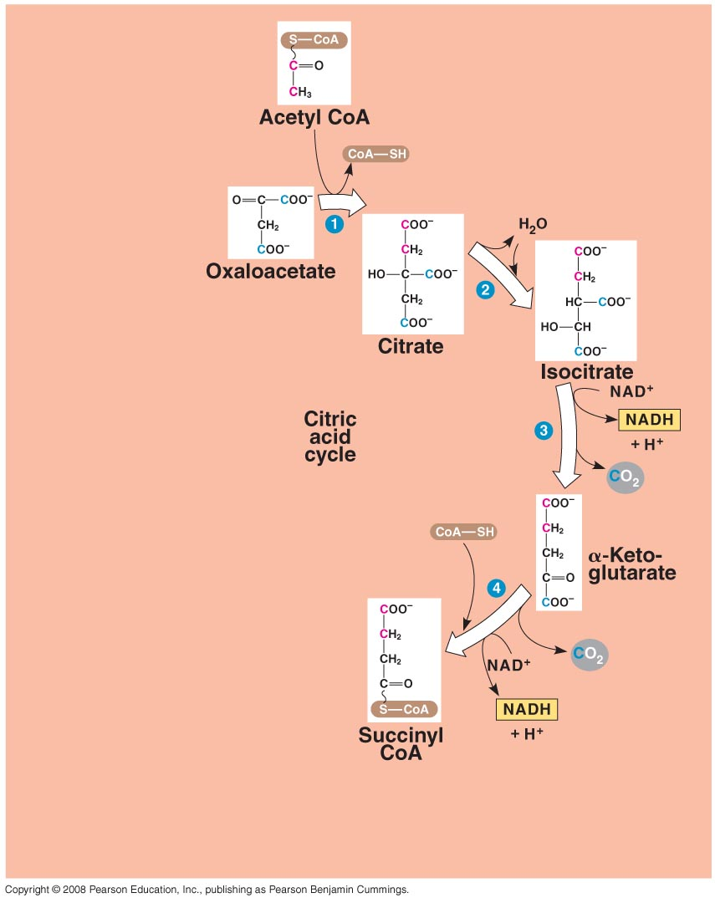
b - Citric Acid Cycle: 2C₂ (acetyl) 4C (CO₂) + NADH, FADH, ATP
C₂ (acetyl) binds to C₄ (oxaloacetate), making a C₆ molecule (citrate)
One C is broken off (CO₂) and NAD accepts energy (NADH)
The second C is broken off (CO₂) and NAD accepts the energy…at this point the acetyl group has been split!!

Slide 33
b - Citric Acid Cycle: 2C₂ (acetyl) 4C (CO₂) + NADH, FADH, ATP
C₂ (acetyl) binds to C₄ (oxaloacetate), making a C₆ molecule (citrate)
One C is broken off (CO₂) and NAD accepts energy (NADH)
The second C is broken off (CO₂) and NAD accepts the energy…at this point the acetyl group has been split!!
The C4 molecules is rearranged, regenerating the oxaloacetate; releasing energy that is stored in ATP, FADH, and NADH.

Slide 34
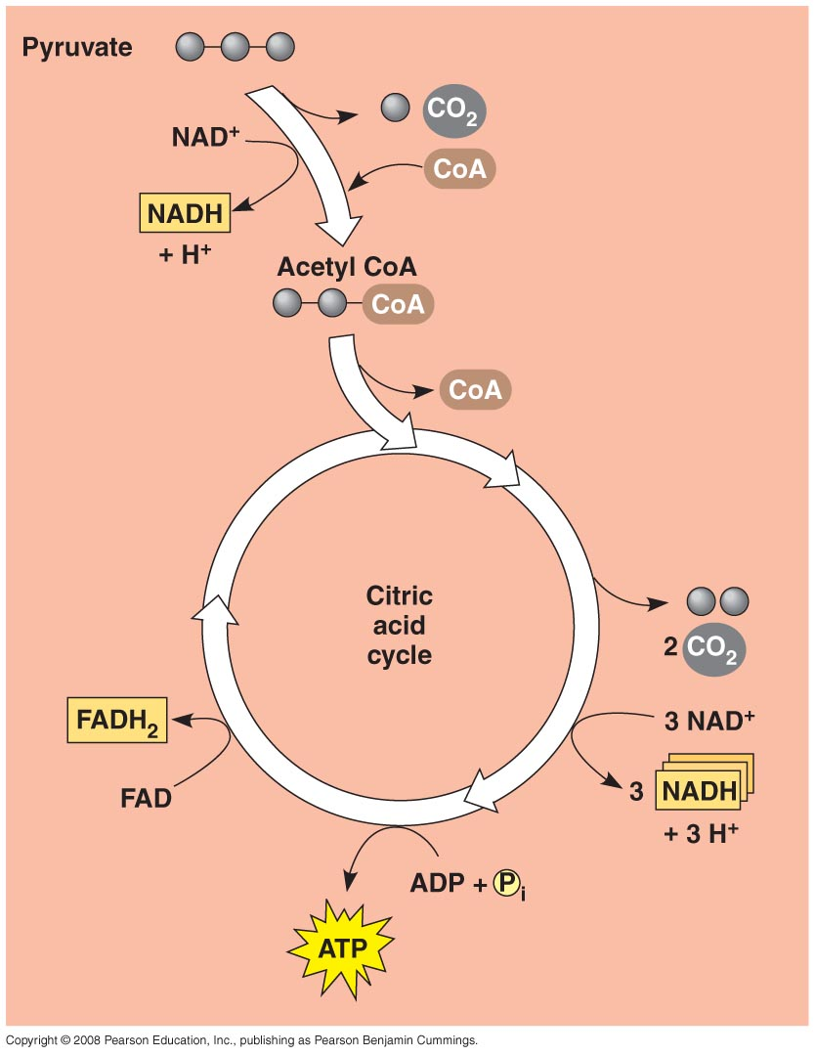
b - Citric Acid Cycle: 2C₂ (acetyl) 4C (CO₂) + NADH, FADH, ATP
C₂ (acetyl) binds to C₄ (oxaloacetate), making a C₆ molecule (citrate)
One C is broken off (CO₂) and NAD accepts energy (NADH)
The second C is broken off (CO₂) and NAD accepts the energy…at this point the acetyl group has been split!!
The C4 molecules is rearranged, regenerating the oxaloacetate; releasing energy that is stored in ATP, FADH, and NADH.
In summary, the C₂ acetyl is split and the energy released is trapped in ATP, FADH, and 3 NADH. (this occurs for EACH of the 2 pyruvates from the initial glucose).

Slide 35
III. Cellular Respiration
Overview:
Glycolysis
Anaerobic Respiration
Aerobic Respiration
a - Glycolysis: C₆ (glucose) 2C₃ (pyruvate) + ATP, NADH
b - Gateway step: 2C₃ 2C₂ (acetyl) + 2C (CO₂) + NADH
c - Citric Acid Cycle: 2C₂ (acetyl) 4C (CO₂) + NADH, FADH, ATP
d - Electron Transport Chain: convert energy in NADH, FADH to ATP

Slide 36
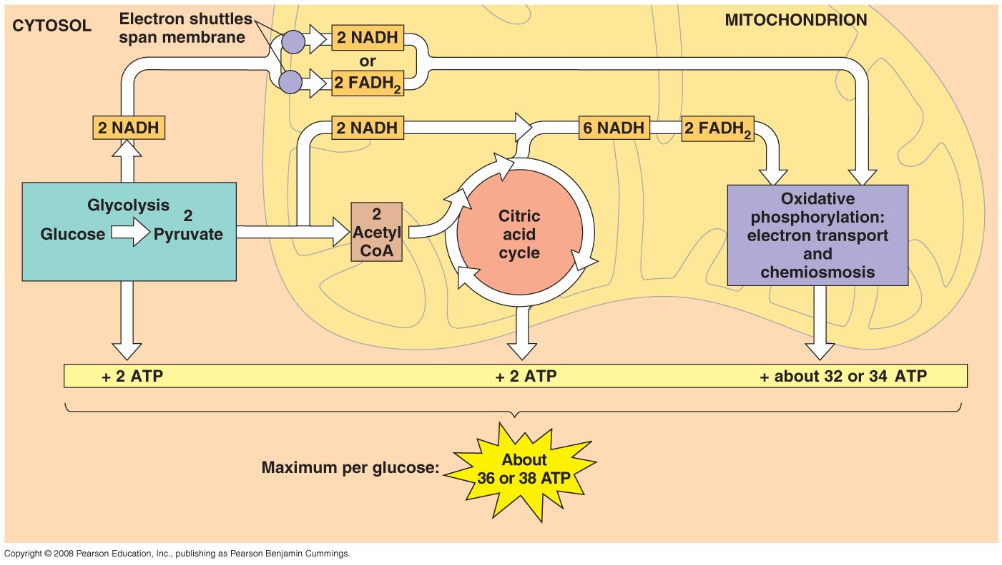
d - Electron Transport Chain: transfer energy in NADH, FADH to ATP

Slide 37
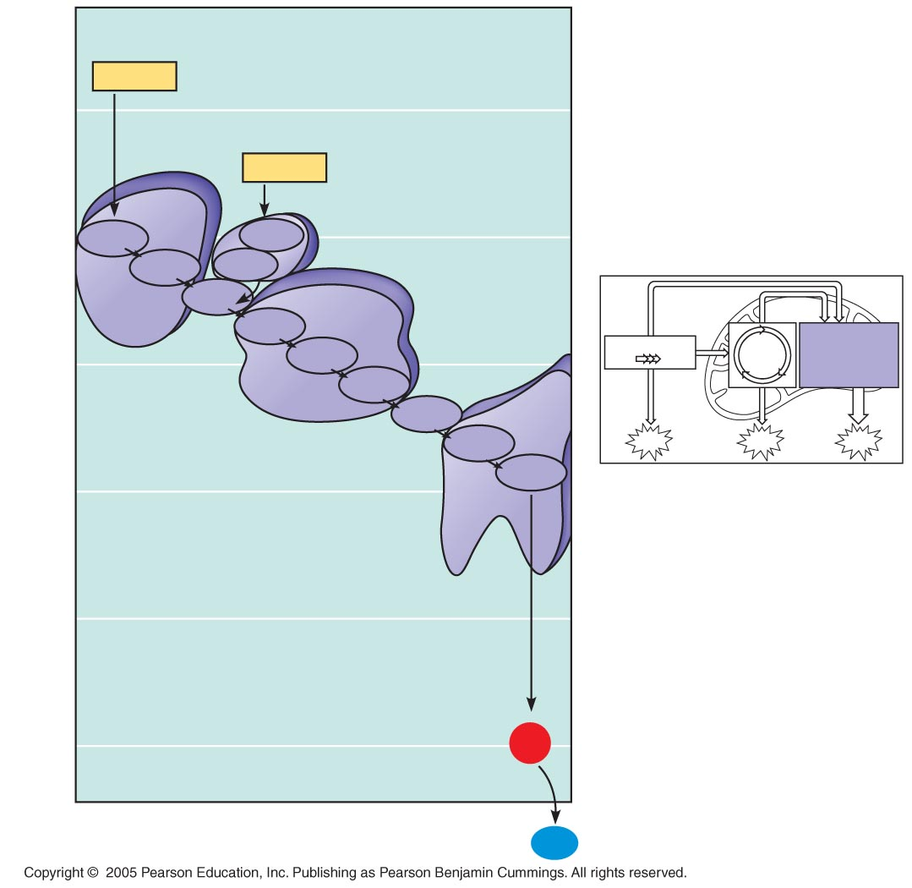
LE 9-13
ATP
STORES ENERGY
NADH
50
FADH₂
Multiprotein
complexes
ADP + P
40
FMN
I
FAD
Fe•S
Fe•S
II
Q
III
Cyt b
Oxidative
phosphorylation:
electron transport
and chemiosmosis
electron
Fe•S
Glycolysis
Citric
acid
cycle
30
Cyt c₁
Free energy (G) relative to O2 (kcal/mol)
IV
Cyt c
Cyt a
ATP
ATP
ATP
Cyt a₃
20
RELEASES ENERGY
10
0
2 H⁺ + ¹/2
O₂
H₂O

Slide 38
LE 9-13
ATP
STORES ENERGY
NADH
50
FADH₂
Multiprotein
complexes
ADP + P
40
FMN
I
FAD
Fe•S
Fe•S
II
Q
III
Cyt b
Oxidative
phosphorylation:
electron transport
and chemiosmosis
electron
Fe•S
Glycolysis
Citric
acid
cycle
30
Cyt c₁
Free energy (G) relative to O2 (kcal/mol)
IV
Cyt c
Cyt a
ATP
ATP
ATP
Cyt a₃
20
RELEASES ENERGY
10
HEY!!! Here’s the first time O₂ shows up!!! It is the final electron acceptor, and water is produced as a waste product!
0
2 H⁺ + ¹/2
O₂
H₂O

Slide 39
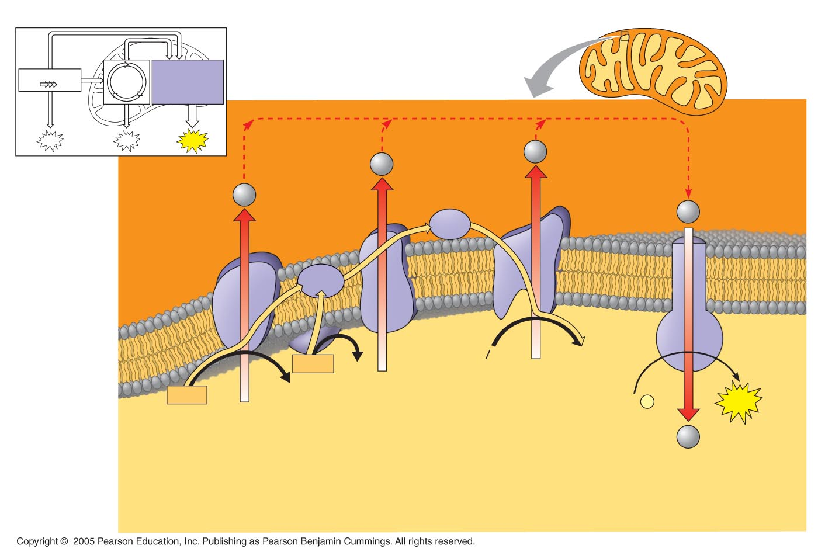
LE 9-15
ETC: energy and electrons from NADH and FADH are used to pump H+ against gradient to inner membrane space…potential E.
Inner
mitochondrial
membrane
Glycolysis
Citric
acid
cycle
Oxidative
phosphorylation:
electron transport
and chemiosmosis
ATP
ATP
ATP
H⁺
H⁺
H⁺
Cyt c
H⁺
Intermembrane
space
Protein complex
of electron
carriers
Q
IV
I
III
ATP
synthase
Inner
mitochondrial
membrane
II
2H⁺ + ¹/2 O₂
H₂O
FADH₂
FAD
NADH
+ H⁺
NAD⁺
ADP +
P
ATP
(carrying electrons
from food)
i
H⁺
Mitochondrial
matrix
Electron transport chain
Electron transport and pumping of protons (H⁺),
Which create an H⁺ gradient across the membrane
Chemiosmosis
ATP synthesis powered by the flow
of H⁺ back across the membrane
Oxidative phosphorylation

Slide 40
LE 9-15
ETC: energy and electrons from NADH and FADH are used to pump H+ against gradient to inner membrane space…potential E.
Inner
mitochondrial
membrane
Glycolysis
Citric
acid
cycle
Oxidative
phosphorylation:
electron transport
and chemiosmosis
ATP
ATP
ATP
H⁺
H⁺
H⁺
Cyt c
H⁺
Intermembrane
space
Protein complex
of electron
carriers
Q
IV
I
III
ATP
synthase
Inner
mitochondrial
membrane
II
2H⁺ + ¹/2 O₂
H₂O
FADH₂
FAD
NADH
+ H⁺
NAD⁺
ADP +
P
ATP
(carrying electrons
from food)
i
H⁺
Mitochondrial
matrix
Electron transport chain
Electron transport and pumping of protons (H⁺),
Which create an H⁺ gradient across the membrane
Chemiosmosis
ATP synthesis powered by the flow
of H⁺ back across the membrane
Oxidative phosphorylation
Chemiosmosis: E in flow of H+ used to make bond in ATP.

Slide 41
III. Cellular Respiration
Overview:
Glycolysis
Anaerobic Respiration
Aerobic Respiration
d - Electron Transport Chain: convert energy in NADH, FADH to ATP
- OXYGEN is just an electron ACCEPTOR
- WATER is produced as a metabolic waste
- All carbons in glucose have been separated
- Energy has been harvested and stored in bonds in ATP

Slide 42
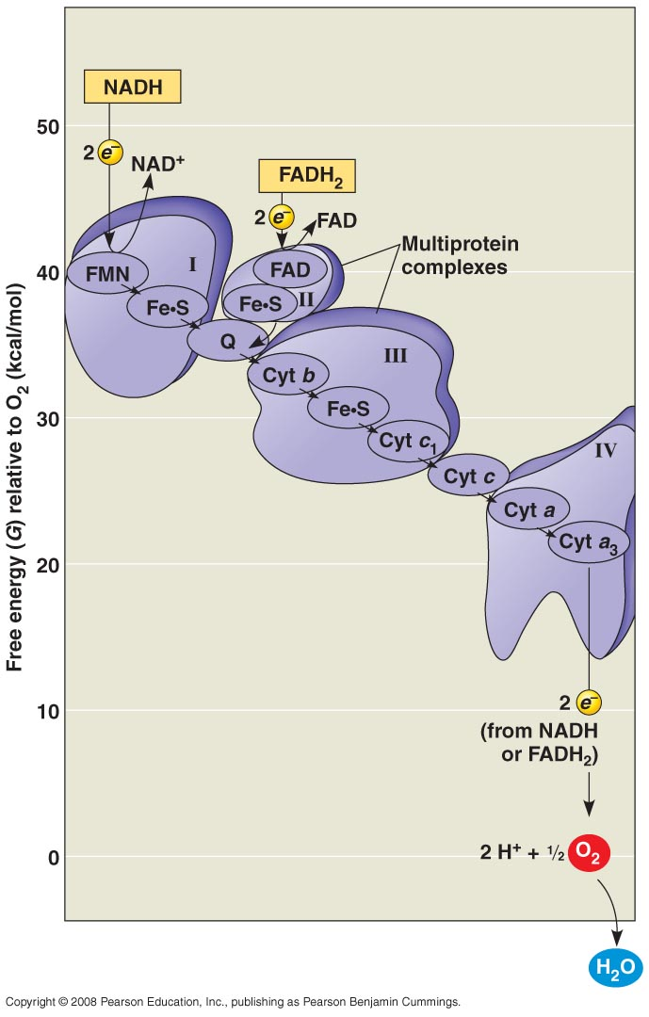
If O₂ is NOT present, the ETC backs up and NADH and FADH can’t give up their electrons and H+ to the ETC

Slide 43
What happens then????
If O₂ is NOT present, the ETC backs up and NADH and FADH can’t give up their electrons and H+ to the ETC

Slide 44
NADH is recycled through FERMENTATION to NAD so at least GLYCOLYSIS can continue!!
If O₂ is NOT present, the ETC backs up and NADH and FADH can’t give up their electrons and H+ to the ETC

Slide 45
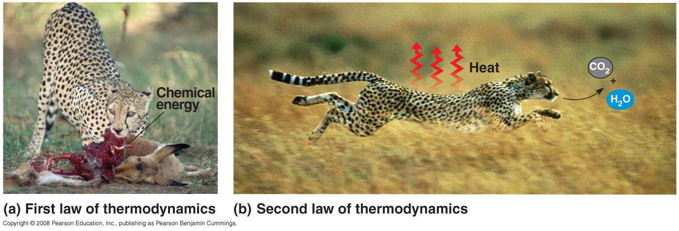
FOOD
CO2, water, and waste
ATP
ADP + P
ANABOLISM WORK

Slide 46
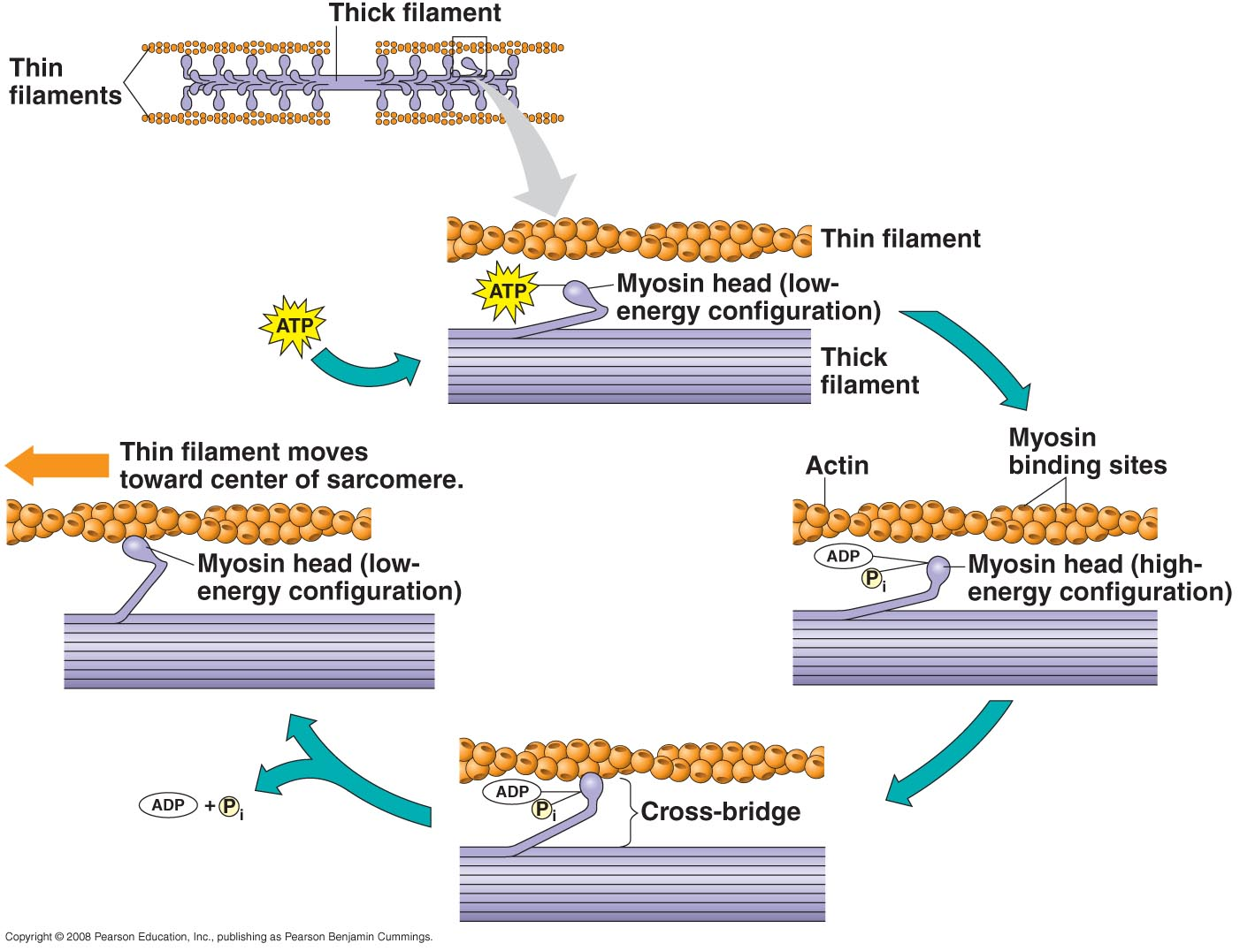
Phosphorylation of myosin causes it to toggle and bond to actin; release of phosphate causes it to return to low energy state and pull actin…contraction.

Slide 47
FOOD
CO2, water, and waste
ATP
ADP + P
ANABOLISM WORK

Slide 48
Cellular Respiration
II. Evolution of Metabolic Pathways
- problem:
how can pathways with useless intermediates evolve? These represent 'maladaptive valleys', don't they?
A
B
C
D
E
How do you get from A to E, if B, C, and D are non-functional?

Slide 49
- Solution - reverse evolution
A
B
C
D
E

Slide 50
- Solution - reverse evolution
suppose E is a useful molecule, initially available in the env.
E

Slide 51
- Solution - reverse evolution
suppose E is a useful molecule, initially available in the env.
As protocells gobble it up, the concentration drops.
E

Slide 52
- Solution - reverse evolution
Anything that can absorb something else (D) and MAKE E is at a selective advantage...
D
E

Slide 53
- Solution - reverse evolution
Anything that can absorb something else (D) and MAKE E is at a selective advantage...
but over time, D may drop in concentration...
D
E

Slide 54
- Solution - reverse evolution
So, anything that can absorb C and then make D and E will be selected for...
C
D
E

Slide 55
- Solution - reverse evolution
A
B
C
D
E
and so on until a complete pathway evolves.

Slide 56
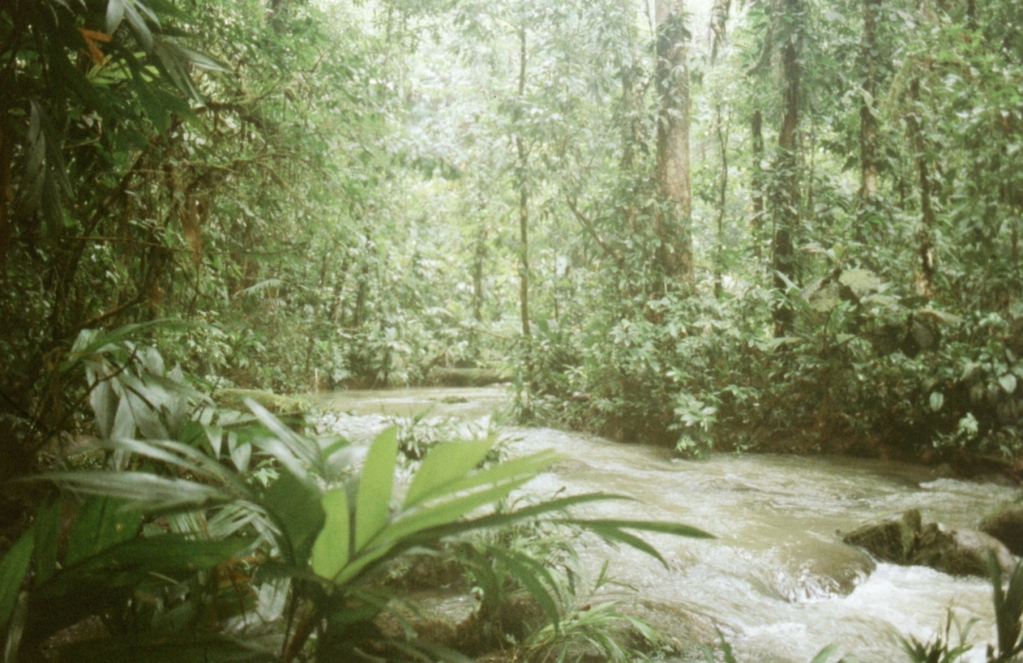
ENERGY HARVEST
Cellular Respiration
Evolution of Metabolic Pathways
III. Photosynthesis

Slide 57
Overview:
A. Step One: Transferring radiant energy to chemical energy
e-
Energy of photon
Transferred to an electron
e-

Slide 58
Overview:
A. Step Two: storing that chemical energy in the bonds of molecules
e-
ATP
C₆ (glucose)
ADP+P
6 CO₂
e-

Slide 59
Overview:
A. Step Two: storing that chemical energy in the bonds of molecules
e-
ATP
C₆ (glucose)
ADP+P
6 CO₂
e-
Light Dependent Reaction
Light Independent Reaction

Slide 60
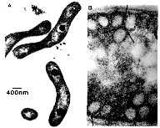
A. Step 1: The Light Dependent Reaction:
1. Primitive Systems
a. Cyclic phosphorylation
e-
Used by photoheterotrophs:
Purple non-sulphur bacteria, green non-sulphur bacteria, and heliobacteria
PS I
“photosystems” are complexes of chlorophyll molecules containing Mg, nested in the inner membrane of bacteria and chloroplasts.

Slide 61
A. Step 1: The Light Dependent Reaction:
1. Primitive Systems
a. Cyclic phosphorylation
e- acceptor
e-
PS I
“photosystems” are complexes of chlorophyll molecules containing Mg, nested in the inner membrane of bacteria and chloroplasts.

Slide 62
A. Step 1: The Light Dependent Reaction:
1. Primitive Systems
a. Cyclic phosphorylation
e- acceptor
e-
e-
The electron is transferred to an electron transport chain
PS I
The electron transport chain is nested in the inner membrane, as well; like in mitochondria….

Slide 63
A. Step 1: The Light Dependent Reaction:
1. Primitive Systems
a. Cyclic phosphorylation
e- acceptor
e-
ATP
e-
ADP+P
The electron is passed down the chain, H+ are pumped out, they flood back in and ATP is made.
PS I
The electron transport chain is nested in the inner membrane, as well; like in mitochondria… and chemiosmosis occurs.

Slide 64
A. Step 1: The Light Dependent Reaction:
1. Primitive Systems
a. Cyclic phosphorylation
e- acceptor
e-
ATP
e-
ADP+P
An electron is excited by sunlight, and the energy is used to make ATP. The electron is returned to the photosystem….CYCLIC PHOSPHORYLATION.
PS I
The electron transport chain is nested in the inner membrane, as well; like in mitochondria… and chemiosmosis occurs.

Slide 65
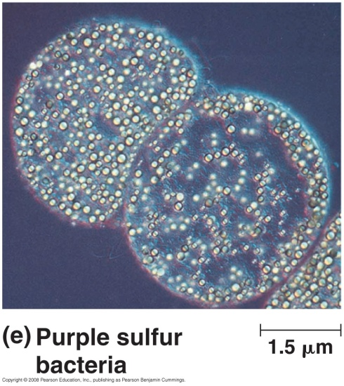
A. Step 1: The Light Dependent Reaction:
1. Primitive Systems
a. Cyclic phosphorylation
b. Sulpher bacteria
e- acceptor
e-
Purple and green sulphur bacteria
ATP
e-
ADP+P
An electron is excited by sunlight, and the energy is used to make ATP. The electron is returned to the photosystem….CYCLIC PHOSPHORYLATION…..
BUT something else can happen…
PS I

Slide 66
A. Step 1: The Light Dependent Reaction:
1. Primitive Systems
a. Cyclic phosphorylation
b. Sulpher bacteria
e- acceptor
e-
NADP
NADPH
ATP
e-
ADP+P
PS I
The electron can be passed to NADP, reducing NADP to NADP- (+H+)

Slide 67
A. Step 1: The Light Dependent Reaction:
1. Primitive Systems
a. Cyclic phosphorylation
b. Sulpher bacteria
e- acceptor
e-
NADP
NADPH
ATP
IF this happens, the electron is NOT recycled back to PSI.
For the process to continue, an electron must be stripped from another molecule and transferred to the PS to be excited by sunlight…
e-
ADP+P
PS I
The electron can be passed to NADP, reducing NADP to NADP- (+H+)

Slide 68
A. Step 1: The Light Dependent Reaction:
1. Primitive Systems
a. Cyclic phosphorylation
b. Sulpher bacteria
e- acceptor
e-
NADP
NADPH
ATP
IF this happens, the electron is NOT recycled back to PSI.
For the process to continue, an electron must be stripped from another molecule and transferred to the PS to be exited by sunlight…
e-
ADP+P
PS I
H₂S
2e + 2H+ + S
The Photosystem is more electronegative than H₂S, and can strip electrons from this molecule – releasing sulphur gas….

Slide 69
A. Step 1: The Light Dependent Reaction:
1. Primitive Systems
a. Cyclic phosphorylation
b. Sulpher bacteria
e- acceptor
e-
So, through these reactions, both ATP and NADPH are produced; sulphur gas is released as a waste product. These organisms are limited to living in an environment with H2S!!! (Sulphur springs).
NADP
NADPH
ATP
e-
ADP+P
PS I
H₂S
2e + 2H+ + S

Slide 70
A. Step 1: The Light Dependent Reaction:
1. Primitive Systems
a. Cyclic phosphorylation
b. Sulpher bacteria
e- acceptor
e-
So, through these reactions, both ATP and NADPH are produced; sulphur gas is released as a waste product. These organisms are limited to living in an environment with H2S!!! (Sulphur springs).
NADP
NADPH
ATP
e-
ADP+P
PS I
If photosynthesis could evolve to strip electrons from a more abundant electron donor, life could expand from these limited habitats… hmmm…. H₂S…. H₂S….
H₂S
2e + 2H+ + S

Slide 71
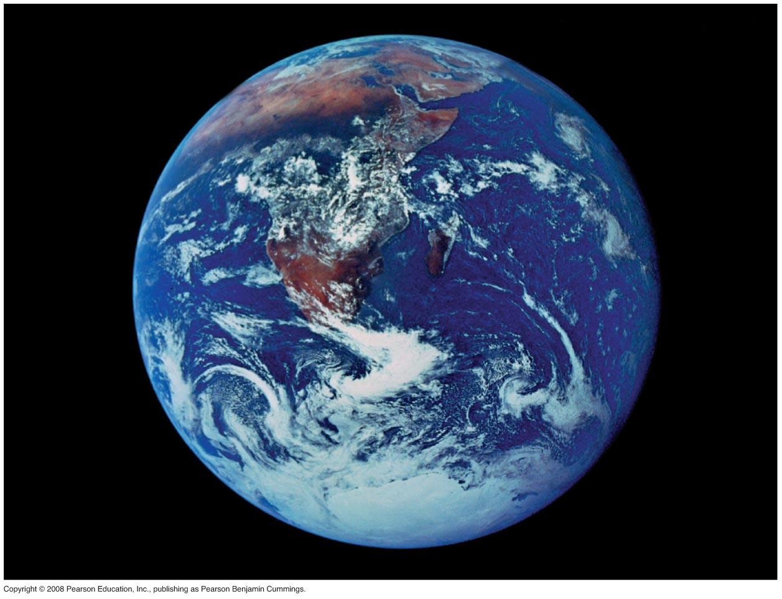

Slide 72
A. Step 1: The Light Dependent Reaction:
1. Primitive Systems
2. Advanced System
e- acceptor
Cyanobacteria, algae, plants
PS I
PS II
RIGHT! H₂O!!! But water holds electrons more strongly than H₂S; this process didn’t evolve until a PS evolved that could strip electrons from water… PSII.

Slide 73
A. Step 1: The Light Dependent Reaction:
1. Primitive Systems
2. Advanced System
e- acceptor
e-
e-
PS I
PS II
Photons excite electrons in both photosystems…

Slide 74
A. Step 1: The Light Dependent Reaction:
1. Primitive Systems
2. Advanced System
e- acceptor
e-
e-
ATP
ADP+P
PS I
PS II
The electron from PSII is passed down the ETC, making ATP, to PSI

Slide 75
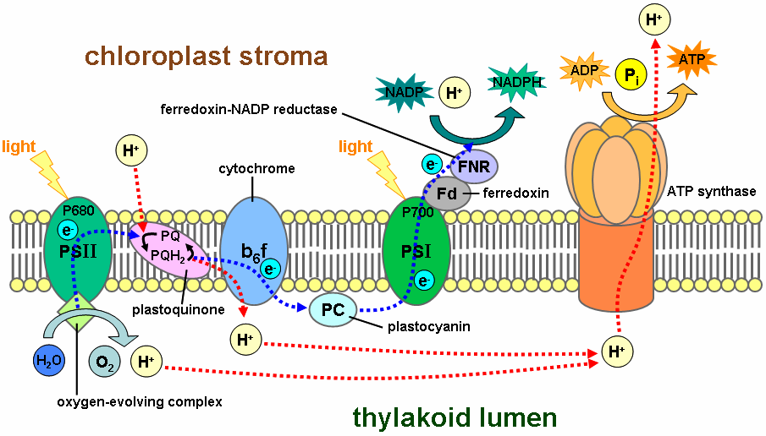

Slide 76
A. Step 1: The Light Dependent Reaction:
1. Primitive Systems
2. Advanced System
e- acceptor
e-
NADP
NADPH
ATP
ADP+P
PS I
e-
PS II
The electron from PSI is passed to NADP to make NADPH

Slide 77
A. Step 1: The Light Dependent Reaction:
1. Primitive Systems
2. Advanced System
e- acceptor
e-
NADP
NADPH
ATP
ADP+P
PS I
e-
The e- from PSII has “filled the hole” vacated by the electron lost from PSI.
PS II

Slide 78
A. Step 1: The Light Dependent Reaction:
1. Primitive Systems
2. Advanced System
e- acceptor
e-
NADP
NADPH
ATP
ADP+P
PS I
e-
Water is split to harvest electrons; oxygen gas is released as a waste product.
PS II
2H₂O
4e + 4H+ + 2O (O₂)

Slide 79
Those were the light dependent reactions; reactions in which photosynthetic organisms transform radiant energy into chemical bond energy in ATP (and NADPH).
e-
ATP
C₆ (glucose)
ADP+P
6 CO₂
e-
Light Dependent Reaction
Light Independent Reaction

Slide 80
A. Step 1: The Light Dependent Reaction:
B: Step 2: The Light-Independent Reaction:
e-
ATP
C₆ (glucose)
ADP+P
6 CO₂
e-
Light Dependent Reaction
Light Independent Reaction

Slide 81
CO₂
B. The Light Independent Reaction
C₆
C₅
RuBP
2 C₃ (PGA)
A molecule of CO₂ binds to Ribulose biphosphate, making a 6-carbon molecule. This molecule is unstable, and splits into 2 3-carbon molecules of phosphoglycerate (PGA)

Slide 82
6CO₂
B. The Light Independent Reaction
6C₆
6C₅
RuBP
12 C₃ (PGA)
Now, it is easier to understand these reactions if we watch the simultaneous reactions involving 6 CO2 molecules

Slide 83
6CO₂
B. The Light Independent Reaction
6C₆
6C₅
RuBP
12 C₃
ATP
ADP+P
10 C₃
2 C₃
C₆
(Glucose)
NADPH
NADP
2 of the 12 PGA are used to make glucose, using energy from ATP and the reduction potential of NADPH… essentially, the H is transferred to the PGA, making carbohydrate from carbon dioxide.

Slide 84
6CO₂
B. The Light Independent Reaction
6C₆
6C₅
RuBP
12 C₃
ATP
ADP+P
ATP
ADP+P
10 C₃
2 C₃
C₆
(Glucose)
NADPH
NADP
More energy is used to rearrange the 10 C₃ molecules (30 carbons) into 6 C₅ molecules (30 carbons); regenerating the 6 RuBP.

Slide 85
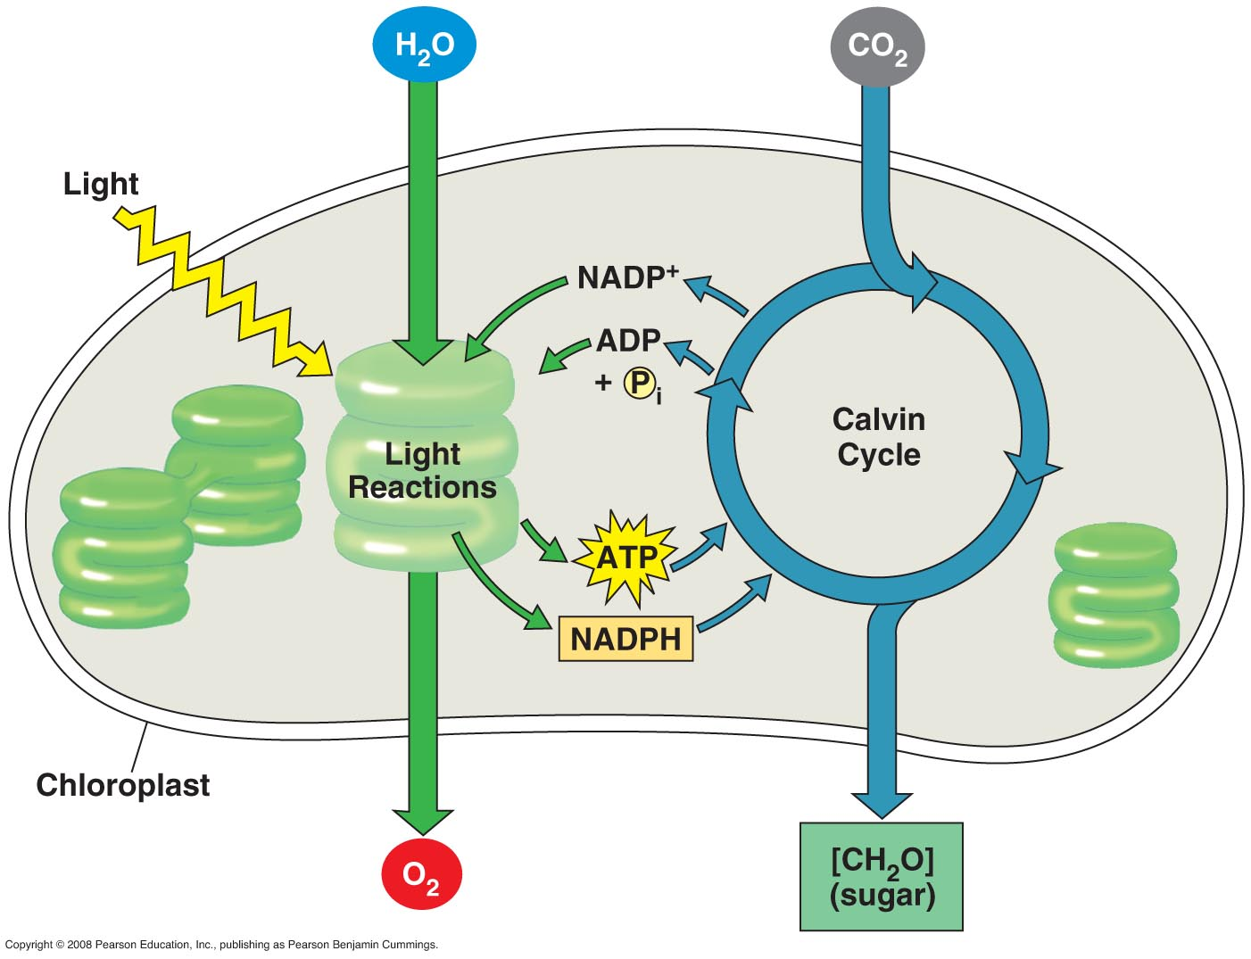
Review

Slide 86
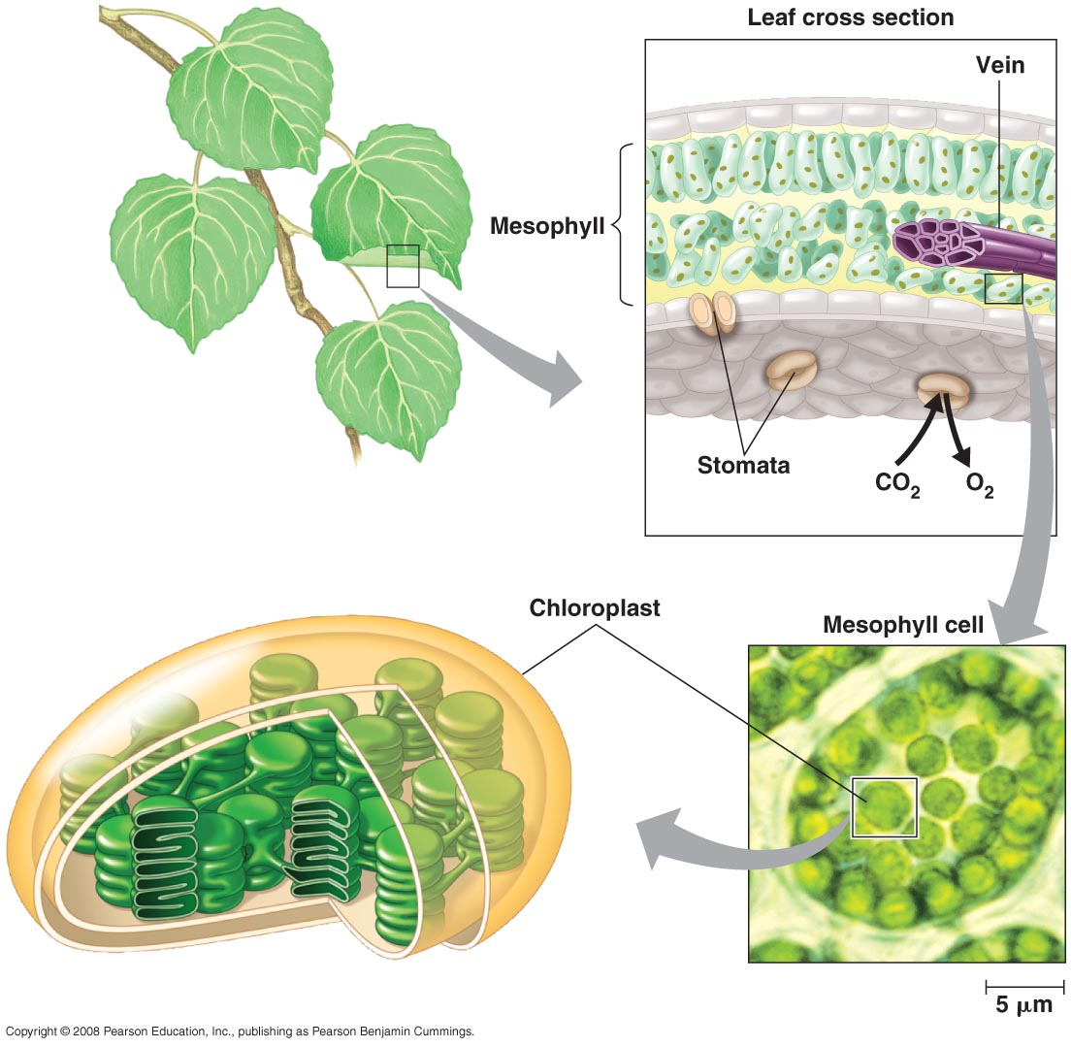
C. Photorespiration
Gas exchange occurs through the stomata – pores in the underside of the leaf. However, water vapor is LOST through these pores when they are open to gas exchange….

Slide 87
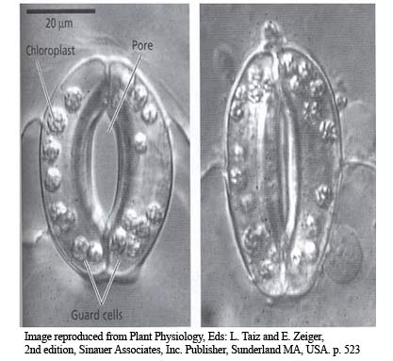
C. Photorespiration
1. Problem
- In hot, dry environments, the stomates will close early in the day to prevent too much water loss.

Slide 88
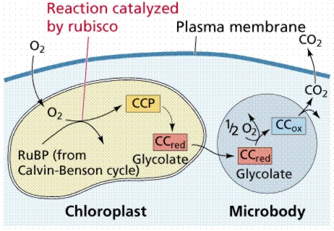
C. Photorespiration
1. Problem
- In hot, dry environments, the stomates will close early in the day to prevent too much water loss.
- photosynthesis will continue in the leaf, so [CO2] will decline and [O2] will increase… this will lead to photorespiration where RUBP is broken down… BAD… photosynthesis stops.

Slide 89
C. Photorespiration
1. Problem
- In hot, dry environments, the stomates will close early in the day to prevent too much water loss.
- photosynthesis will continue in the leaf, so [CO2] will decline and [O2] will increase… this will lead to photorespiration where RUBP is broken down… BAD… photosynthesis stops.
plants that live in these habitats have evolved two modifications to their photosynthetic processes… “C4” and “CAM” metabolism.

Slide 90
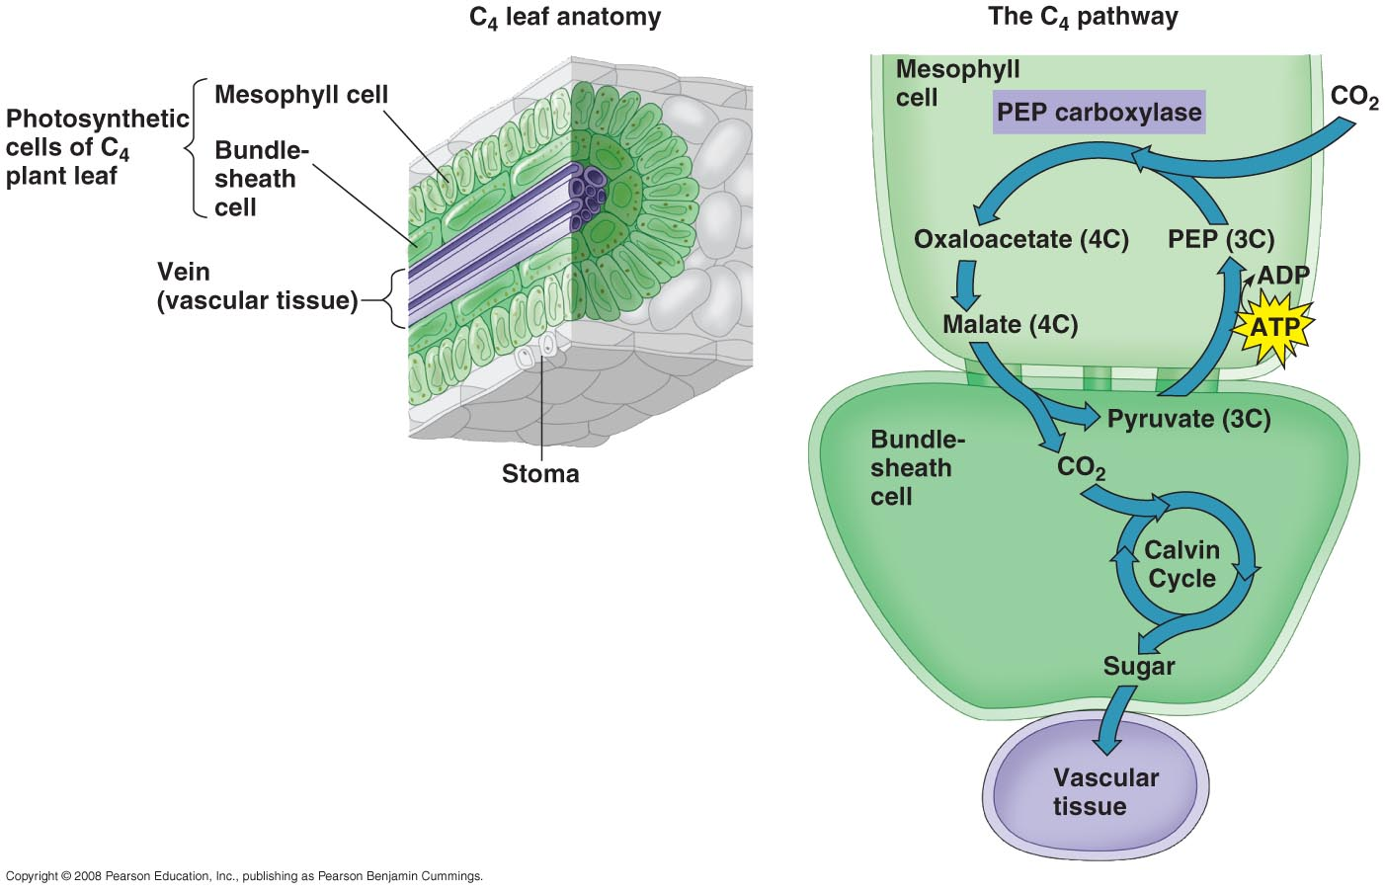
C. Photorespiration
1. Problem
2. Solutions
a. C4 Metabolism
- Spatial separation of carbon fixation and the Calvin Cycle.
- common in grasses (dominate in dry grasslands).
Carbon Fixation
Calvin Cycle

Slide 91
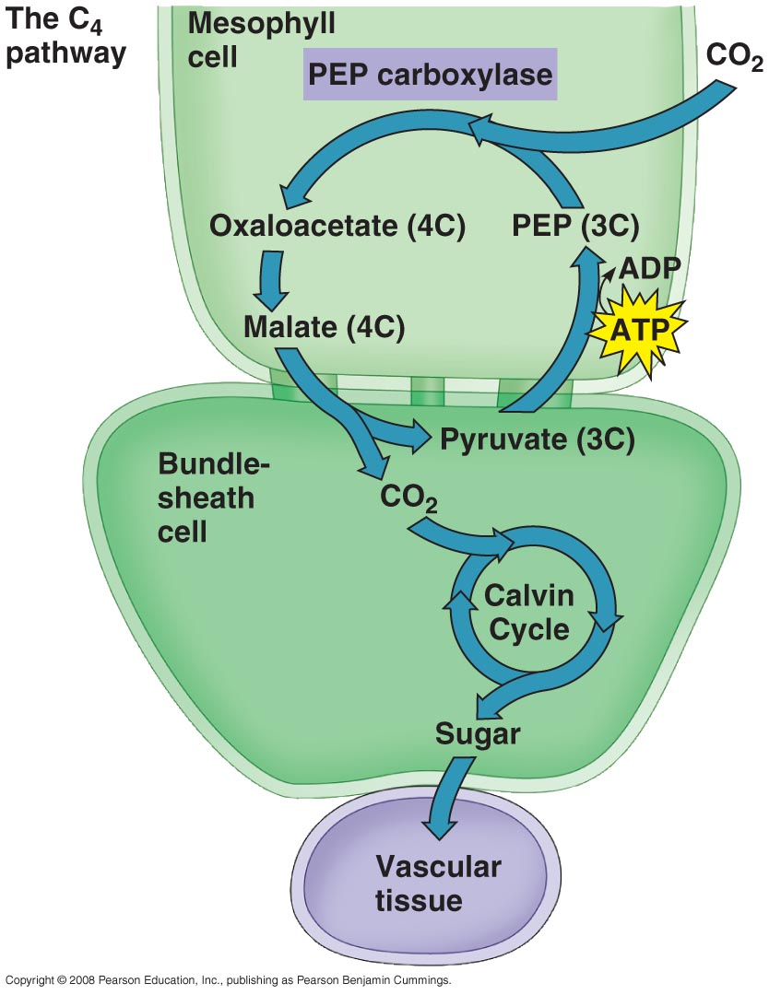
a. C4 Metabolism
1. When the leaf closes, the relative [CO2] starts to drop…
2. In C4 plants, the mesophyll cells absorb the CO2 and bind it to PEP (C3). PEP has a greater affinity for CO2 at low [CO2] than RuBP.

Slide 92
a. C4 Metabolism
1. When the leaf closes, the relative [CO2] starts to drop…
2. In C4 plants, the mesophyll cells absorb the CO2 and bind it to PEP (C3). PEP has a greater affinity for CO2 at low [CO2] than RuBP.
3. The C4 product is passed to the bundle shealth cells, where the CO2 is broken off. This keeps [CO2] high enough for RuBP to keep working, making glucose long after the leaf closed because of the PEP pump.

Slide 93
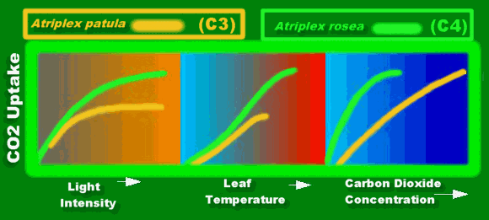
So, C4 plants do better in high light and warm environments than typical “C3” plants.
C3 refers to PGA -the first stable product of carbon dioxide fixation.
C4 refers to oxaloacetate – the first stable product of carbon fixation.
http://www.botany.hawaii.edu/faculty/webb/BOT311/bot311-00/PSyn/PsynDark4.htm

Slide 94
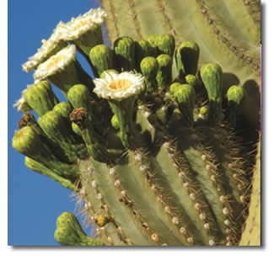
C. Photorespiration
1. Problem
2. Solutions
a. C4 Metabolism
b. Crassulacean Acid Metabolism (CAM)
1. In cacti and stone plants that live in the driest areas.
2. The habitat is SO dry that stomates can’t be open AT ALL during the day, or too much water will be lost.
3. So how can gas exchange and photosynthesis occur if stomates are closed???
4. There is TEMPORAL separation of CO2 fixation and the calvin cycle….

Slide 95
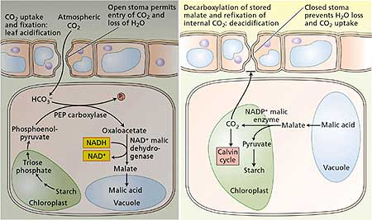
b. Crassulacean Acid Metabolism (CAM)
4. AT NIGHT, stomates are open and CO2 is fixed by PEP (C3) into malate (C4)

Slide 96
b. Crassulacean Acid Metabolism (CAM)
4. IN DAY, malate is mobilized and split; the CO2 is run through the Calvin Cycle with the ATP and NADPH made in the sunlight….

Slide 97
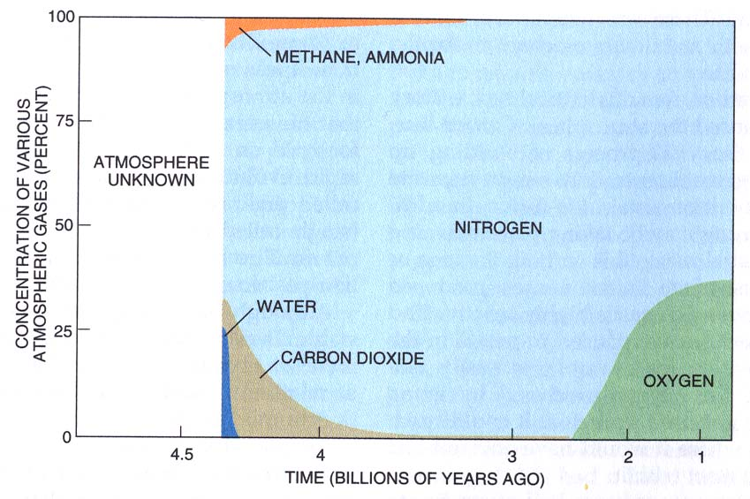
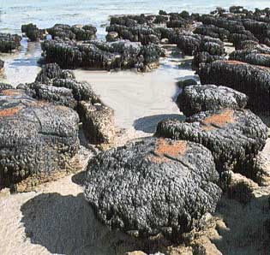
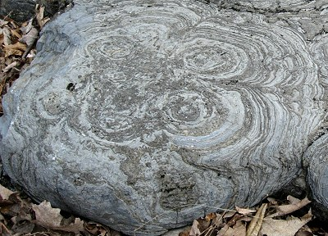
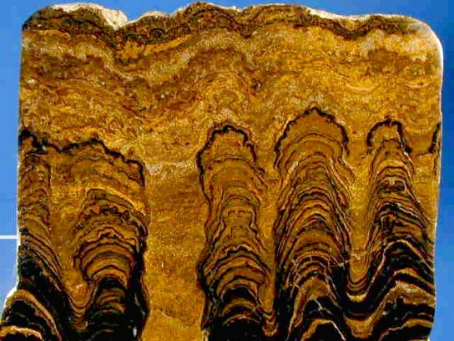
A History of Photosynthesis
Photosynthesis evolved early; at least 3.8 bya – bacterial mats like these stromatolites date to that age, and earlier microfossils exist that look like cyanobacteria. Also, CO2 levels drop (Calvin cycle + dissolved in rain)

Slide 98
A History of Photosynthesis
What kind of photosynthesis was this???

Slide 99
A History of Photosynthesis
What kind of photosynthesis was this???
Cyclic phosphorylation and Sulphur photosynthesis, because it was non-oxygenic.

Slide 100
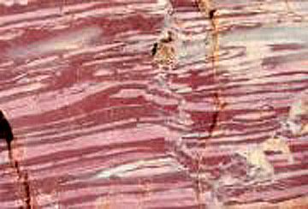
A History of Photosynthesis
And 2.3 bya is when we see the oldest banded iron formations, demonstrating for the first time that iron crystals were exposed to atmospheric oxygen during sedimentation.

Slide 101
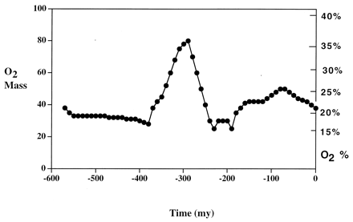
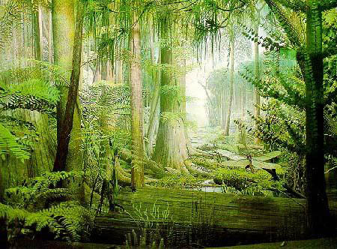
Carboniferous: 354-290 mya
This is the period when our major deposits of fossil fuel were laid down as biomass © that did NOT decompose. So, that carbon was NOT returned to the atmosphere as CO2…lots of photosynthesis and less decomposition means a decrease in CO2 and an increase in O2 in the atmosphere…

