Slide 1
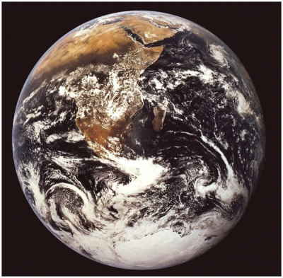
CLIMATE and BIOMES
An Abrupt Climate Change Scenario and Its Implications for United States National Security (Pentagon Report, 2003). Global warming “should be elevated beyond a scientific debate to a US national security concern... future wars will be fought over the issue of survival rather than religion, ideology or national honour.”
Understanding climate matters...

Slide 2
CLIMATE
I. Large Scale Determinants
A. Solar Radiation
1. Average Radiation Budget
- Solar Constant = 2 calories/cm²/min
- 50% is reflected, absorbed, reradiated (Most ultraviolet light is reflected/absorbed) by the atmosphere

Slide 3
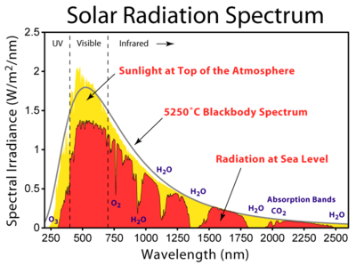
- 50% is reflected, absorbed, reradiated (Most ultraviolet light is reflected/absorbed)

Slide 4
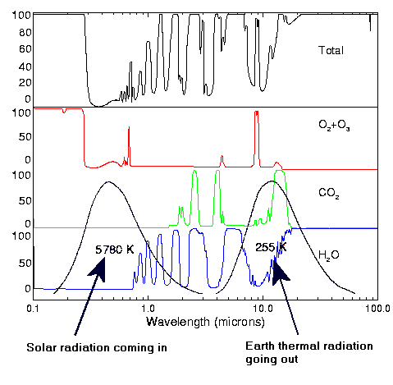
ABSORBANCE
Greenhouse effect

Slide 5
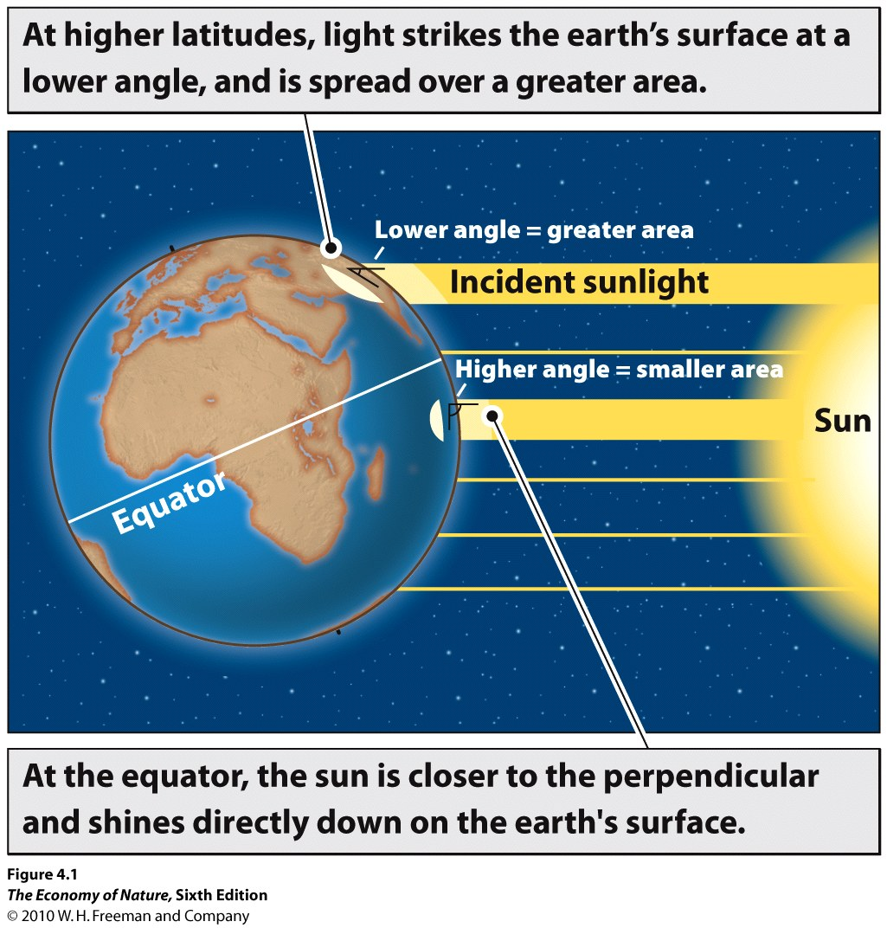
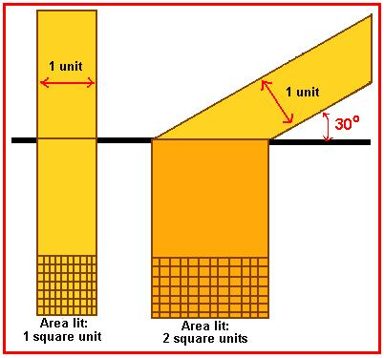
A. Solar Radiation
1. Average Radiation Budget
2. Local Radiation Budget – Angle of incidence (latitude and season)

Slide 6
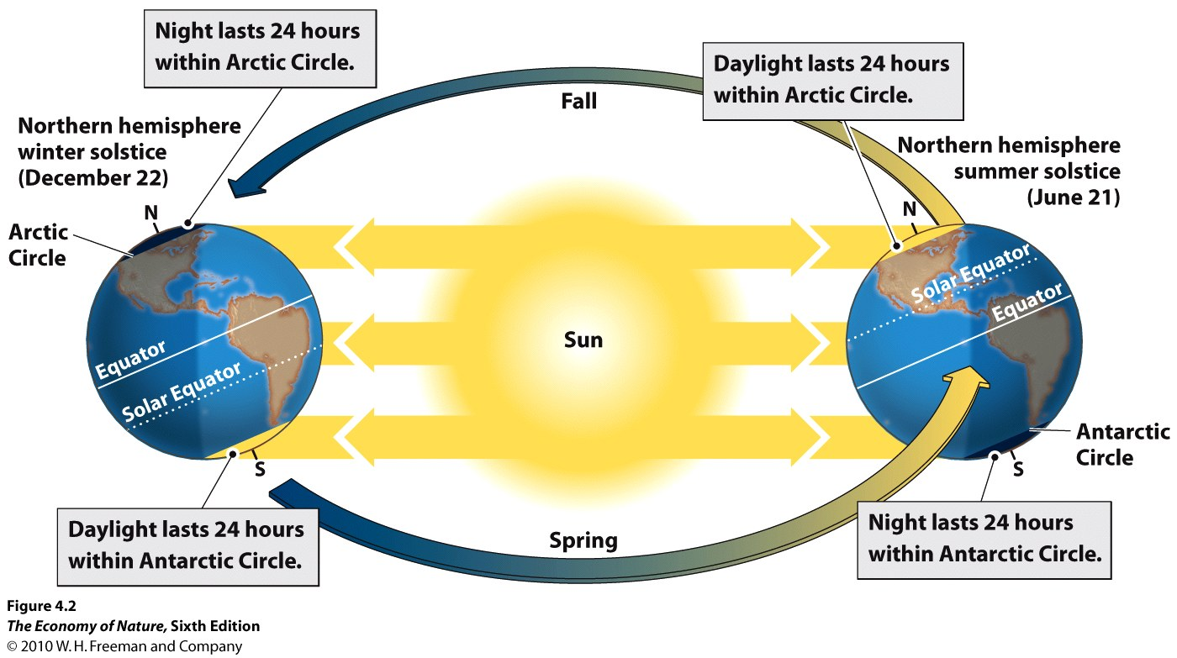
A. Solar Radiation
1. Average Radiation Budget
2. Local Radiation Budget – Angle of incidence (latitude and season)

Slide 7
LOW ENERGY
LOW ENERGY
HIGH ENERGY

Slide 8
LOW ENERGY
LOW ENERGY
HIGH ENERGY

Slide 11
As air rises:
- decrease pressure
- increase volume
- decrease energy/unit volume
- decrease temperature

Slide 12
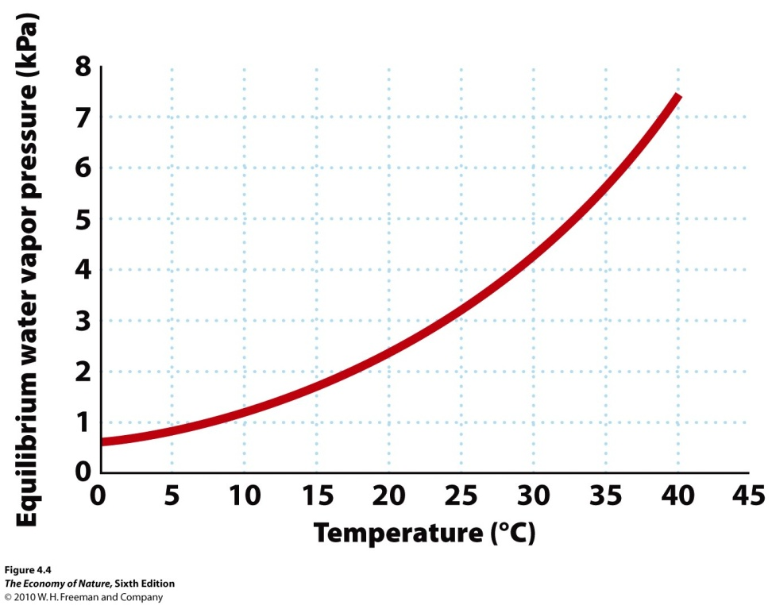
As air rises:
- decrease pressure
- increase volume
- decrease energy/unit volume
- decrease temperature
Decrease temp, increase tendancy of water vapor to condense

Slide 13
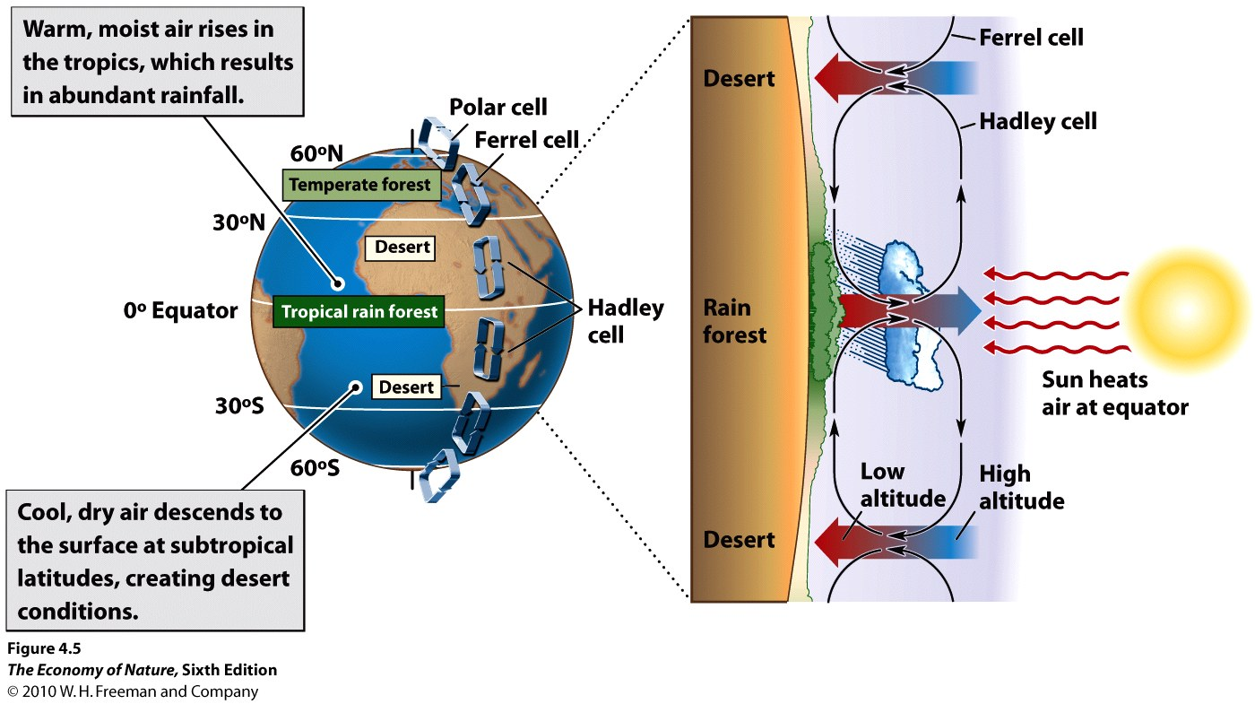

Slide 14
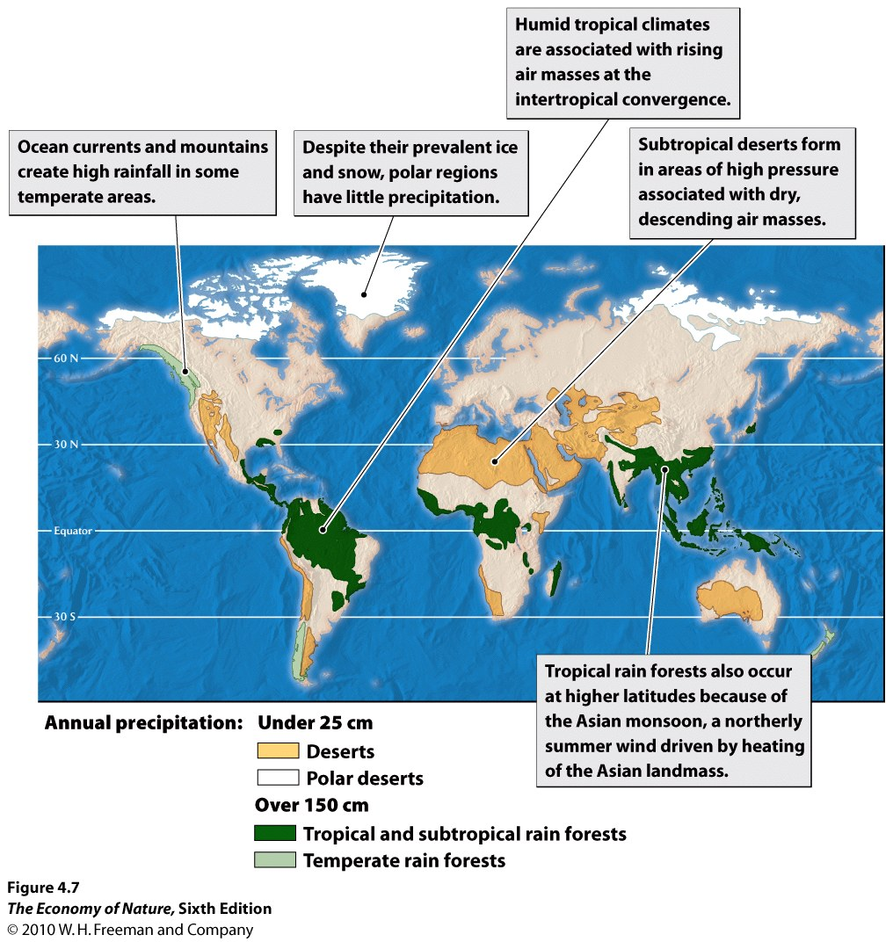

Slide 15
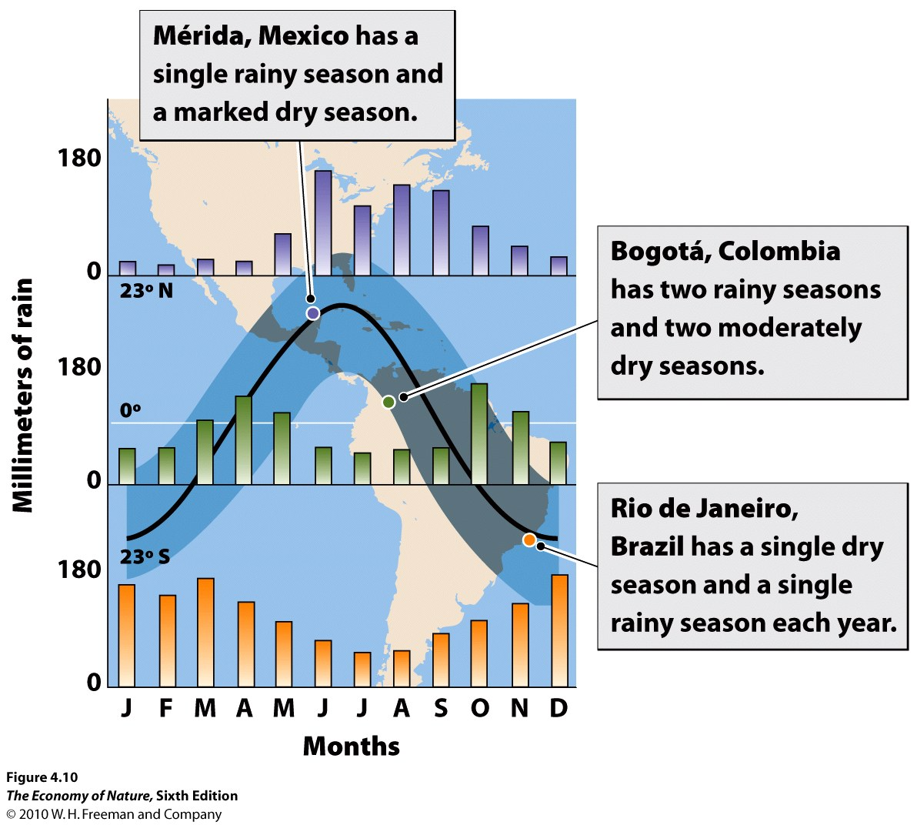

Slide 16
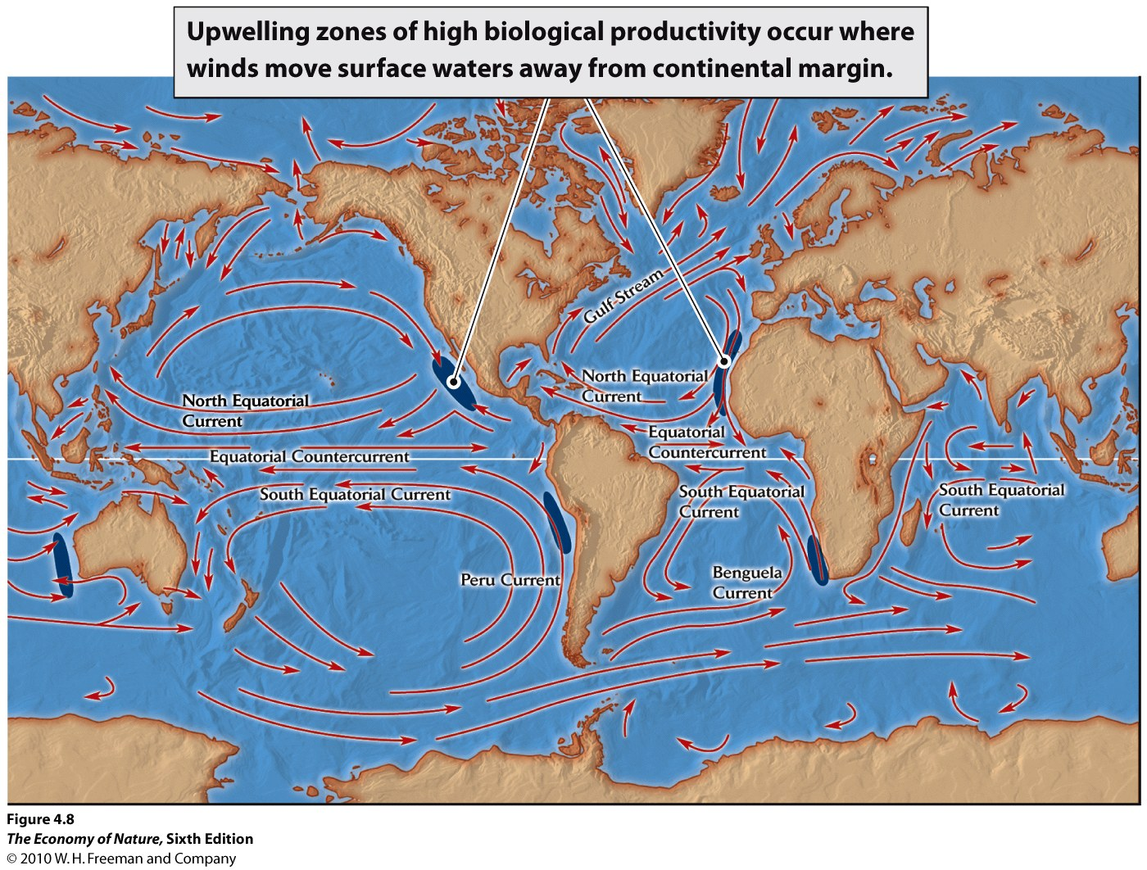

Slide 17
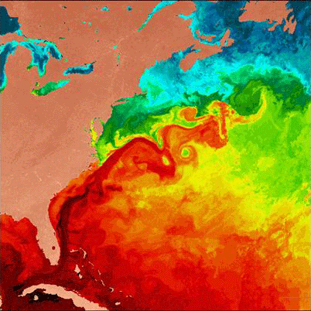

Slide 18
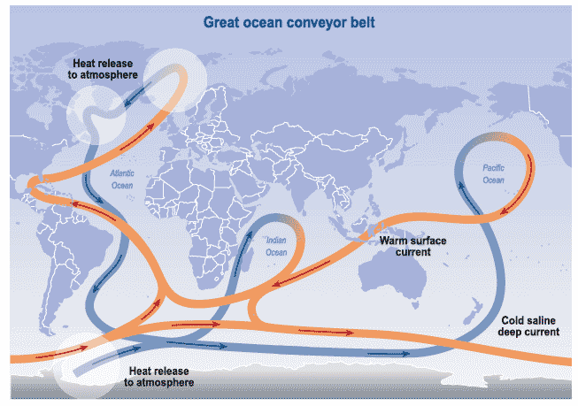

Slide 19
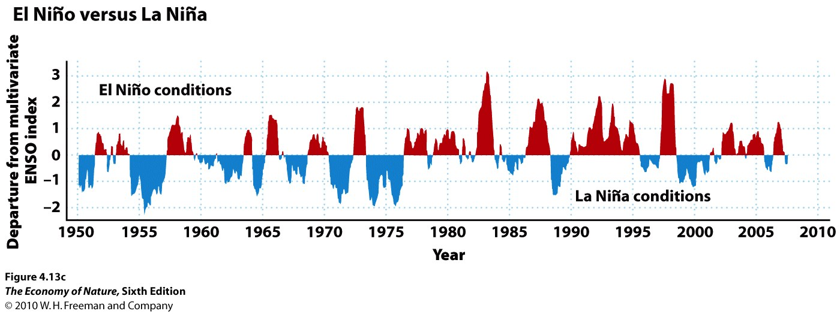
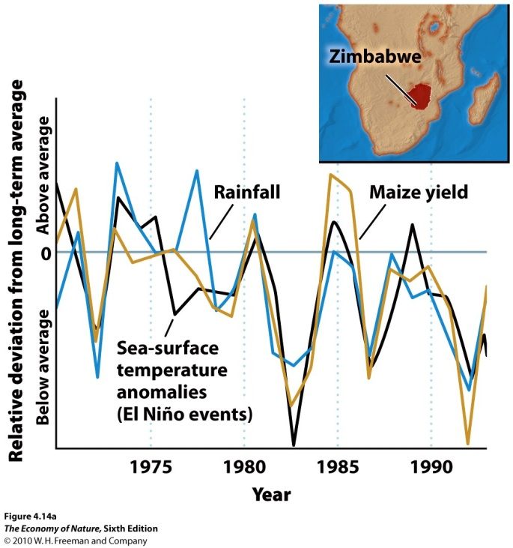

Slide 20
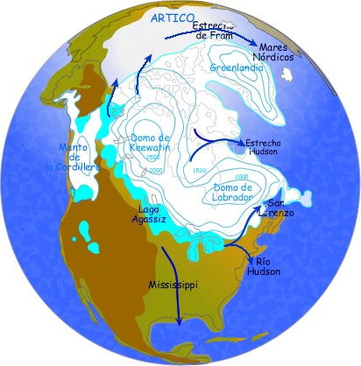

Slide 21
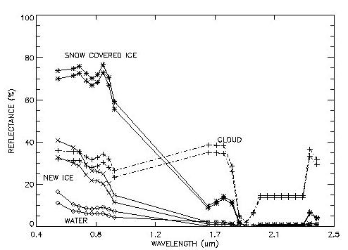

Slide 22
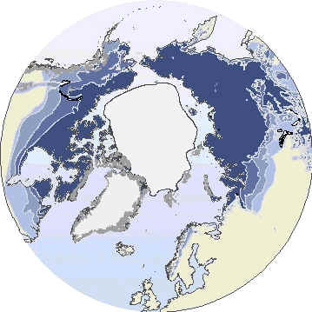
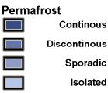

Slide 24
Climate and Biomes
II. Determinants of Local Climates
A. Topography

Slide 25
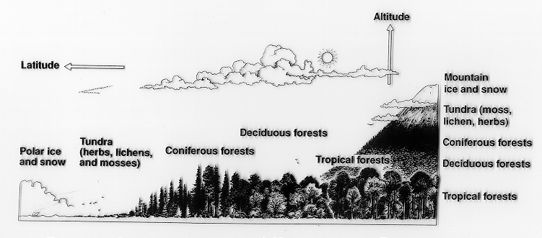

Slide 26
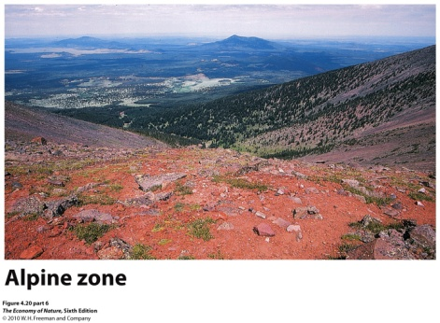
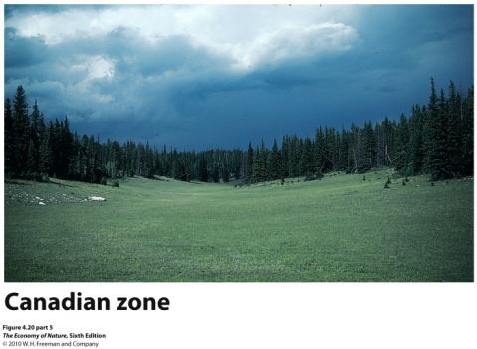
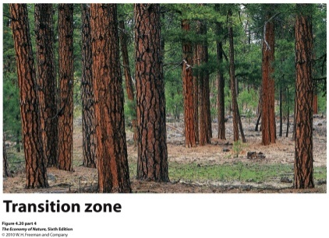
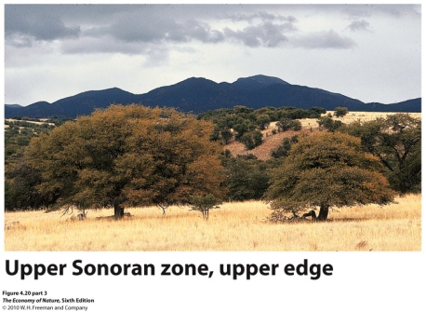
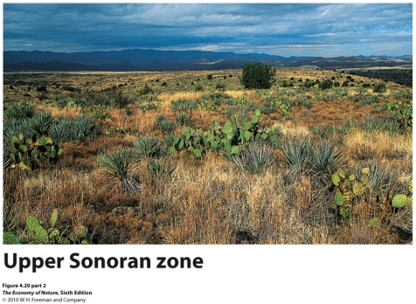
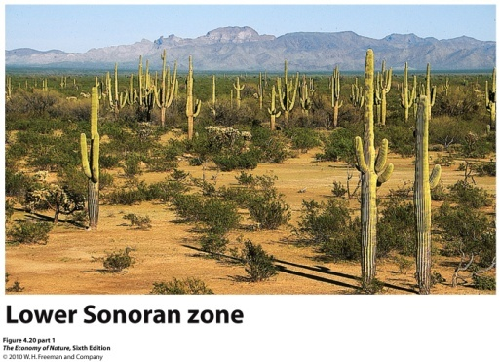
Merriam’s Life Zones in the southwestern U.S.

Slide 27
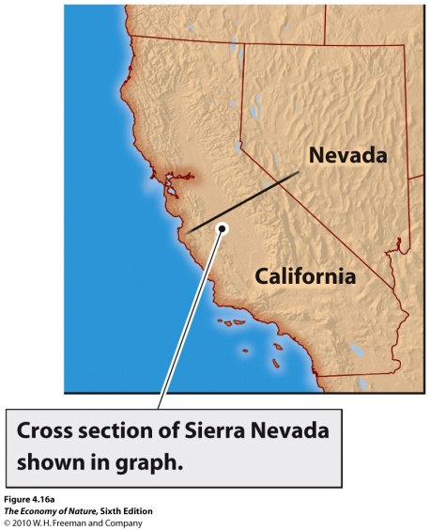
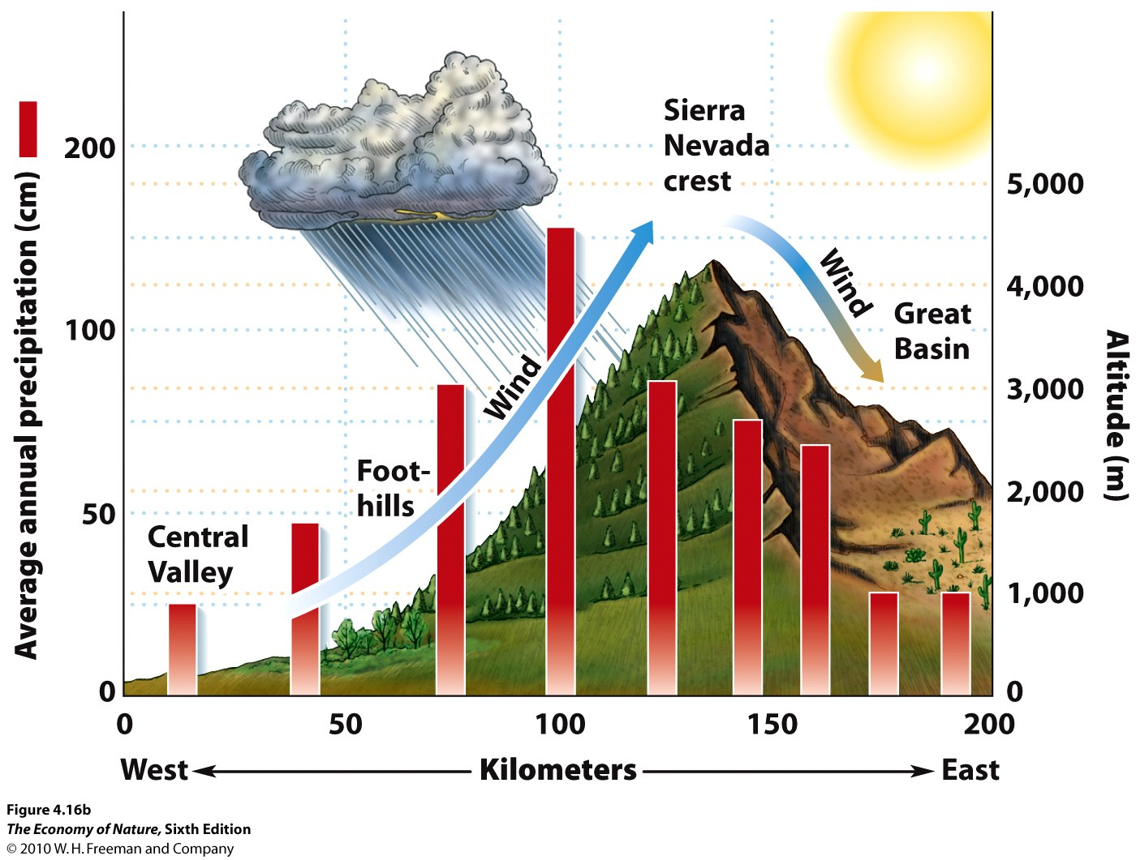

Slide 28
Valleys - Day

Slide 29
Valleys - Night

Slide 30
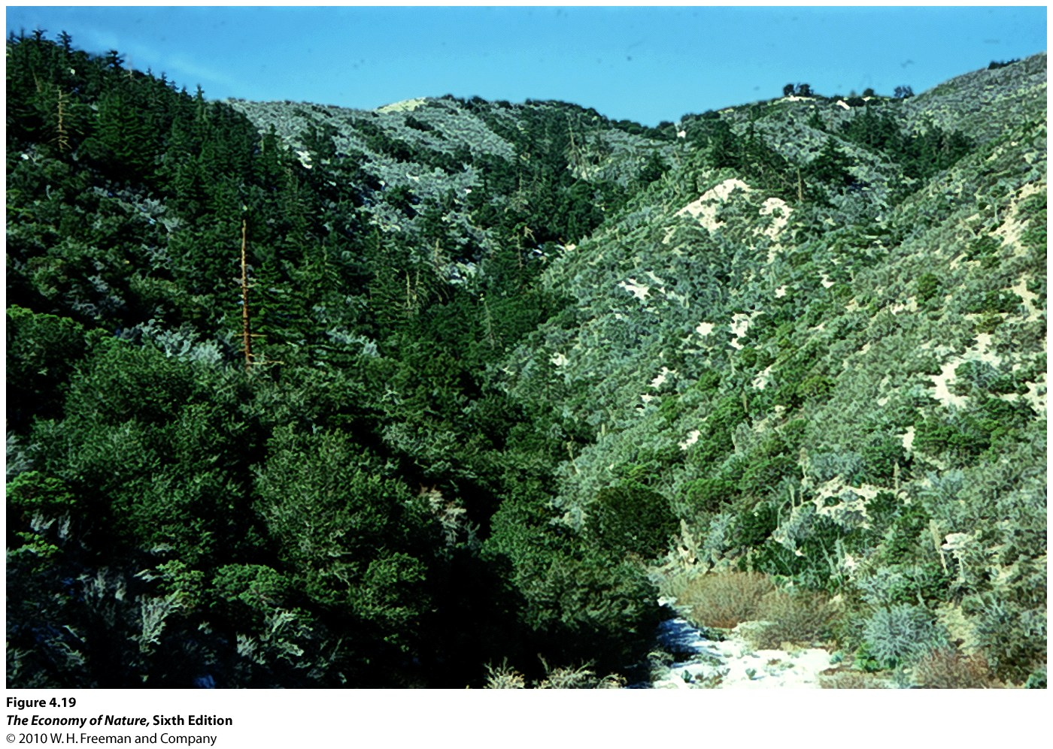

Slide 31
B. Water Bodies - act as heat sink/source as temp changes more slowly than air
SPRING to SUMMER
Land warms more rapidly than water body; heat transfers to cold water...increase in temp is buffered

Slide 32
B. Water Bodies - act as heat sink/source as temp changes more slowly than air
FALL to WINTER
Land cools more rapidly than water body; heat transfers to cold land...decrease in temp is buffered

Slide 33
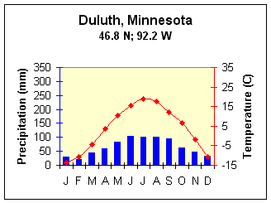
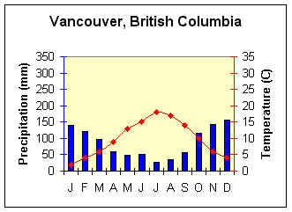
B. Water Bodies - act as heat sink/source as temp changes more slowly than air
CONTINENTAL CLIMATE
MARITIME CLIMATE
Continental climate
Maritime climate
focus on temp (red) and NOTE scales differ!!

Slide 34
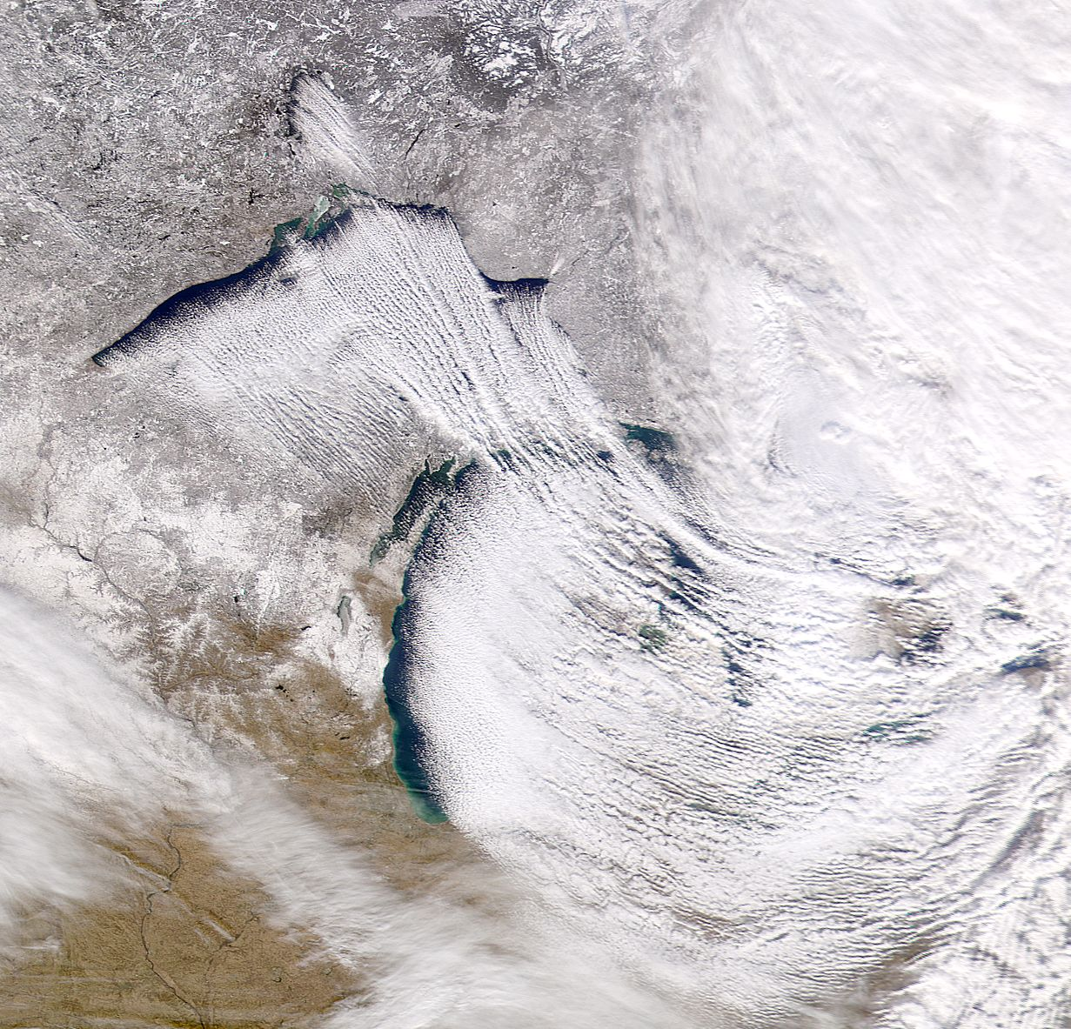
B. Water Bodies
- also a source of moisture

Slide 35
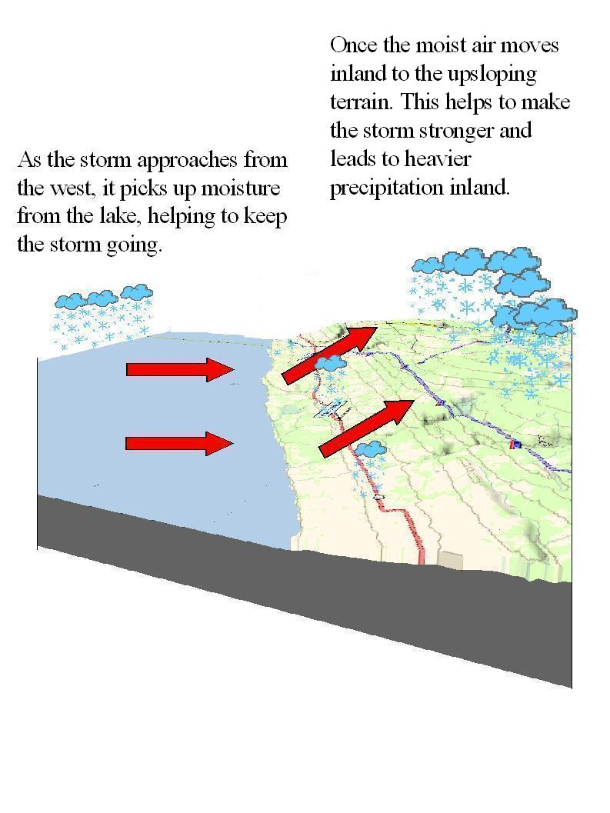
B. Water Bodies
- also a source of moisture
Maritime climate

Slide 36
B. Water Bodies
also a source of moisture
Continental climate (max 100)
Maritime climate (max 160)
focus on precip (blue)

Slide 37
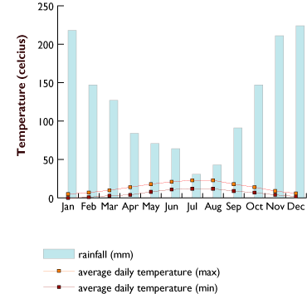
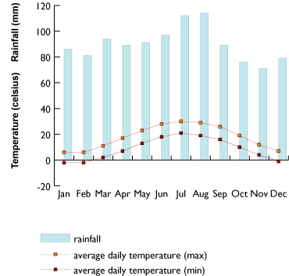
B. Water Bodies
also a source of moisture
depends on onshore vs. offshore winds/currents
Vancouver, 49N
Boston, 42 N
Note differences in scale

Slide 38
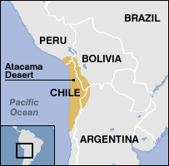
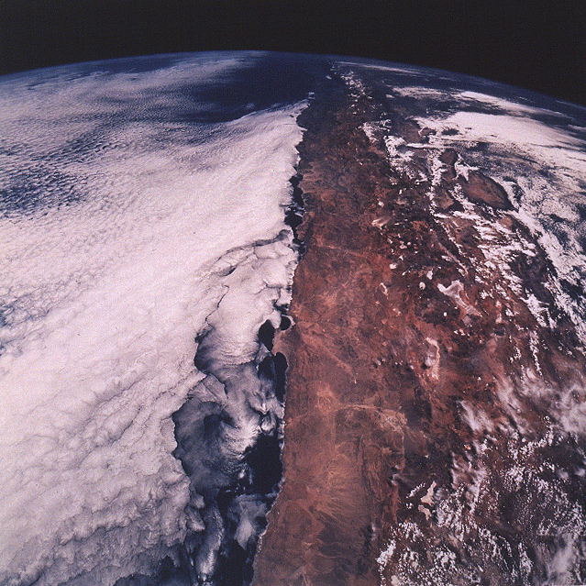
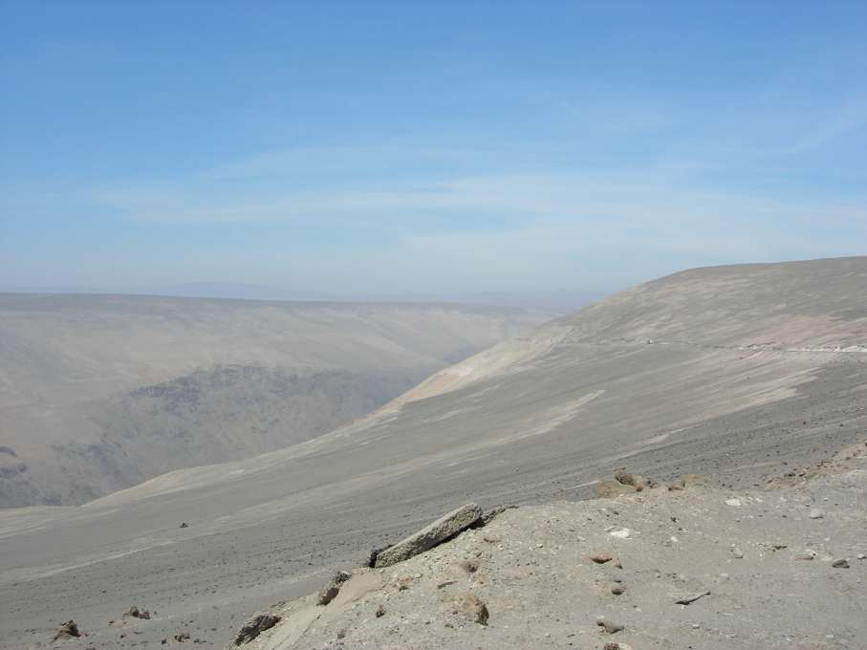
Atacama Desert:Additive Effects

Slide 39
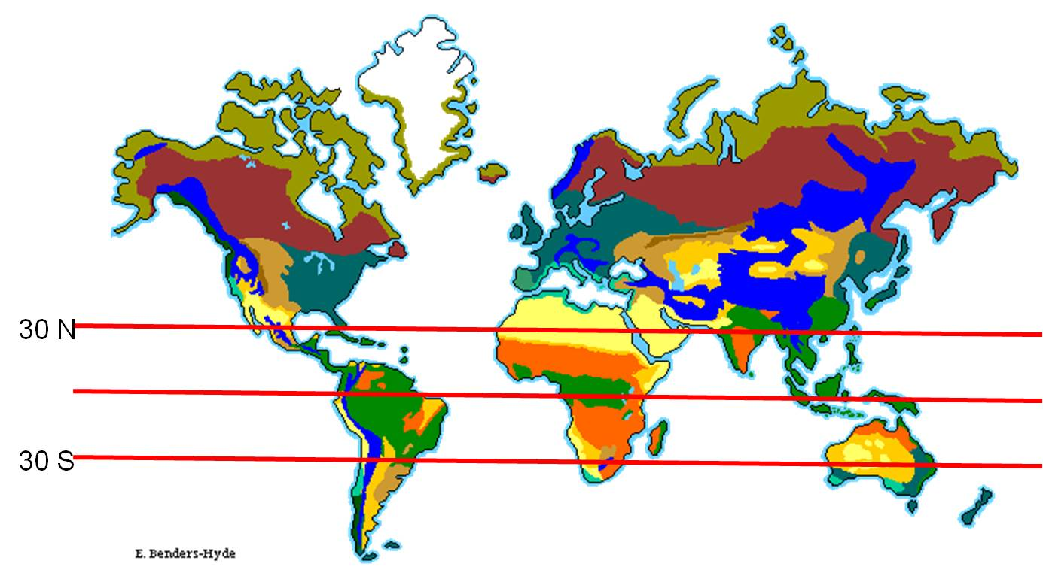
Biomes: Classifications of ecosystems based on climate and dominant plant growth forms

Slide 40
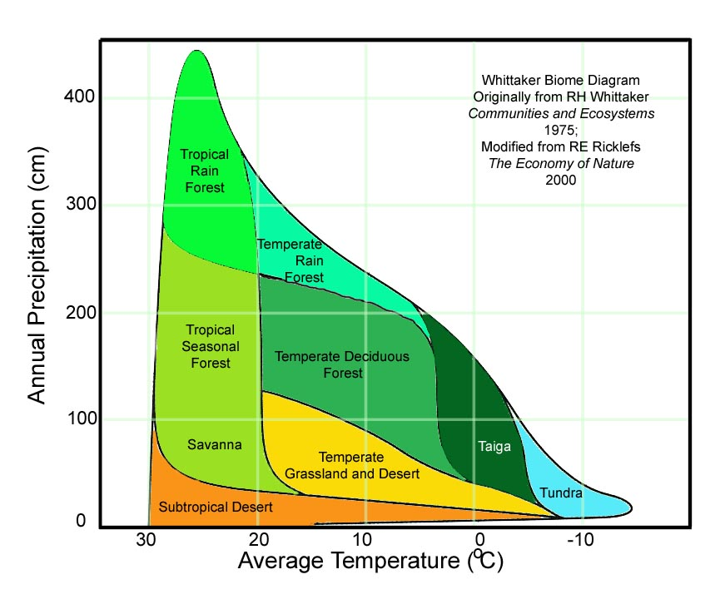

Slide 41
RAIN FOREST
SEASONAL FOREST
GRASSLANDS
DESERTS

Slide 42
RAIN FOREST
SEASONAL FOREST
GRASSLANDS
DESERTS
as temp increases, more water is needed by plants...

Slide 43
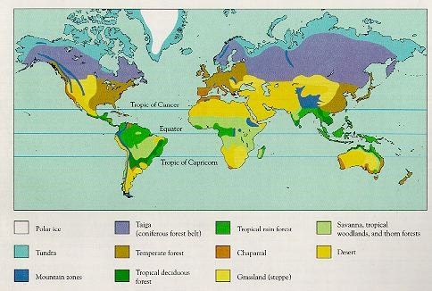
The Tropics: BIOMES

Slide 44
The Tropics:
BIOMES
Differences in tropical biomes are driven by differences in rainfall.

Slide 45
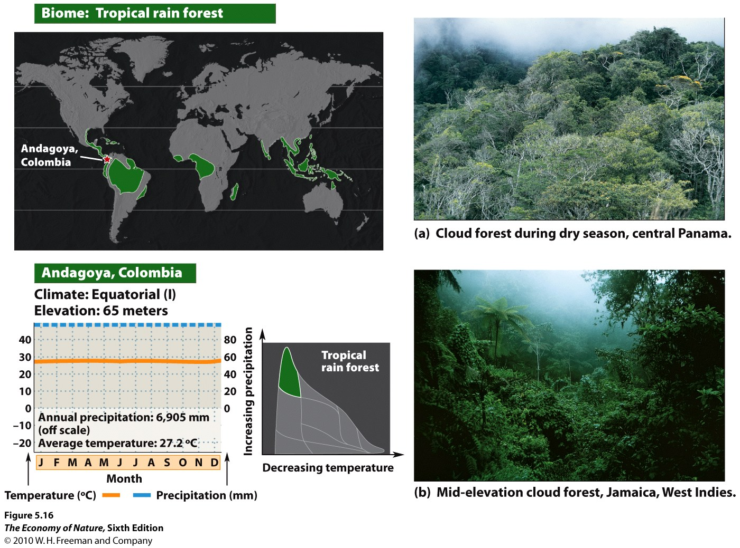
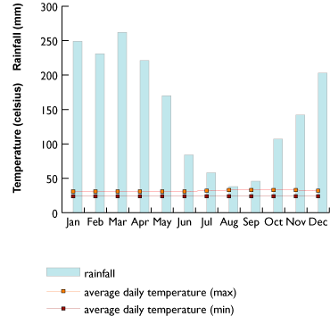
Manaus, Brazil

Slide 46
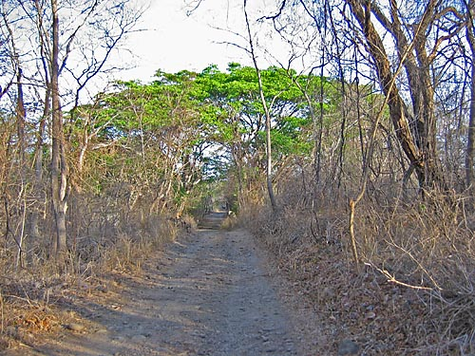
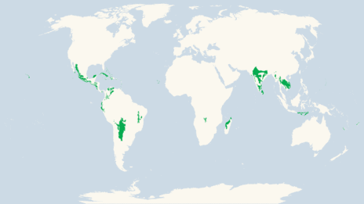
Tropical Dry Forest

Slide 47
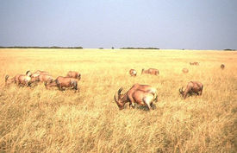
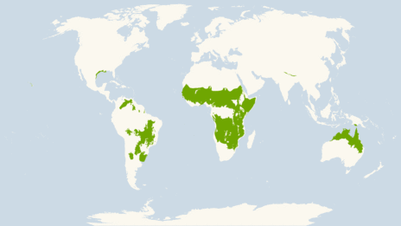
Savannah

Slide 48
The Temperate Zone:
BIOMES
Differences in temperate zone biomes are driven by a combination of temp and rainfall.

Slide 49
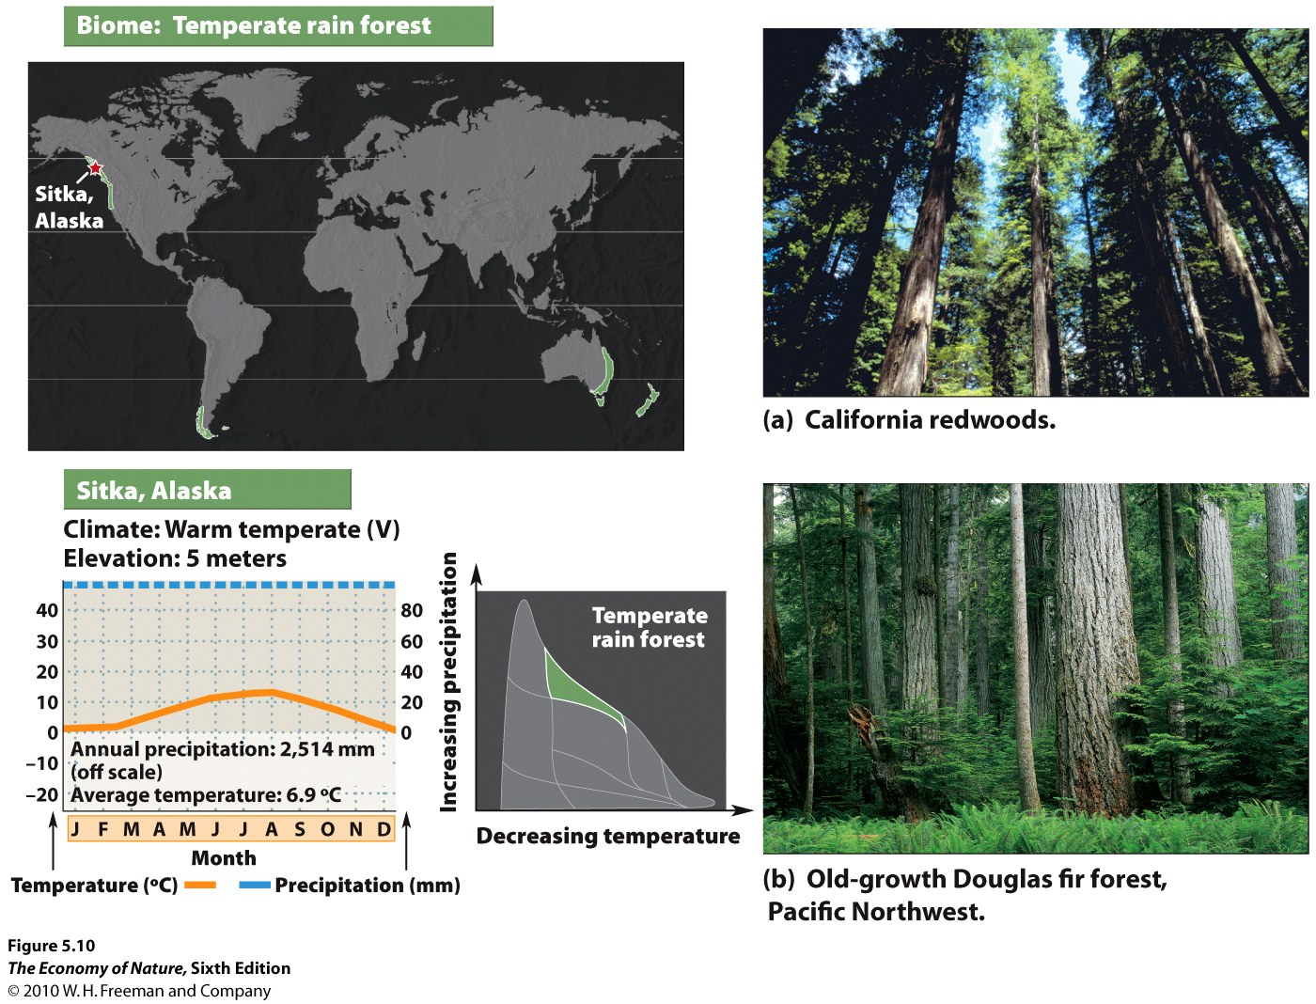

Slide 50
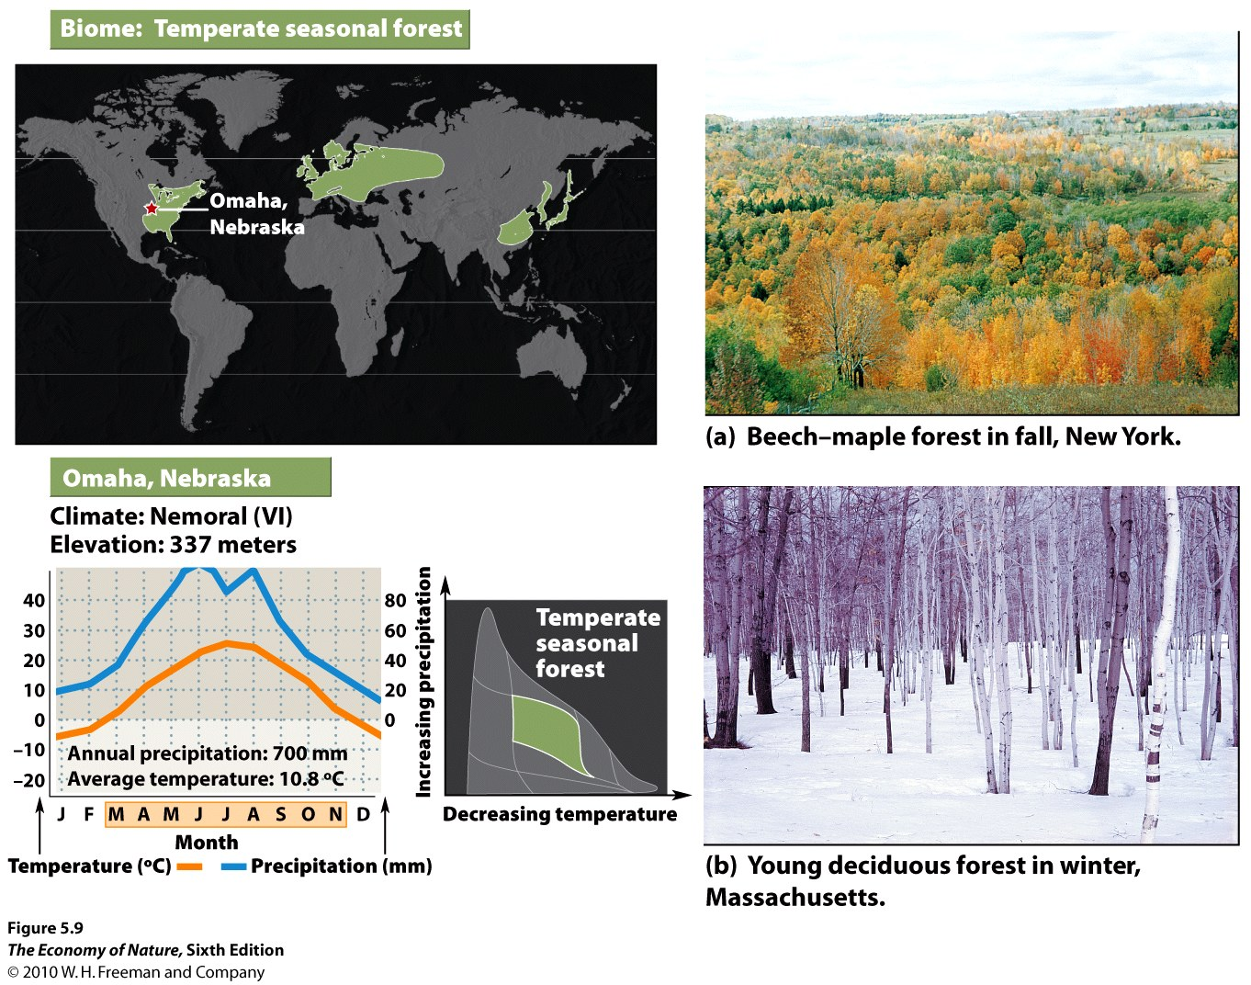

Slide 51
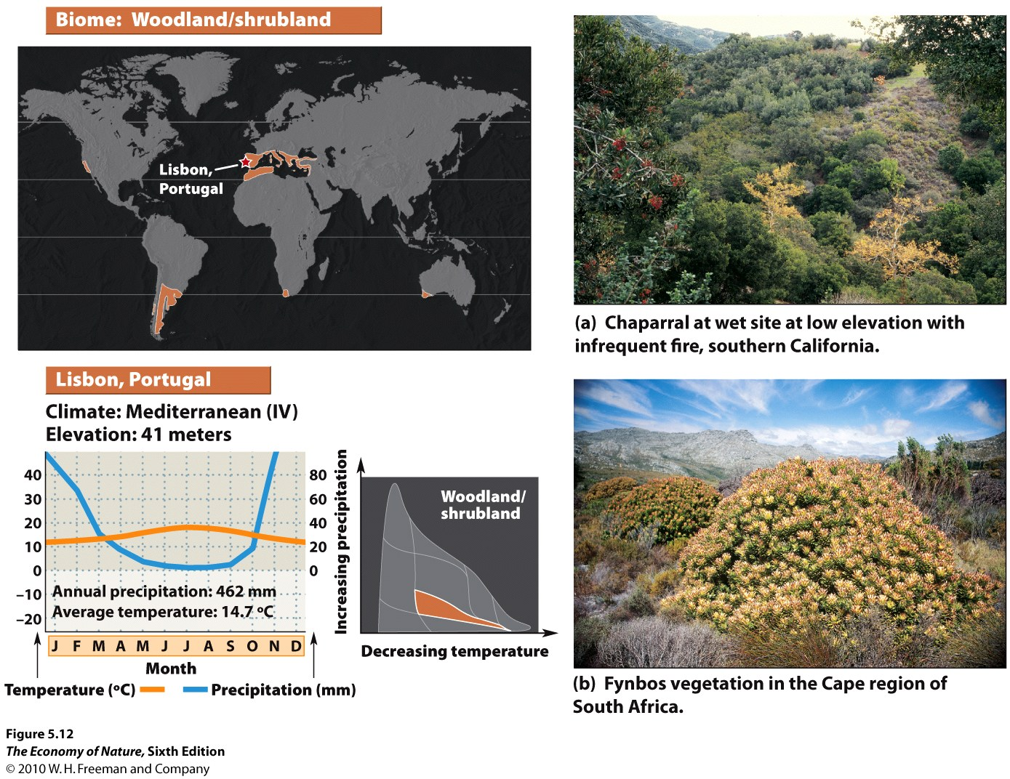

Slide 53
Deserts

Slide 56
Alpine Tundra

