Slide 1
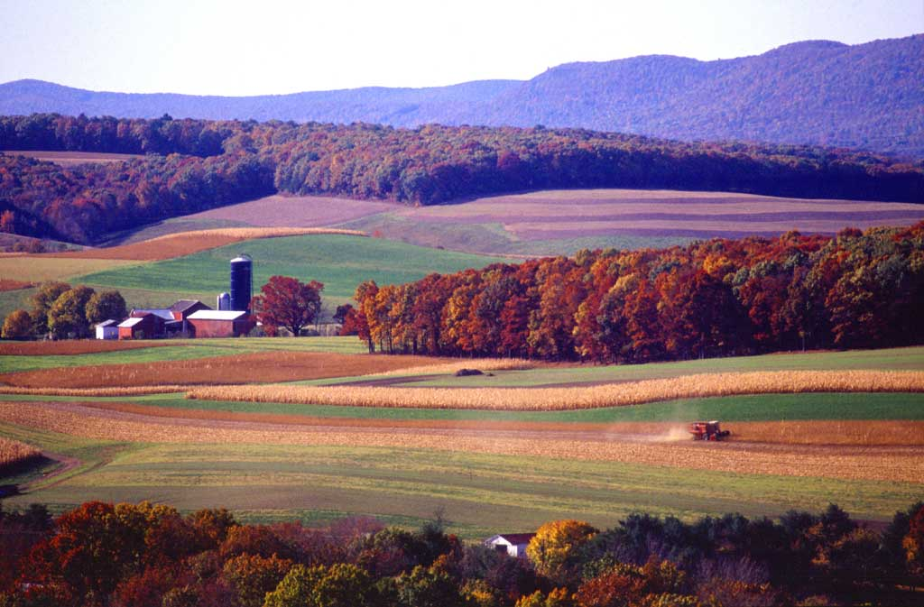
Arable Land Usage
Adrian McInnis

Slide 2
Outline
Introduction- Arable Land Use
Current State and Trends
Reasons for lose of arable land
Issues
Environment
Ecological
Management
Possible Solutions
Conclusion

Slide 3
Arable Land Usage
“Arable land includes land defined by the FAO as land under temporary crops (double-cropped areas are counted once), temporary meadows for mowing or for pasture, land under market or kitchen gardens, and land temporarily fallow.
Land abandoned as a result of shifting cultivation is excluded.

Slide 4
General Trends and History of Arable Land
General plateau for arable land usage in developed countries and world.
Undeveloped countries are using more and more arable land to sustain economy by agricultural means. Usually because there is a high demand for food, low employment, and lack of technology.
Tropical forest deforestation leading to more arable land.
Increase in populations and low rates for clearing forest for farming induces creation of arable land.
http://data.worldbank.org/indicator/AG.LND.ARBL.ZS

Slide 5
World Land Use & Distribution
http://www.fao.org/fileadmin/templates/solaw/files/thematic_reports/TR_01_web.pdf

Slide 6
Anticipated trends
The land balance (land with crop production potential not being used for agricultural) is unevenly distributed between regions and countries. Half the total balance is concentrated in seven countries: Brazil, Democratic Republic of the Congo, Angola, Sudan, Argentina, Colombia and Bolivia. At the other extreme, no spare land is available for rainfed agricultural expansion in South Asia and the Near East/North Africa.
Must have technological improvements and proper irrigation to use this land.
http://www.fao.org/fileadmin/templates/solaw/files/thematic_reports/TR_01_web.pdf

Slide 7
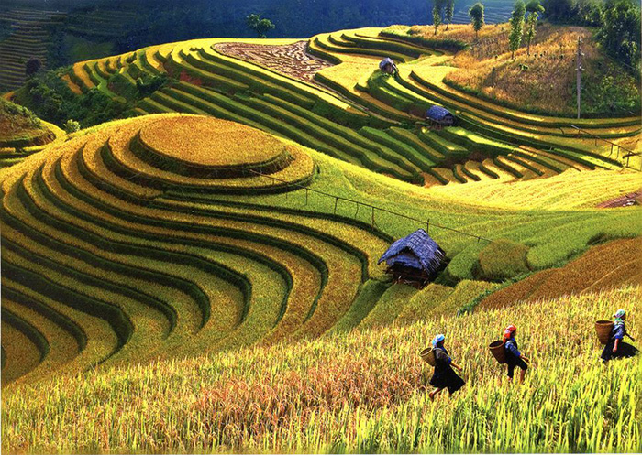
Variables affecting arable land
Degradation
Irrigation
Deforestation
Desertification
Intensification
Urban Encroachment/ Human Development
Terracing
Incentive programs
Habitat restoration & species conservation
Bills: crop insurance, subsidy, food stamps, research, conservation

Slide 8
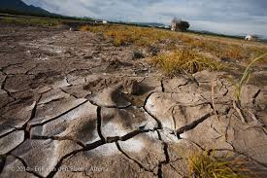
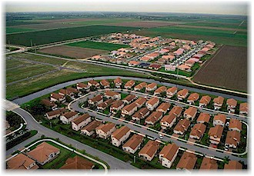
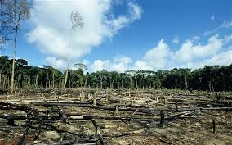
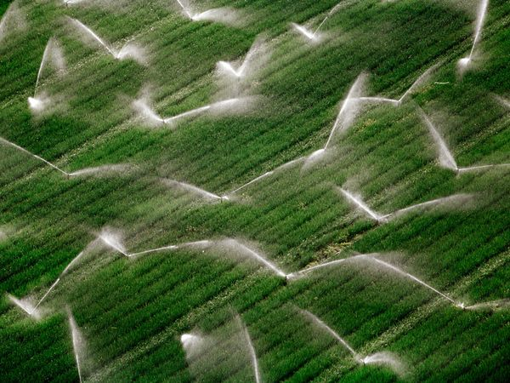

Slide 9
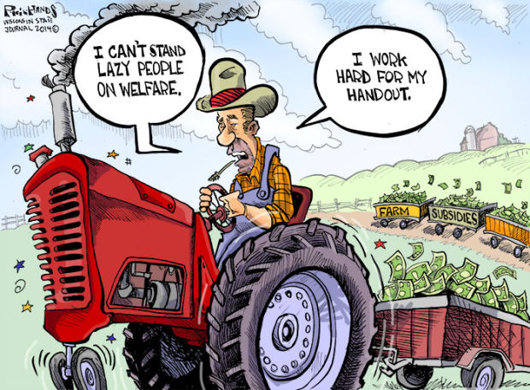
Economic Considerations
Farmers must find a way of being competitive and profitable while protecting environmental quality and investing in the natural resource base upon which their enterprise and the local economy depend
Incentive Programs
Absentee Leasing: Pine Plantations
Subsidies- Farm Bill

Slide 10
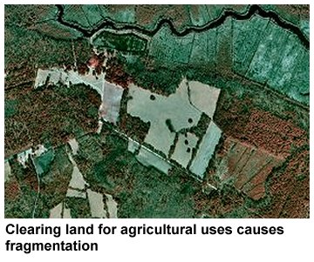
Ecological Considerations
Habitat Alteration
fragmentation
Species Compositions
Nestedness
Species Invasion
Soil Composition
Wind
Water
Radiation- Sunlight

Slide 11
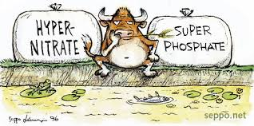
Management Considerations
Sustainable Agriculture
Nutrient and Pest Management
Water Management
Biodiversity
Crop Residue Management
Crop Rotation Management

Slide 12
Possible Solutions
The production of more arable land
An increase in the productive capacity of existing cultivated land
Reach 95% of potential for 16 major food crops could add 2.3 billion tons of food which would increase food production by 58%.(Solutions to a Cultivated Planet).
The conservation of arable land in order to prevent degradation
Waste Reduction
33 million tons of food makes its way to landfills each year. (Environmental Protection Agency)
Approximately 40 percent of food in the U.S. goes to waste. Food and Agriculture Organization
Roughly one third of the food produced in the world for human consumption every year — approximately 1.3 billion tons — gets lost or wasted. Food and Agriculture Organization

Slide 13
Conclusion
Information must be made available to direct agents of arable land
Must be valued appropriately
Must be economically advantageous and sustainable for the user and benefit the environment and intended population.
The ramifications must be made clear and understood
Develop Action Plan
Current Assessment- Inputs/Outputs
Label Goals: Financial or Environmental
Set Short & Long Term Goals
Implement Plan
Review progress

Slide 14
Resources
World Bank Group. “Agriculture & Rural Development.” 2014. Retrieved on November23, 2014. <http://data.worldbank.org/about/worlddevelopment- indicators-data/agriculture-and-rural-development>.
NA. ”Agriculture Land Use Issues.” Date NA. Retrieved on November 23, 2014.
<http://nerrs.noaa.gov/doc/siteprofile/acebasin/html/modules/landuse/lmagrlnu.htm>.
Prue Campbell. “The Future Prospects for Global Arable Land.” 19 May 2011.
Retrieved on November 23, 2014.
<http://www.futuredirections.org.au/publications/food-and-water-
crises/53-the-future-prospects-for-global-arable-land.html>.
Julie Menter. “Helping U.S. Farmers Increase Production and Protect the Land.” 05 Jul 2012. Retrieved on November 23, 2014. <http://e360.yale.edu/feature/ helping_us_farmers_increase_production_and_protect_the_land/2549/>.

