Slide 1
Invasive Species
Amy Pope, 2 Dec 2014

Slide 2
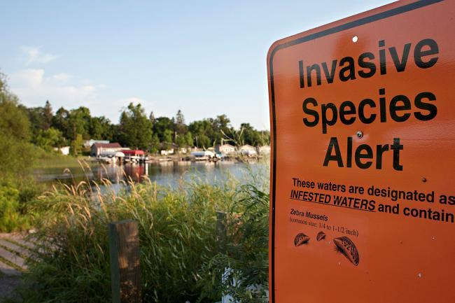
Invasive Species
Native or Exotic
Flora or Fauna
Uncontrolled Populations
Harmful effects

Slide 3
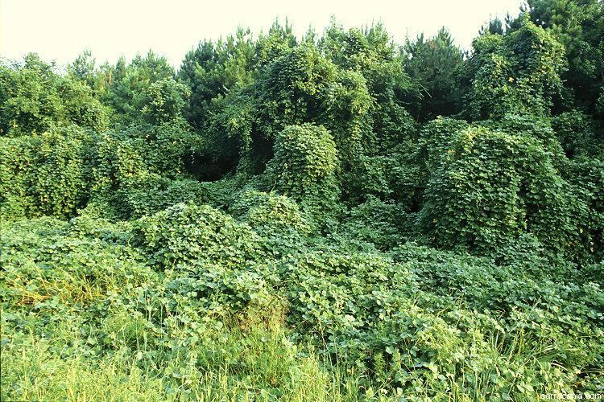
Kudzu

Slide 4
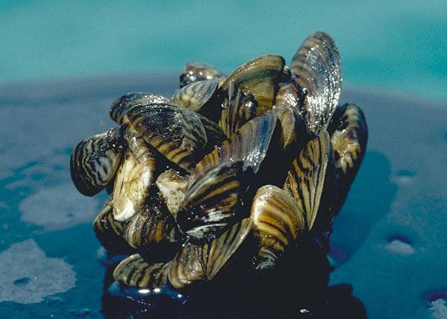
Zebra Mussels

Slide 5
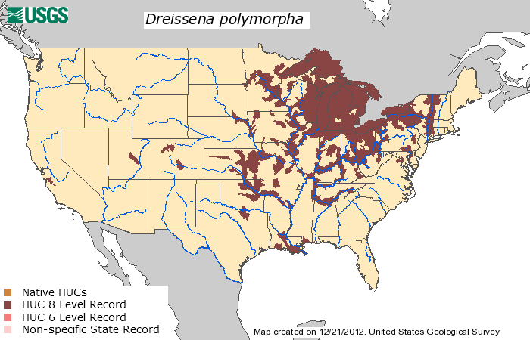

Slide 6
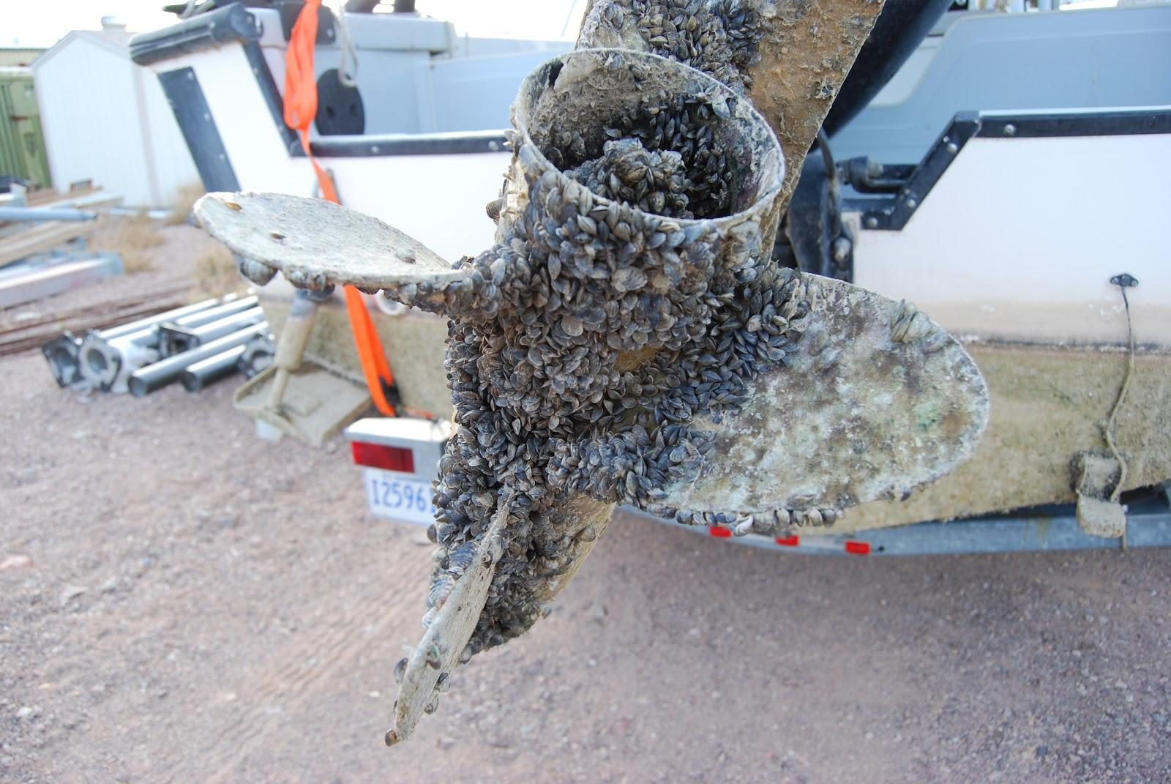

Slide 7
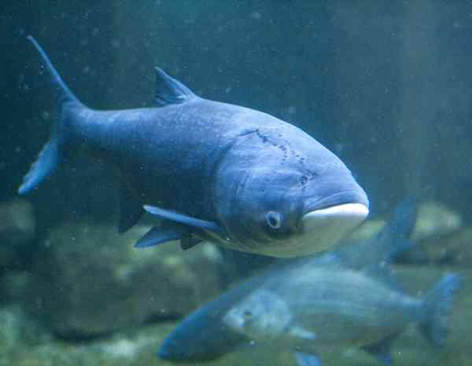
Asian Carp

Slide 8
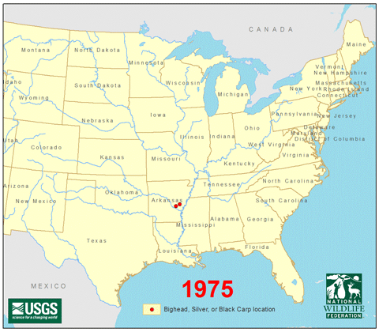

Slide 9
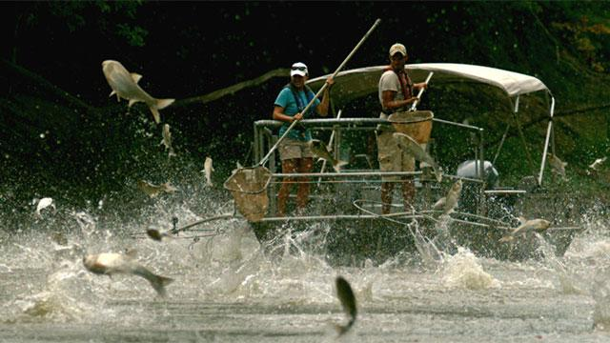

Slide 10
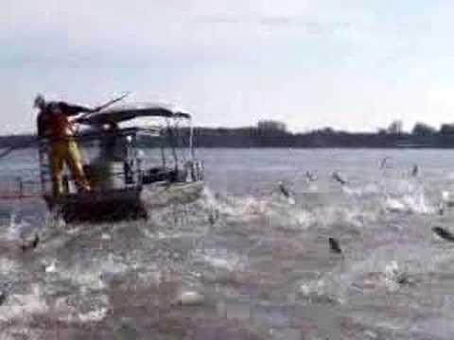

Slide 11
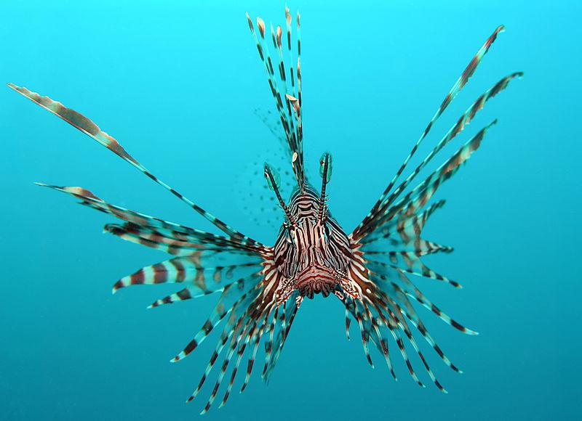
Lionfish

Slide 12
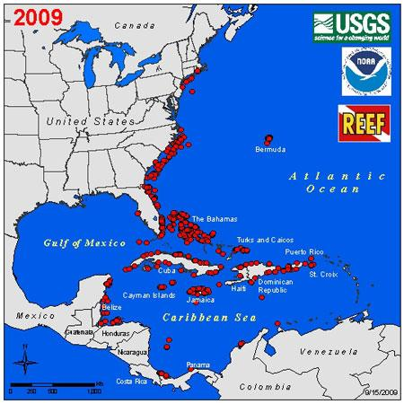

Slide 13
