Slide 1
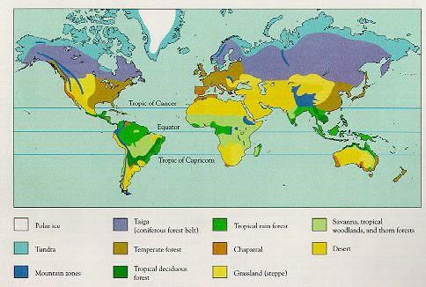
Temperate Zone:

Slide 2
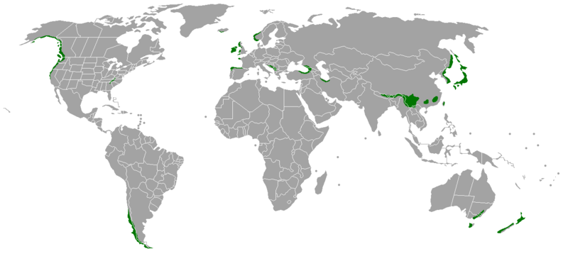
TEMPERATE ZONE:
Temperate Rain Forest

Slide 3
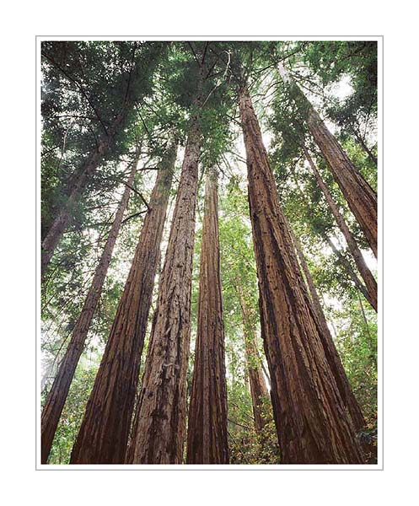
TEMPERATE ZONE:
Temperate Rain Forest
TEMP: seasonal but not extreme - moderated by coastal currents. Cool - 10C mean.
RAINFALL: High but seasonal - dry summer moderated by fogs
EVAPOTRANSPIRATIONAL STRESS: low due to fog
LIGHT: Seasonally limiting in winter and under closed canopies.
SOILS: deep, rich humus layer, rich A horizon. Slow decomposition and shallower bedrock keep nutrients at surface
DISTURBANCE: winter, treefalls, storms
NUTRIENTS and CYCLING: stalled by winter and dry summer, but otherwise wet .

Slide 4
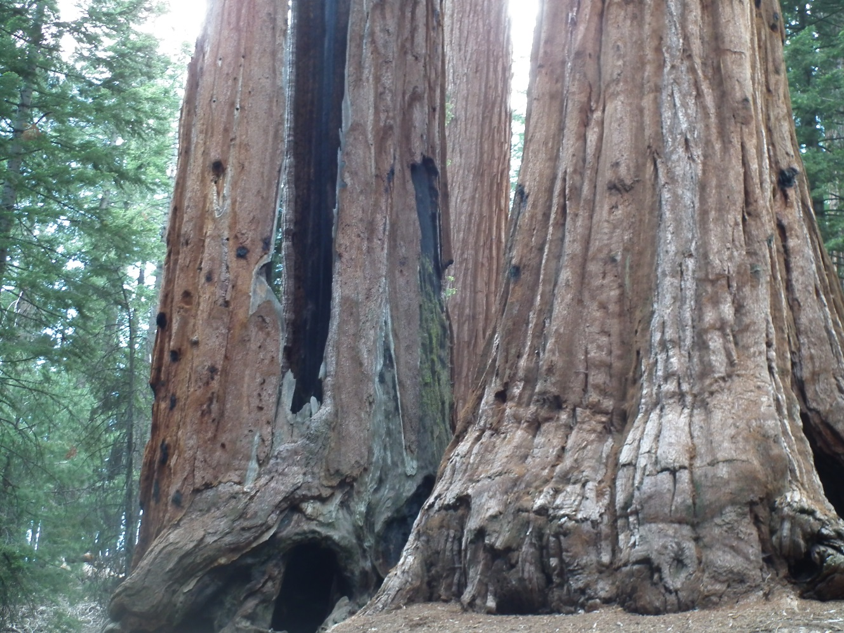
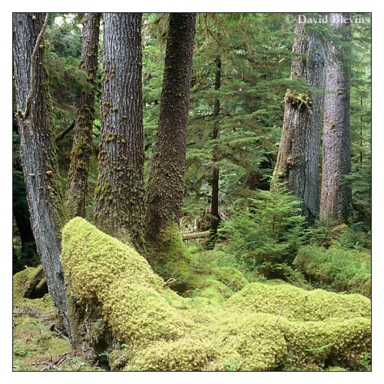
TEMPERATE ZONE:
Temperate Rain Forest
BIOTA:
Low diversity, but tallest trees on the planet, in NA, hemlock and spruce in north give way to redwoods and sequoia in south
Structurally simple; dark understory retards growth of understory except mosses... heavy epiphyte load

Slide 5
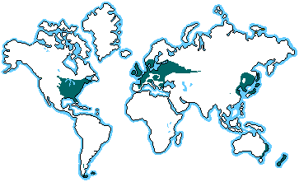
Temperate Zone:
Temperate Deciduous Forest

Slide 6
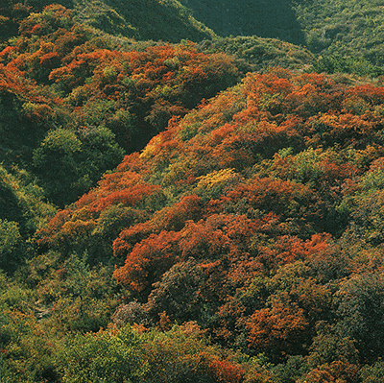
TEMPERATE ZONE:
Temperate Deciduous Forest
TEMP: Seasonality is more extreme, with more severely cold winters but moist spring and summer.
RAINFALL: More even throughout year; no pronounced drought period.
EVAPOTRANSPIRATIONAL STRESS: low for most the year; hot summer and dry winter
LIGHT: Seasonally limiting in winter and under closed canopies.
SOILS: Soils are rich in nutrients and fairly deep
DISTURBANCE: winter, storms, fires on dry substrates
NUTRIENTS and CYCLING: Slow but efficient; deep litter layer.

Slide 7
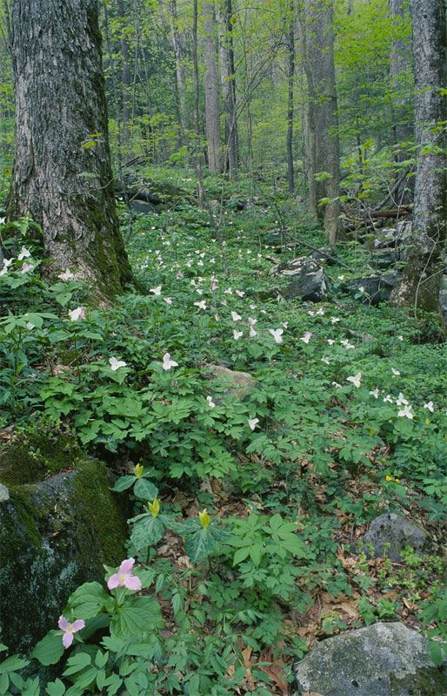
TEMPERATE ZONE:
Temperate Deciduous Forest
BIOTA:
Deciduous trees dominate on good soils; pines dominate on sandy soils, dry slopes, early in succession, and nutrient poor soils.
Simple four-layer structure to forest.
herbs flower in in spring when light abundant; also when wind-dispersed canopy trees pollinate
Biota varies dramatically with climate, from northern hardwoods of Beech and Maple to Southern Poplar-Oak (moist) and Oak-Hickory (dry).

Slide 8
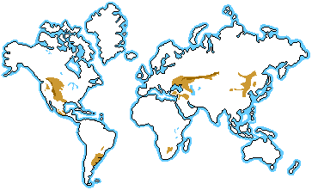
Temperate Zone:
Temperate Grassland

Slide 9
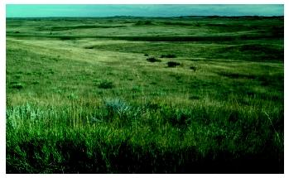
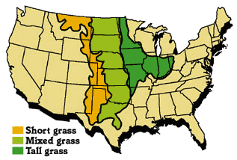
TEMPERATE ZONE:
Temperate Grasslands
TEMP: seasonal extremes - continental climate limits growing season depending on latitude and temperature extremes.
RAINFALL: Low summer rainfall is predictably seasonal. Rainfall is too low to leach cations from soil but can be high enough for grasses.
EVAPOTRANSPIRATIONAL STRESS: high, especially in dry season; selects for C4 grasses but C3 grasses still plentiful
LIGHT: seasonally limiting
SOILS: deep and rich
DISTURBANCE: fire - selects for grasses
NUTRIENTS and CYCLING: moist grasslands are richest soils on Earth, rich in nutrients and organics
Increasing rainfall

Slide 10
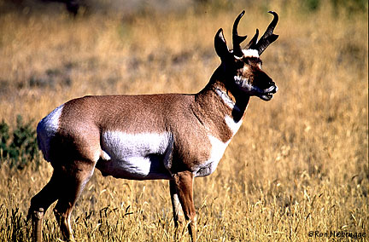
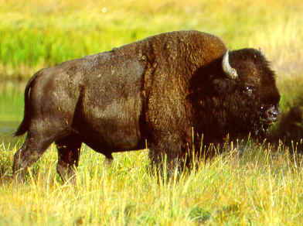
TEMPERATE ZONE:
Temperate Grasslands
BIOTA:
The height and density of grasses correlates with rainfall, which changes the soil conditions. Perennial C4 grasses dominate.
Again, large grazers and predators dominate the food webs.

Slide 11
Deserts:

Slide 12
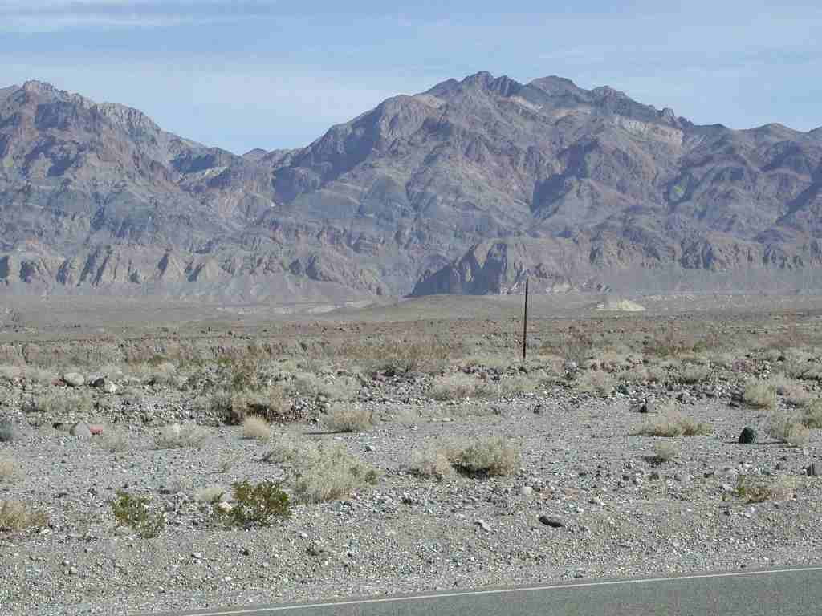
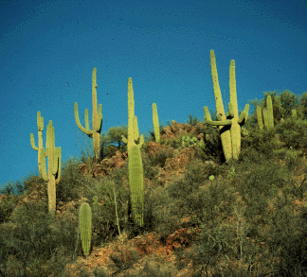
Deserts:
TEMP: Temperatures vary from hot to freezing, dramatically, depending on time of day, time of year, and latitude.
RAINFALL: <25cm. Limits growth.
EVAPOTRANSPIRATIONAL STRESS: very high; evaporation exceeds rainfall. In Phoenix, AZ, potential evapotranspiration is 130 cm a year, but rainfall is only 18 cm/year.
LIGHT: not limiting during growing season
SOILS: mineral with little organic input. Salts rise to form hardpan called caliche, exacerbating desiccation.
DISTURBANCE: desiccation, drought, temperature extremes
NUTRIENTS and CYCLING: very poor

Slide 13
BIOTA:
Xerophyllic plants adapted to extreme drought stress dominate (CAM plants)
strong diurnal patterns in animal and plant activity (CAM)
Plant density tightly linked to water availability.

Slide 14
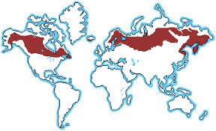
BOREAL and POLAR ZONES:
Boreal Forest or Taiga

Slide 15
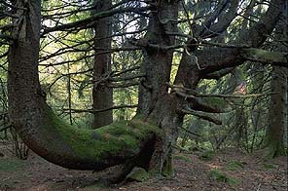
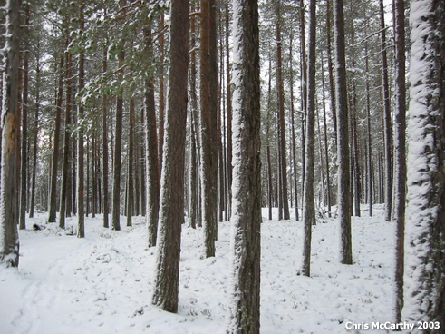
TBOREAL AND POLAR ZONE:
Boreal Forest (Taiga)
TEMP: Cold; short growing season
RAINFALL: Precip. is low (40-100 cm/year) and mostly snow
EVAPOTRANSPIRATIONAL STRESS: Severe in long winter due to low water availability
LIGHT: Seasonally limiting in winter and under closed canopies.
SOILS: Soils are shallow due to recent glaciation; nutrient poor due to slow decomposition, and often saturated due to shallow depth of bedrock and rapid spring/summer melt. Deep acidic humus layer. Bogs develop in depressions
DISTURBANCE: winter, storms

Slide 16
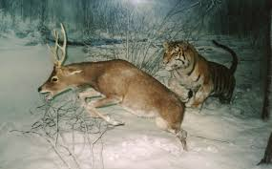
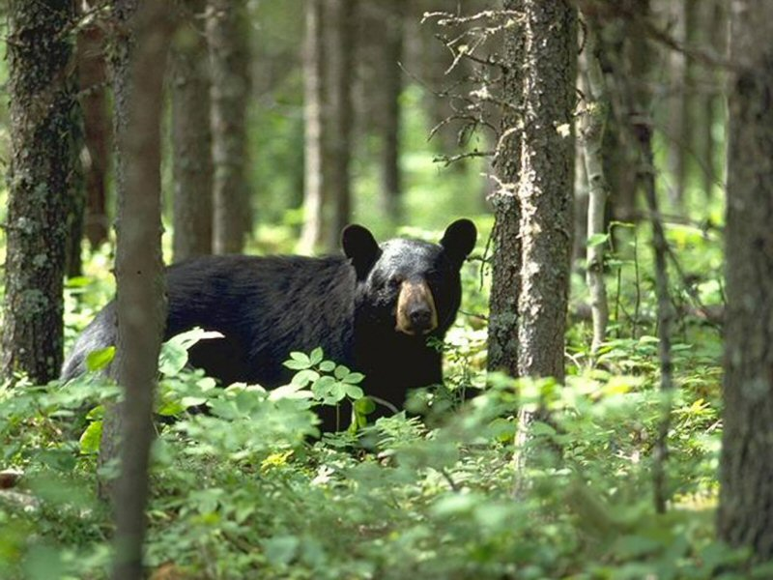
BOREAL and POLAR ZONE:
Boreal Forest (Taiga)
BIOTA:
Slow growing, evergreen conifers dominate; spruce, fir, pine. Birch and Aspen are only deciduous trees to make it.
dense brush in gaps; otherwise no shrub layer to speak of
dramatic seasonality to many animal populations, too: migrate or hibernate

Slide 17
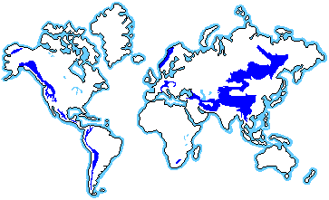
Tundra (Arctic and Alpine)

Slide 18
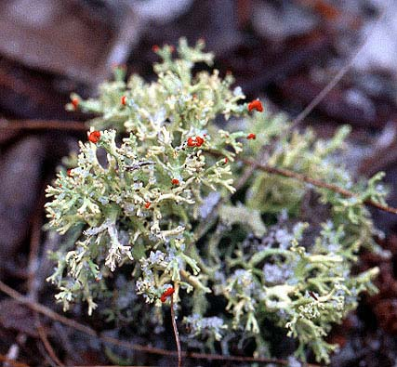
ARCTIC TUNDRA
TEMP: Cold most of the year, with a growing season less than 100 days. The summer does have long days, but light intensities are still low due to oblique angle.
RAINFALL: Precipitation is very low, less than 25cm/year.
EVAPOTRANSPIRATIONAL STRESS: high, largely due to desiccating effects of dry, strong cold winds and water frozen as ice most of year.
LIGHT: Limiting most of year; growing season very short
SOILS: shallow; just above permafrost; boggy in summer; very slow decomposition - mats of peat that transfer little nitrogen to soil
DISTURBANCE: winter, freez-thaw cycles, storms, exposure
NUTRIENTS and CYCLING: soils nutrient poor and shallow
BIOTA:
Shrubs, grasses, mosses, and lichens.

Slide 19
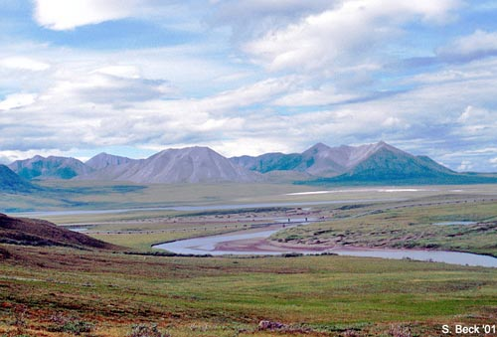
ARCTIC TUNDRA
BIOTA:
No trees - above treeline.
Perennial grasses, mosses, and lichens dominate; the growing season is even too short for annual herbs to really get going.
Mammals tend to remain all year, relying on thick fur to weather winters. Some migration into the boreal forest does occur.

Slide 20
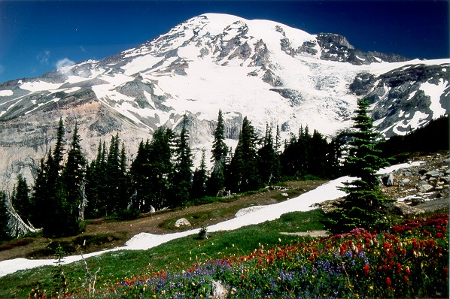
ALPINE TUNDRA
Elevational treelines vary with latitude, being 900m at 65N, 2100m at 49N, 3300m at 40N, and 4200m at 19N.
The presence of cold-hardy trees is also critical. In Brazil near 22S, the treeline is below 2000m because there are no cold-tolerant trees in the region.
Short growing season and a long cold winter, but lots of precipitation, lower oxygen, high UV radiation, and unpredictable storms makes this a very different environment from arctic tundra.
Soils lack permafrost but are thin and "new". Well drained (water runs downslope and does not pool) and summer droughts can occur.
BIOTA:
plants are perennial grasses and cushion plants; animals migrate altitudinally to take advantage of seasonal flush of grasses

Slide 21
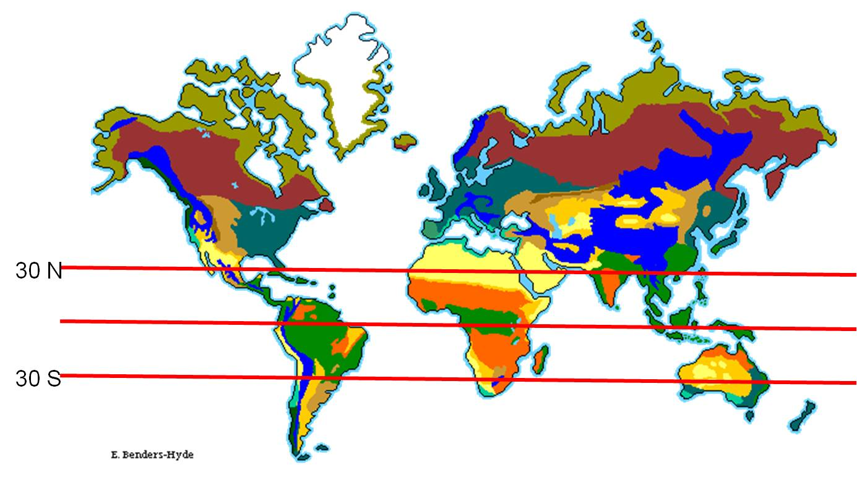
Biomes: Classifications of ecosystems based on climate and dominant plant growth forms

Slide 22
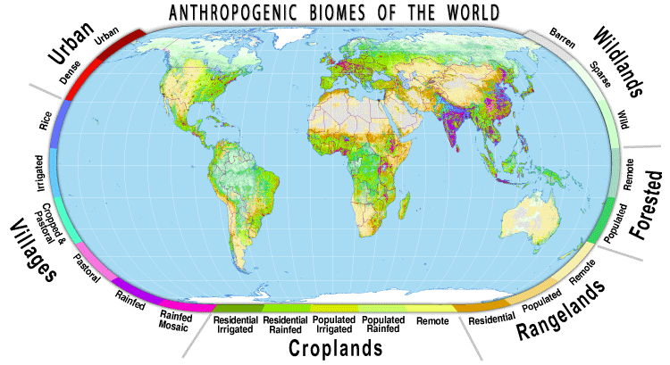
Anthromes: Anthropogenic Biomes
Classifies landscapes based on human use, human density, and vegetation type
Anthromes, also known as Anthropogenic Biomes, or Human Biomes, are the globally significant ecological patterns created by sustained interactions between humans and ecosystems. (http://ecotope.org/anthromes/faq/#Are_biomes_obsolete)

Slide 23
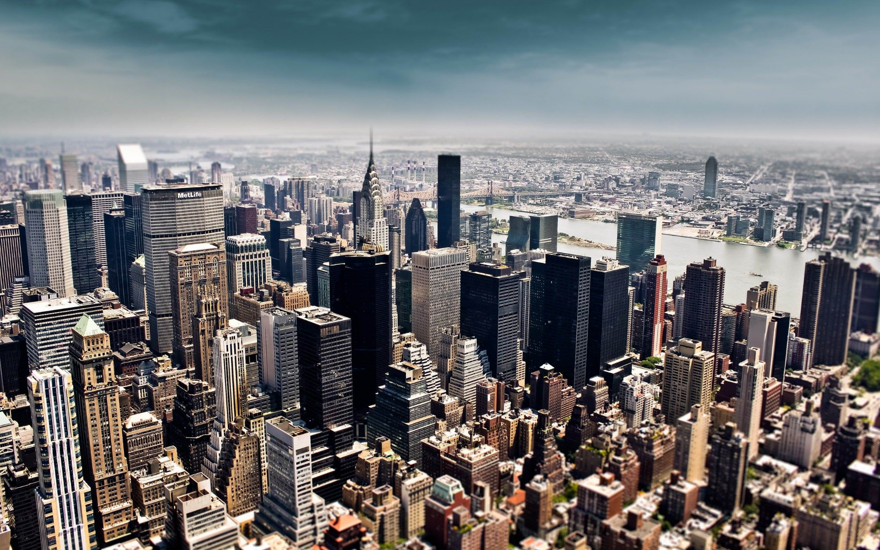
URBAN: Urban and Dense Settlements: > 100 people/km²
2.6 billion people, 1.5 mill km²
VILLAGES: Dense rural populations with agriculture
2.6 billion people, 8 mill km²
CROPLANDS: Agriculture
0.9 billion people, 27 mill km²
RANGELANDS: Grazing
0.3 billion people, 40 million km²
FORESTED:
0.04 billion people, 25 million km²
WILDLANDS:
0 people, 29 million km²
Antarctica – 14 mill km²
TOTAL land surface area = 148 million
This is no longer Temperate Deciduous Forest

Slide 24
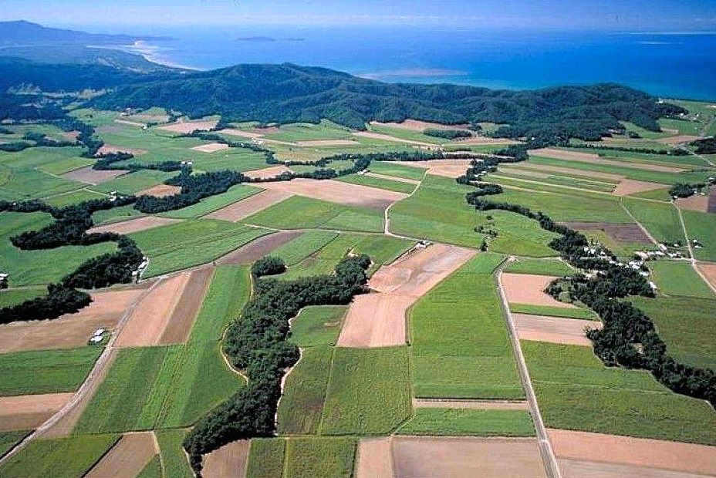
Farmland within the Eastern Deciduous Forest, or Forest in Farmland?

Slide 25
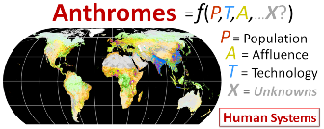
http://ecotope.org/anthromes/paradigm/
The Anthromes Paradigm Human systems, with natural systems embedded within them Most of the biosphere reshaped by human systems. Human systems are primary shapers of ecosystem form, process and biodiversity. Humans create and sustain a diverse spectrum of anthropogenic ecosystems, or anthromes. Planetary stewardship based on humans as permanent managers of the biosphere.

Slide 26
URBAN: Urban and Dense Settlements:
> 100 people/km²
2.6 billion people, 1.5 mill km²
VILLAGES: Dense rural populations with agr. 2.6 billion people, 8 mill km²
CROPLANDS: Agriculture
0.9 billion people, 27 mill km²
RANGELANDS: Grazing
0.3 billion people, 40 million km²
FORESTED:
0.04 billion people, 25 million km²
WILDLANDS:
0 people, 29 million km²
Antarctica – 14 mill km²
TOTAL land surface area = 148 million
Includes forests that are radically different ecologically, from the Amazon to the Boreal Forest
How humans might use these sustainably will vary dramatically because of climatic, “biomic” distinctions

Slide 27
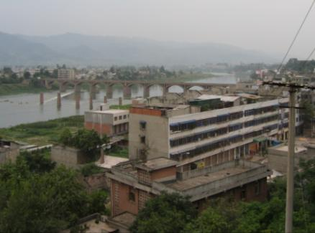
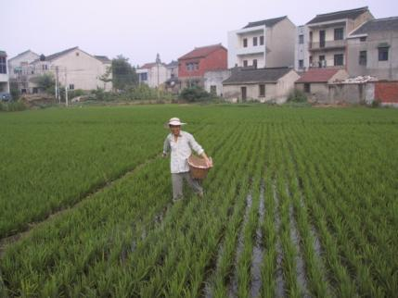
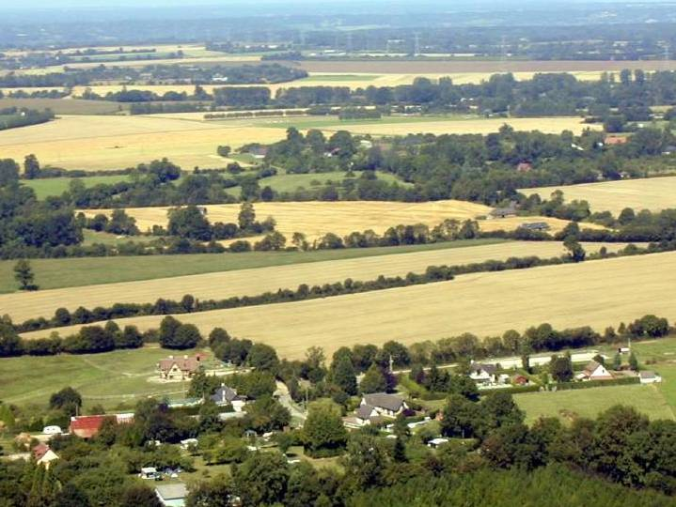
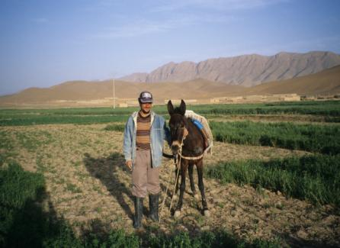
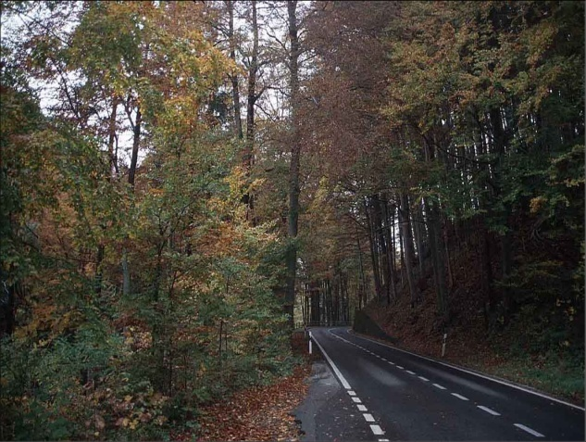
1700
1800
1900
2000
Global Land
Dense Settlements
Urban
Dense settlements
Villages
Used
Rice
Irrigated
Rainfed
Pastoral
Croplands
Residential Irrigated
Residential Rainfed
Populated
50%
Remote
Rangelands
Residential
Seminatural
Populated
Remote
Seminatural
Residential Woodlands
Populated Woodlands
Wild
Remote Woodlands
Inhabited Treeless
&
Wildlands
Barren lands
Ellis et al., 2010
Wild Woodlands
Wild Treeless
&
Barren lands

Slide 28
Are biomes obsolete? No. Even though humans have transformed most of the terrestrial biosphere into anthromes, biomes remain useful both as a basic concept in biology and ecology (globally-significant large-scale units of ecosystem form and function- anthromes are merely "anthropogenic biomes") The classic biomes defined by climate are still useful global units for ecology, differentiating profound global variations in ecosystem form and function, including biodiversity and primary productivity. (http://ecotope.org/anthromes/faq/#Are_biomes_obsolete)
This perspective is probably productive in describing these transformed landscapes, with a recognition that there is dramatic climatic and “biomic” variation in each category.
Also productive in understanding interactions between islands of natural ecosystem and the ‘matrix’ of human systems surrounding them.

Slide 29
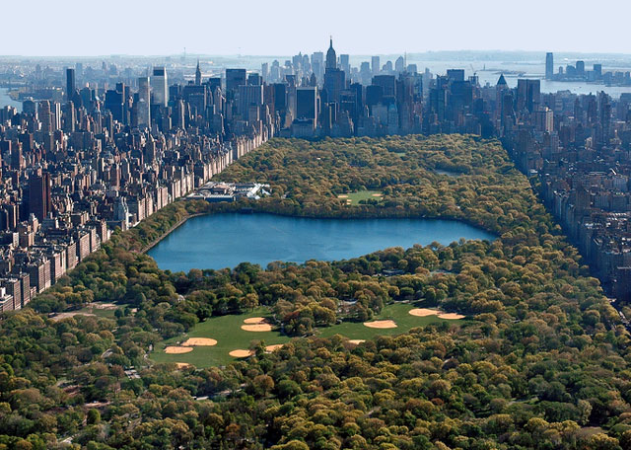
The dynamics in both human systems and natural systems are affected by the interactions between them.
These forest patches will “act” differently because of the differences in the anthromes that surround them.

Slide 30
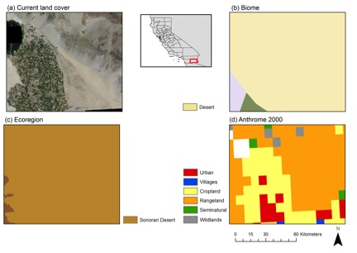

Slide 31
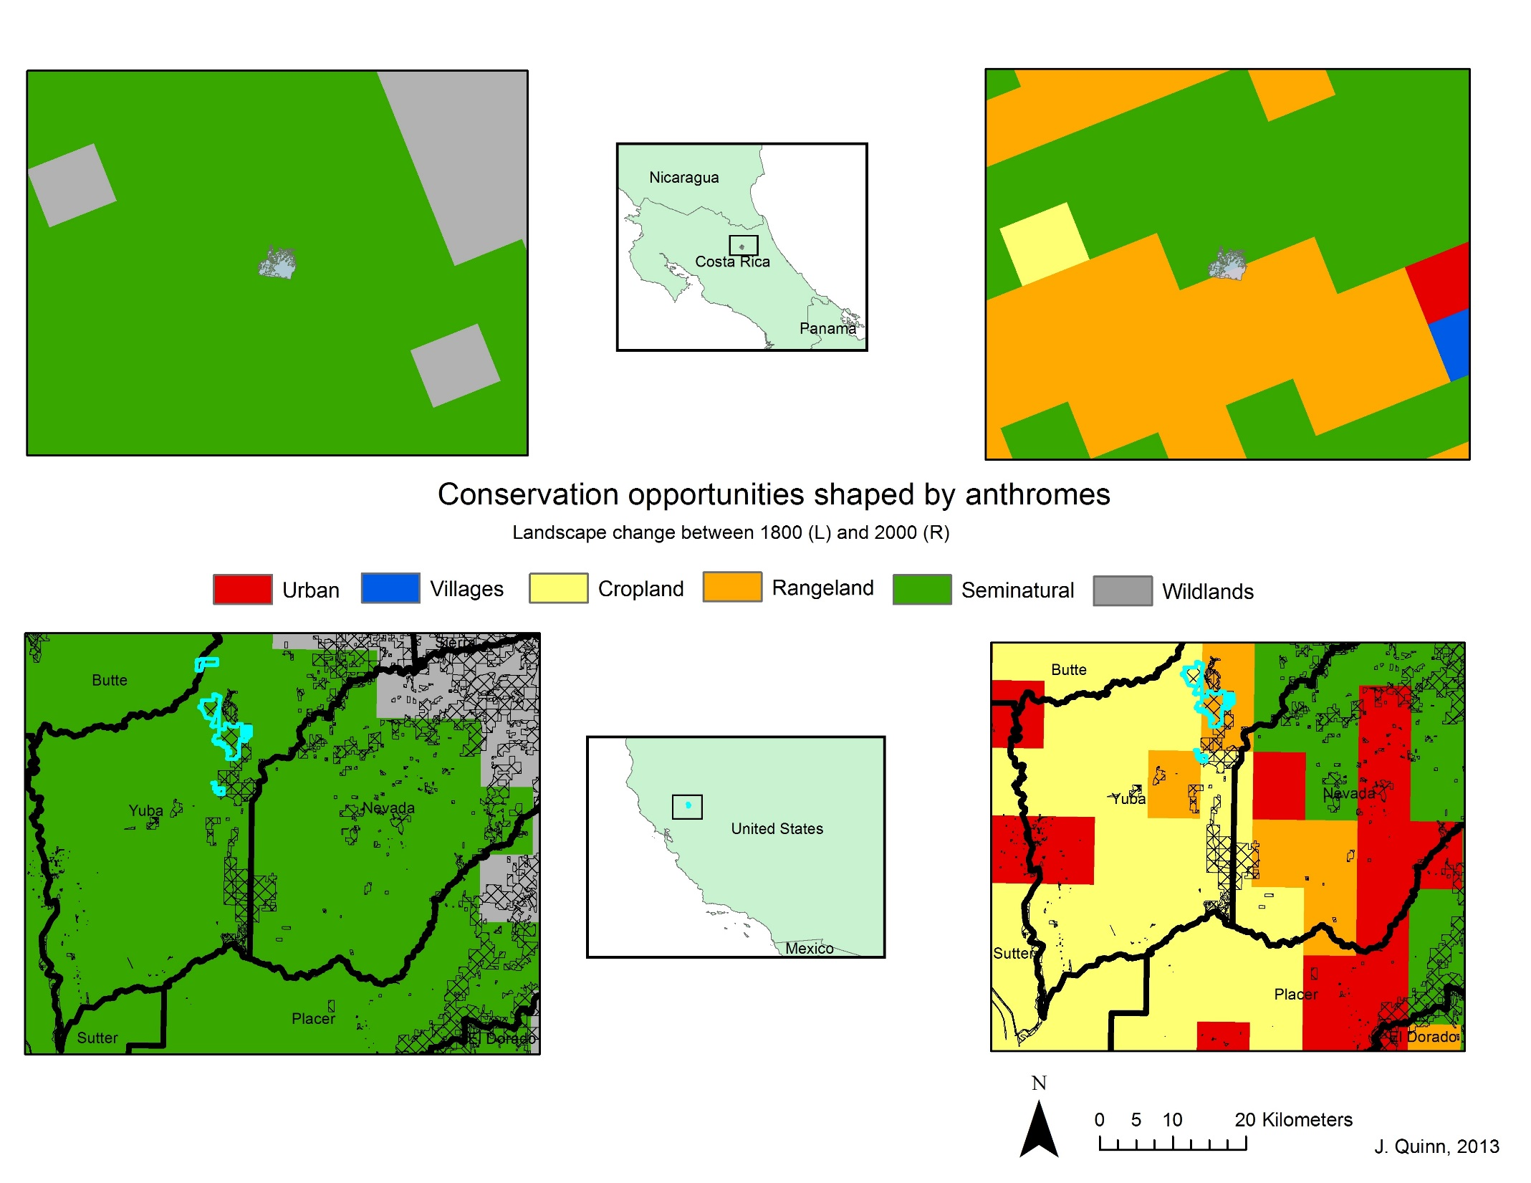

Slide 32
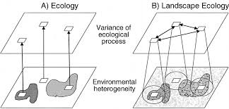
We will return to these considerations at the end of the course…

