Slide 1
Ecological Refugees
By: Coralia Balasca

Slide 2
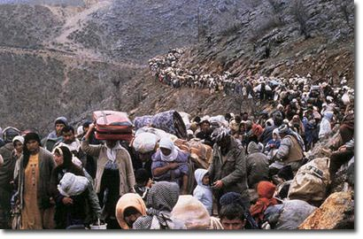
Ecological Refugees: Defined
Displaced persons who are forced to leave their location due to an environmental disruption or depletion

Slide 3
What effects cause people to become ecological refugees?

Slide 4
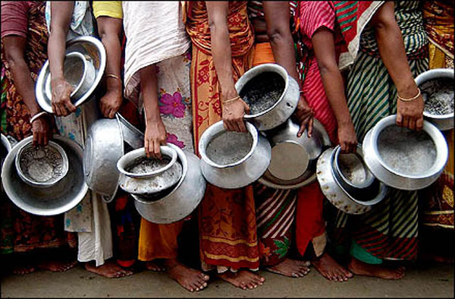
Direct Effect 1: Food and Water Shortages

Slide 5
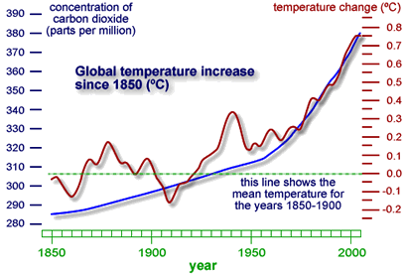
Direct Effect 2: Gradual Climate Change
desertification
sea level rise

Slide 6
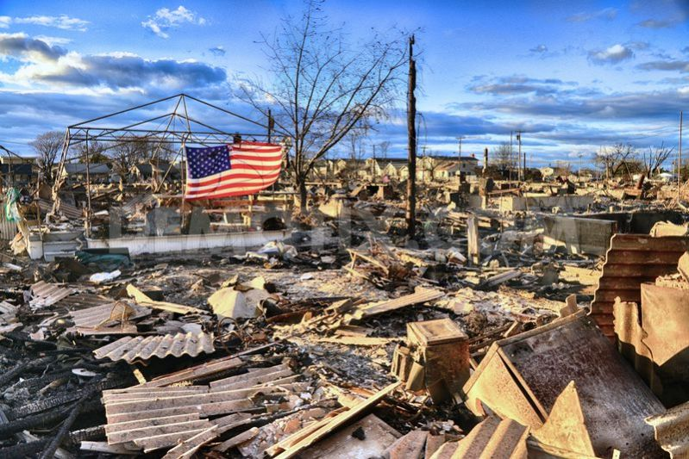
Direct Effect 3: Instant Climate Change
hurricane
floods
damaging storms

Slide 7
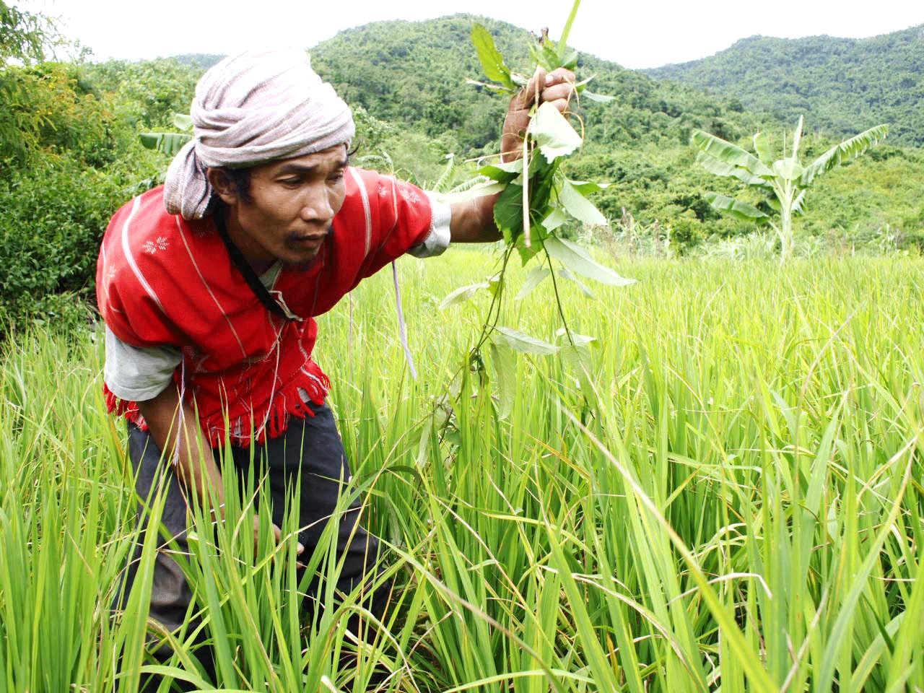
Indirect Effect 1: Loss of Livelihood
directly connected to previous three types that cause a person not to be able to earn a sustainable living

Slide 8
Soo….
ARE ECOLOGICAL REFUGEES AN OVERALL POSITIVE OR NEGATIVE THING?

Slide 9
Positives
brings new skills and knowledge into host community
increases local markets and reduces commodity prices

Slide 10
Negatives
depletion of certain resources
competition for land
uncompensated public expenditure
available land area decreasing throughout the world

Slide 11
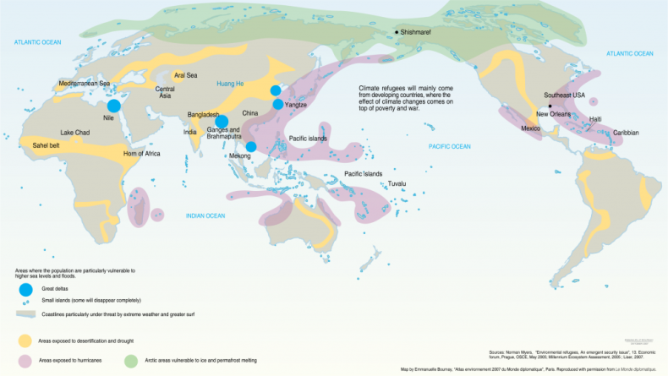
In Conclusion
While there are both negatives and positives to ecological refugees, the negatives outweigh the positives with an eye to the future

Slide 12
Why does this matter?
“In 2020, the UN has projected that we will have 50 million environmental refugees”

Slide 13
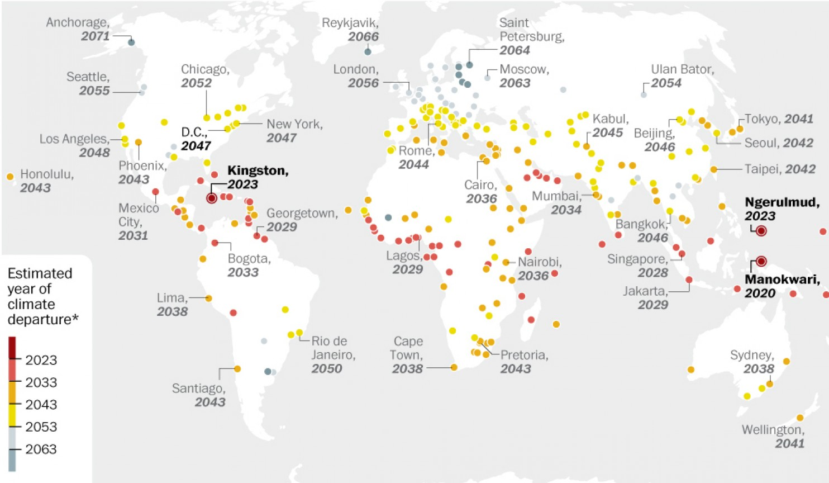
Why does this matter continued...

