Slide 1
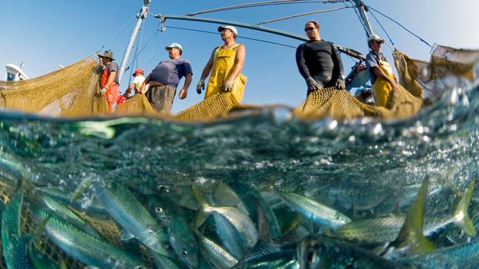
State of the World’s Fisheries
Jack Morgan
http://www.bbc.com/future/story/20120920-are-we-running-out-of-fish
Notes:
A fishery (an area with high abundances in select stocks of fish that we harvest locally or commercially for consumption or to create other products)
There are both inland (freshwater) and marine fisheries.

Slide 2
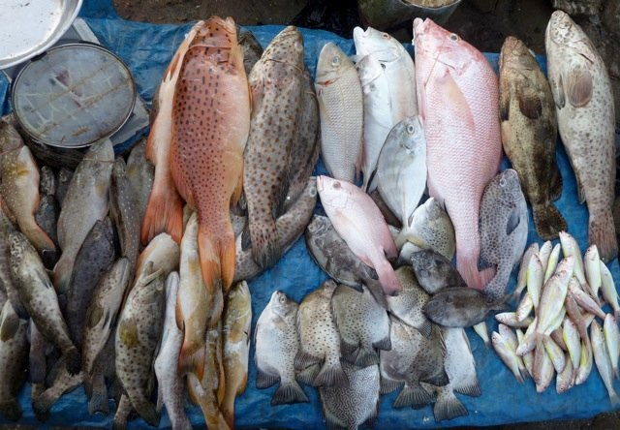
Importance of Fish
Ecological
Societal and Cultural
-19.2 kg consumed/year
-91.3 million tonnes harvested in 2012
-58.3 million employed
-200 countries
-129.2 billion US dollars
https://www.st.nmfs.noaa.gov/Assets/international/capacity/indonesia/12-fish%20diversity%20at%20market.jpeg
Notes:
Fish are a highly diverse group of organism that exhibit a wide variety of morphologies, sizes, behaviors. They are highly prolific, and can be found in nearly all bodies of water both fresh and salt no matter the environmental conditions. They are integral parts of aquatic food webs as both prey and effective predators.
People consume fish as a form of nutrition (high in proteins and vitamins, low in fats). 19.2 kg eaten by the average person a year. As the human population grows, they will continue to be an important source of food.
Large economic impact as well. 91.3 million tons gathered by the fishing industry which employs 200 million+. Global trade: Around 200 countries export fish and fish products.

Slide 3
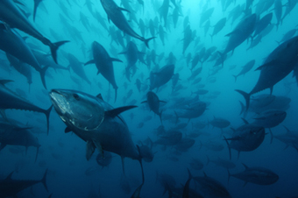
Health
Stocks are in decline
1. Human Water Usage
2. Overfishing
http://conservationbiologyforall.blogspot.com/2012/12/cascading-effects-of-overexploitation.html
Notes:
All around the world, scientists and fishermen are noticing a decline in the health and abundances of fisheries.
Two contributing factors are water allocations by human societies and overfishing.

Slide 4
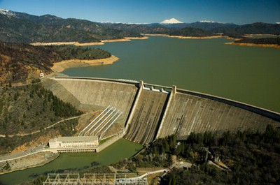
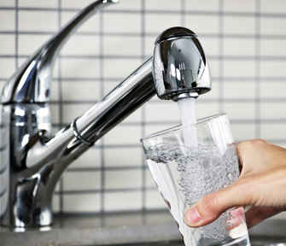
Water Usage
Irrigation
Drinking Water
Energy
Waste Management
http://www.artinaid.com/wp-content/uploads/2013/03/Presa-de-Agua.jpg
http://www.scruffytv.com/home/wp-content/uploads/water-infrastructure2.jpg
Notes:
Much infrastructure of modern nations (irrigation, drinking source, energy, waste management) require large amounts of water. As we draw millions of gallons away from freshwater sources, build dams and channel, and dump pollution we greatly reduce the health of these ecosystems. Less durable fish (those needing very clean water or that need the ability to navigate whole river systems) are excluded.

Slide 5
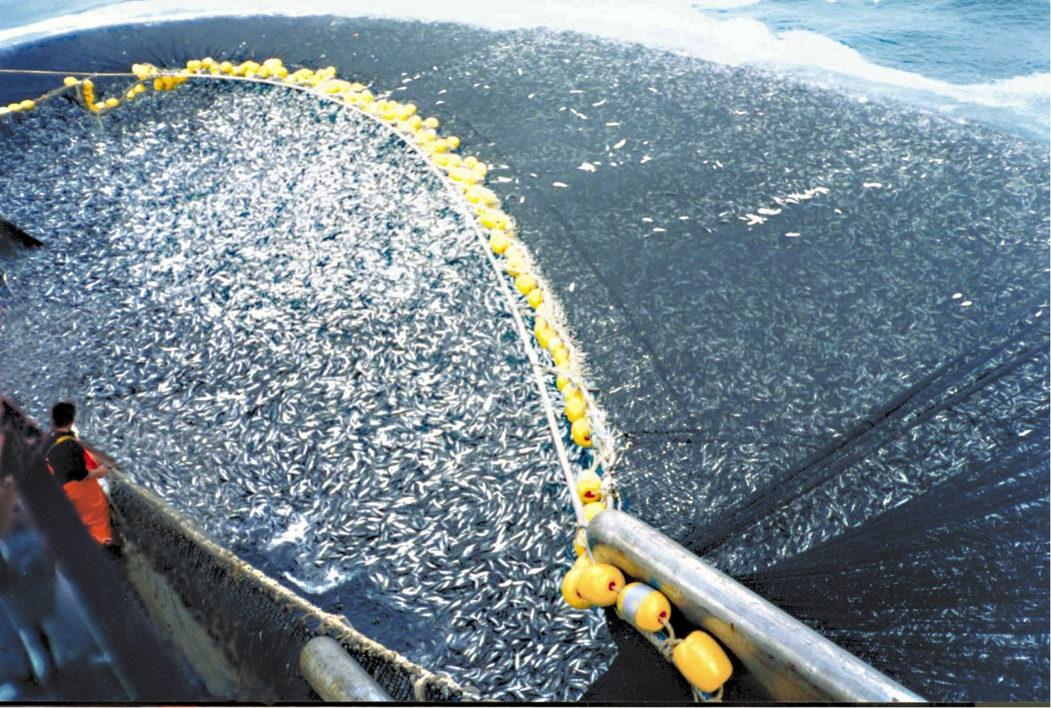
Overfishing
28.8% Over-Exploited
61.3% Fully-Exploited
9.9% Under-Exploited
Reasons:
1. Tech./Methods
2. Overestimation
http://www.photolib.noaa.gov/htmls/fish2172.htm
Notes:
Overexploiting 28.8 percent of the world fisheries. Overexploitation is considered the removal of fish stocks below the maximum sustainable yield. (the amount of individuals that can be taken from a population without affecting its growth rate). Of the 71.2 percent not over exploited 61.3 are fully exploited and no more room for development.
Species in serious trouble include anchovy, Alaskan pollack, Atlantic herring, chub mackerel, and many varieties of tuna.
Areas in the most rapid decline (catches decreasing the fastest): Mediterranean, the Black Sea, the Southeast Atlantic
Reasons:
technology/methods
Overestimation

Slide 6
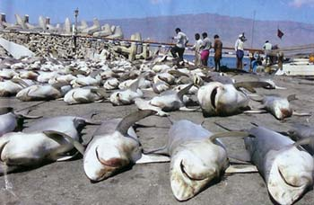
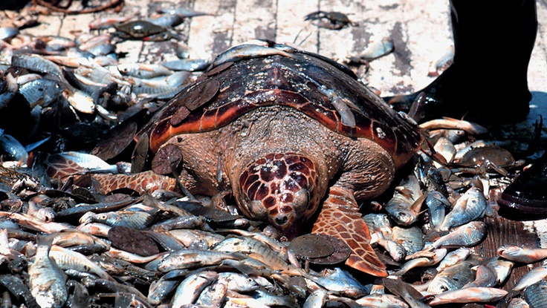
Technology
http://my.telegraph.co.uk/wp-content/blogs.dir/1/user/blueplanet/fish5-uae.gova.jpg
http://www.joeshoulak.com/wp-content/uploads/2013/03/salmon-for-online2011.jpg
http://s1.hubimg.com/u/4552192_f260.jpg
Notes:
Fleets of large commercial fishing vessels have replaced small local fishing boats. These ship are capable of tremendous horsepower, giving them the ability to drag massive trawls, set massive purse seines, and deploy kilometers of drift nets. They have the ability to catch and store thousands of tonnes of fish per run.
Besides being highly effective techniques, many are also destructive and nonselective. Some marine methods such as bottom trawling and dredging(pulling weighted nets along the sea floor) destroys habitat in the sea floor ecosystem making recovery for the fish stock more difficult because many of their resources are disrupted. Likewise other species of non-targeted aquatic organism are captured accidently. The often perish in the process. Many sharks and marine mammals have seen sharp declines because of this.

Slide 7
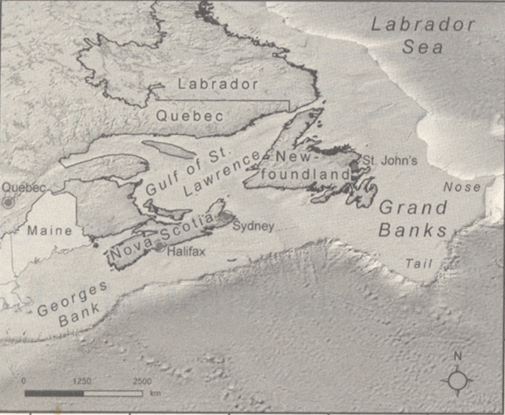
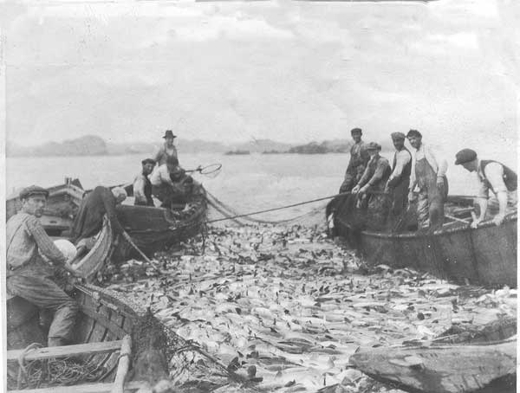
Overestimation
Cod Fisheries/Grand Banks
Monitoring deficiencies
Economic profit
http://www.sjsu.edu/faculty/watkins/grandbanks01.gif
http://2.bp.blogspot.com/-WtfDzZcis3w/Tp9SgW7jW8I/AAAAAAAAHuU/SfD6xpxjMZc/s1600/cod2.jpg
Notes:
They went from being one of the most productive fisheries in the world to totally collapsed by 1992. The abundances of fish stocks was way over estimated by measures of virtual population analysis. Fleet expansion after Canada claimed marine jurisdiction to the area in 1976 quickly depleted the remaining stocks. Besides blindly trusting faulty estimations, the Canadian government was so optimistic about the size and recovery of the stocks due to the prospect of making great economic profit.
Most data from fisheries comes from two sources: fishermen catch records and independent research. If the catches are false (IUU fishing) or data has simply not been collected for long enough, these estimates can be way off.
Fishing is good business because it generates jobs and supports trade. Easy to get caught up making profit until no fish are left.

Slide 8
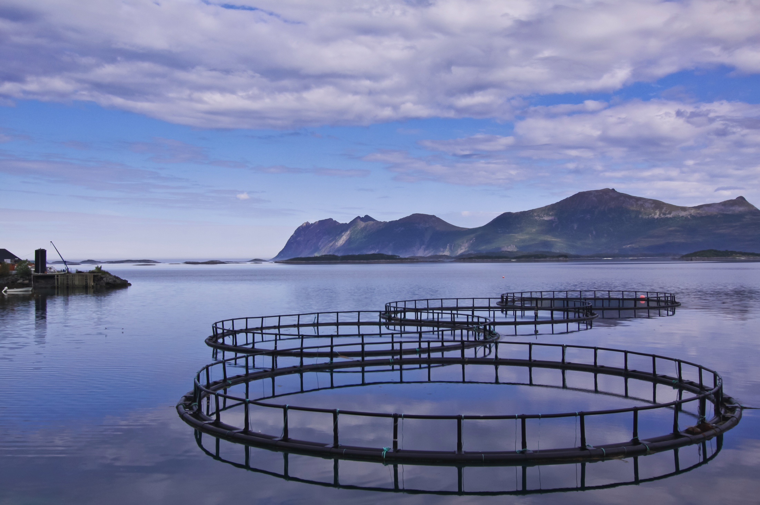
Possible Solutions
Set More Realistic/Sustainable Quotas
Ban Destructive Techniques
Stop IUU Fishing
Protected Areas/Marine Reserves
Aquaculture
http://www.environmental-watch.com/wp-content/uploads/2013/06/shutterstock_88536259.jpg
Notes:
The best way to help the fisheries of the world is to learn how to set more realistic and sustainable quotas. With more research we can assure fish stocks are not haversted below their maximum sustainable yield.
Destructive harvesting techniques by fishermen and IUU fishing must be stopped too. Methods, such as bottom trawling, are devastating to fisheries because they not only remove large fish stocks but the also disturb the ecosystems where they are implemented, making both the recovery for the target stocks and life for other aquatic organisms more difficult.
IUU fishing not only removes stocks from an area without any legal claim contributing to other issues such as marine jurisdiction and malnutrition, but also it takes unknown quantities of fish from fisheries. Without accurate knowledge of the number of fish being taken from an area, unreliable information can be published leading to overestimations on stock sizes and decline in fish stocks.
It is important that we set aside certain amounts of land/ocean to protect both inland and marine fisheries. Only 1% of the world’s oceans are protected in reserves. These areas could give relief to fish stocks under a lot pressure and make sure habitats with high biodiversity (coral reefs) are undisturbed. For inland fisheries, the surrounding waters and land can be set aside. National parks.
Aquaculture, more widely known as fish farming is the raising of commercial fish stocks either in manmade or natural bodies of water utilizing containment. This industry is highly effective; 41.9 and 24.7 million tonnes of inland and oceanic fish respectively were raised in farms that contribute to 42% of fish reaching the market. There are many problems that have made activist groups criticize the business such as sanitation, genetic modifications, and waste production. Still with the amounts of product produced, fish farming will become more prevalent in the future.

Slide 9
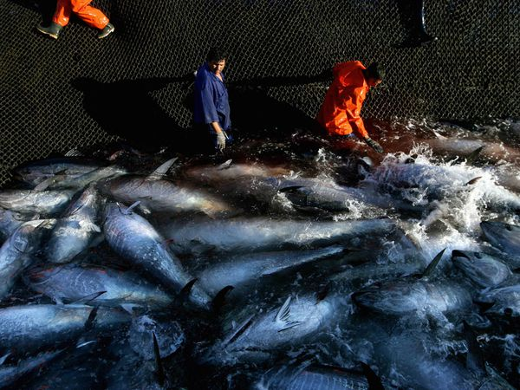
Thanks
http://ocean.nationalgeographic.com/ocean/critical-issues-overfishing/

