Slide 1
Crop Genetic Diversity

Slide 2
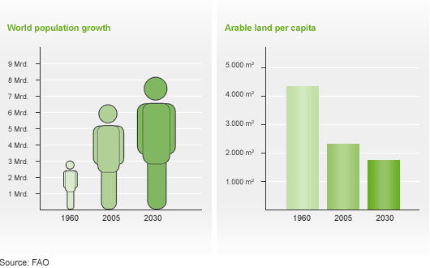
Growing Demand for Crops and Increasing Population
Currently 3 billion people are not getting the nutrients they need.
The world population is expected to increase to 9 billion in coming decades
Demand for crops will only increase .

Slide 3
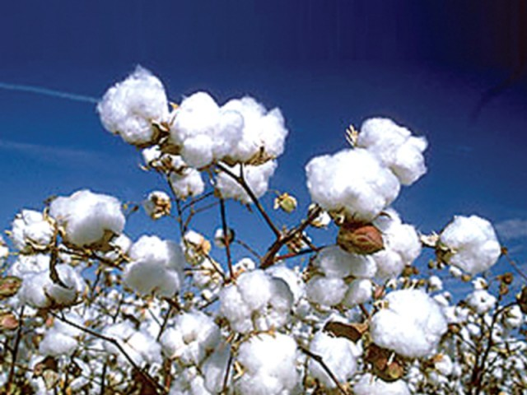
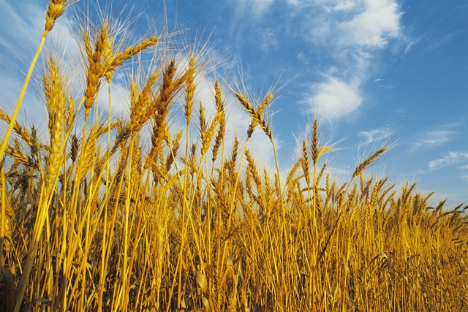
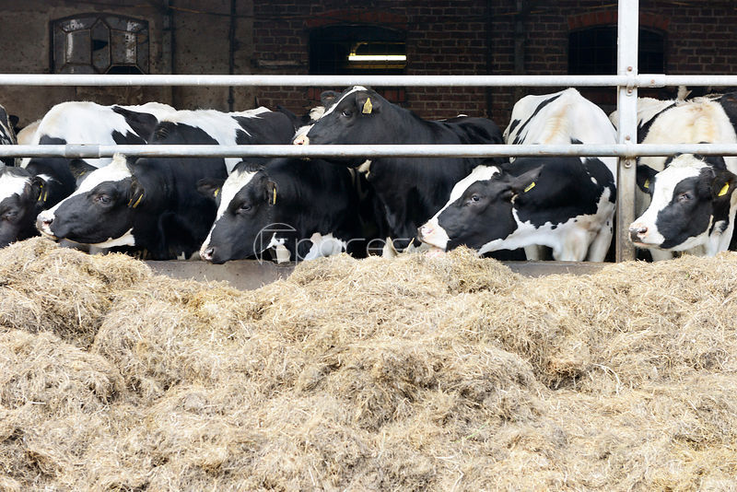
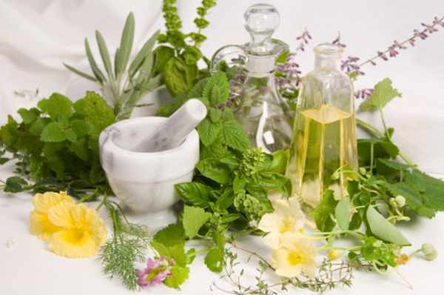
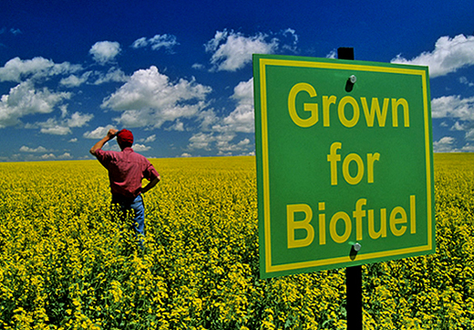
Uses of Crops

Slide 4
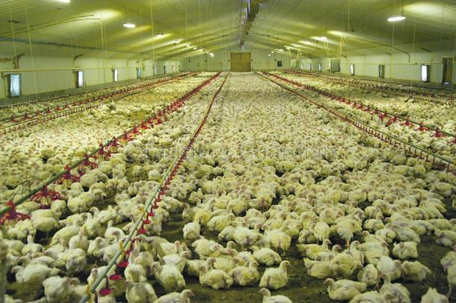
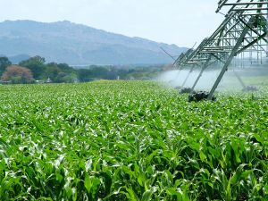
Economy Selecting for Greatest Agricultural Outputs with Fewest Inputs

Slide 5
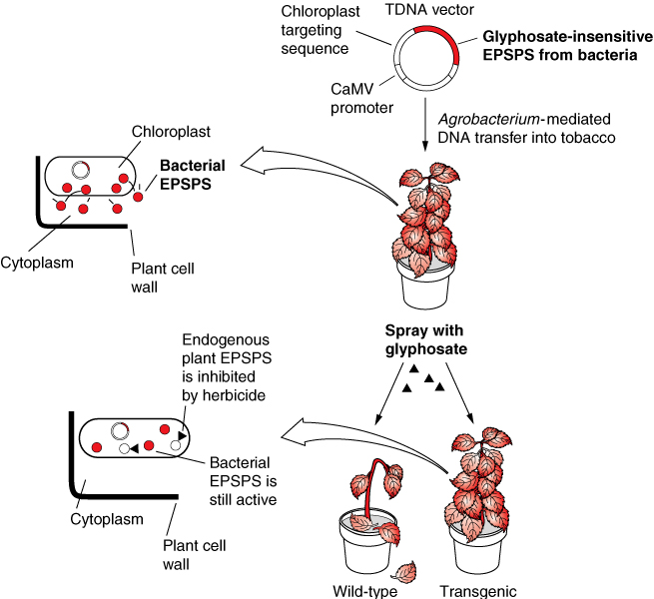
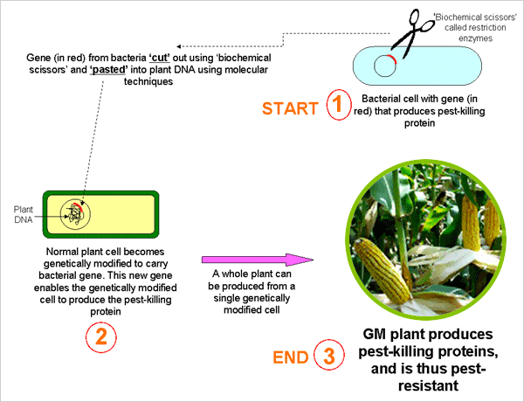
GMOs

Slide 6
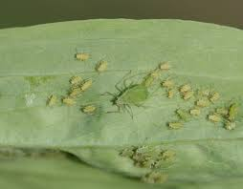
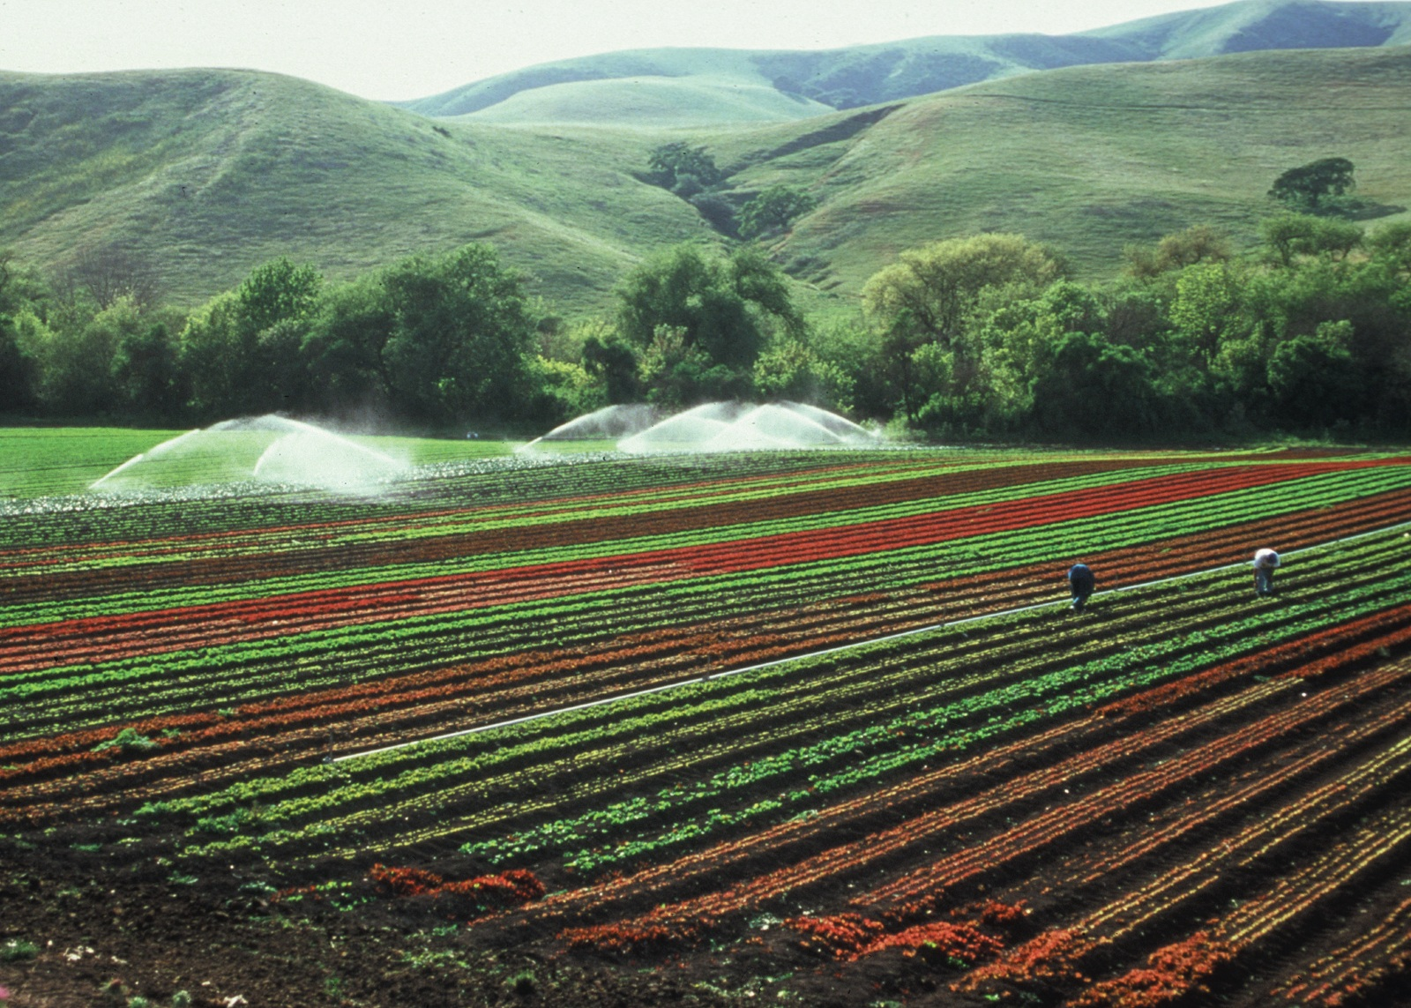
Pros
Pest resistance
Disease resistance
Temperature resistance
Efficient use of resources → increased food supply
Added nutrition

Slide 7
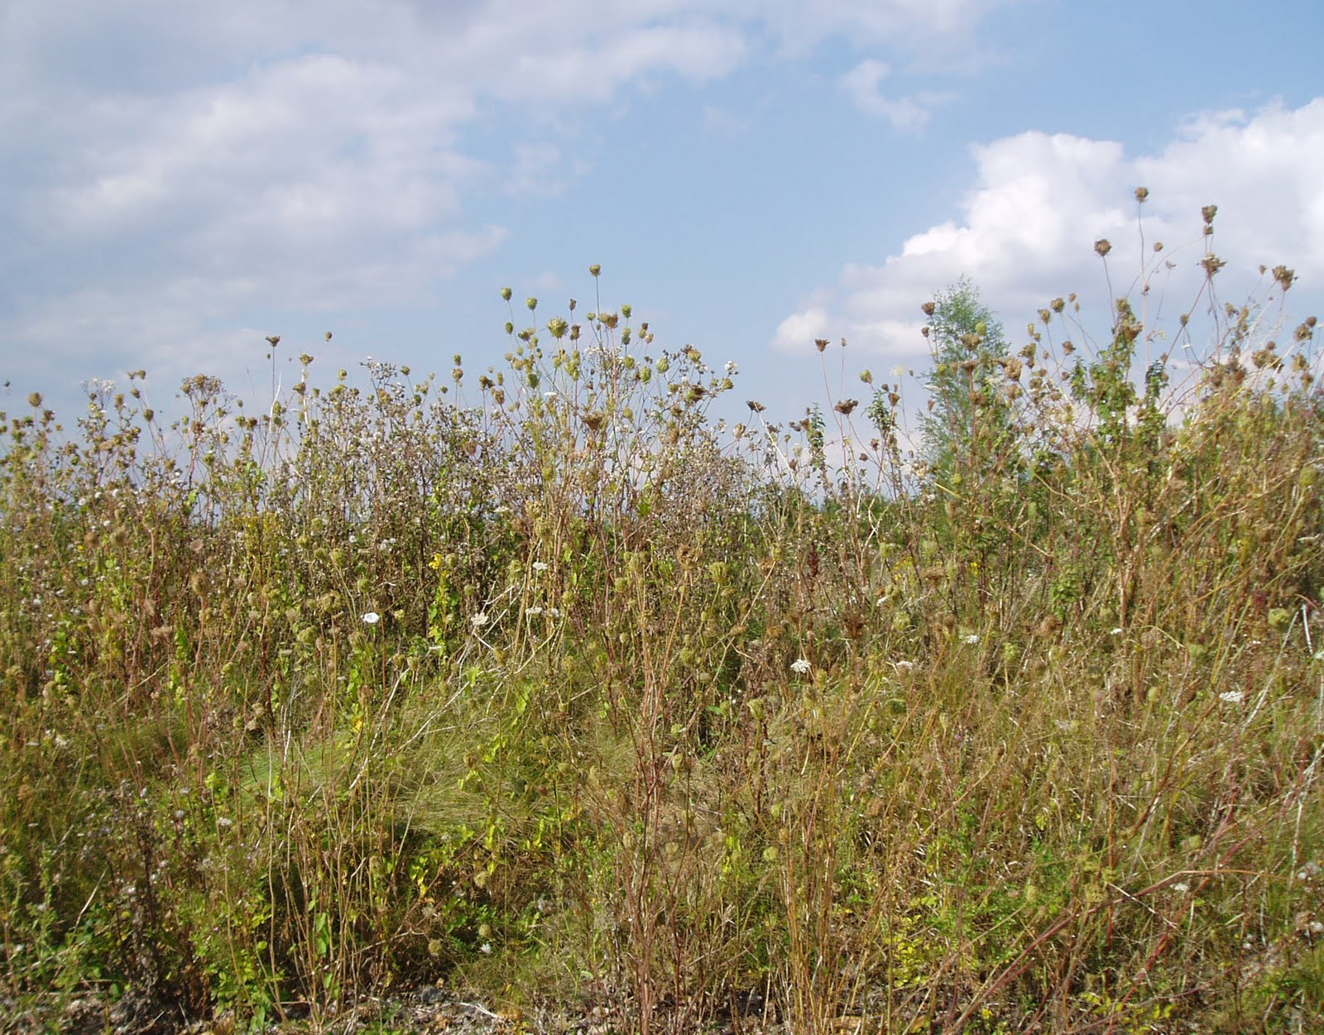
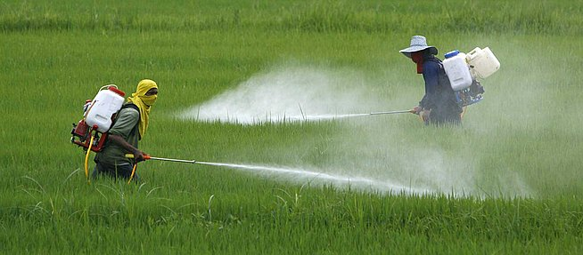
Cons
Toxins
Potential allergens
Biodiversity of wild crop relatives threatened
Monocultures
Wealth distribution gap between small and large farmers

Slide 8
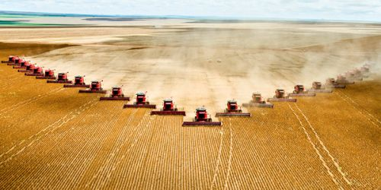
Monocultures

Slide 9
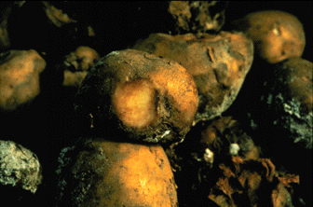
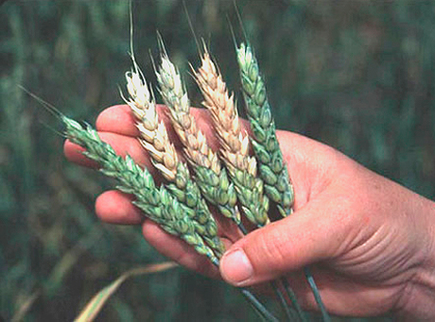
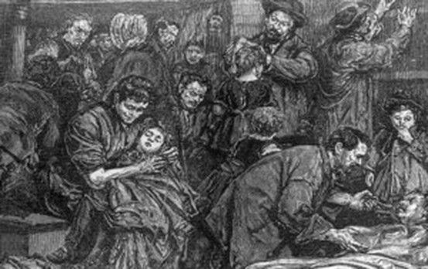
How Monocultures Apply
Irish Potato Famine
Fusarium Head Blight

Slide 10
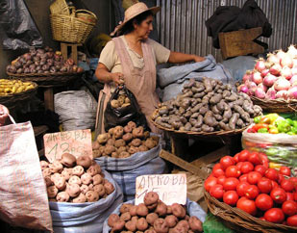
Agrobiodiversity Solutions
Agricultural biodiversity refers to all components of biodiversity as it relates to food and agriculture, which includes the use and maintenance of cultivated crops along with their wild crop relatives (WCRs).
High biodiversity
High resilience

Slide 11
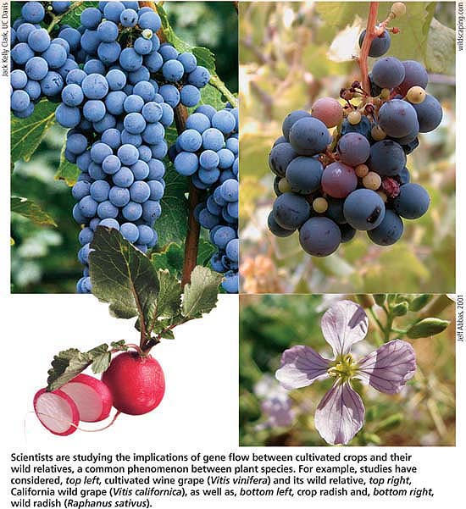
Pros
Natural pest control
Natural disease control
More nutrients
Sustainable solution

Slide 12
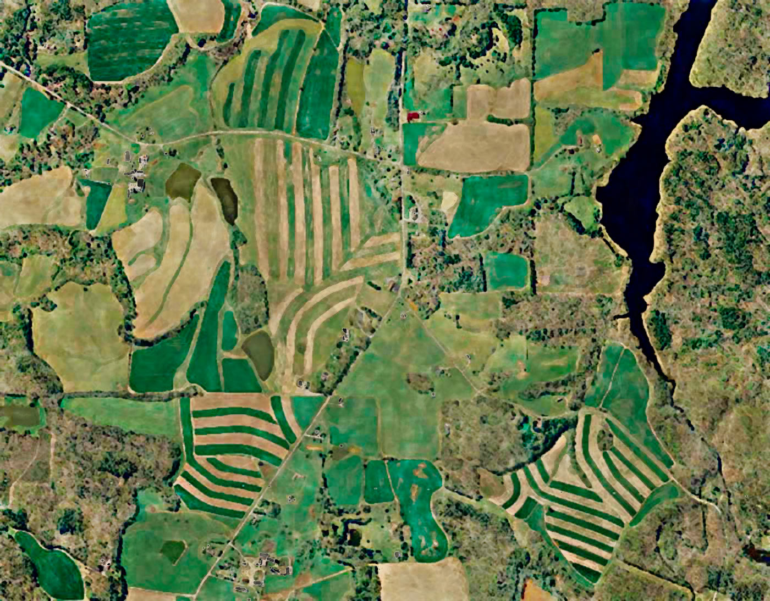
Cons
Less efficient than GMOs and monocultures
More land use → decreased biodiversity in surrounding landscape
Difficulty managing CWR reserves

Slide 13
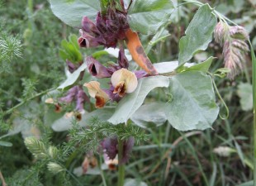
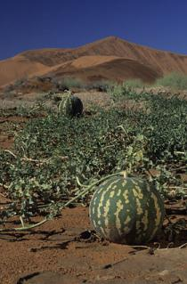
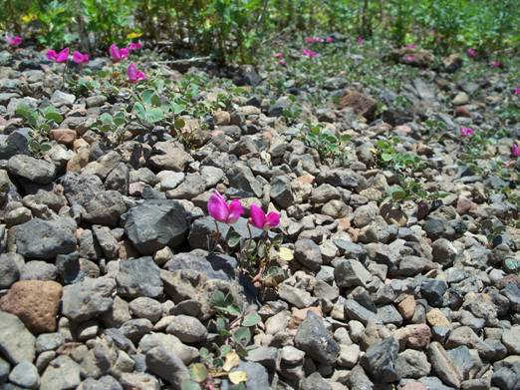
In-situ Conservation

Slide 14
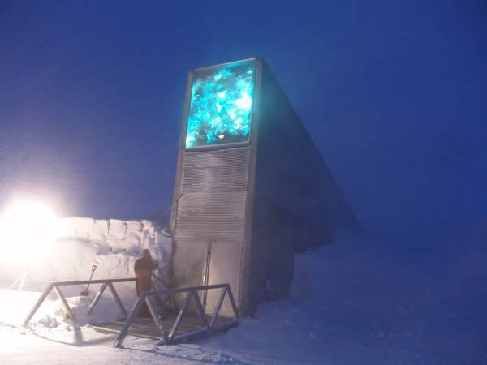
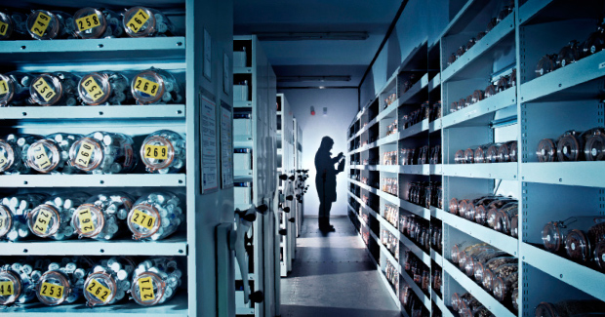
Ex-situ Reserves

Slide 15
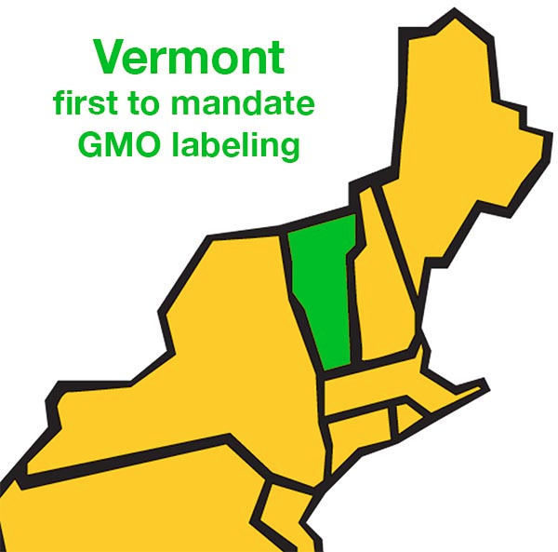
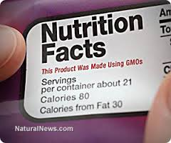
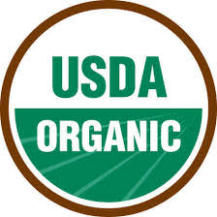
Moving Toward Crop Genetic Diversity

