Slide 1
Sea Level Changes
Lisa Snodgrass

Slide 2
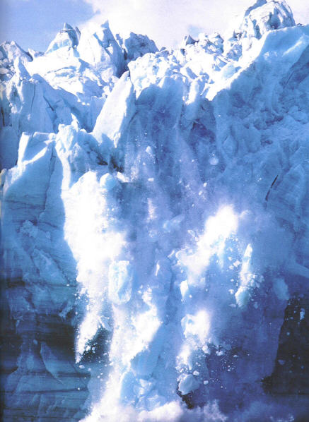
Causes
Global Warming
Thermal Expansion
Glacial/Ice Sheet Melting

Slide 3
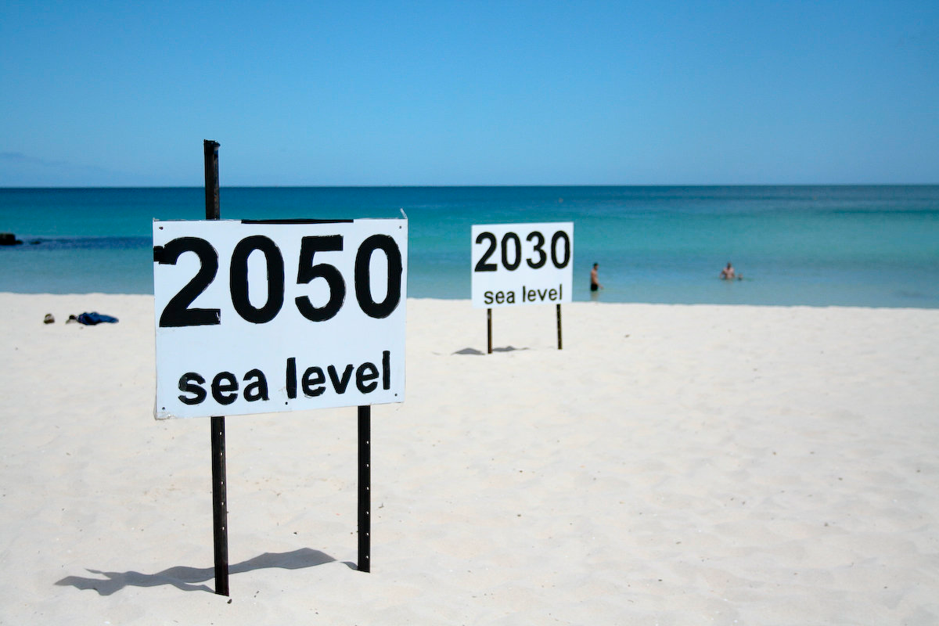
Future Trends in Rising Seas
Complications with MSL
Rise 1-7 ft by 2100
Potentially 11in with no human emissions
Highly unfeasibly

Slide 5
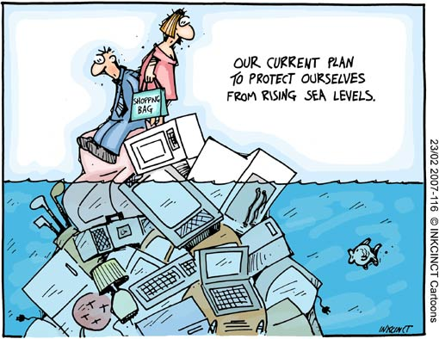
Effects on Human Population
Climate refugees
Agriculture and aquaculture losses
World food crisis
Loss of tourism and
recreation

Slide 6
Environmental Impacts
Flooding
Declination in soil quality
Coastal erosion
Inhibition of primary production systems
Changes in surface and ground water
Loss of land habitat

Slide 8
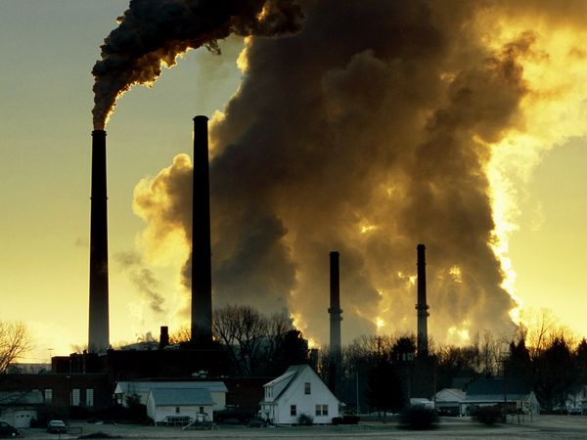
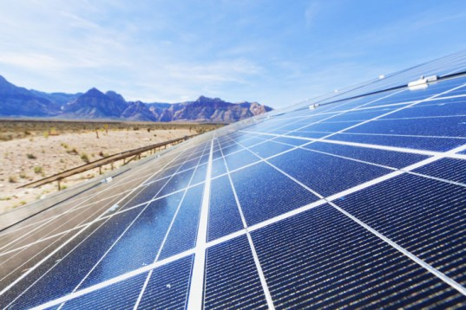
Necessary Change
Greenhouse gas emissions
Alternative energy

Slide 9
Questions? Comments? Concerns?
Thank you!

Slide 10
Work Cited
"Climate Change: Basic Information." EPA. Environmental Protection Agency, n.d. Web. 29 Nov. 2014.
"Climate Change: Basic Information." Sea Level Rise. Environmental Protection Agency, n.d. Web. 01 Dec. 2014.
"FAQ 5.1 ﻿﻿Is Sea Level Rising?﻿." FAQ 5.1. Intergovernmental Panel on Climate Change, n.d. Web. 02 Dec. 2014.
"Is Sea Level Rising?" Is Sea Level Rising? National Oceanic and Atmospheric Administration, n.d. Web. 30 Nov. 2014.
"Sea Temperature Rise -- National Geographic." National Geographic. National Geographic, n.d. Web. 01 Dec. 2014.
AMAP, 2012. Arctic Climate Issues 2011: Changes in Arctic Snow, Water, Ice and Permafrost. SWIPA 2011 Overview Project. Arctic Monitoring and Assessment Program (AMAP), Oslo. xi + 97pp.
Walsh, John, and Donald Wuebbles. "Menu." Sea Level Rise. U.S. Global Change Research Program, n.d. Web. 01 Dec. 2014.

