Slide 1
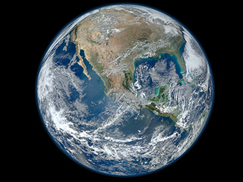
Does life simply live on an environmentally static Earth, or does life determine the Earth’s environment?

Slide 2
Does life simply live on an environmentally static Earth, or does life determine the Earth’s environment?
If life changes on the Earth, the conditions on Earth won’t change
If life changes on the Earth, the conditions on Earth will change

Slide 3
Does life simply live on an environmentally static Earth, or does life determine the Earth’s environment?
If life changes on the Earth, the conditions on Earth won’t change
If life changes on the Earth, the conditions on Earth will change
What is the Earth’s environment like, and why?

Slide 4
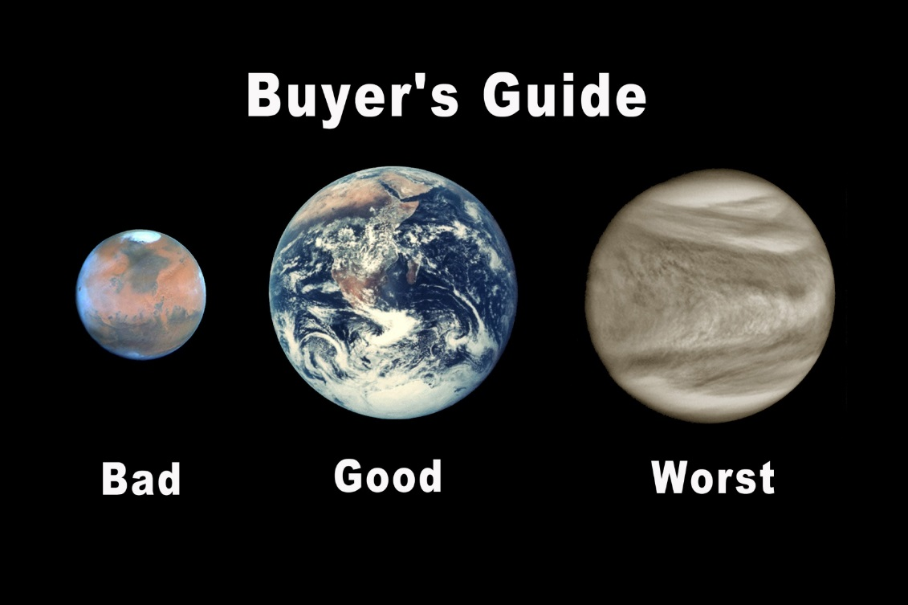
Lecture I: The Water Planet
II. The Earth and its Neighbors
A. Size and Temps
-153 – 20ºC
-88 – 58ºC
462ºC

Slide 5
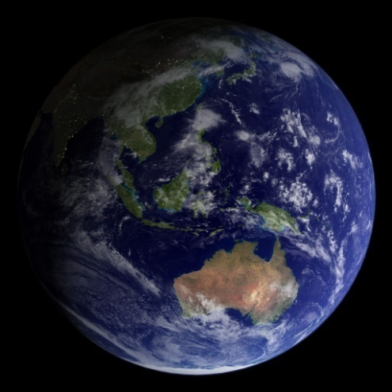
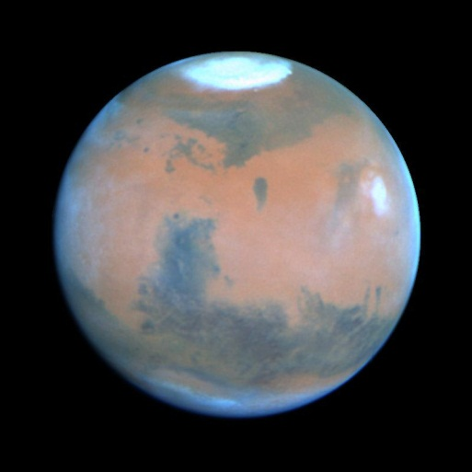
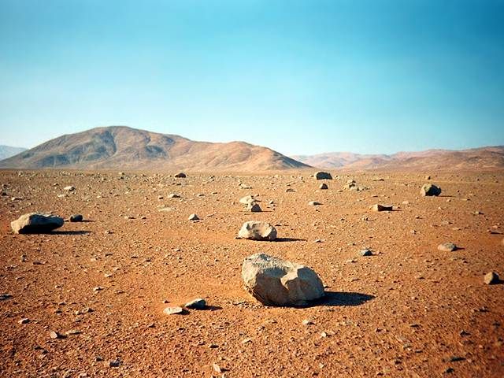
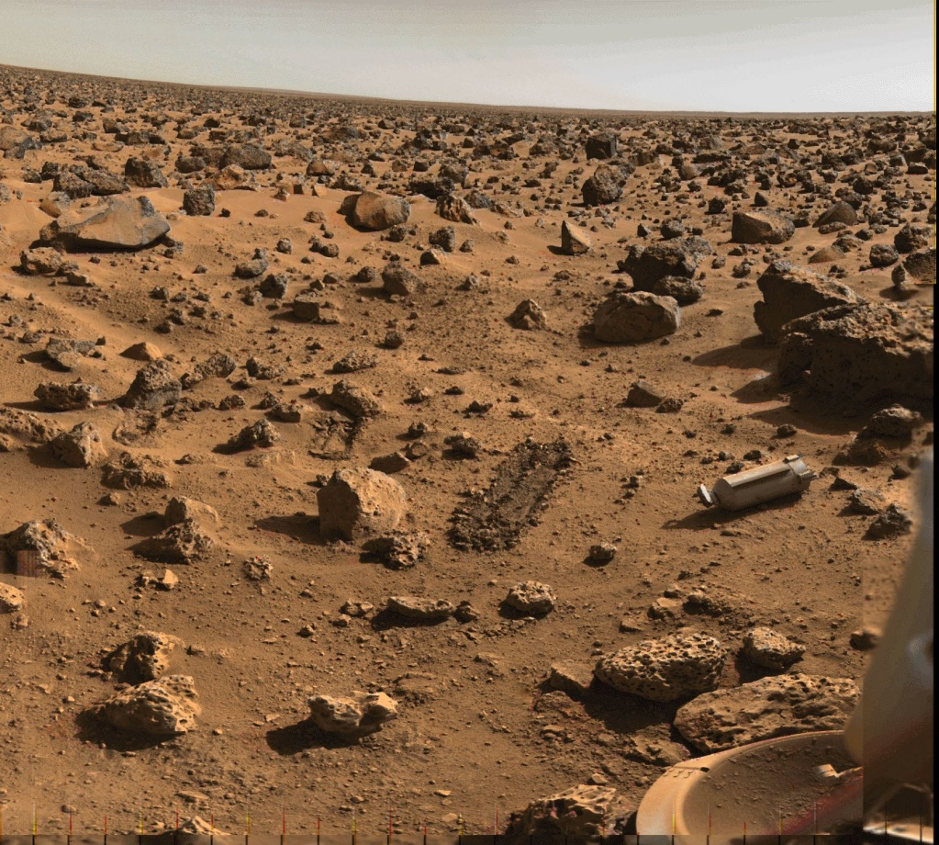

Slide 6
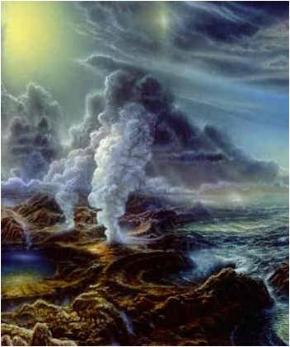
Lecture I: The Water Planet
II. The Earth and Its Neighbors
A. Size and Temps
B. Atmospheric Composition
 | Earth | Venus | Mars
CO₂ | 0.035% | 96% | 95%
N₂ | 77% | 3.5% | 2.7%
H₂O | 1% | 0.01% | 0.007%
Ar | 0.93% | 0.007% | 1.6%
O₂ | 21% | trace | trace

Slide 7
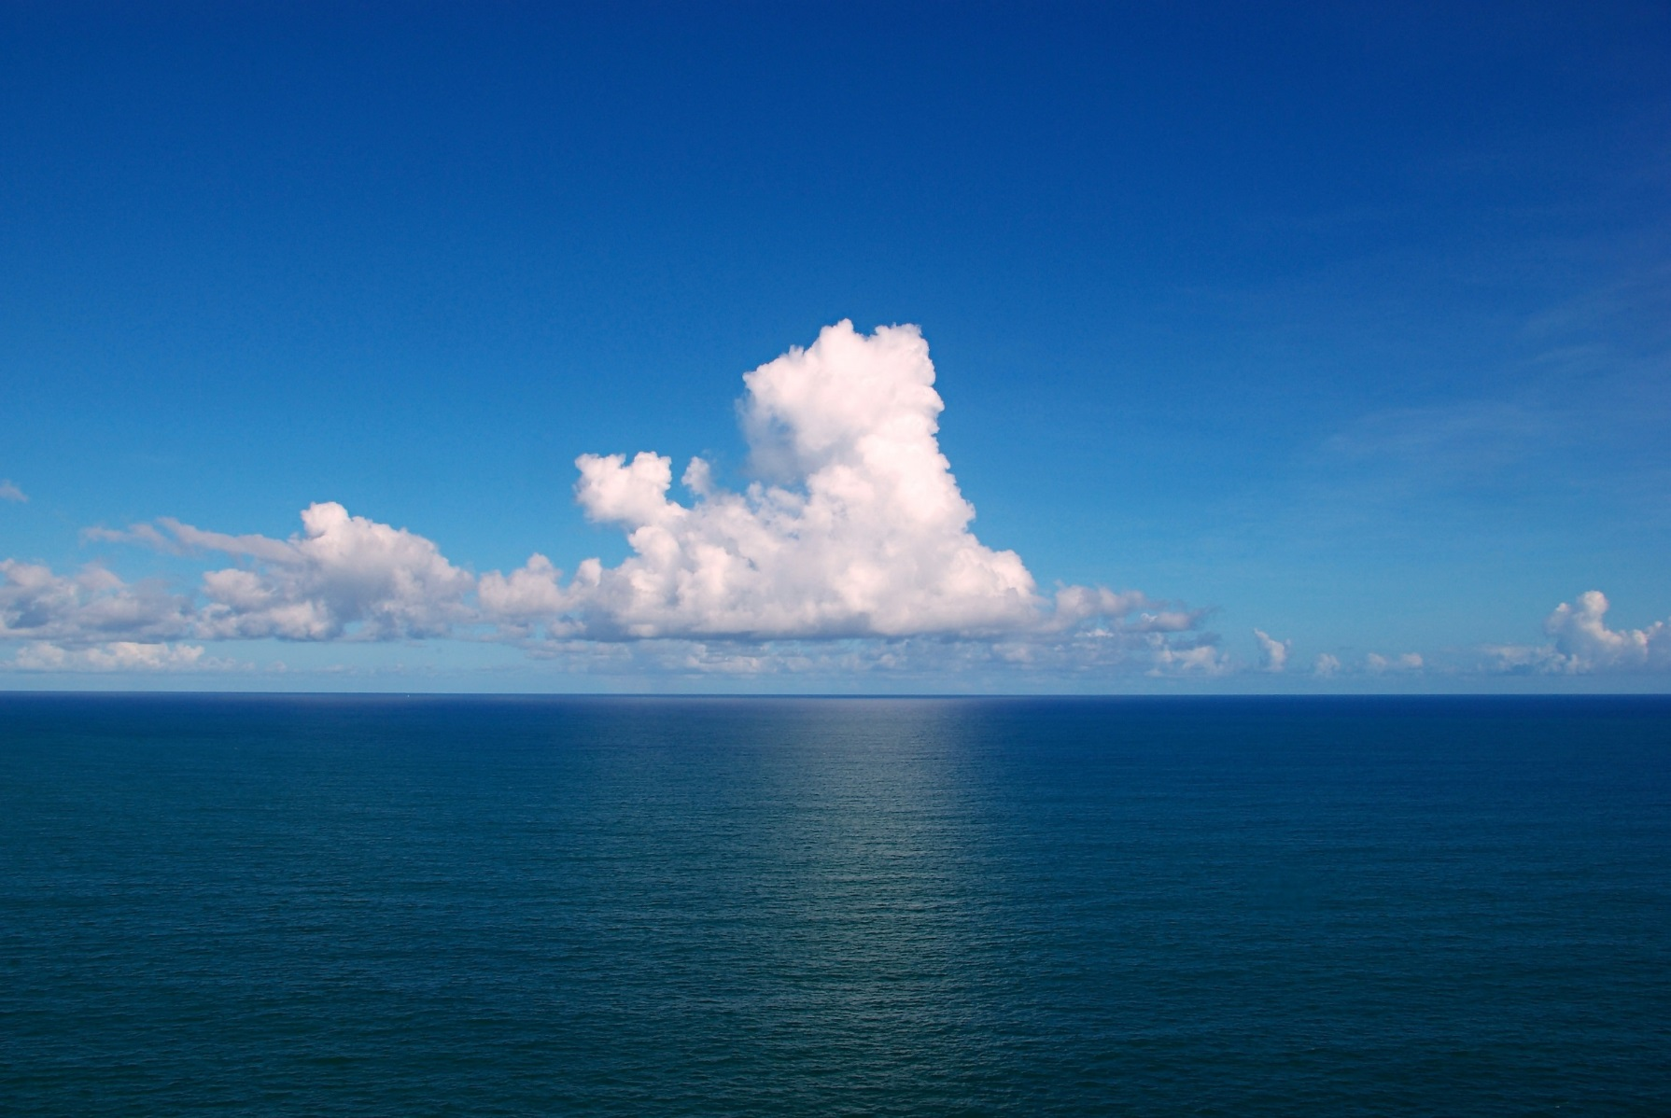
Lecture I: The Water Planet
II. The Earth and Its Neighbors
III. Why The Differences?
A. The Effects of Liquid Water
About 4.4 bya, the period of heavy asteroid bombardment ended, and water could collect at the surface without being vaporized by meteorite impacts.

Slide 8
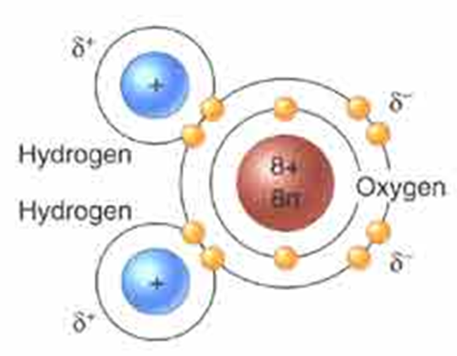
Lecture I: The Water Planet
III. Why The Differences?
A. The Effects of Liquid Water
1. Water’s molecular structure

Slide 9
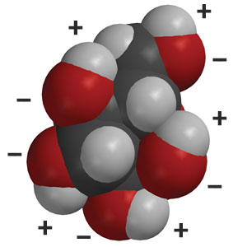
Lecture I: The Water Planet
The Earth and Its Neighbors
Why The Differences?
A. The Effects of Liquid Water
1. Water’s molecular structure
2. Water is called the “universal solvent”
- ions and polar compounds dissolve in water
Charged regions of a glucose molecule

Slide 10
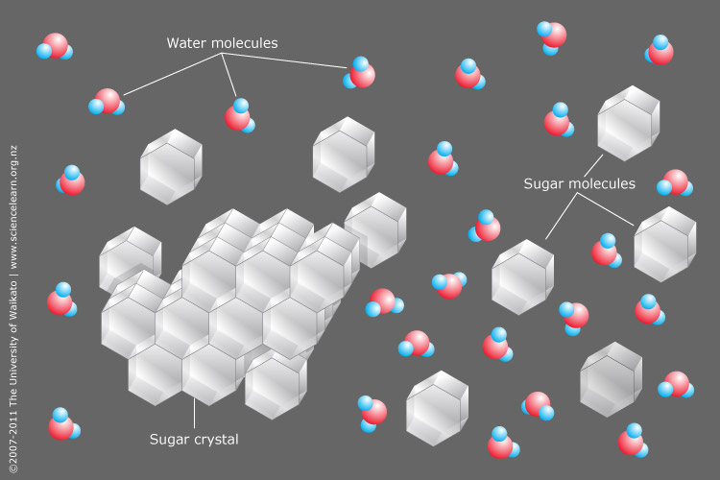

Slide 11
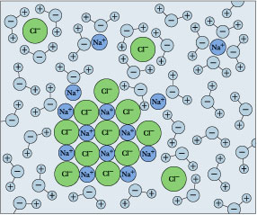
Lecture I: The Water Planet
III. Why The Differences?
A. The Effects of Liquid Water
1. Water’s molecular structure
2. Water is called the “universal solvent”
- ions and polar compounds dissolve in water

Slide 12
Lecture I: The Water Planet
III. Why The Differences?
A. The Effects of Liquid Water
1. Water’s molecular structure
2. Water is called the “universal solvent”
- ions and polar compounds dissolve in water
- Rocks are composed of ionic compounds (minerals)
- So many rocks dissolve

Slide 13
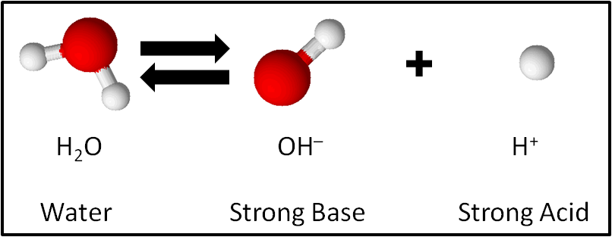
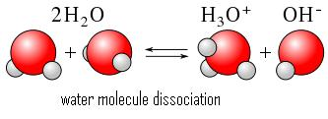
Lecture I: The Water Planet
III. Why The Differences?
A. The Effects of Liquid Water
1. Water’s molecular structure
2. Water is called the “universal solvent”
3. Water dissociates
Hydronium:
Oxygen: 8 protons, 2e first shell, 8 second
3 H: 3 protons
Total: 11 protons, 10 electrons = +1 charge
(will readily give up H+ ion
Hydronium can give up an H+, so same net effect as above…

Slide 14
Lecture I: The Water Planet
III. Why The Differences?
A. The Effects of Liquid Water
1. Water’s molecular structure
2. Water is called the “universal solvent”
3. Water dissociates
In pure water, 1 in 10,000,000 (1 x 10⁻⁷) molecules will be dissociated at any one time
The “power” (in terms of exponent) of Hydrogen… you can think of it as percent or proportion of H+.
pH scale is negative exponent… so water = 7.0

Slide 15
Lecture I: The Water Planet
III. Why The Differences?
A. The Effects of Liquid Water
1. Water’s molecular structure
2. Water is called the “universal solvent”
3. Water dissociates
17+
1+
HCl (Hydrochloric acid) dissociates much more readily in solution.
1 in 100 molecules are dissociated = 1 x 10⁻²
pH = 2.0

Slide 16
Lecture I: The Water Planet
III. Why The Differences?
A. The Effects of Liquid Water
1. Water’s molecular structure
2. Water is called the “universal solvent”
3. Water dissociates
4. Weathers rock, putting ions into solution
CATION DISPLACEMENT
Feldspar Minerals (60%)
K-Al-Si₃O₈
Na-Al-Si₃O₈
Ca-Al-Si₂O₈
In presence of water, H⁺ replaces K⁺, Na⁺, and CA⁺²

Slide 17
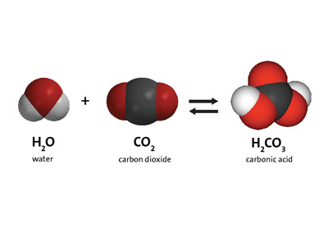
Lecture I: The Water Planet
III. Why The Differences?
A. The Effects of Liquid Water
1. Water’s molecular structure
2. Water is called the “universal solvent”
3. Water dissociates
4. Carbon dioxide reacts with water to form carbonic acid

Slide 18
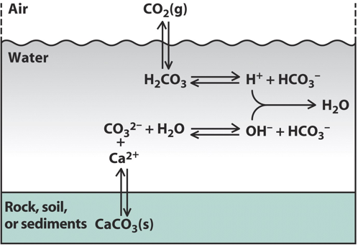
Abiogenic Limestone Formation
Bicarbonate ion
Carbonic acid
Carbonate ion
Calcium Carbonate (limestone)

Slide 19
Abiogenic Limestone Formation
 | Earth | Venus | Mars
CO₂ | 0.035% | 96% | 95%
Bicarbonate ion
Carbonic acid
Carbonate ion
Calcium Carbonate (limestone)

Slide 20
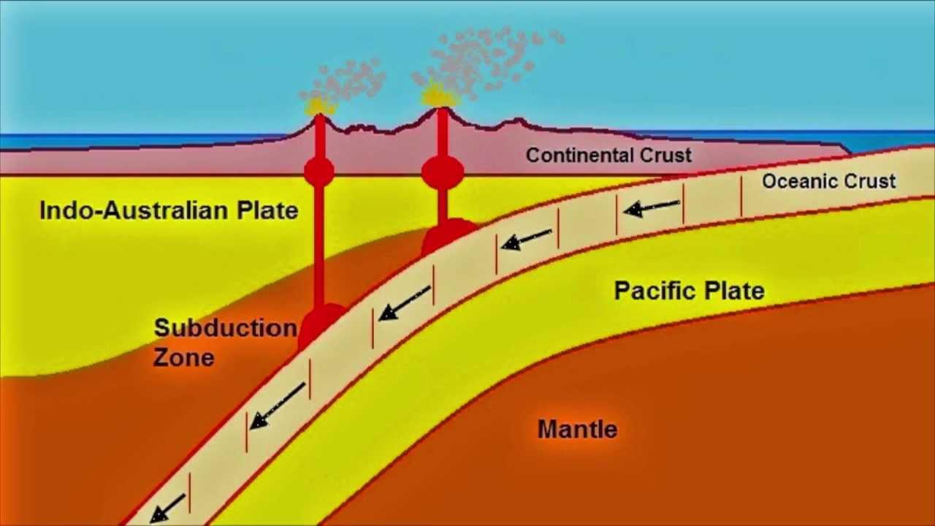
Lecture I: The Water Planet
III. Why The Differences?
A. The Effects of Liquid Water
B. Tectonic Activity and Subduction
Limestone

Slide 21
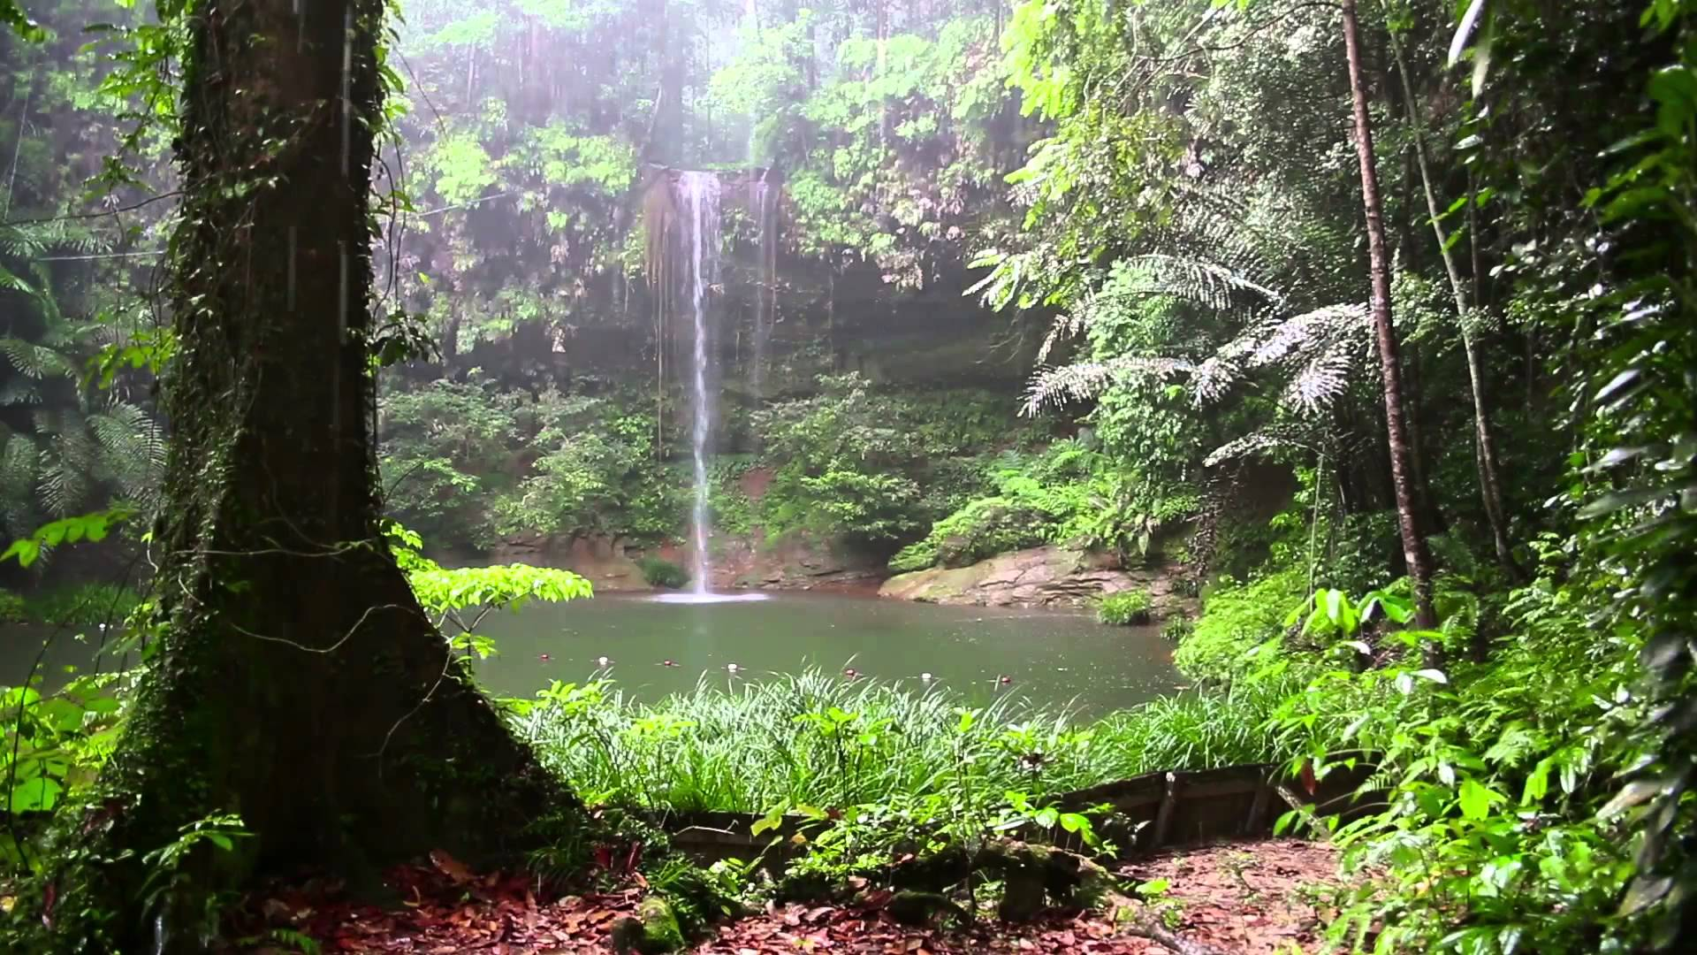

Slide 22
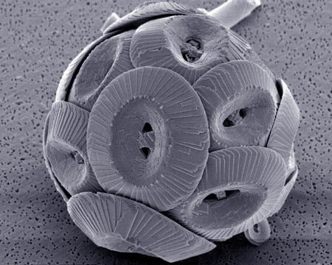
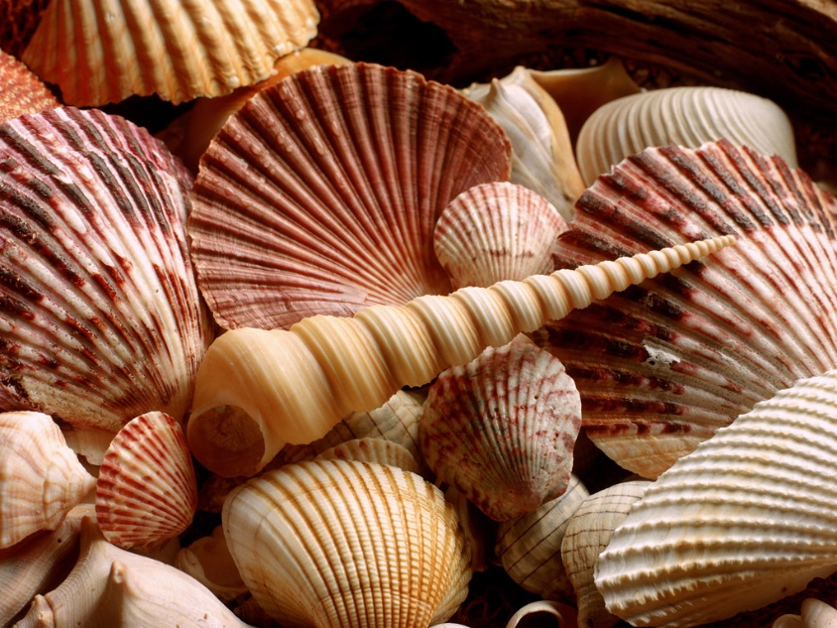
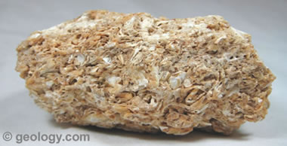
Coccolithophore
(single celled marine algae)
Lecture I: The Water Planet
III. Why The Differences?
A. The Effects of Liquid Water
B. Tectonic Activity and Subduction
C. The Effects of LIFE
1. Biogenic Limestone Formation
“Coquina”

Slide 23
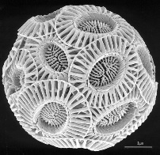
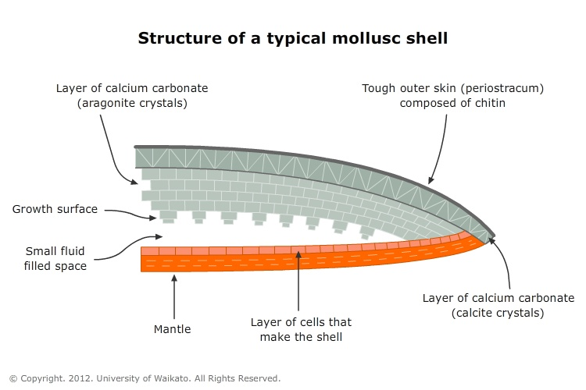
Lecture I: The Water Planet
III. Why The Differences?
A. The Effects of Liquid Water
B. Tectonic Activity and Subduction
C. The Effects of LIFE
1. Biogenic Limestone Formation
SHELLS
Settled out

Slide 24
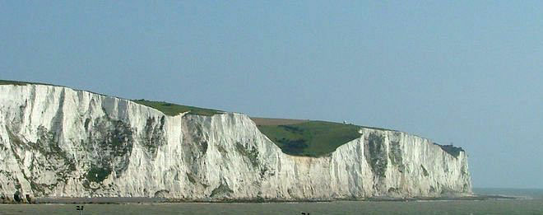
400 m
4 um (4/1000’s of a mm; 250,000 per meter)
100,000,000 deep, but they are crushed, so it’s actually more…

Slide 25
400 m
4 um (4/1000’s of a mm; 250,000 per meter)
100,000,000 deep, but they are crushed, so it’s actually more…
Little things, big effects…

Slide 26
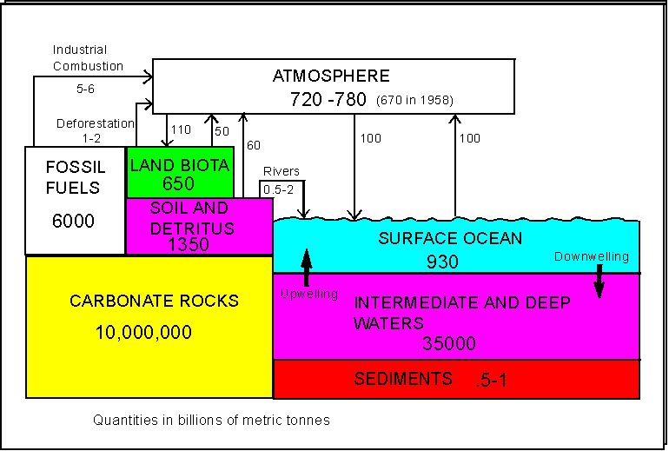
Where did all the carbon go?

Slide 27
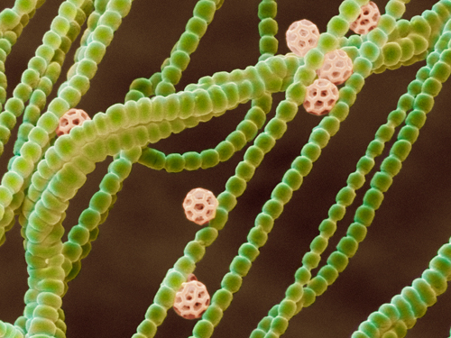
Lecture I: The Water Planet
III. Why The Differences?
A. The Effects of Liquid Water
B. Tectonic Activity and Subduction
C. The Effects of LIFE
1. Biogenic Limestone Formation
2. Photosynthesis
Photosynthetic bacteria

Slide 28
Overview:
A. Step One: Transferring radiant energy to chemical energy
e-
Energy of photon
Transferred to an electron
e-

Slide 29
Overview:
A. Step Two: storing that chemical energy in the bonds of molecules
e-
ATP
ADP+P
e-
Light Dependent Reaction
Electron becomes trapped in a chemical bond (phosphate bond) between PO₄ and ADP

Slide 30
Overview:
A. Step Two: storing that chemical energy in the bonds of molecules
e-
ATP
ADP+P
e-
Light Dependent Reaction
Where do the electrons come from?

Slide 31
Overview:
A. Step Two: storing that chemical energy in the bonds of molecules
e-
ATP
ADP+P
e-
Light Dependent Reaction
Where do the electrons come from?
Photosynthetic organisms split WATER:
to harvest electrons
2 (H-O-H) 2O + 4H⁺ + 4e-
O₂

Slide 32
Overview:
A. Step Two: storing that chemical energy in the bonds of molecules
e-
ATP
BUT… P~P bonds are weak. To “store” this energy, stronger, more stable bonds need to be made.
ATP bonds are broken and C-C bonds are made.
ADP+P
e-
Light Dependent Reaction
Where do the electrons come from?
Photosynthetic organisms split WATER:
2 (H-O-H) 2O + 4H⁺ + 4e-
O₂

Slide 33
Overview:
A. Step Two: storing that chemical energy in the bonds of molecules
e-
ATP
C₆ (glucose)
ADP+P
6 CO₂
e-
Light Dependent Reaction
Light Independent Reaction
Where do the electrons come from?
Photosynthetic organisms split WATER:
2 (H-O-H) 2O + 4H⁺ + 4e-
O₂

Slide 34
Lecture I: The Living Planet
III. Why The Differences?
A. The Effects of Liquid Water
B. Tectonic Activity and Subduction
C. The Effects of LIFE
1. Biogenic Limestone Formation
2. Photosynthesis
 | Earth | Venus | Mars
CO₂ | 0.035% | 96% | 95%
N₂ | 77% | 3.5% | 2.7%
H₂O | 1% | 0.01% | 0.007%
Ar | 0.93% | 0.007% | 1.6%
O₂ | 21% | trace | trace
Little things (photosynthetic bacteria), big effects…

Slide 35
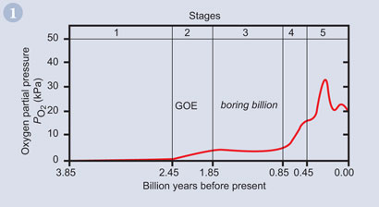
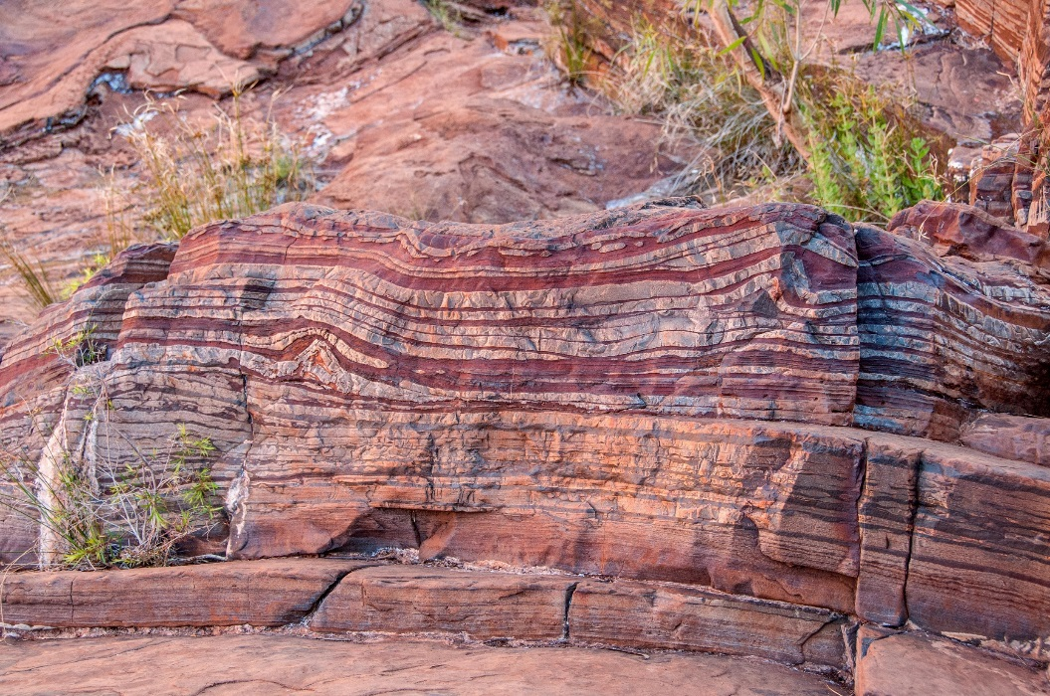
How do we know that oxygen wasn’t always present in the Earth’s atmosphere? Maybe Earth is just different from Venus and Mars…
Banded iron formations are first seen 2.5 billion years ago, showing that oxygen must have been present in the ocean to precipitate iron out of solution as iron oxides in sedimentary strata. There absence in older strata means that oxygen was not present in appreciable amounts.

Slide 36
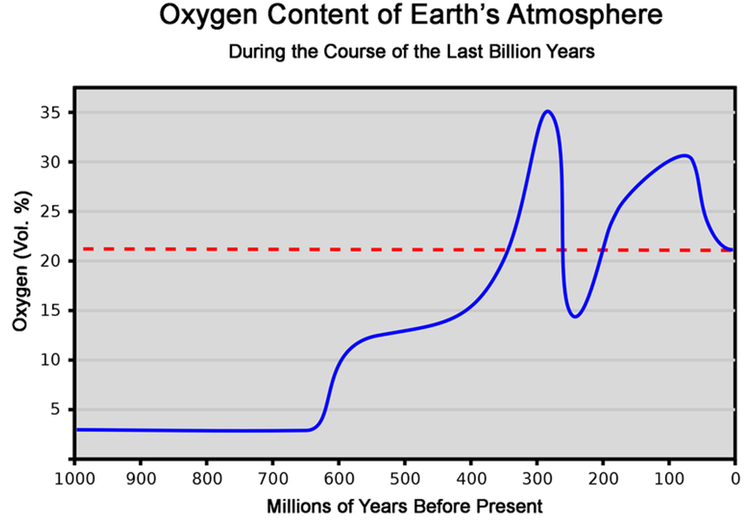
The Carboniferous “Pulse”

Slide 37
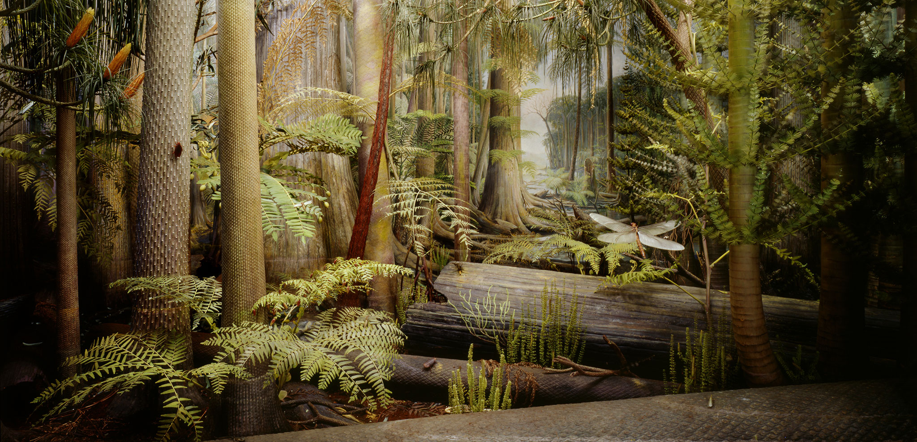
Terrestrial plants were radiating, sucking up CO₂ and producing O₂.
Huge expanses of swamp forests dominated the equatorial zone. Photosynthetic rates were high, but the trees were preserved under sediments when they died and fell…. Creating our coal deposits. Photosynthesis produced lots of O₂, but with less decay, it stayed in the air instead of being breathed in and used by decomposing bacteria.

Slide 38
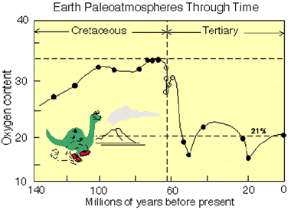
The K-T Extinction affected atmospheric oxygen levels as plants went extinct and terrestrial photosynthetic activity declined.

Slide 39
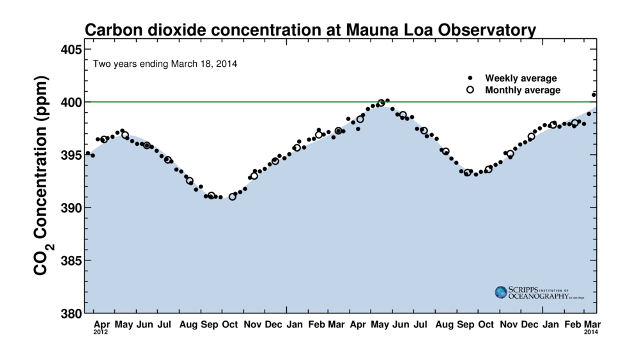
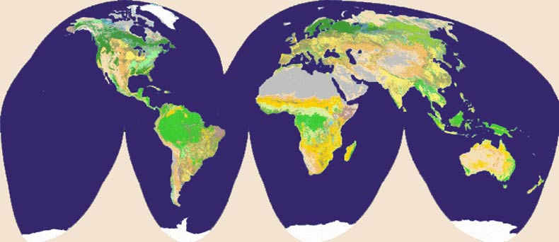
And Today?
The Earth is a living planet…
It breathes.

Slide 40
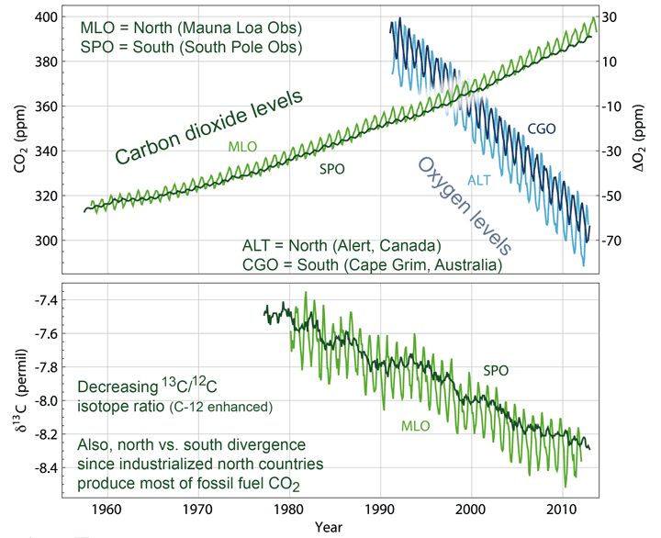
And today?
The Earth is a living planet… it breathes.
CO₂ – increased from 320 to 400 ppm 25% in 50 years
O₂ – declined by 70 ppm, but it is
21% of the atmosphere (210,000,000 ppm)
So the decline of 70 ppm is not dramatic.

