Slide 1
Emergent Diseases
State of the World
Marian Baker
BIO-340

Slide 2
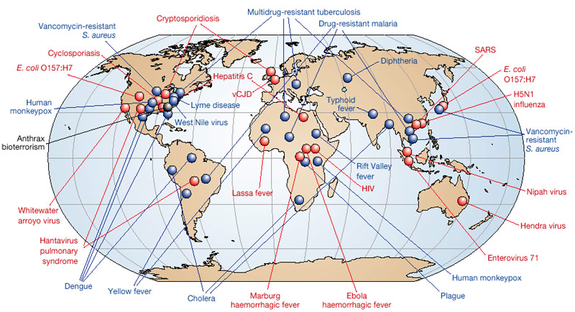
What is an emergent disease?
An emergent disease is one that has appeared in a population for the first time, or that may have existed previously but is rapidly increasing in incidence or geographic range (WHO, FAO, OIE 2004).

Slide 3
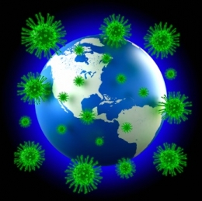
Why are emergent diseases important?
Studying emergent disease is important because it allows us to examine the spread and origin of a disease. By studying emergent diseases, we can also combat their spread and thus improve human health or preserve biodiversity.

Slide 4
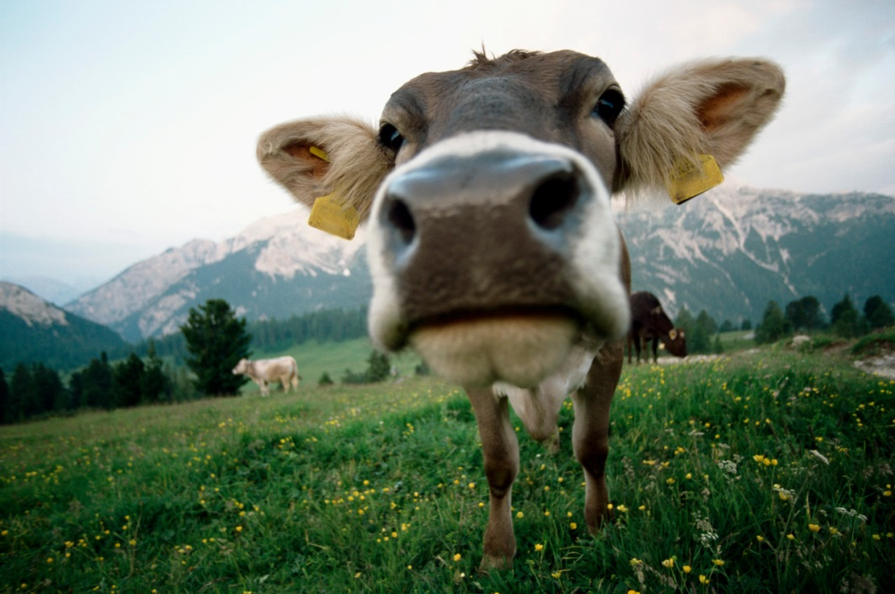
Important Terms
Zoonotic Disease—a zoonotic disease or zoonosis is a disease that is naturally transmissible from vertebrate animals to humans (WHO, FAO, OIE 2014).
Epidemiology—the study of a disease in a population.

Slide 5
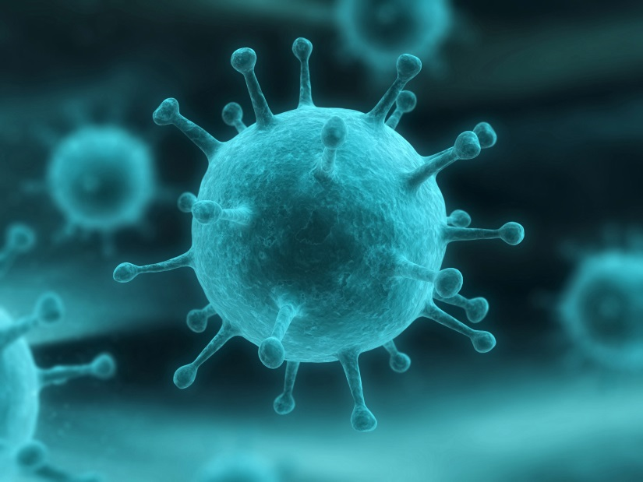
How do pathogens emerge?
cross-species transfer
spatial diffusion
pathogenic evolution
new recognition
changes in the human-environment relationship (Mayer 2000).

Slide 6
Factors that can Create Emergent Disease
microbiological adaptation
environmental changes
globalization of agriculture
Food production and trade
human behavioural factors
decline of public health systems
an increasing number of people who are potentially more susceptible to infection (Think B/G x S)
Decreased host diversity

Slide 7
Aspects of Dealing with Emergent Disease
Prevention
Detection
Surveillance
Response
Control (WHO, FAO, OIE 2004).

Slide 8
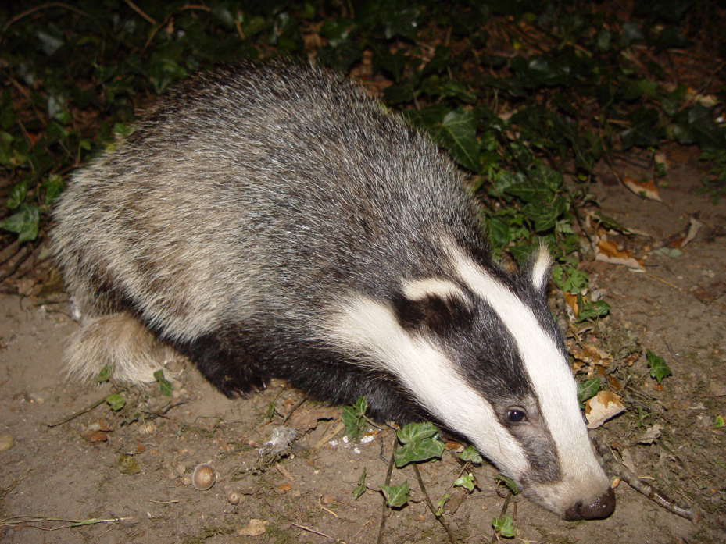
Prevention
Population Reduction
Dilution Effect—diverse host communities will display reduced disease.
Perturbation Effects
Badgers and Bovine Tuberculosis

Slide 9
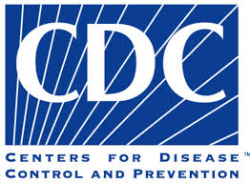
Surveillance, Response, and Control
Monitoring Agencies
Mapping
GPS and GIS are used for epidemiological analysis
However: what about demographic data?
Southern Plant Diagnostic Network – for plants
CDC, WHO – for humans
Control: continued surveillance and response until the threat is sufficiently diminished.

Slide 10
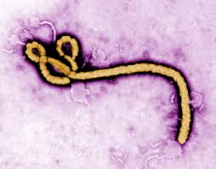
Examples of Emergent Diseases
Ebola virus
Chikungunya virus in Latin America
Seasonal Influenza
Potato mop-top virus in Florida
Batrachochytrium dendrobatidis in amphibians

Slide 11
References
Mayer JD. 2000. Geography, ecology, and emerging infectious diseases. Soc Sci Med. 50(7-8):937-952.
[WHO, FAO,OIE] World Health Organization, Food and Agriculture Organization, World Organisation for Animal Health. 2004. Report of the WHO/FAO/OIE joint consultation on emerging zoonotic diseases. Report 3-5 May 2004. Geneva:WHO. Report No.: WHO/CDS/CPE/ZFK/2004.9. Available from: http://www.whqlibdoc.who.int/hq/2004/who_cds_cpe_zfk_2004.9.pdf

