Slide 1
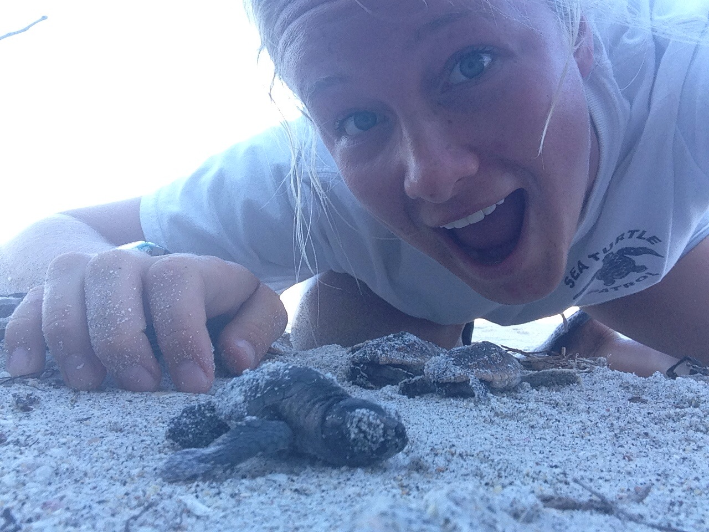
Sea Turtles and the Environment
Human Impact in Australia
Martha Robinson

Slide 2
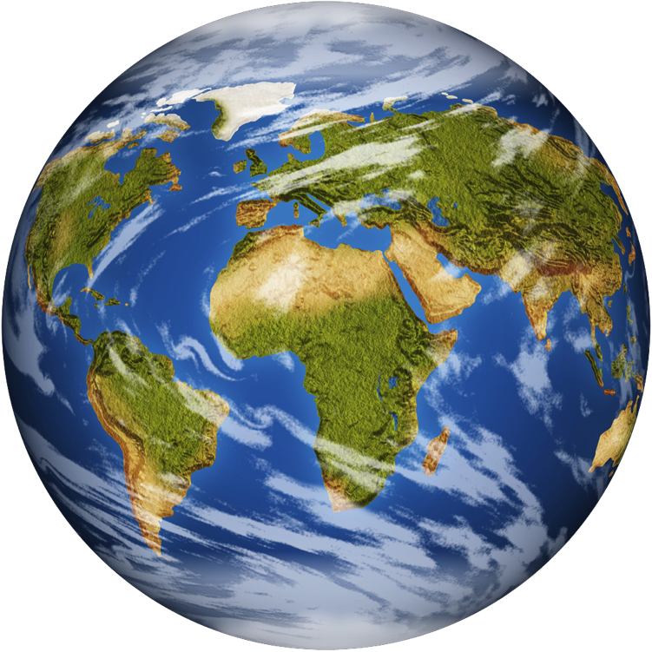
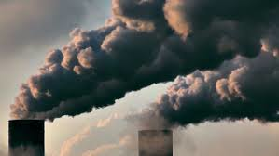
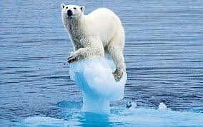
Climate Change
Human impact
Early impact: agriculture, fires
Industrial Revolution
- Carbon Emissions
- Increased agriculture: land cultivation and degradation, loss of habitat for wild animals
- growing population supported by increased technology
Result: increased temperatures, ocean acidification, unpredictable and violent weather, loss of species

Slide 3
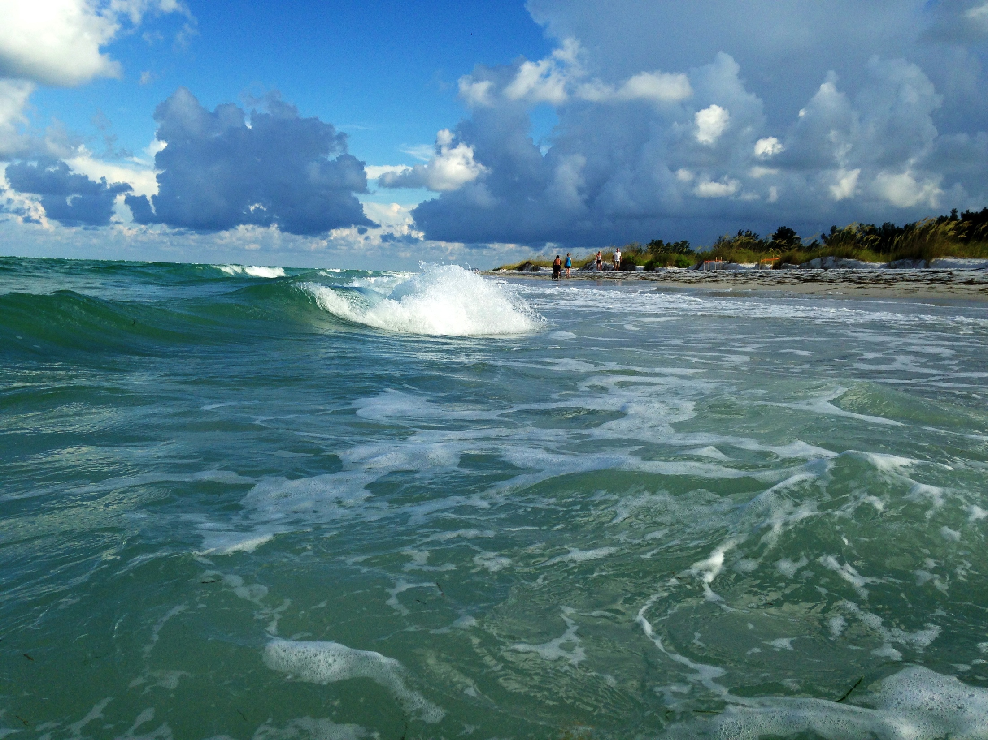
The Ocean
Important indicator of climate change
properties of water allow ocean to be relatively constant: change in temperature means HUGE input of energy in the form of heat
Increased acidification results from carbon absorption from atmosphere
Smallest changes in ocean reflect massive changes in the rest of environment
Biodiversity

Slide 4
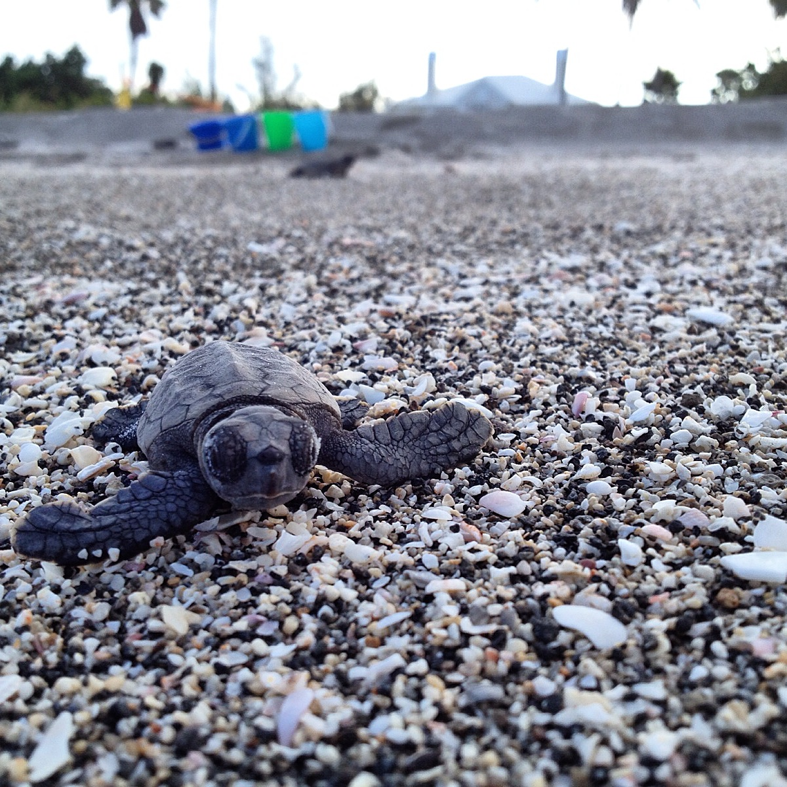
Sea Turtles
Reptiles: body temperature depends on external environment
Migratory: migrate between nesting grounds and open ocean where they feed
Nesting patterns: every 2-3 years, 3-8 clutches per season, 60- 200 eggs per clutch, beach at night

Slide 5
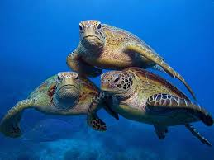
Australia- A Unique Home for Sea Turtles
6 of 7 sea turtle species
Only place in the world with flatback sea turtle (Natator depressus): 20-21000 nesting females
Highest density of nesting greens (Caretta caretta) in Raine Island
subspecies of greens in southern part of Great Barrier Reef

Slide 6
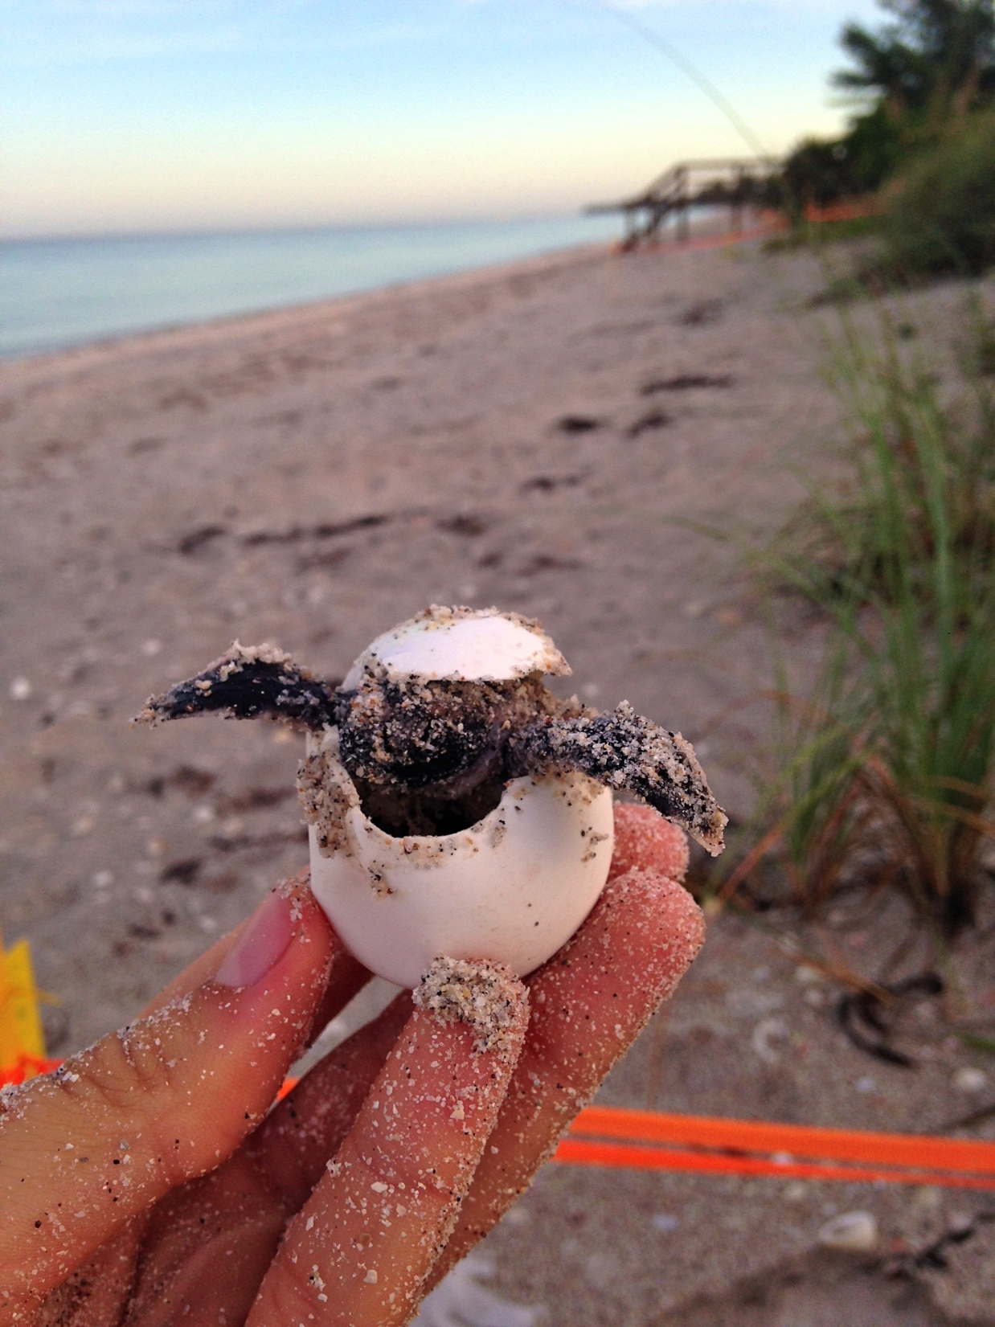
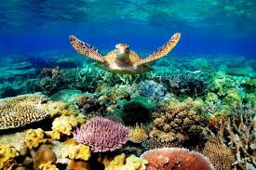
Sea Turtles Greatest Threat: Climate change
Direct effects: migration, sex ratio in populion (TDSD)
Indirect effects: destruction of coral in Great Barrier Reef

Slide 7
Positive Human Impacts: Conservation Efforts
Importance of regional, national, and international study and collaboration
Comprehensive study of Great Barrier Reef’s health conducted every 5 years by Australian Government
Local organizations: Jurabi Turtle Center, Exmouth Visitors Center
Larger organizations: WWF, Sea Turtle Conservancy, UNEP
Legislation: Environment Protection and Biodiversity Conservation Act 1999, National Recovery Program for Marine Turtles in Australia
Address indigenous needs as well

Slide 8
