Slide 1
Air Quality (Pollution)
Theodora Turrin

Slide 2
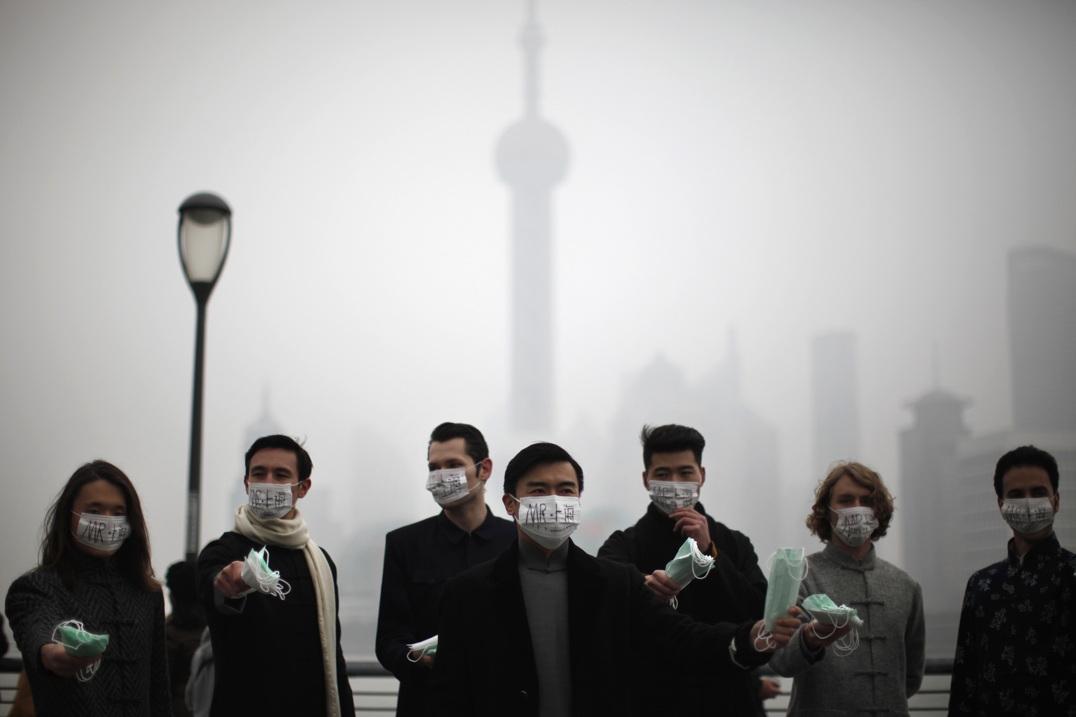
1. Air Pollutants
A. Ozone/Smog
B. Particle Pollution
C. Nitrogen Oxides
D. Sulfur Dioxide
E. Haze
F. Toxic Air Pollutants
wwww.scmp.com

Slide 3
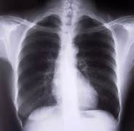
A. Ozone/Smog
ground level and upper portions of atmosphere.
commonly referred to as smog
Not emitted directly by any specific source.
www.delcollo.us
Adverse Health Effects: chronic lung disease, asthma, irritated airways

Slide 4
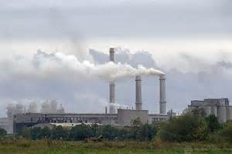
B. Particle Pollution
Particulate matter (PM)
Mixture of solid particles and liquid droplets found in the air.
staticflickr.com
Adverse Health Effects: can enter deep in lungs/the blood stream, heart attacks, decreased lung function, asthma, lung disease

Slide 5
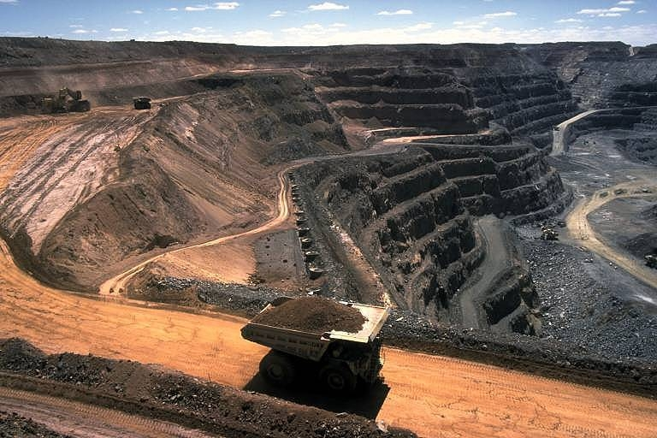
C. Nitrogen Oxides ( No_{x} )
composed of different levels of nitrogen and oxygen
form from combustion of certain fuels at high temperatures
NO₂ is used as the indicator
http://www.aditnow.co.uk

Slide 6
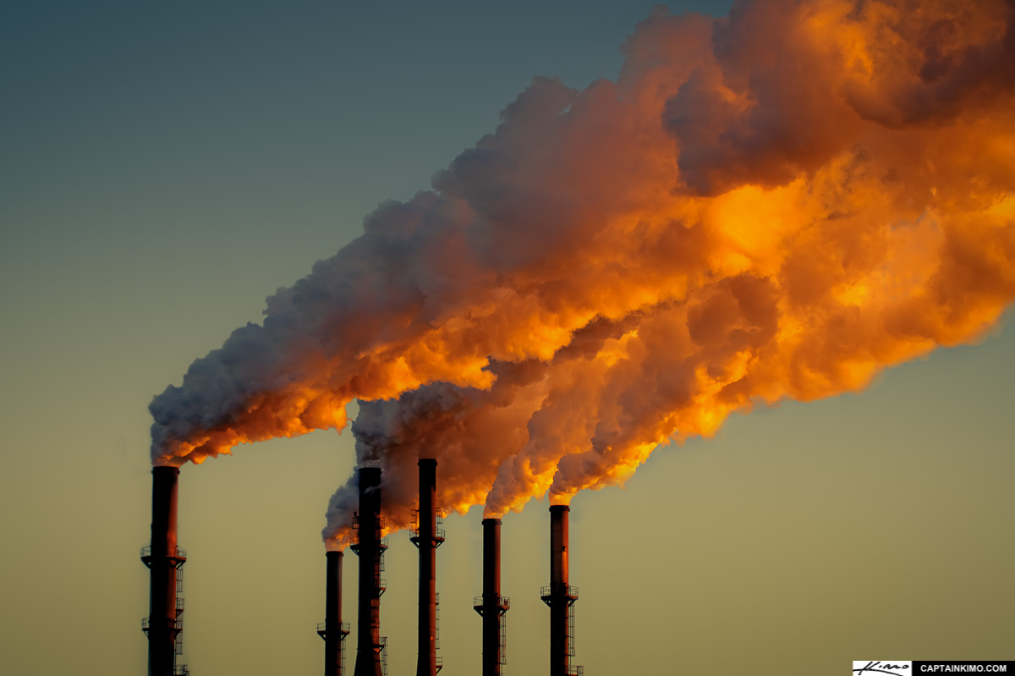
D. Sulfur Dioxide (SO₂ )
Highly reactive gas
Over 90 percent of SO₂ emissions come from fossil fuel combustion at power plants and other industrial facilities.
photopostsblog.com
Adverse Health Effects: narrowing of airways, respiratory illness, asthma

Slide 7
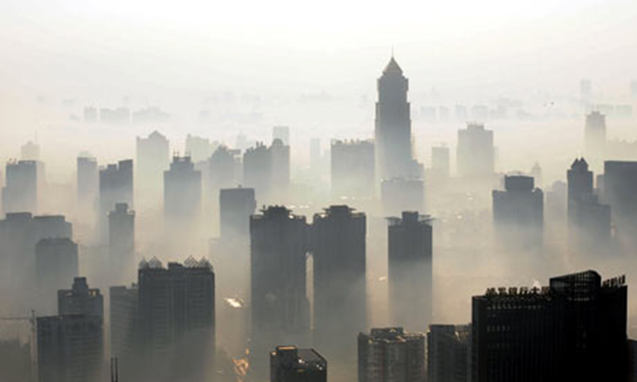
E. Haze
number of sources
Emits fine particle pollution
Sources of fine particles natural or manmade.
EPA: Regional Haze Rule
greenpeace.org
Adverse Health Effects: visual impairment

Slide 8

F. Toxic Air Pollutants
cause cancer or other serious health effects
gaseous, aerosol, or particulate forms
clker.com
Adverse Health Effects: reproductive, birth or developmental defects, and neurological, cardiovascular, and respiratory disease.

Slide 9
2. Global Warming & The Greenhouse Effect
Occurs naturally
Climate Change
Human activities in the past century have increased greenhouse gasses in the atmosphere
Major greenhouse gasses: carbon dioxide, methane, nitrous oxide and fluorinated gasses

Slide 10
3. Industrial Sources of Pollution
Power Plants
Manufacturing Facilities
Agriculture

Slide 11
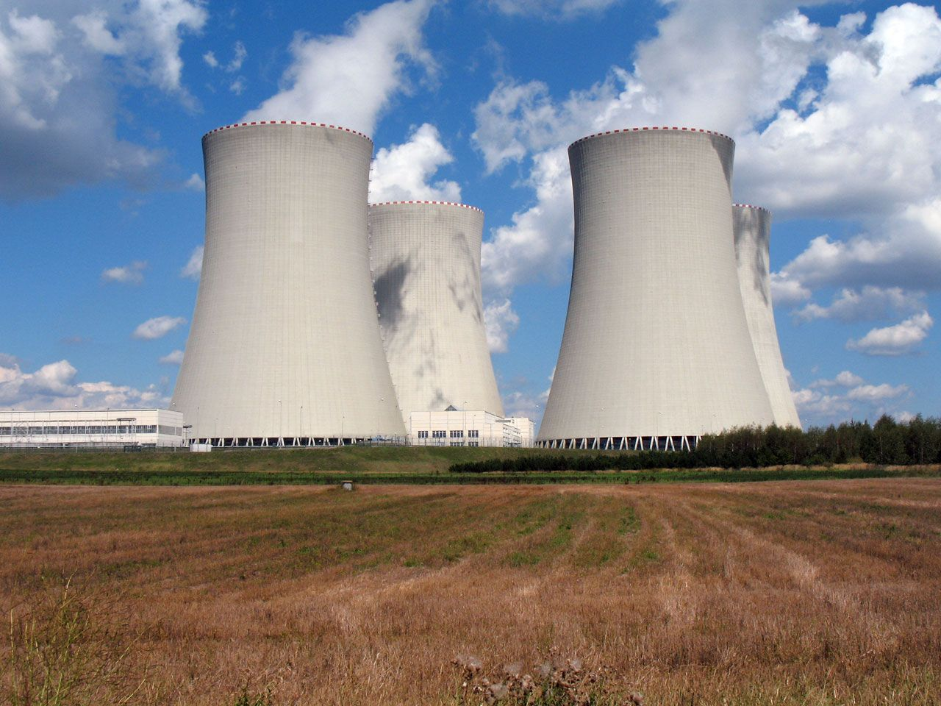
Power Plants
dominant emitters of mercury sulfur dioxide, acid gases and arsenic in the US .
emissions of greenhouse gases and nitrogen oxides.
emissions come from coal- and oil-fired power plants.
Inweekly.net

Slide 12
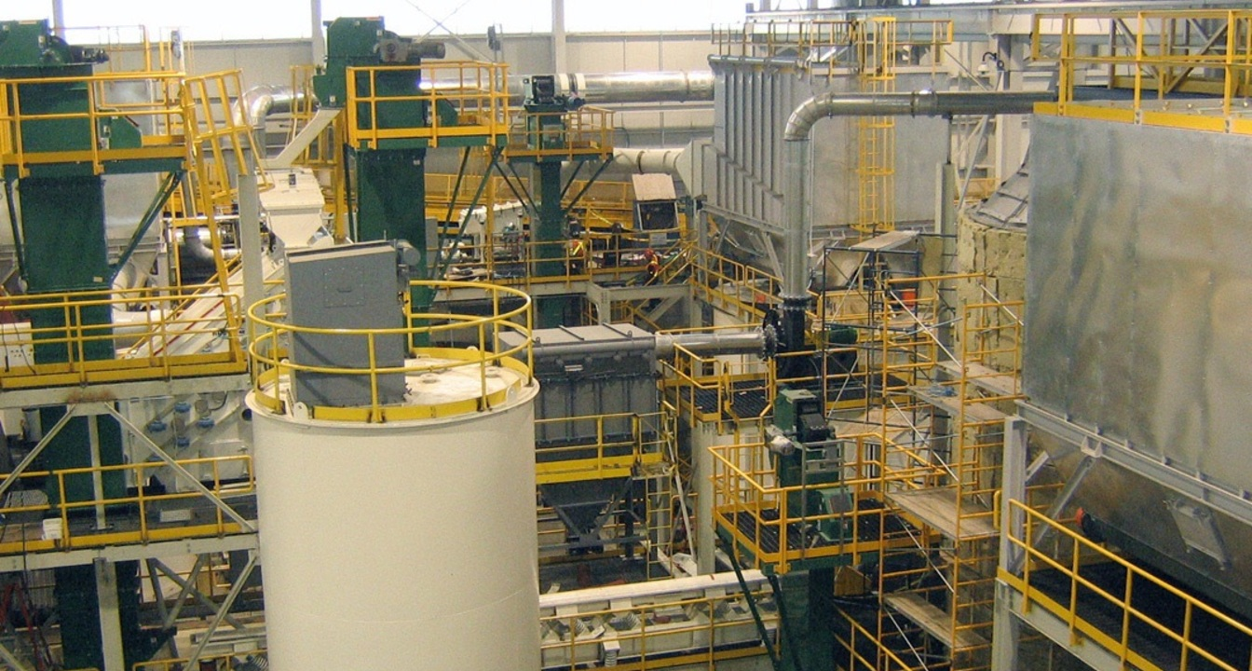
Manufacturing Facilities
factories and other operations that produce goods that will be used by individual consumers
facilities that make intermediate goods.
galleryhip.com

Slide 13
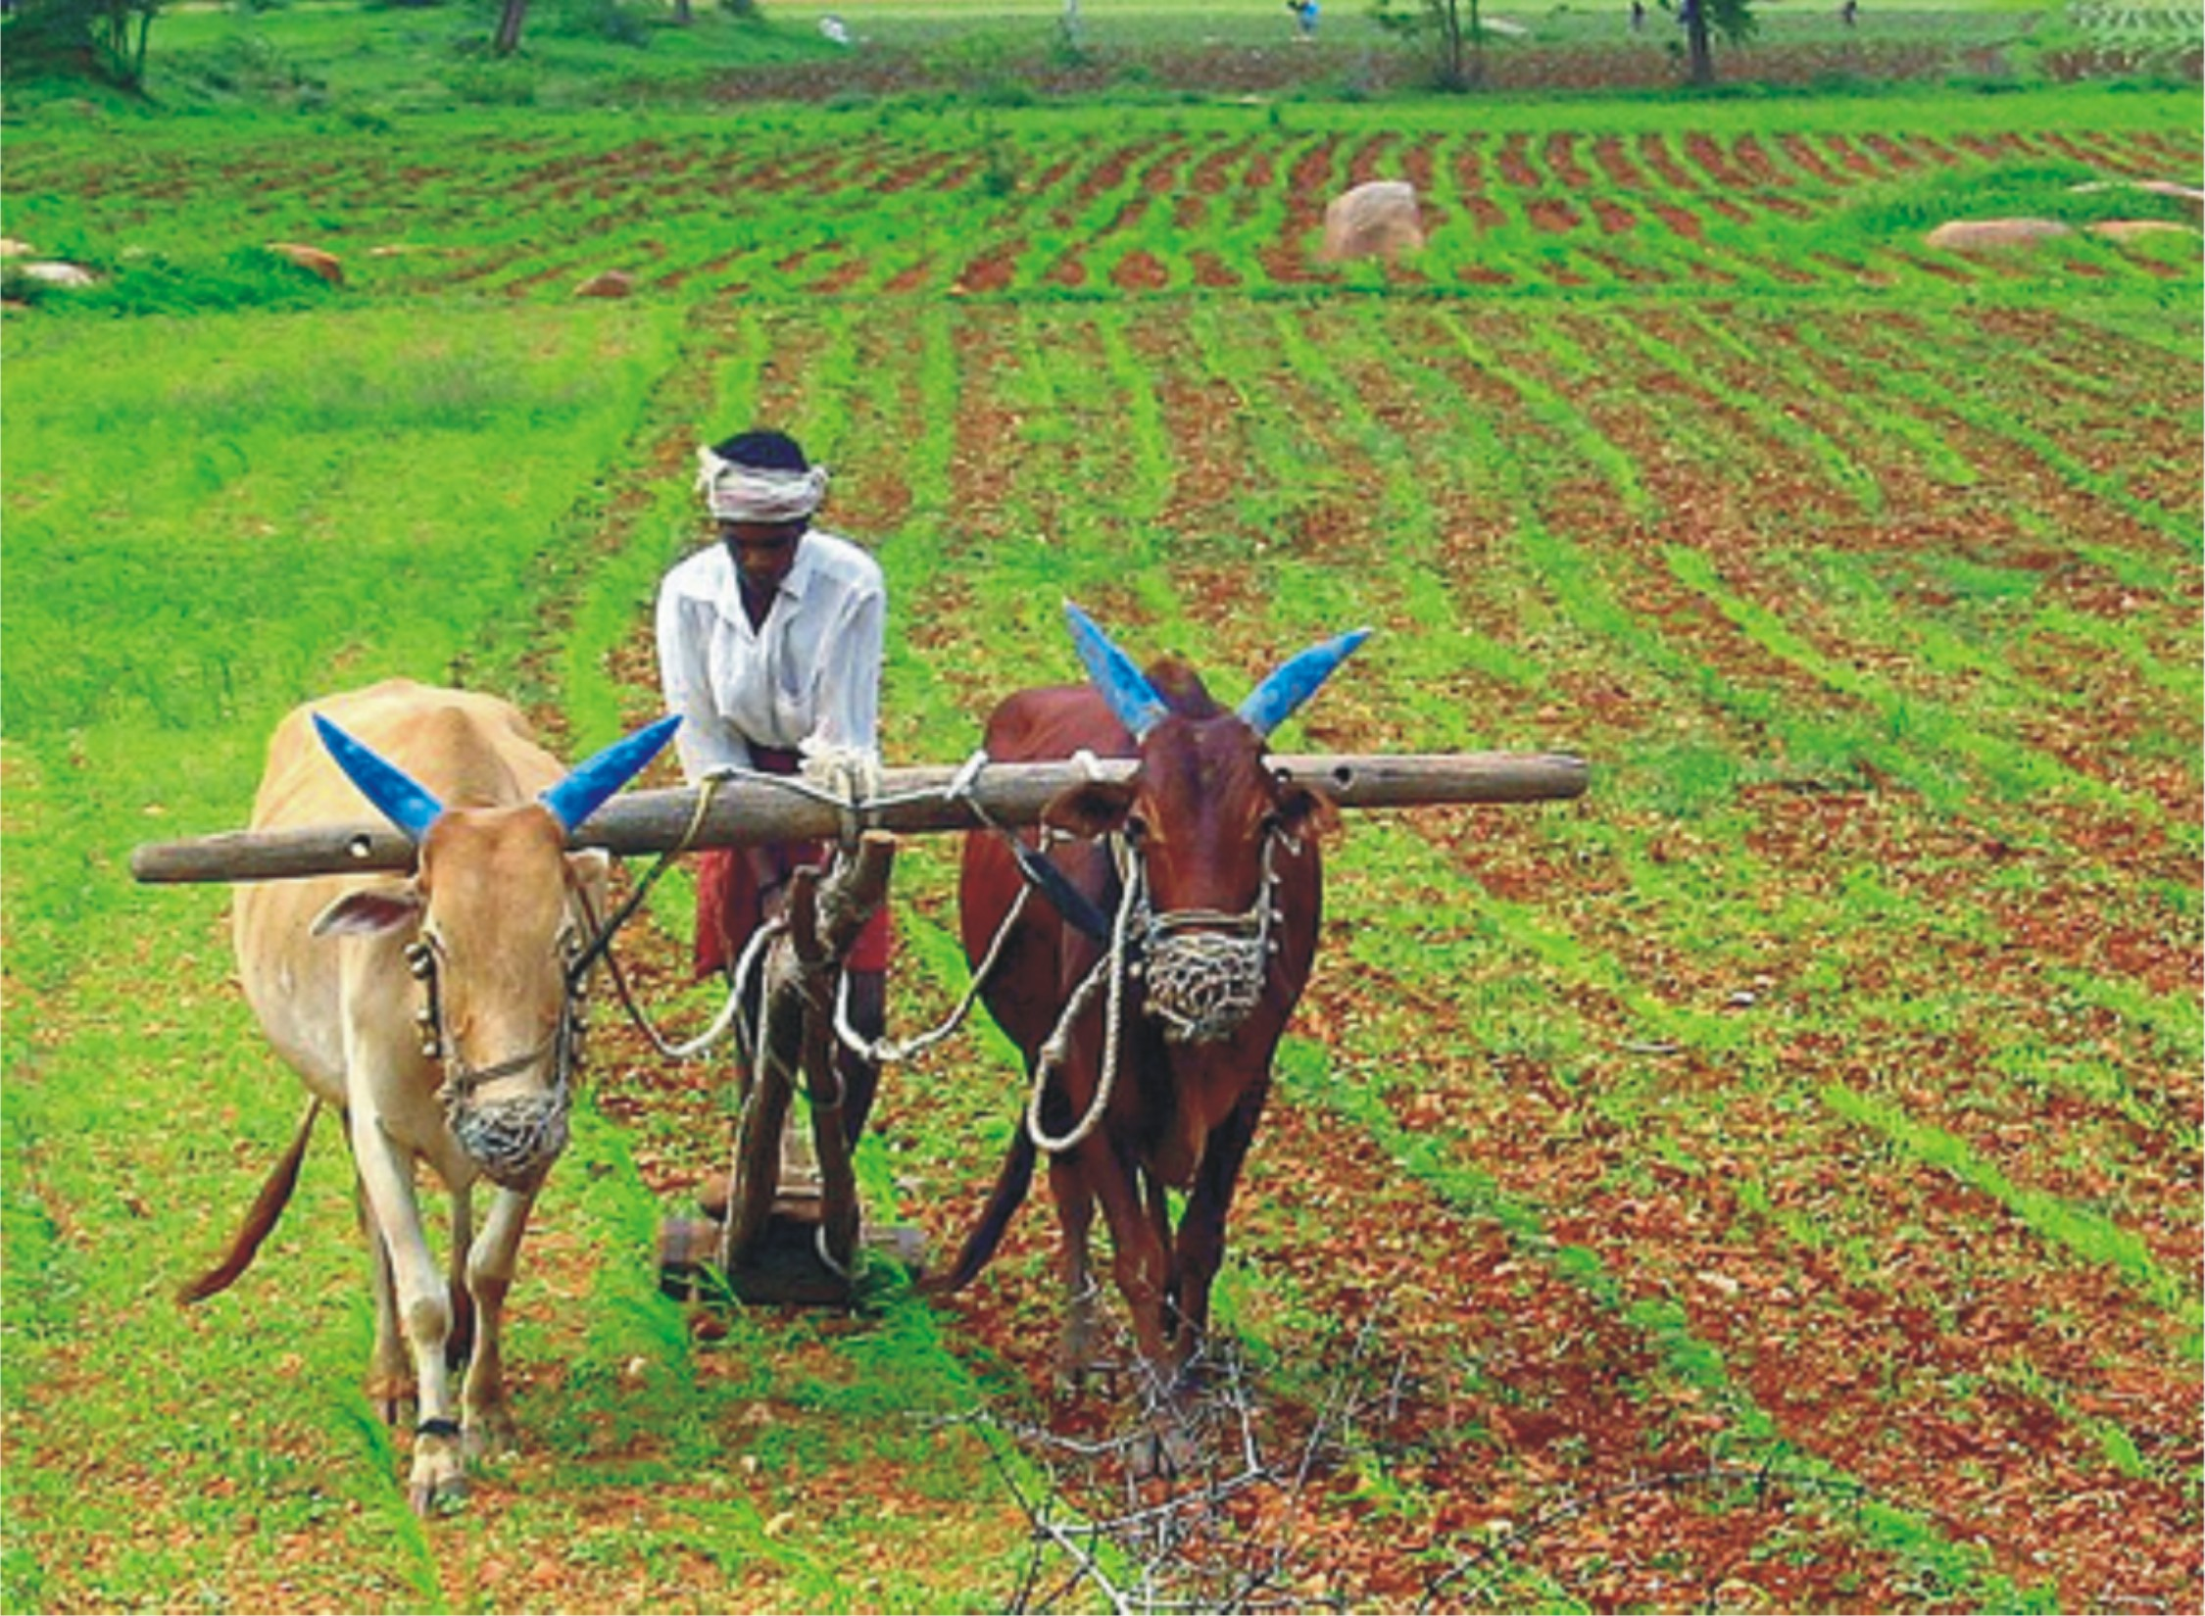
Agriculture
variety of processes:
  enteric fermentation
  manure management
  rice cultivation
  soil management
  machines
  burning of agricultural residues.
http://sagarkatdare.files.wordpress.com

Slide 14
4. Indoor Air Pollutants
Contaminants accumulating inside buildings
Contaminant groups: dusts, vapors, gasses, biological agents
Due to an incomplete or inadequate control of combustion world wide
Household chemicals
Building materials
Naturally occurring radon gas and mold
Can be avoided by increasing the amount a building is sealed from the outside

Slide 15
5. Reducing/Controlling Air Pollution
World Health Organization
National Association of Clean Air Agencies (NACAA)
U.S. Environmental Protection Agency (EPA)
Clean Air Act

Slide 16
World Health Organization (WHO)
WHO Air Quality Guidelines
Policies and investments
Creates detailed health-related assessments of different types of air pollutants
Produces evidence regarding the linkage of air pollution to specific diseases

Slide 17
National Association of Clean Air Agencies (NACAA)
The national, non-partisan, non-profit association of air pollution control agencies in 41 states, four territories and 116 metropolitan areas
NACAA takes positions in order to articulate perspectives and recommendations on important air pollution issues

Slide 18
U.S. Environmental Protection Agency (EPA)
Conducts air research to protect human health and the environment
Implementing new ground level ozone standards
Air Quality Research
Air Pollution research
Developing new technologies for air monitoring
Clean Air Act

Slide 19
Clean Air Act
Comprehensive federal law that regulates air emissions from stationary and mobile sources
authorizes EPA to establish National Ambient Air Quality Standards
protect public health and public welfare and to regulate emissions of hazardous air pollutants

Slide 20
Air Tools/Technologies
Atmospheric Modeling
SmartWay Tech Program
Air Markets Program Data

Slide 21
Work Cited
Chen, Y., L. Craig, and D. Krewski. "Air Quality Risk Assessment and Management." Journal of Toxicology and Environmental Health, Part A: Current Issues 71.1-2 (2008): 24-39. ProQuest. Web. 2 Dec. 2014.
"Climate Change." Clean Air World. N.p.,n.d. Web. 30 Nov. 2014. <http://www.cleanairworld.org/TopicDetails.asp? parent=19>.
EPA. "Summary of the Clean AIr Act." EPA: United States Environmental Protection Agency. United States Government, 12 Nov. 2014. Web. 30 Nov. 2014. <http://www.4cleanair.org/>.
"Indoor Air Pollution." Clean Air World. N.p., n.d. Web. 01 Dec. 2014. <http://www.cleanairworld.org/TopicDetails.asp?parent=20>.
Larsen, R. I. "An Air Quality Data Analysis System for Interrelating Effects, Standards, and Needed Source Reductions: Part 13 - Applying the EPA Proposed Guidelines for Carcinogen Risk Assessment to a Set of Asbestos Lung Cancer Mortality Data." Journal of the Air & Waste Management Association 53.11 (2003): 1326-39. ProQuest. Web. 2 Dec. 2014.
NACAA. "AIR POLLUTANTS." NACAA: National Association of Clean Air Agencies.N.p.,n.d.Web.30 Nov. 2014. <http://www.4cleanair.org/topics/details/air-pollutants>.
Trivero, P., Biamino, W., Borasi, M., Cavagnero, M., Musa, M., Rinaudo, C., & Sesia, V. (2012). An air quality balance index estimating the total amount of air pollutants at ground level. Environmental Monitoring and Assessment, 184(7), 4461-4472. doi:http://dx.doi.org/10.1007/s10661-011-2278-1
WHO. "Ambient (outdoor) Air Quality and Health." WHO: World Health Organization. N.p., Mar. 2014. Web. 01 Dec. 2014. <http://www.who.int/mediacentre/factsheets/fs313/en/>.

