Slide 1
Spider web decorations or Stabilimenta: function and adaptive significance
By Emery Longan

Slide 2
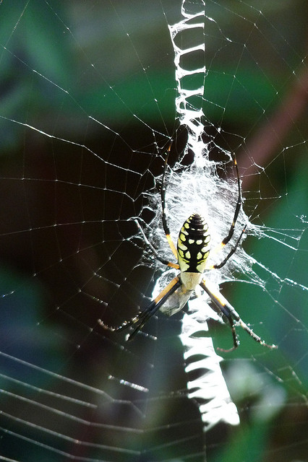
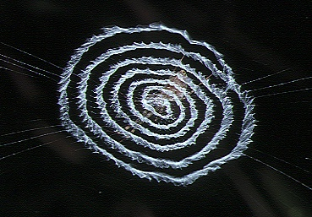
What are Stabilimenta?
Conspicuous
Break the symmetry of the typical orb web
Made of silk, detritus, and/or egg sacs

Slide 3
More general Info
Evolved independently nine times
Ulborodae and Araneidae
Because of independent evolution…
Likely multiple selective pressures brought these about
Likely different selective pressures have allowed for different derived traits

Slide 4
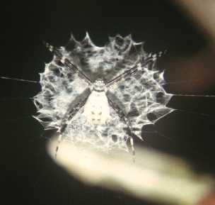
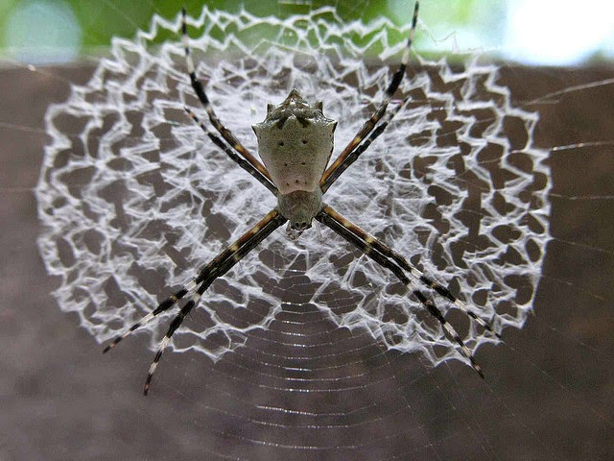
Types of Stabilimenta
Disc like

Slide 5
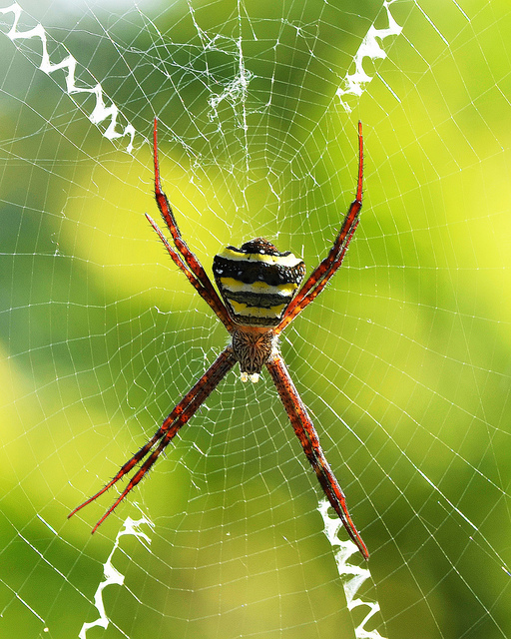
Types of Stabilimenta
“X-like”

Slide 6
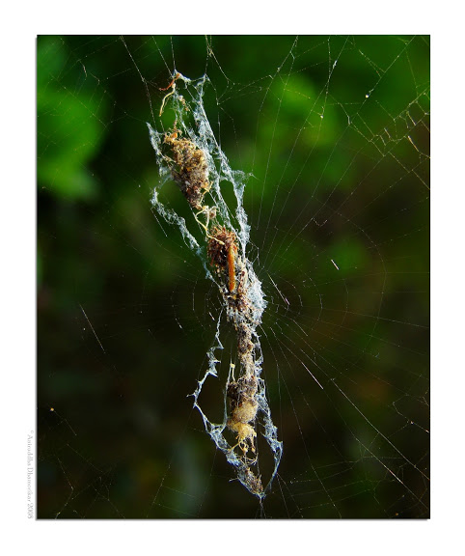
Types of Stabilimenta
Vertical conglomerate

Slide 7
Camouflage
First studies found stabilimenta make spiders harder to detect by humans
Spiders orient their body position next to stabilimenta to make outline harder to discern
This orientation is not maintained at night

Slide 8
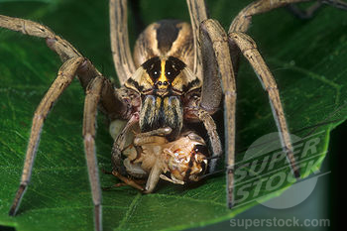
Prey attractant
Thought to be a flower mimic
Or reflect ultraviolet light that attracts insects
Some insects captured more by decorated webs, but some are not

Slide 9
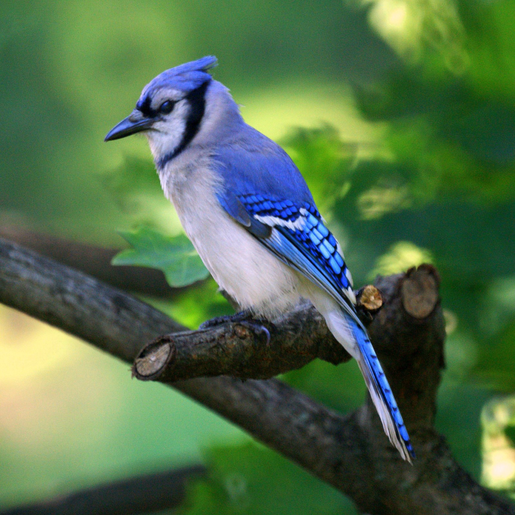
Large animal deterrent
Web is valuable resource
Signal large animals of web’s presence, limit inadvertent destruction
Contradictory selective pressure

Slide 10
Strengthen the web
If stabilimenta strengthen the web, then we would expect more stabilimenta in windier areas
Often this is not the case
Stabilimenta loosely attached to web
Largely not supported by data

Slide 11
Thermoregulation
Juvenile spiders make disc like stabilimenta at a higher frequency
Smaller, more vulnerable to changes in temp
Can thermoregulate using shade provided by stabilimenta
Not fully tested, but intuitively it makes sense

Slide 12
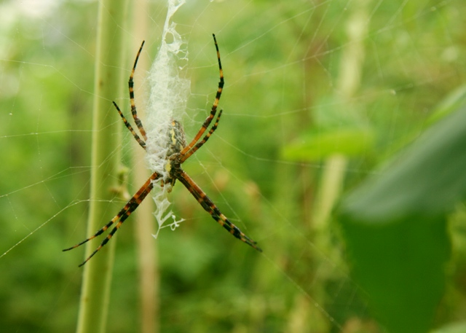
Non-adaptive explanations
Silk regulation
Physiological byproduct of stress response

Slide 13
In conclusion…
Adaptive significance hard to tease out
Lots of lineages, so probably lots of reasons these structures persisted and continue to persist
However, we can say a few things with decent confidence…

Slide 14
Photo credits
http://www.scilogs.fr/best-of-bestioles/files/04-Octonoba.yaeyamensis.stabilimentum.1.-.takinawa.jpg
http://farm5.staticflickr.com/4048/4351158397_d9db91a5ae_z.jpg
http://4.bp.blogspot.com/-zFLB-olBcHA/VCb5eU3IiTI/AAAAAAAA1r8/GEDHpJkyJvc/s1600/stabilimenta%2Bspider%2Bweb.jpg
http://www.animalbehavioronline.com/spider3.JPG
https://c1.staticflickr.com/9/8110/8602996685_45431e6965_z.jpg
http://wwwdelivery.superstock.com/WI/223/4141/PreviewComp/SuperStock_4141-50394.jpg
http://irvingparkgardenclub.files.wordpress.com/2011/01/blue-jay1.jpg
http://breakinggroundgreenroof.com/blog/wp-content/uploads/BananSpider2_Edited_Web2.jpg

Slide 15
References
Bruce MJ, Herberstein ME, Elgar MA, Bruce MJ. 2001. Signaling conflict between prey and predator attraction : Signal conflict in spiders. J Evol Biol 14(5):786.
Blackledge T, Wenzel J, Blackledge TA, Wenzel JW, Blackledge TA. 1999. Do stabilimenta in orb webs attract prey or defend spiders? Behav Ecol 10(4):372.
Craig CL. 1994. Limits to learning: Effects of predator pattern and colour on perception and avoidance-learning by prey. Anim Behav 47(5):1087.
Craig CL and Bernard GD. 1990. Insect attraction to ultraviolet-reflecting spider webs and web decorations. Ecology 71(2):616-23.
Eberhard WG. 1973. Stabilimenta on the webs of uloborus diversus (araneae: Uloboridae) and other spiders. J Zool 171(3):367-84.
Eberhard WG. 2003. Substitution of silk stabilimenta for egg sacs by Allocyclosa bifurca (araneae: Araneidae) suggests that silk stabilimenta function as camouflage devices. Behaviour 140(7):847-68.
Eisner T and Nowicki S. 1983. Spider web protection through visual advertisement: Role of the stabilimentum. Science 219(4581):185-7.
Herberstein ME, Craig CL, Coddington JA, Elgar MA. 2000. The functional significance of silk decorations of orb-web spiders: A critical review of the empirical evidence. Biological Reviews 75(4):649.
Jaffé R, Eberhard W, Angelo CD, Eusse D, Gutierrez A, Quijas S, Rodríguez A, Rodríguez M. 2006. Caution, webs in the way! possible functions of silk stabilimenta in gasteracantha cancriformis (araneae, araneidae). J Arachnol 34(2):448-55.
Kerr AM. 1993. Low frequency of stabilimenta in orb webs of Argiope appensa (araneae: Araneidae) from Guam: An indirect effect of an introduced avian predator? Pac Sci 47(4):328-37.
Lubin YD. 1974. Stabilimenta and barrier webs in the orb webs of Argiope argentata (araneae, araneidae) on Daphne and Santa Cruz Islands, Galapagos. J Arachnol 2(2):119-26.
Seah WK and Li D. 2001. Stabilimenta attract unwelcome predators to orb-webs. Proc Biol Sci 268(1476):1553-8.
Starks Philip T. 2002. The adaptive significance of stabilimenta in orb-webs: A hierarchical approach. Annales zoologici fennici Helsinki: Suomen Biologian Seura Vanamo, 1964-. 307 p.
Tso I. 1996. Stabilimentum of the garden spider Argiope trifasciata: A possible prey attractant. Anim Behav 52(1):183.

