Slide 1
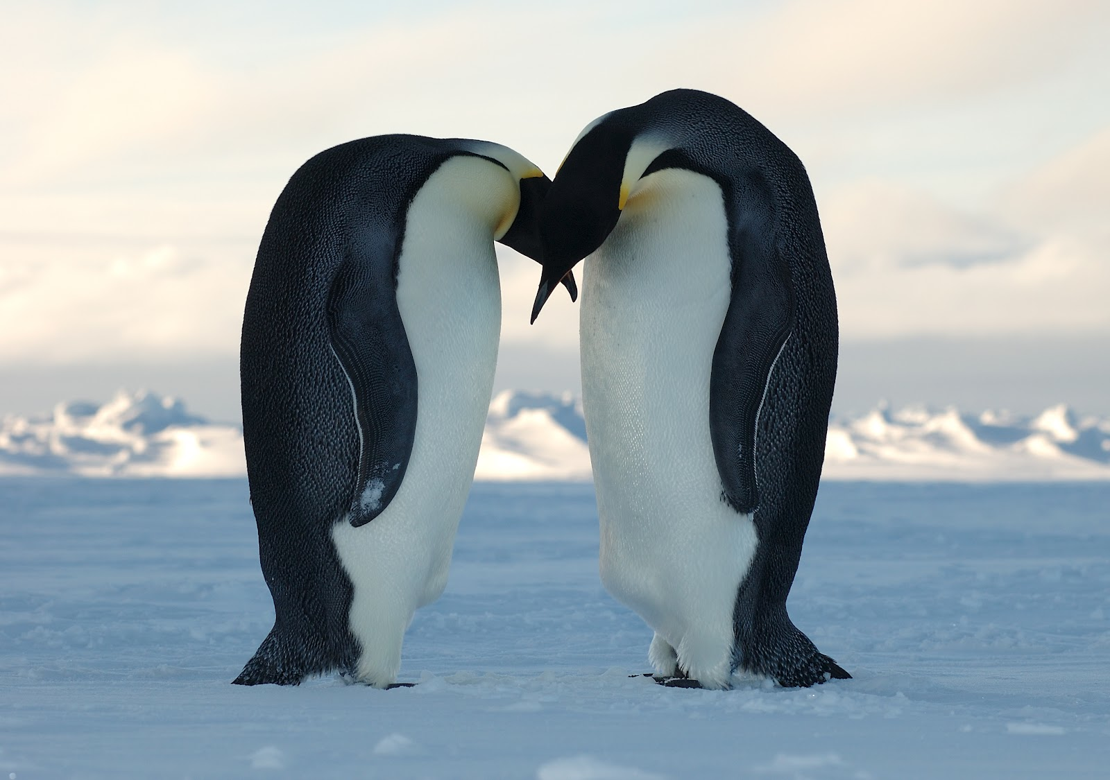
The Evolution of Monogamy

Slide 2
Monogamy- general facts
Only 5% of mammals are monogamous
Mammals tend to form social groups
Obligate monogamy- biparental care
Facultative monogamy- dispersal
Both disproven!
Organisms in polygamous species are more widely dispersed
Species that are monogamous where one parent chooses not to invest in their offspring

Slide 3
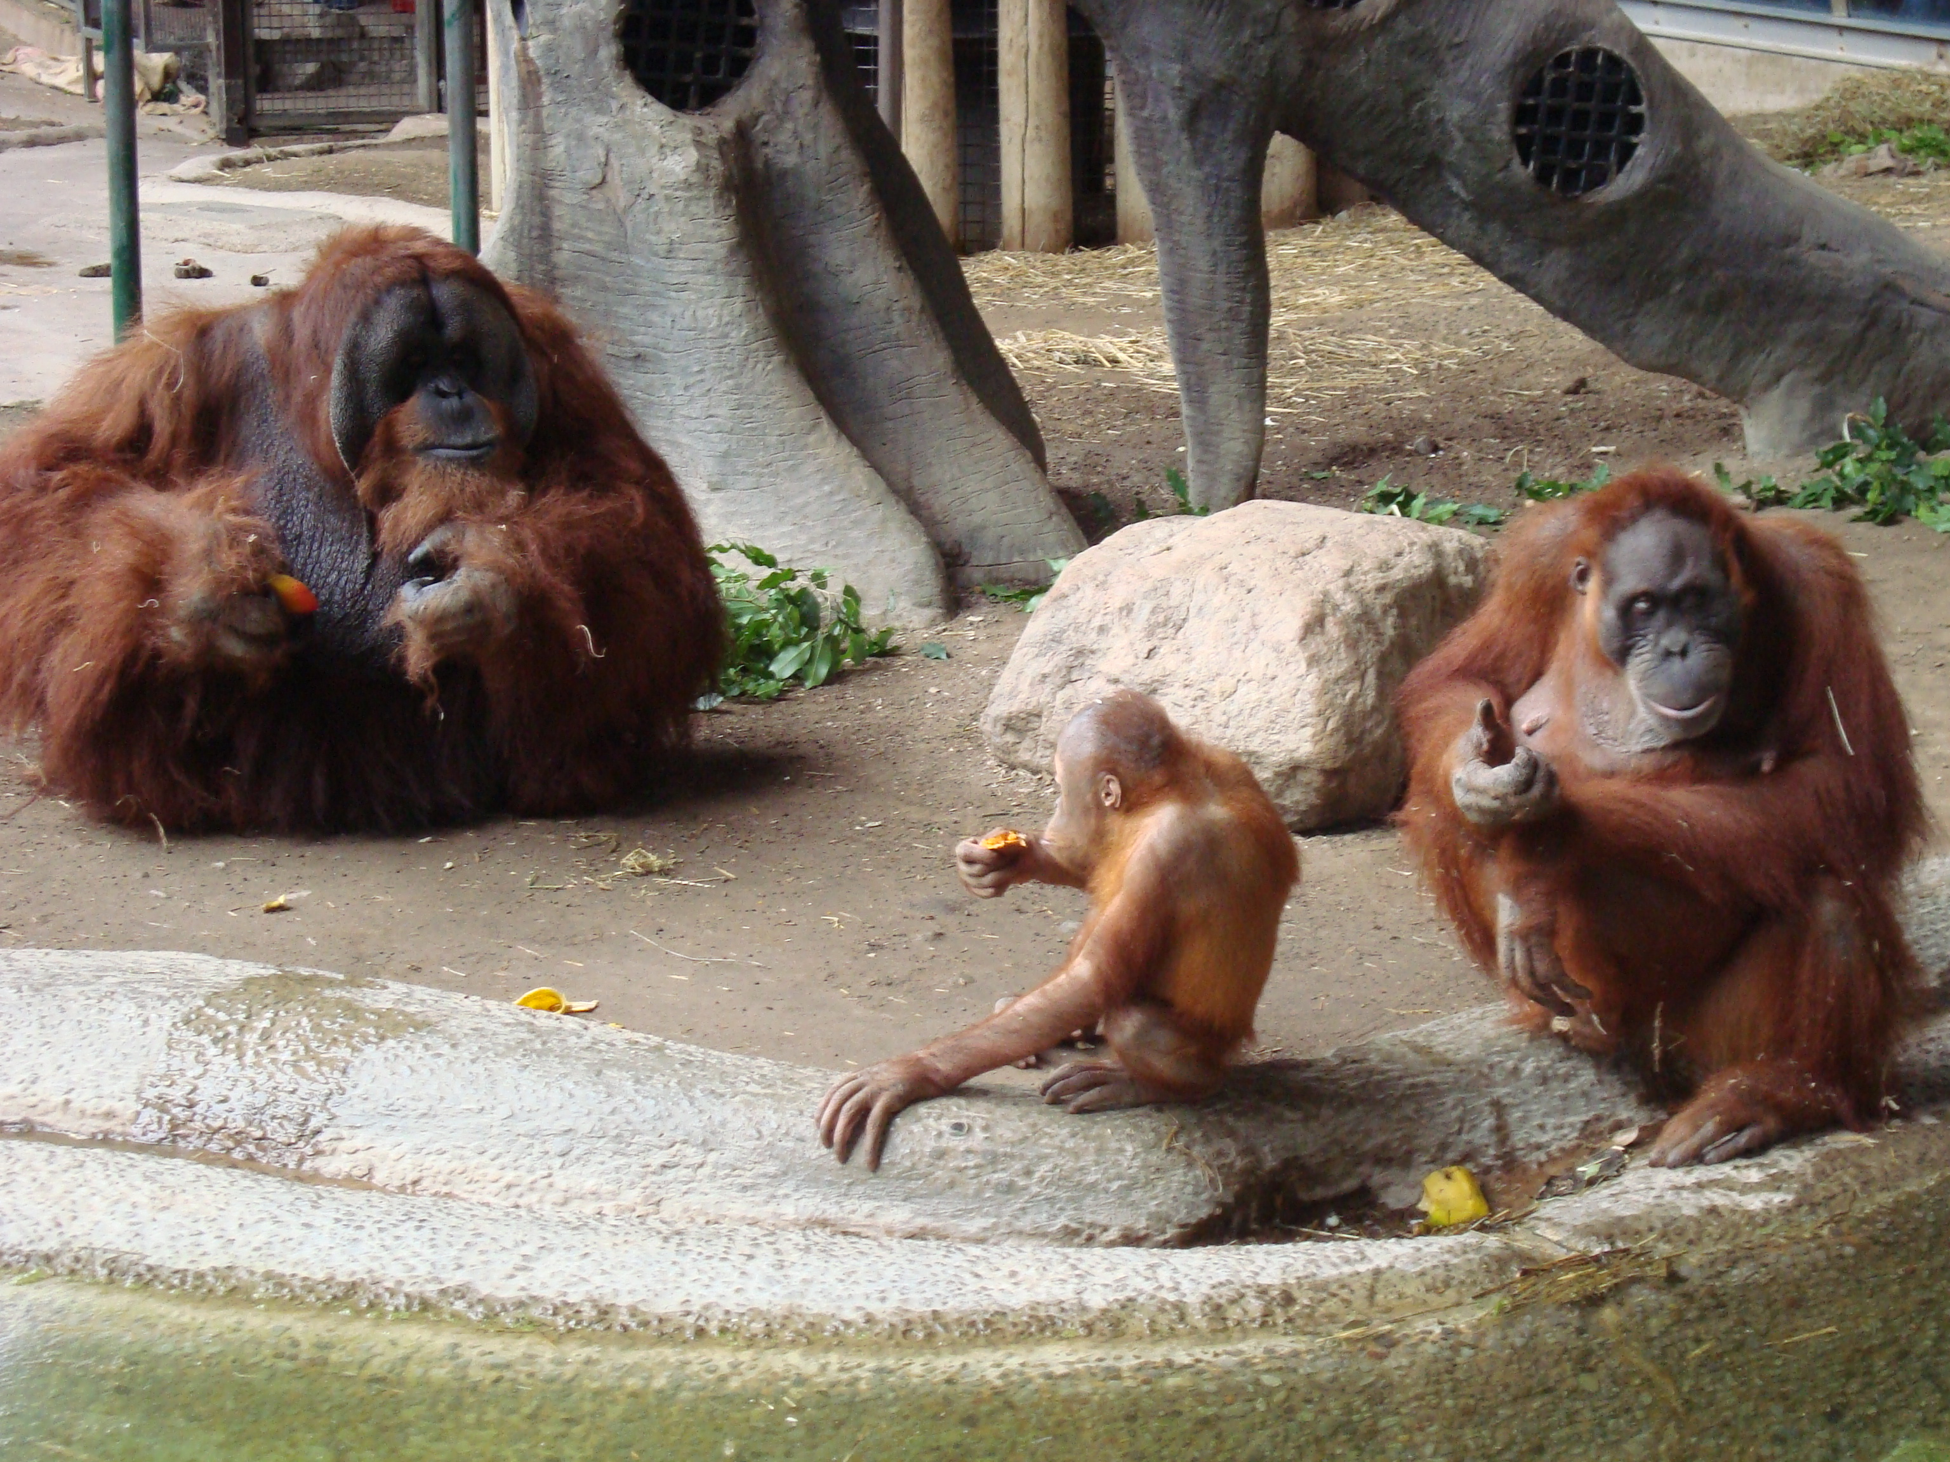
Theories on monogamy
Defensibility of females
Resource partitioning
Parental investment
Territoriality
Solitary organisms

Slide 4
Parental care
Evolution favors monogamy with parental care above monogamy without it
Association between father and offspring
Recognition of male kin increases the chance of monogamy
Low-ranking males often choose monogamy, as females may choose the survival of their offspring over the secondary sexual features of their mate
Monogamy in mammals occurs especially in
tough environments
Species where raising the offspring requires a lot of parental investment

Slide 5
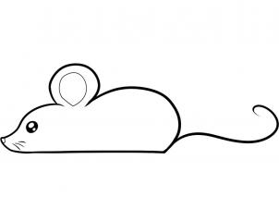
Firman’s research on mice
Trade-off between male investment and pre- and post-copulatory selected traits
Placed females in a box with several males
Some from polygamous lines, some from monogamous lines
Looked for the amount of time the females spent with each male
Also looked for the qualities of the males that the females chose
Body weight
Scent
Vocalizations

Slide 6
Firman research cont.
Negative relationship between secondary sexual traits and ejaculate quality
Males that are from polygamous lines have gone through sperm selection
Females chose monogamous males more often than polygamous males
50% monogamous paternity representation in the litters
Females were attracted to the scent of males that showed signs of territoriality

Slide 7
Female choice
Monogamy is much more common in species where females control their own resources
Females choose to live apart from other females
Females often group together for food or protection
Monogamy begins to develop when resources become scarce, competition increases, and intolerance between females develops
Association between monogamy and density of social groups
Monogamous females choose males based on their ability to invest as well as secondary traits

Slide 8
Paternal choice
If females in a population choose solitude, there is still another step before the population becomes monogamous!
Males must choose as well
Defend the territory of one female
Dominate over a group of females
If a male exerts dominance, the range must be small enough for males to defend
Risk aversion
Males often choose one female because it reduces the variance in mating success
Selection favors females who allocate paternity based on the degree of male investment

Slide 9
Paternal Investment
Paternity threshold
“Mother’s Brother” phenomenon
Males are more likely to care for their own offspring
If they do not have any offspring, they are more likely to care for organisms that are directly related to them
Paternal care is not directly related to the evolution of monogamy
Increases the likelihood of offspring survival in many species
Monogamous “transfer”
Often allocate resources to a single organism even if it does not choose a single mate

Slide 10
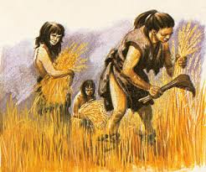
Humans and monogamy
83% of humans are polygamous
Socially imposed monogamy
Hides differences in reproductive
success
Leads to cohesion of the group
Shift in dietary patterns
Less pressure on males
Reduced female density
Development of agricultural techniques
Males farm the land, and provide for their offspring
Males then pass down their land to their offspring

Slide 11
Humans cont.
In many cultures, monogamy is a mating strategy
Males focus on allocating their resources to the next generation
Lower fitness for males
Females grant higher fidelity
Dominant males sometimes have greater reproductive success (cheating)
Humans choose monogamy because offspring survival is benefitted
Importance of resources
In polygamous societies, there are still monogamous males
Lack of resources means they can’t provide for several offspring

Slide 12
Polygamy and Polyandry
Polygamy/Polygyny
males with multiple females
Polyandry
females with multiple males
See all 3 in humans
Balance between male and female choice

Slide 13
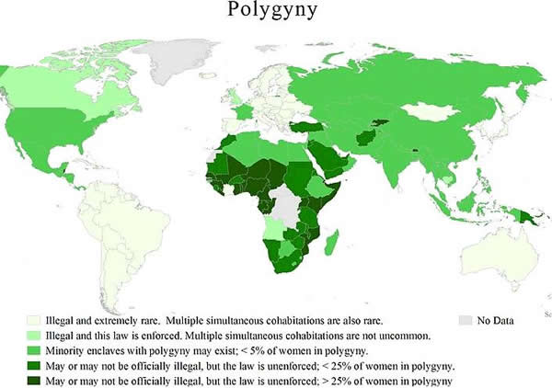

Slide 14
Works cited
Archetti M. 2013. Evolution of polygamous marriag by maximization of inclusive fitness. J Theor Biol. 319(1):134-143.
Firman R. 2014. Female social preference for males that have evolved via monogamy: evidence of a trade-off between pre- and post-copulatory sexually selected traits? Biol Lett. 10(10):1-4.
Fortunato L, Archetti M. 2010. Evolution of monogamous marriage by maximization of inclusive fitness. J Evol Biol. 23(1):149-156.
Gavrilets, S. 2012. Human origins and the transition from promiscuity to pair-bonding. Proc of the Nat Acad of Sci. 109(25):9923-9928.
Komers P, Brotherton P. 1997. Female space use is the best predictor of monogamy in mammals. Proc Biol Sci. 264(1386): 1261-1270.
Lukas D, Clutton-Brock T. 2013. The Evolution of Social Monogamy in Mammals. Science. 341(6145):526-530.
Rutberg A. 1982. The Evolution of Monogamy in Primates. J Theor Biol. 104(1): 93-112.

